Slide 1

1 Introduction
Peter H. Chen

Slide 2
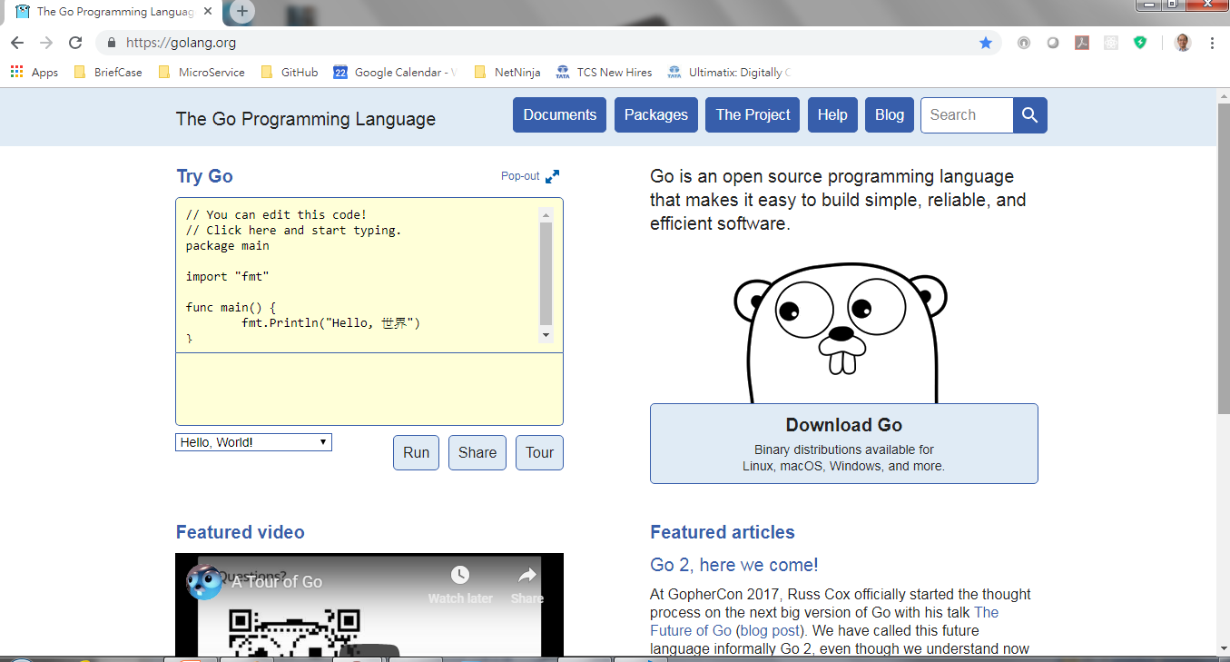
1 Introduction
ttps://www.youtube.com/watch?v=nSYFfWijl8U&index=2&list=PLQVvvaa0QuDeF3hP0wQoSxpkqgRcgxMqX
Go language is invented by Google.
Go has concurrency support.
It is lower level language and super fast like C++ with defined data type for web development.

Slide 3
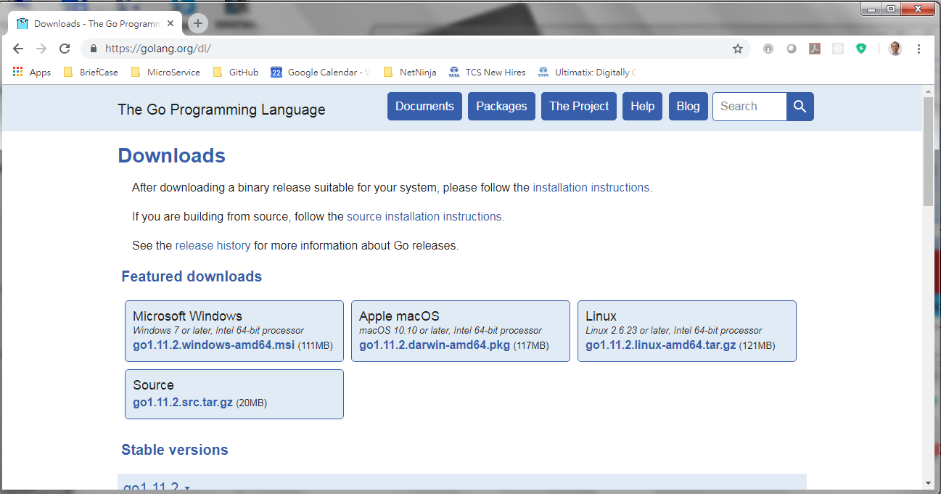
1 Introduction
ttps://www.youtube.com/watch?v=nSYFfWijl8U&index=2&list=PLQVvvaa0QuDeF3hP0wQoSxpkqgRcgxMqX
Download go from https://golang.org/dl

Slide 4

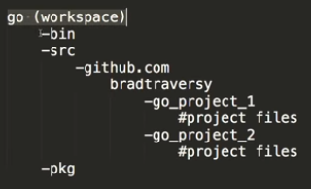
1 Introduction
ttps://www.youtube.com/watch?v=nSYFfWijl8U&index=2&list=PLQVvvaa0QuDeF3hP0wQoSxpkqgRcgxMqX
> go version
> go get

Slide 5
End of Chapter

