Slide 1

2 Syntax
Peter H. Chen

Slide 2
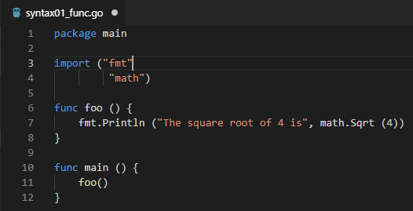

2 Syntax
ttps://www.youtube.com/watch?v=nSYFfWijl8U&index=2&list=PLQVvvaa0QuDeF3hP0wQoSxpkqgRcgxMqX
Function Example:

Slide 3
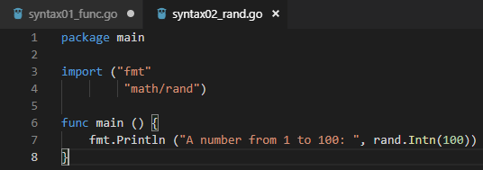
2 Syntax
ttps://www.youtube.com/watch?v=nSYFfWijl8U&index=2&list=PLQVvvaa0QuDeF3hP0wQoSxpkqgRcgxMqX
Random number Example:

Slide 4
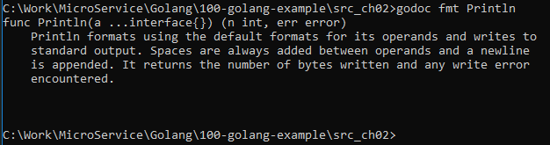
2 Syntax
ttps://www.youtube.com/watch?v=nSYFfWijl8U&index=2&list=PLQVvvaa0QuDeF3hP0wQoSxpkqgRcgxMqX
Use “godoc fmt Println”:

Slide 5
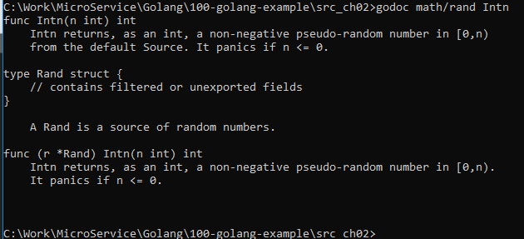
2 Syntax
ttps://www.youtube.com/watch?v=nSYFfWijl8U&index=2&list=PLQVvvaa0QuDeF3hP0wQoSxpkqgRcgxMqX
Use “godoc math/rand Intn”:

Slide 6
End of Chapter

