Slide 1

3 Type
Peter H. Chen

Slide 2
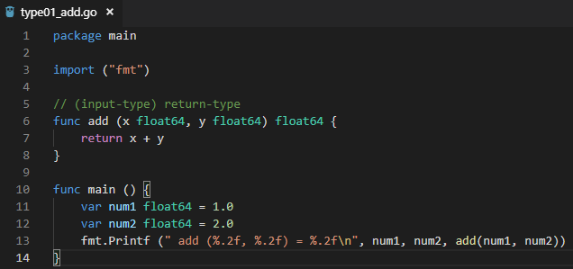
3 Type
ttps://www.youtube.com/watch?v=nSYFfWijl8U&index=2&list=PLQVvvaa0QuDeF3hP0wQoSxpkqgRcgxMqX
Type add Example:

Slide 3
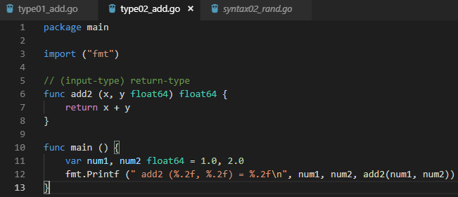

3 Type
ttps://www.youtube.com/watch?v=nSYFfWijl8U&index=2&list=PLQVvvaa0QuDeF3hP0wQoSxpkqgRcgxMqX
Remove duplicated type definition add Example:

Slide 4
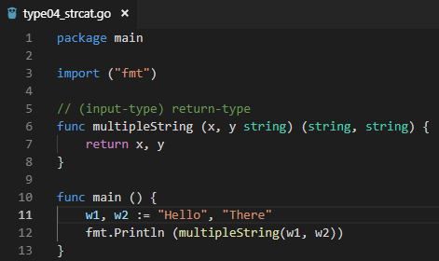

3 Type
ttps://www.youtube.com/watch?v=nSYFfWijl8U&index=2&list=PLQVvvaa0QuDeF3hP0wQoSxpkqgRcgxMqX
Return multiple strings.

Slide 5
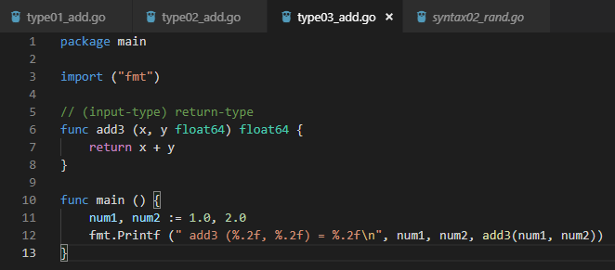

3 Type
ttps://www.youtube.com/watch?v=nSYFfWijl8U&index=2&list=PLQVvvaa0QuDeF3hP0wQoSxpkqgRcgxMqX
Remove type definition in function. Let go figure out. Data size is fixed, not dynamic:

Slide 6
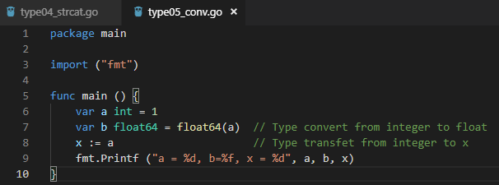
3 Type
ttps://www.youtube.com/watch?v=nSYFfWijl8U&index=2&list=PLQVvvaa0QuDeF3hP0wQoSxpkqgRcgxMqX
Type conversion and type transfer.

Slide 7
End of Chapter

