Slide 1

10 Access Internet
Peter H. Chen

Slide 2
10 Access Internet
ttps://www.youtube.com/watch?v=nSYFfWijl8U&index=2&list=PLQVvvaa0QuDeF3hP0wQoSxpkqgRcgxMqX
Parse XML structure:
<stiemapindex>
<sitemap> or <url>
<loc>https://www.washingtonpost.com/business/color-of-money-live-december-20/2018/12/13/5efd82f2-fe36-11e8-a17e-162b712e8fc2_livediscussion.html</loc>
</sitemap> or </url>
<sitemap> or <url>
<loc>https://www.washingtonpost.com/business/boy-scouts-exploring-all-options-to-address-fiscal-woes/2018/12/13/541f7ca2-ff10-11e8-a17e-162b712e8fc2_story.html</loc>
</sitemap> or </url>
</sitemapindex>
XML structure:
type SitemapIndex struct {
/*
[5] type == array
[5][5] int == array
[] type == slice
*/
//Locations []Location `xml:"sitemap"`
Locations []Location `xml:"url"`
}
type Location struct {
Loc string `xml:"loc"`
}

Slide 3
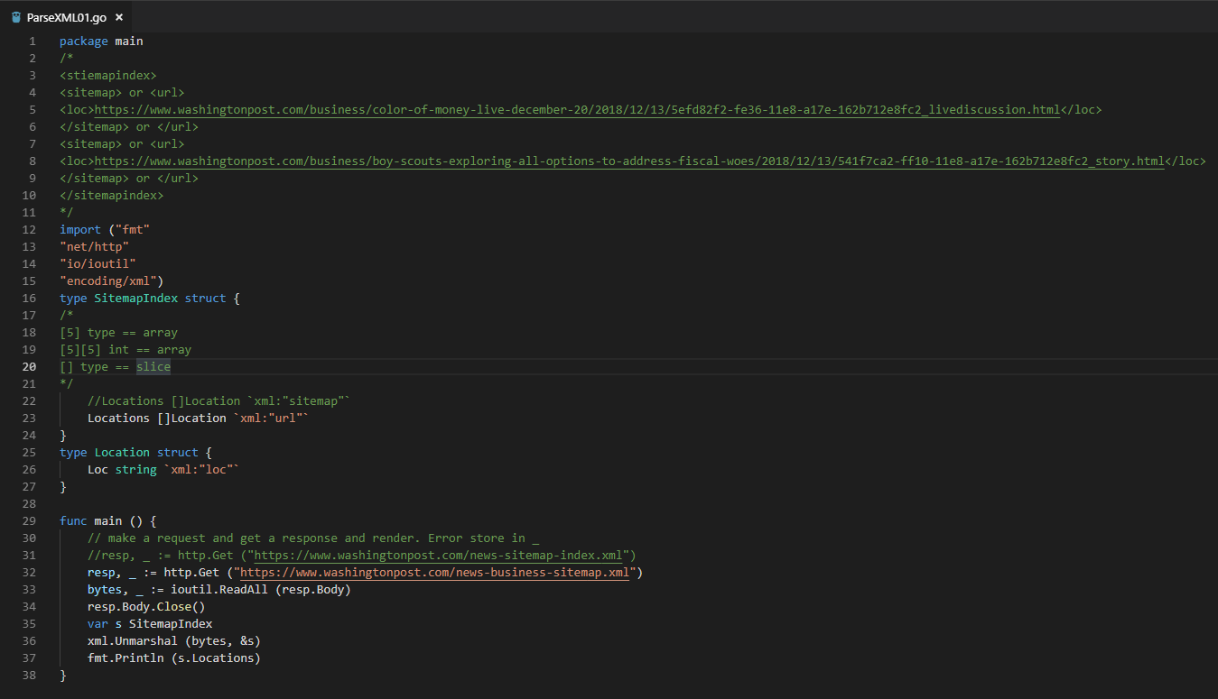
10 Access Internet
ttps://www.youtube.com/watch?v=nSYFfWijl8U&index=2&list=PLQVvvaa0QuDeF3hP0wQoSxpkqgRcgxMqX
Parse XML structure

Slide 4
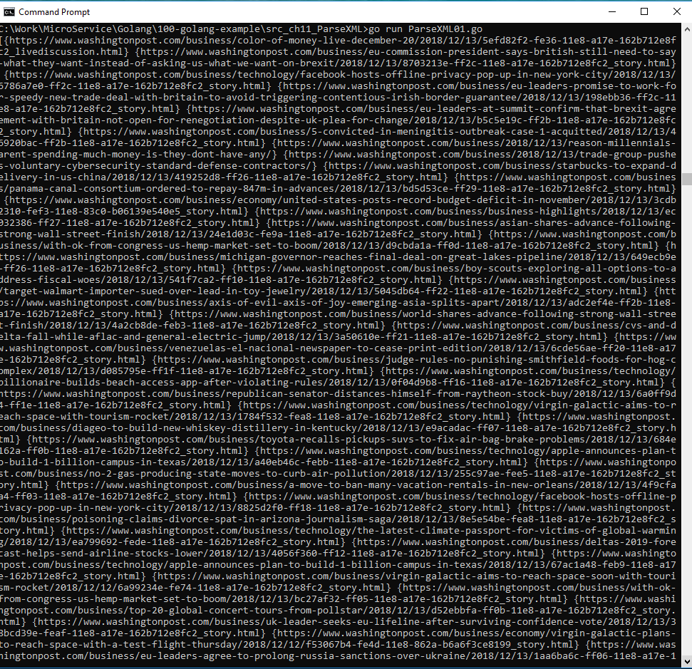
10 Access Internet
ttps://www.youtube.com/watch?v=nSYFfWijl8U&index=2&list=PLQVvvaa0QuDeF3hP0wQoSxpkqgRcgxMqX
> go run ParseXML01.go

Slide 5
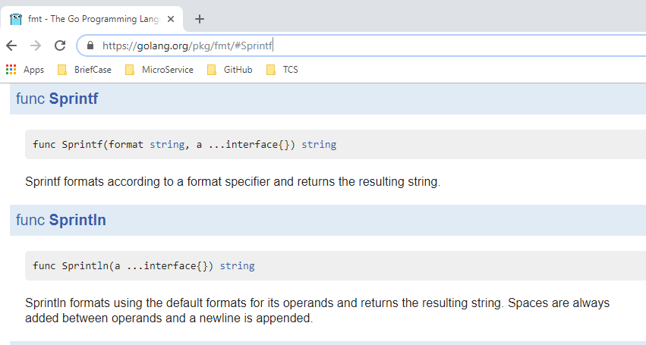
10 Access Internet
ttps://www.youtube.com/watch?v=nSYFfWijl8U&index=2&list=PLQVvvaa0QuDeF3hP0wQoSxpkqgRcgxMqX
Sprinf Syntax:
https://golang.org/pkg/fmt/#Sprintf

Slide 6
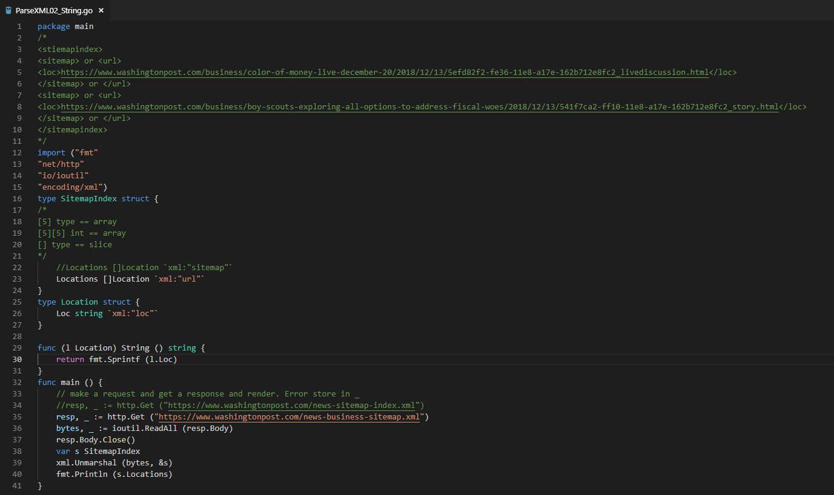
10 Access Internet
ttps://www.youtube.com/watch?v=nSYFfWijl8U&index=2&list=PLQVvvaa0QuDeF3hP0wQoSxpkqgRcgxMqX
Use value method (l Location) to call String() and use sprintf to remove {}.
Convert a struct into a string

Slide 7
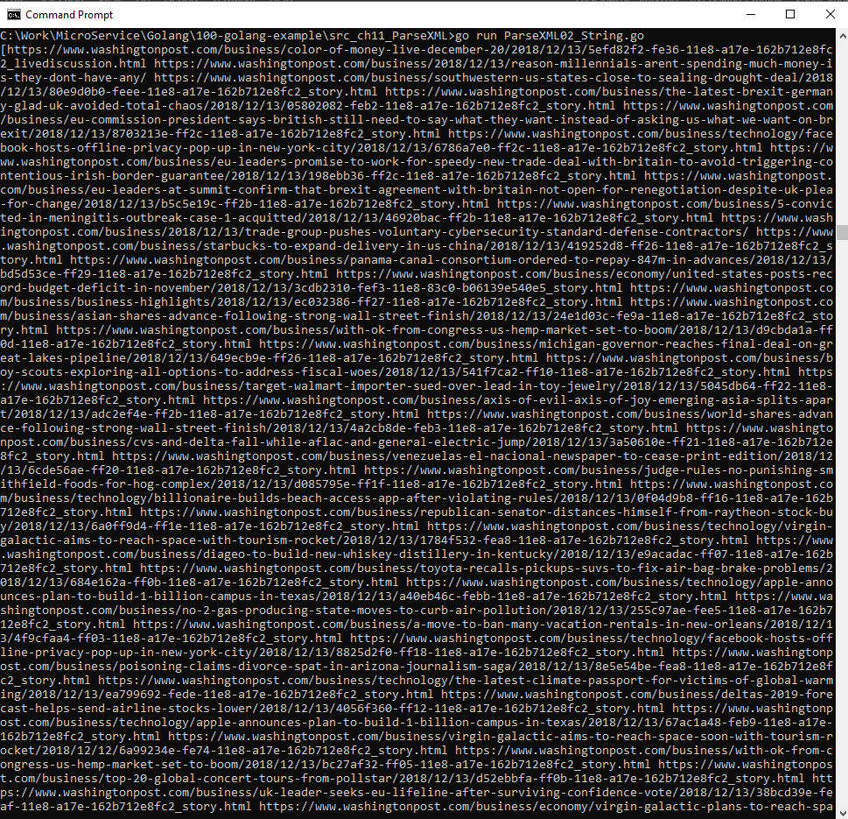
10 Access Internet
ttps://www.youtube.com/watch?v=nSYFfWijl8U&index=2&list=PLQVvvaa0QuDeF3hP0wQoSxpkqgRcgxMqX
Use sprintf to remove {}.

Slide 8
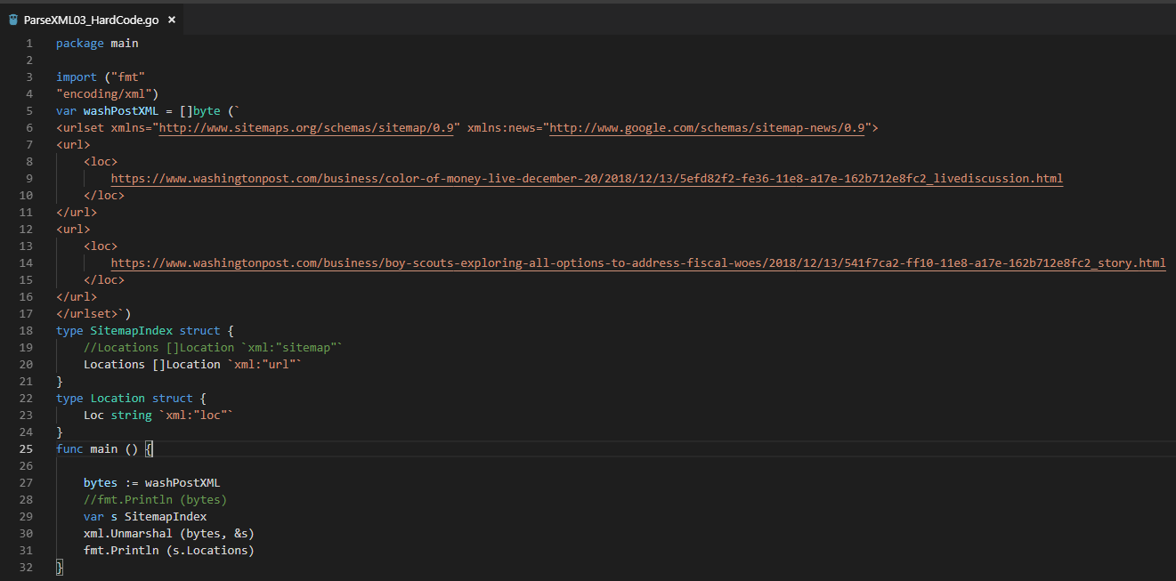
10 Access Internet
ttps://www.youtube.com/watch?v=nSYFfWijl8U&index=2&list=PLQVvvaa0QuDeF3hP0wQoSxpkqgRcgxMqX
Hard code the string with byte.
The strings need header, such as, “<urlset xmlns …> … </urlset>” for XML parser.

Slide 9
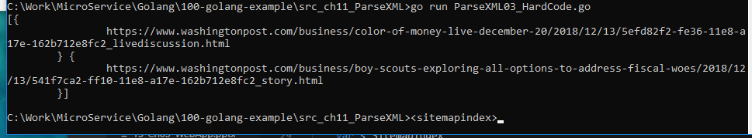
10 Access Internet
ttps://www.youtube.com/watch?v=nSYFfWijl8U&index=2&list=PLQVvvaa0QuDeF3hP0wQoSxpkqgRcgxMqX
> go run ParseXML03_HardCode.go

Slide 10
End of Chapter

