Slide 1

6 Struct
Peter H. Chen

Slide 2
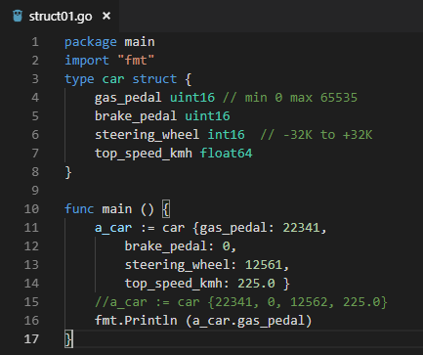

6 Struct
ttps://www.youtube.com/watch?v=nSYFfWijl8U&index=2&list=PLQVvvaa0QuDeF3hP0wQoSxpkqgRcgxMqX
Go language does not have class.
Go language has struct.

Slide 3
End of Chapter

