Slide 1

15 Map New Data
Peter H. Chen

Slide 2
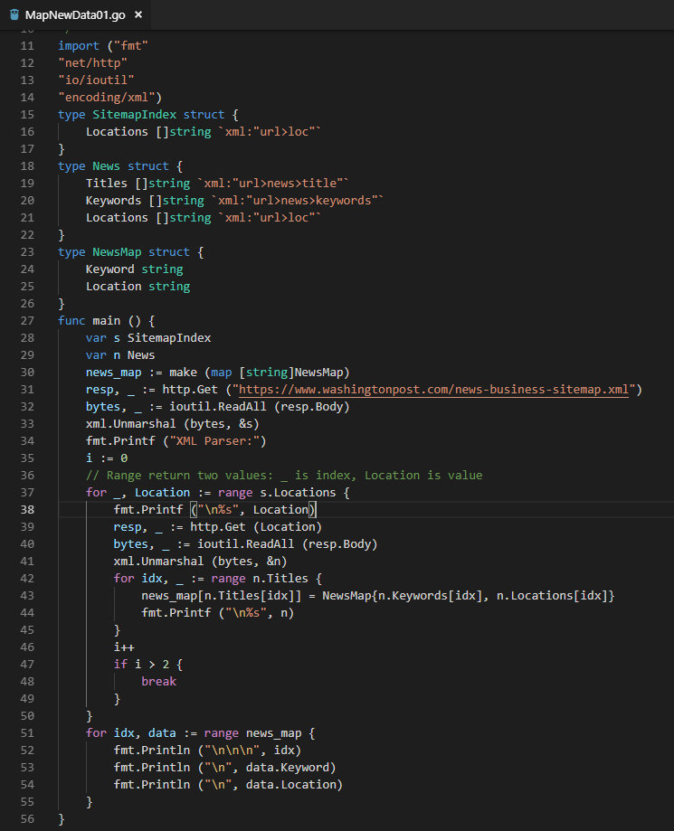
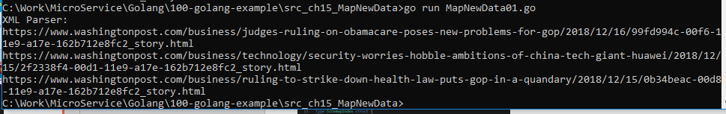
15 Map New Data
ttps://www.youtube.com/watch?v=nSYFfWijl8U&index=2&list=PLQVvvaa0QuDeF3hP0wQoSxpkqgRcgxMqX
Map New Data.

Slide 3
End of Chapter

