Slide 1

9 Web Develop
Peter H. Chen

Slide 2
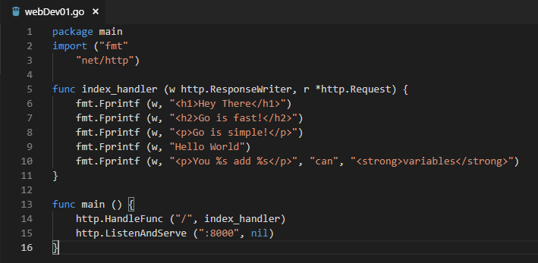
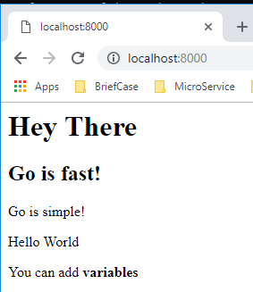
9 Web Develop
ttps://www.youtube.com/watch?v=nSYFfWijl8U&index=2&list=PLQVvvaa0QuDeF3hP0wQoSxpkqgRcgxMqX
Write in html format

Slide 3
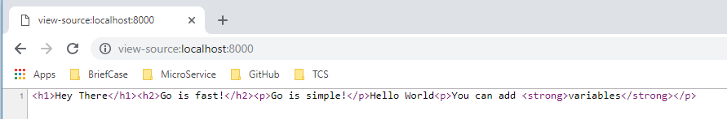
9 Web Develop
ttps://www.youtube.com/watch?v=nSYFfWijl8U&index=2&list=PLQVvvaa0QuDeF3hP0wQoSxpkqgRcgxMqX
View Source: view-source:localhost:8000

Slide 4
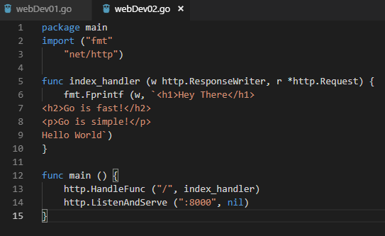
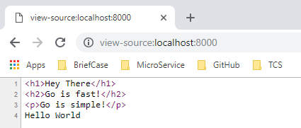
9 Web Develop
ttps://www.youtube.com/watch?v=nSYFfWijl8U&index=2&list=PLQVvvaa0QuDeF3hP0wQoSxpkqgRcgxMqX
Write in `` format

Slide 5
End of Chapter

