Slide 1

10 Access Internet
Peter H. Chen

Slide 2
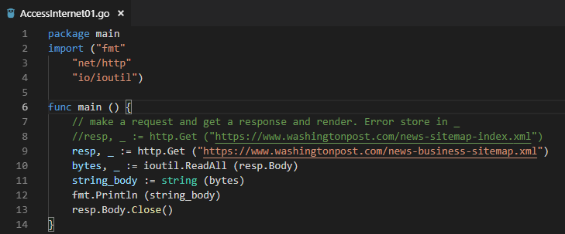
10 Access Internet
ttps://www.youtube.com/watch?v=nSYFfWijl8U&index=2&list=PLQVvvaa0QuDeF3hP0wQoSxpkqgRcgxMqX
Read “https://www.washingtonpost.com/news-business-sitemap.xml”

Slide 3
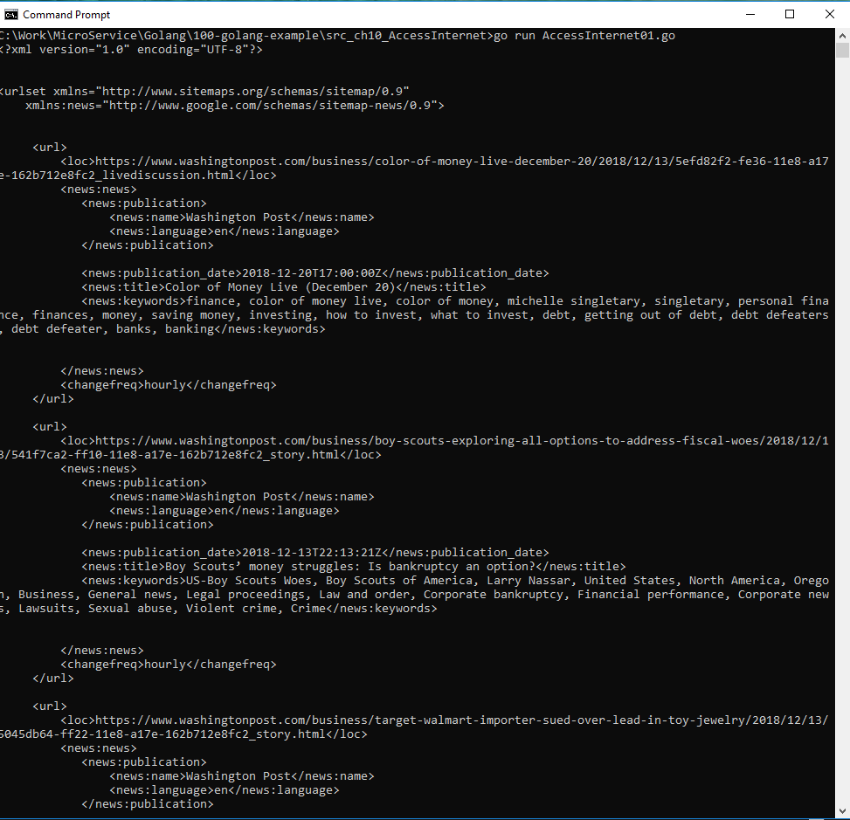
10 Access Internet
ttps://www.youtube.com/watch?v=nSYFfWijl8U&index=2&list=PLQVvvaa0QuDeF3hP0wQoSxpkqgRcgxMqX
> go run AccessIntenet01.go

Slide 4
End of Chapter

