Slide 1

7 Method
Peter H. Chen

Slide 2
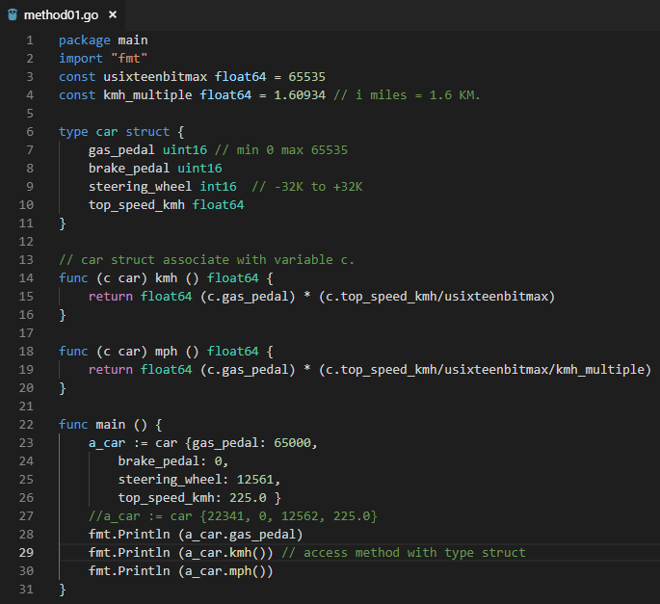

7 Method
ttps://www.youtube.com/watch?v=nSYFfWijl8U&index=2&list=PLQVvvaa0QuDeF3hP0wQoSxpkqgRcgxMqX
Method is can be accessed by type struct.

Slide 3
End of Chapter

