Slide 1

4 Pointer
Peter H. Chen

Slide 2
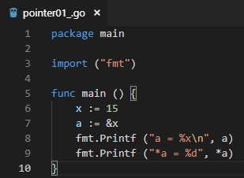

4 Pointer
ttps://www.youtube.com/watch?v=nSYFfWijl8U&index=2&list=PLQVvvaa0QuDeF3hP0wQoSxpkqgRcgxMqX
Pointer address and content Example:

Slide 3
End of Chapter

