Slide 1

5 Web App
Peter H. Chen

Slide 2
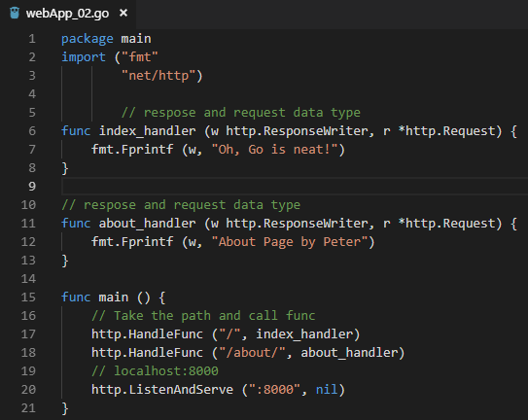
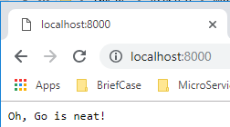
5 Web App
ttps://www.youtube.com/watch?v=nSYFfWijl8U&index=2&list=PLQVvvaa0QuDeF3hP0wQoSxpkqgRcgxMqX
Go language: A handler and and Listen port:8000
> go run webApp_01.go
Open Chrome and enter “localhost:8000”

Slide 3
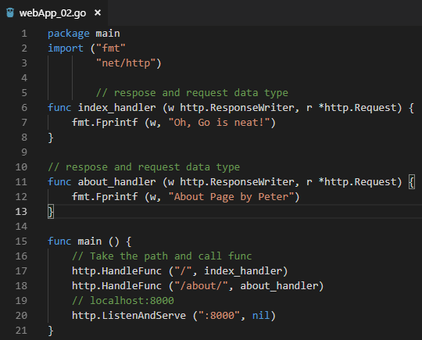
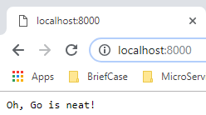
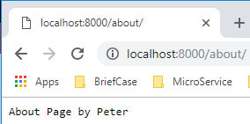
5 Web App
ttps://www.youtube.com/watch?v=nSYFfWijl8U&index=2&list=PLQVvvaa0QuDeF3hP0wQoSxpkqgRcgxMqX
Go language: add home and about page handler
> go run webApp_02.go
Open Chrome, enter “localhost:8000”, and enter “localhost:8000/about”

Slide 4
End of Chapter

