Slide 1

14 JasperReports API: L
Peter H. Chen

Slide 2
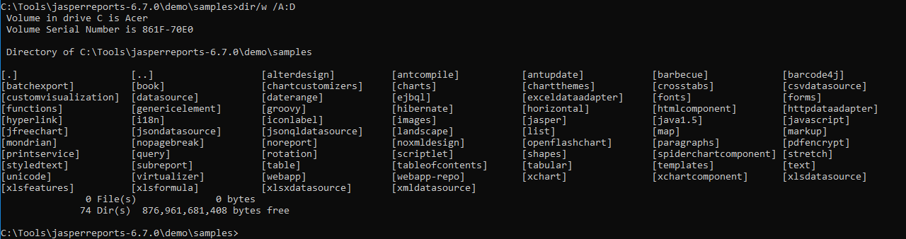
14 JasperReports API: L
https://community.jaspersoft.com/project/jasperreports-library
JasperReport API:
> dir/w /A:D # totally, we have 74 examples in Jasper Report 6.7.0

Slide 3
14.1 API: landscape

Slide 4
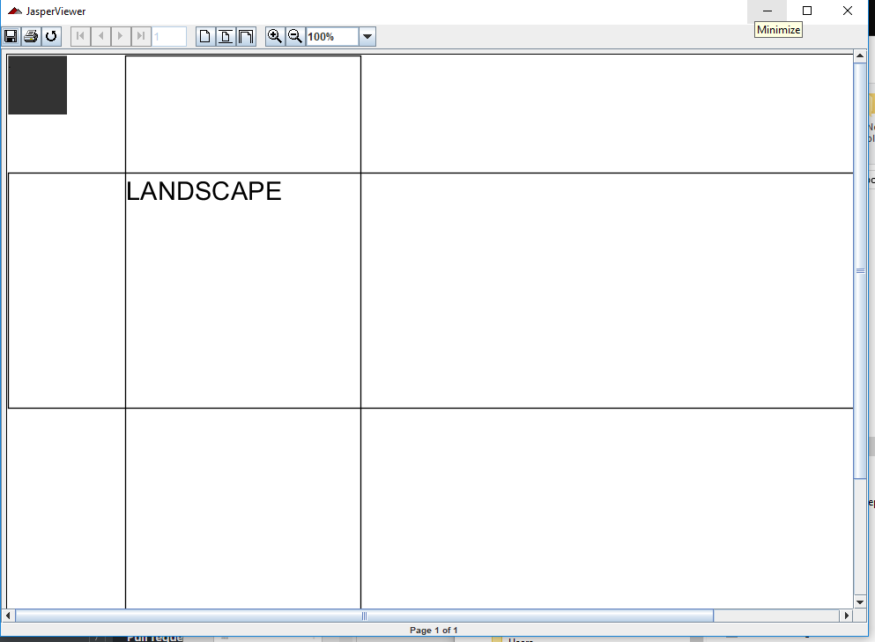
14.1 API: landscape
https://community.jaspersoft.com/wiki/jasperreports-library-first-steps
API: landscape
> ant -p, ant clean, ant javac, ant compile, ant fill, ant view

Slide 5
14.2 API: list

Slide 6
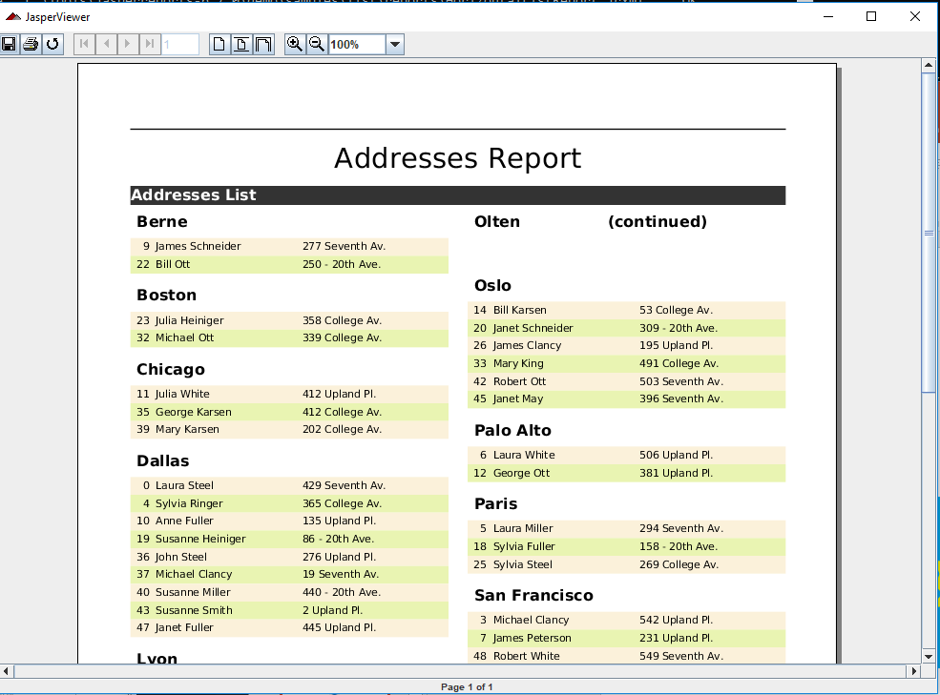
14.2 API: list
https://community.jaspersoft.com/wiki/jasperreports-library-first-steps
API: list
> ant -p, ant clean, ant javac, ant compile, ant fill, ant view

Slide 7
End of Chapter

