Slide 1

1 JasperReport Library
Peter H. Chen

Slide 2
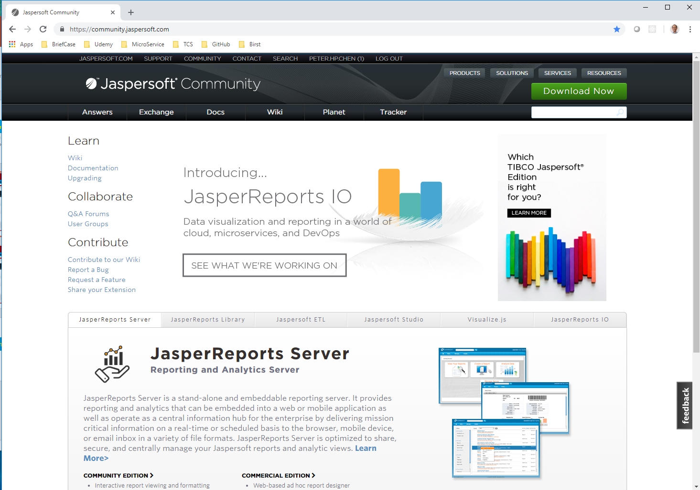
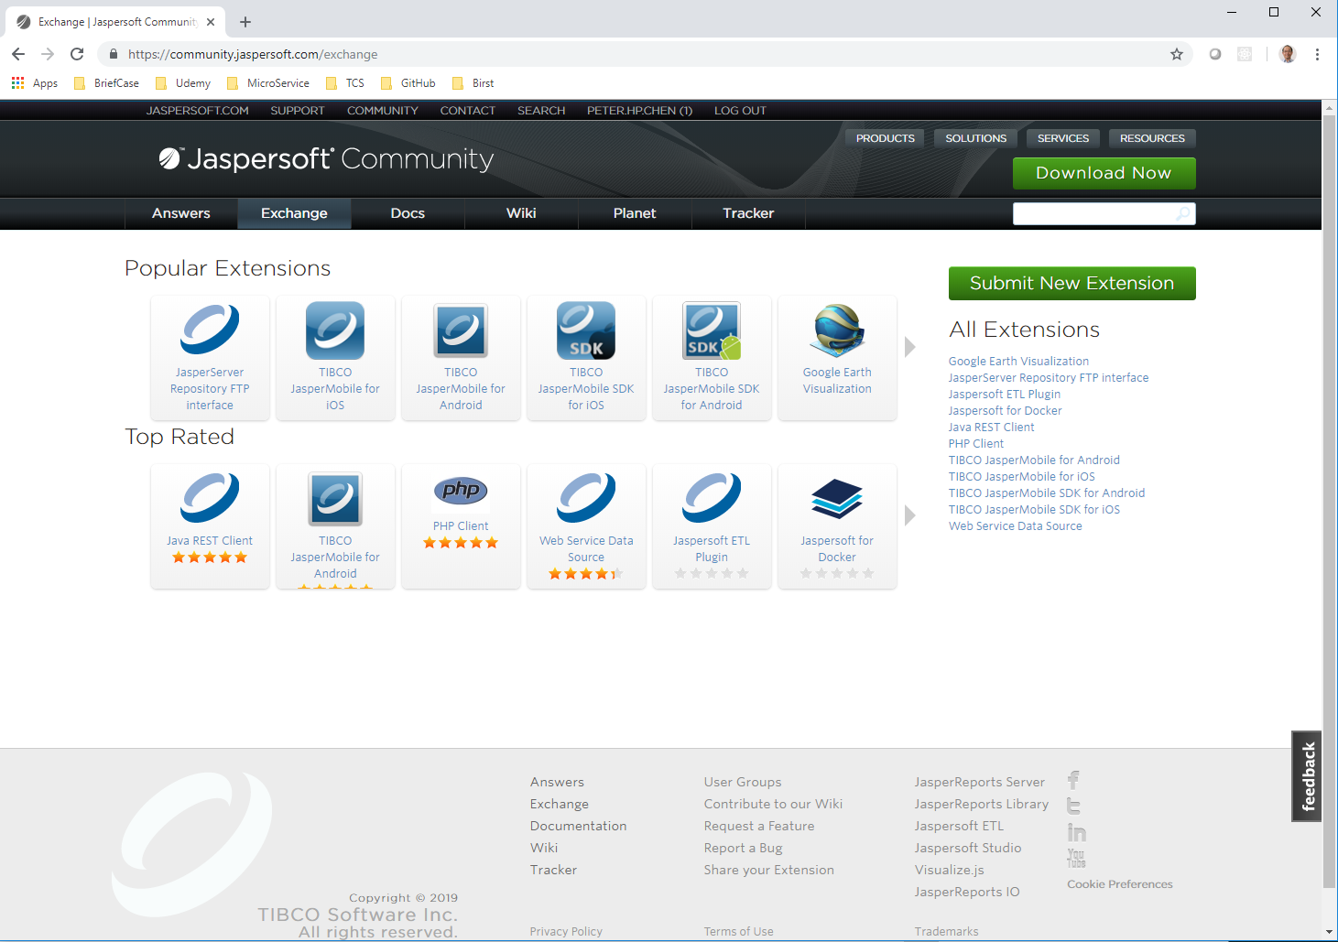
1 JasperReports Library
https://community.jaspersoft.com/project/jasperreports-library
Go to Jaspersoft.com
Click “Exchange” Tab.
Click “JasperReports Library”

Slide 3
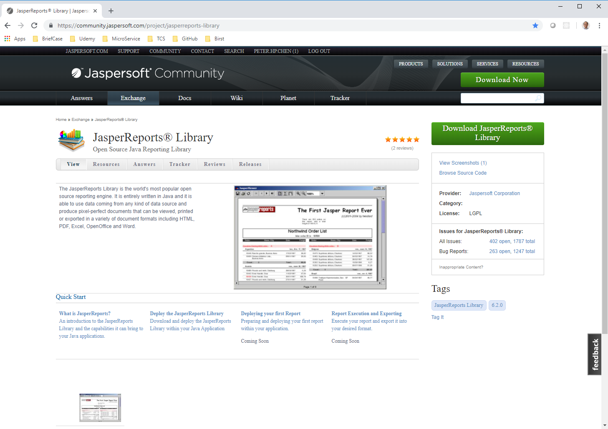
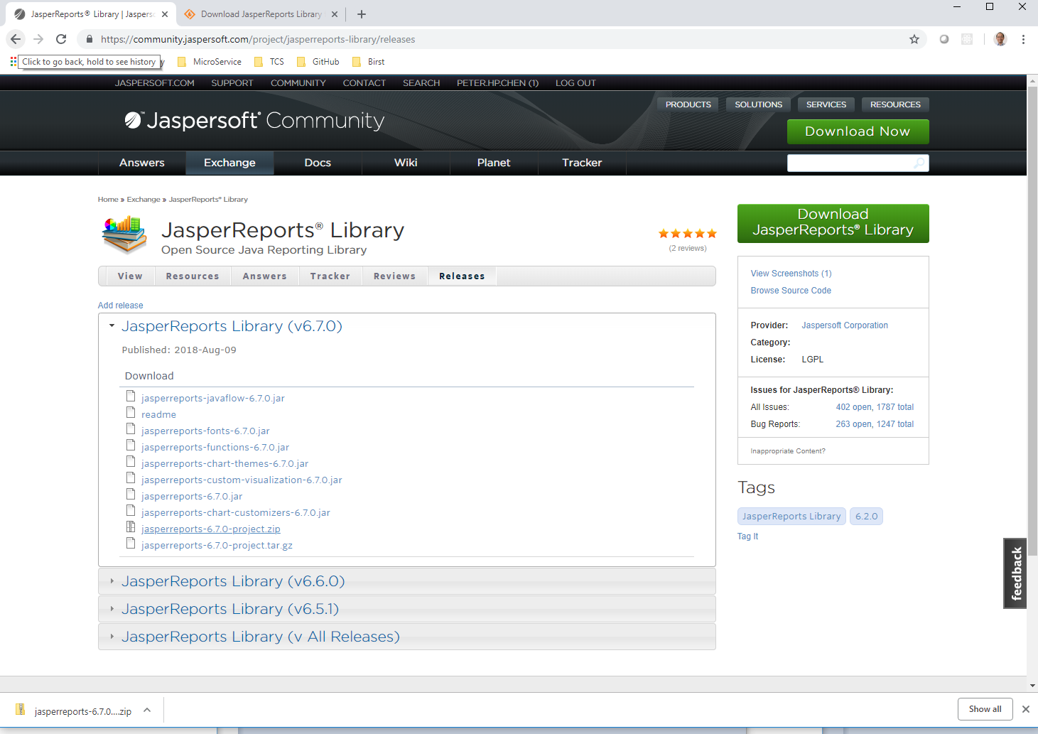
1 JasperReport Library
https://community.jaspersoft.com/project/jasperreports-library
JasperReports Library: Open Sources Java Reporting Library
Click “Download JasperReports Library”
Select and download “jasperReports-6.7.0-project.zip”

Slide 4
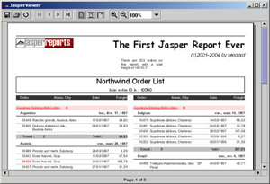
1 JasperReport Library
https://community.jaspersoft.com/project/jasperreports-library
The JasperReports Library is the world's most popular open source reporting engine.
It is entirely written in Java and it is able to use data coming from any kind of data source and produce pixel-perfect documents that can be viewed, printed or exported in a variety of document formats including HTML, PDF, Excel, OpenOffice and Word.

Slide 5
1 JasperReport Library
https://community.jaspersoft.com/project/jasperreports-library
What is JasperReports Library?
JasperReports Library is a Java Library that offers an interface to the JasperReports Library reporting engine.
This library is the engine at the core of the iReport Designer, Jaspersoft Studio, and JasperReports Server. In addition, it is embedded in thousands of applications around the world.
The list of JasperReports Library Features is as below:

Slide 6
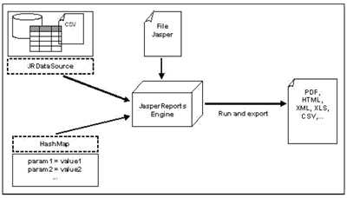
1 JasperReport Library
https://community.jaspersoft.com/project/jasperreports-library
JasperReports Library - Features and Highlights

Slide 7
1 JasperReport Library
https://community.jaspersoft.com/project/jasperreports-library
Layout and Interactive Features
Pixel-perfect page-oriented or continuous output for web or print Dashboards, tables, crosstabs, charts, gauges, and widgets
Subreports easily handle highly complex layouts
Integrated barcode support
Visual text rotation
Styles library
Drill-through / hypertext links, including support for PDF bookmarks
Interactive table elements and subreports for interactive and complex layouts
Conditional printing
Flexible Deployment and Output
Report output in PDF, XML, HTML, CSV, XLS, RTF, TXT
Internationalized and localizable for global deployments

Slide 8
1 JasperReport Library
https://community.jaspersoft.com/project/jasperreports-library
Any Data Source Connectivity (1)
JasperReports uses any data source provider, allowing it to extend reporting capabilities to almost any third-party application.
When it is not possible to access data through JDBC, or when you do not want JasperReports to interact directly with a database, you can implement a custom JasperReports data source.
In addition, any report can use data from multiple data sources, which can be of different types.

Slide 9
1 JasperReport Library
https://community.jaspersoft.com/project/jasperreports-library
Any Data Source Connectivity (2)
JasperReports includes JDBC-wrapped data providers for relational databases (RDBMS), JavaBeans (EJB, Hibernate), plain old Java objects (POJO), and XML data sources.
In addition, parameters can be passed from your application to JasperReports. Parameters are simple to implement and very powerful, allowing you to qualify, restrict, or enhance the data that is delivered to users based on run-time conditions.
Spring-loaded Hibernate connection
EJBQL connection
Mondrian OLAP connection
Query Executor mode
Empty data source
Custom iReport connection
XMLA server connection
Spring-loaded Hibernate connection
EJBQL connection
Mondrian OLAP connection
Query Executor mode
Empty data source
Custom iReport connection
XMLA server connection

Slide 10
1 JasperReport Library
https://community.jaspersoft.com/project/jasperreports-library
Scalable Architecture
No limit to report size
Report virtualizers to optimize for memory utilization and I/O performance
Query governors to protect system resources

Slide 11
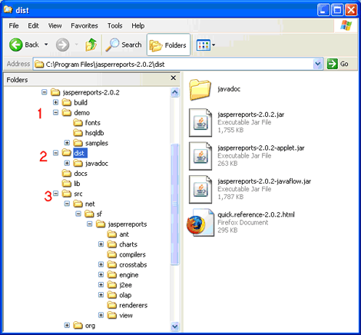
1 JasperReport Library
https://community.jaspersoft.com/project/jasperreports-library
Distributions (2)

Slide 12
1 JasperReport Library
https://community.jaspersoft.com/project/jasperreports-library
Distributions (2)
Extensive sample files get you up and running quickly
Pre-compiled JavaDocs and embeddable distribution files for generating, viewing, and printing JasperReports
Complete and transparent source code with documented API's and ready-to-run build files

Slide 13
1 JasperReport Library
https://community.jaspersoft.com/project/jasperreports-library
System Requirements
JasperReports Library has few external dependencies. The two requirements are:
Java JDK 1.6 or higher
JDBC 2.1 driver (if RDBMS used)
Installation
JasperReports Library is a .jar file. Installation is completed by adding the jar file to your Java classpath along with other required jar files that support the JasperReports Library. For more information see JasperReports Library - First Steps (https://community.jaspersoft.com/wiki/jasperreports-library-first-steps)
Configuration
Optional Configurations
Most of the JasperReports Library configuration is done within the JasperReports Library.properties file (for global settings) or at the report level by setting the appropriate settings within the JRXML.
JasperReports Library Configuration Reference (http://jasperreports.sourceforge.net/config.reference.html)

Slide 14
1 JasperReport Library
https://community.jaspersoft.com/project/jasperreports-library
Using JasperReports Library
It is highly recommended when you first get started with JasperReports Library that you leverage the Desktop Report Designer for JasperReports Library, iReport Designer.
Many successfully use XML editors to create and modify the JRXML consumed by JasperReports Library, but it is much more effective in the majority of cases to work within iReport Designer (https://community.jaspersoft.com/wiki/getting-started-ireport-designer).
The JasperReports Library project includes many samples that are found in the sample folder (ttps://community.jaspersoft.com/wiki/jasperreports-library-samples)

Slide 15
End of Chapter

