Slide 1

2 Setup Ivy
Peter H. Chen

Slide 2
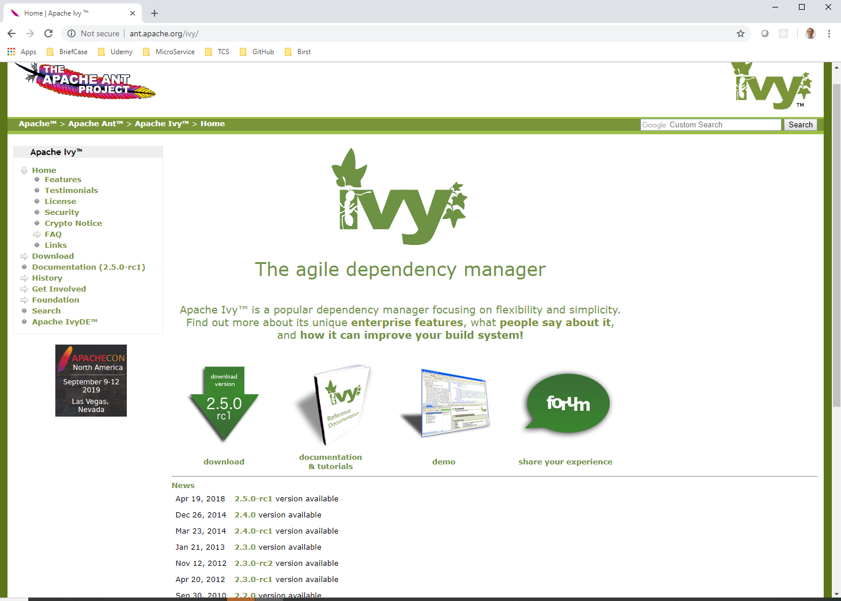
2 Setup Ivy
https://community.jaspersoft.com/project/jasperreports-library
Go to ant.apache.org/ivy and download ivy.
Unzip ivy into C:\Tools

Slide 3
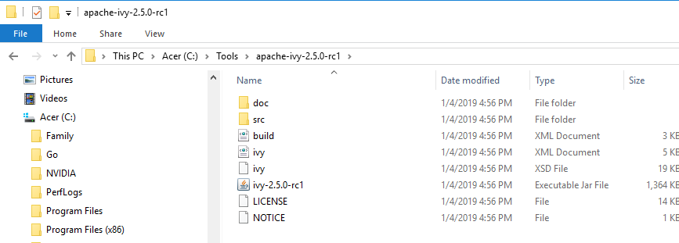
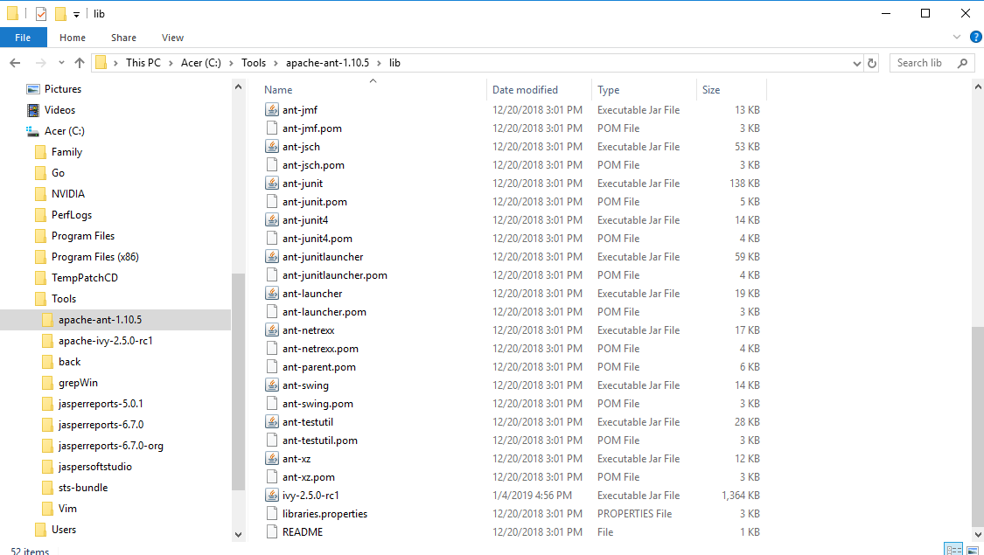
2 Setup Ivy
https://community.jaspersoft.com/project/jasperreports-library
Under C:\Tools\apache-ivy-x.x.x-xxx.
Find “ivy-x.x.x-xxx.tar” and copy to “C:\Tools\a[ache-ant-x.x.x\lib”

Slide 4
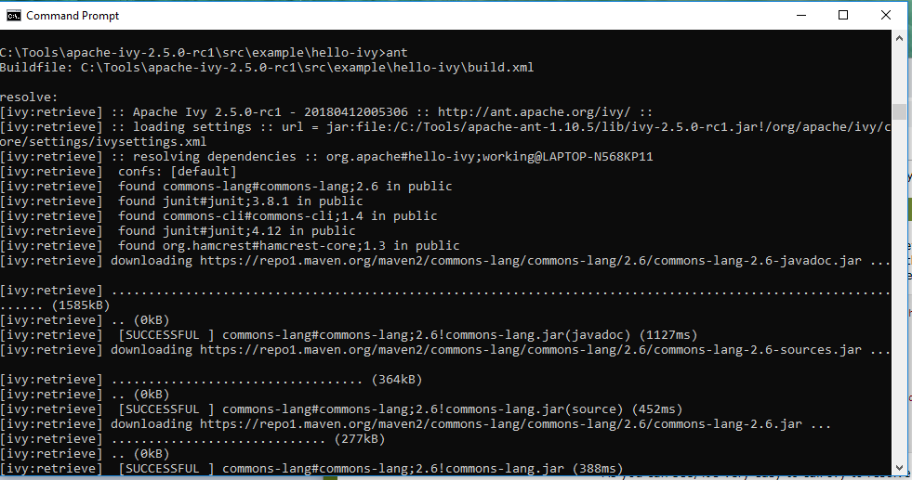
2 Setup Ivy
https://community.jaspersoft.com/project/jasperreports-library
> ant
Execute ant and ivy to parse ivy.xml and build.xml

Slide 5
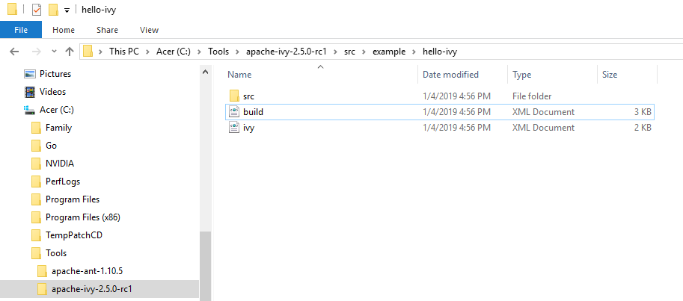
2 Setup Ivy
https://community.jaspersoft.com/project/jasperreports-library
http://ant.apache.org/ivy/history/master/tutorial/start.html
In the “C:\Tools\apache-x.x.x-xxx\src\example\hello-ivy folder, we have ivy.xml and build.xml

Slide 6
2.1 Ivy.xml

Slide 7
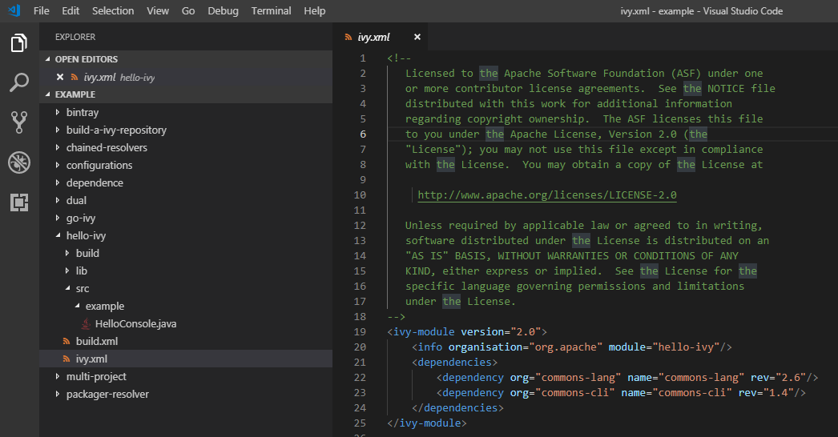
2.1 Ivy.xml
http://ant.apache.org/ivy/history/master/tutorial/start.html
Open “C:\Tools\apache-x.x.x-xxx\src\example\ivy.xml”

Slide 8
2.1 Ivy.xml
http://ant.apache.org/ivy/history/master/tutorial/start.html
Ivy.xml (1):
The ivy.xml describes the dependencies of the project on other libraries:
<ivy-module version="2.0">
<info organisation="org.apache" module="hello-ivy"/>
<dependencies>
<dependency org="commons-lang" name="commons-lang" rev="2.0"/>
<dependency org="commons-cli" name="commons-cli" rev="1.0"/>
</dependencies>
</ivy-module>

Slide 9
2.1 Ivy.xml
http://ant.apache.org/ivy/history/master/tutorial/start.html
Ivy.xml (2):
First, the root element is ivy-module, with the version attribute telling Ivy which lowest version of Ivy this file is compatible with.
Second, there is an info tag, which provides information about the module for which we are defining dependencies. Here we define only the organization and module names. You are free to choose whatever you want for them, but we recommend avoiding spaces for both.
Finally, the dependencies section defines dependencies. In this example, this module depends on two libraries: commons-lang and commons-cli. As you can see, we use the org and name attributes to define the organization and module name of the dependencies we need. The rev attribute is used to specify the version of the module you depend on.

Slide 10
2.1 Ivy.xml
http://ant.apache.org/ivy/history/master/tutorial/start.html
Ivy.xml (3):
To know what to put in these attributes, you need to know the exact information for the libraries you depend on. Ivy uses the Maven 2 central repository by default, so we recommend you use mvnrepository.com to look for the module you want. Once you find it, you will have the details of that module in the pom.xml file of that module. For instance:
<project ....>
<groupId>commons-lang</groupId>
<artifactId>commons-lang</artifactId>
<version>2.0</version>
...

Slide 11
2.1 Ivy.xml
https://community.jaspersoft.com/project/jasperreports-library
Ivy.xml (4):
To convert this maven format into an Ivy dependency declaration, all you have to do is use the groupId as organization, the artifactId as module name, and the version as revision.
Here, the dependencies is commons-lang and commons-cli.
Note that having commons-lang and commons-cli as organization is not the best example of what the organization should be. It would be better to use org.apache, org.apache.commons, or org.apache.commons.lang.
However, this is how these specific modules were identified in the Maven 2 repository, so the simplest way to get them is to use the details as is (you will see in Building a repository that you can use namespaces to redefine these names if you want something cleaner).
If you want more details on what you can do in Ivy files, you can have a look at the Ivy files reference documentation.

Slide 12
2.2 build.xml

Slide 13
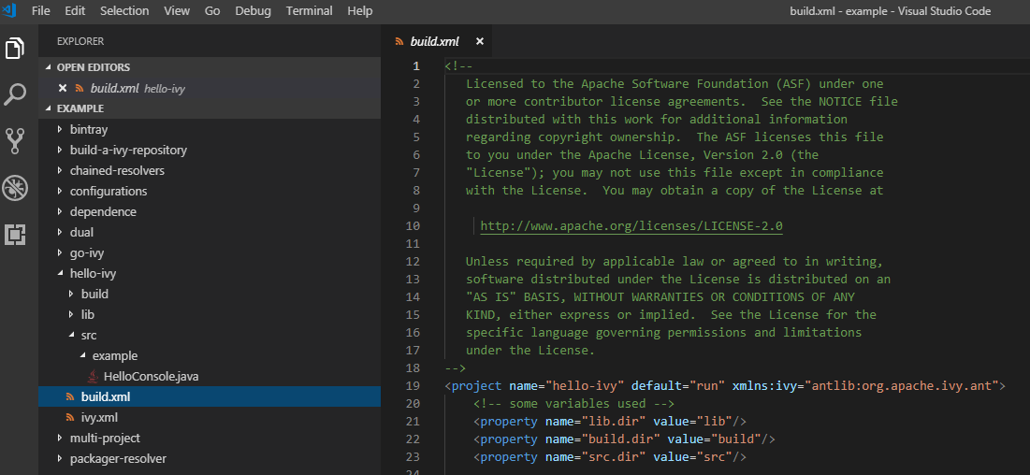
2.2 build.xml
http://ant.apache.org/ivy/history/master/tutorial/start.html
build.xml (1):
The build.xml is as follow:

Slide 14
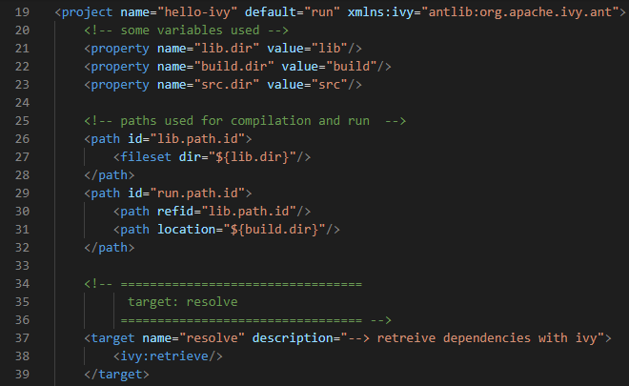
2.2 build.xml
http://ant.apache.org/ivy/history/master/tutorial/start.html
build.xml (2):
The corresponding build file contains a set of targets, allowing you to resolve dependencies declared in the Ivy file, to compile and run the sample code, produce a report of dependency resolution, and clean the cache or the project.
<project xmlns:ivy="antlib:org.apache.ivy.ant" name="hello-ivy" default="run">
...
<!-- =================================
target: resolve
================================= -->
<target name="resolve" description="--> retrieve dependencies with Ivy">
<ivy:retrieve/>
</target>
</project>

Slide 15
2.2 build.xml
http://ant.apache.org/ivy/history/master/tutorial/start.html
build.xml (3):
Ivy resolves and retrieves dependencies:
If Ivy is properly installed is to define an XML namespace in your Ant file (xmlns:ivy="antlib:org.apache.ivy.ant").
Then all the Ivy Ant tasks will be available in this namespace.
Here we use only one task: the retrieve task.
With no attributes, it will use default settings and look for a file named ivy.xml for the dependency definitions.
That’s exactly what we want, so we need nothing more than that.
Note that in this case we define a resolve target and call the retrieve task. This may sound confusing, actually the retrieve task performs a resolve (which resolves dependencies and downloads them to a cache) followed by a retrieve (a copy of those file to a local project directory).

Slide 16
2.3 Execute Project

Slide 17
2.3 Execute Project
http://ant.apache.org/ivy/history/master/tutorial/start.html
Execute Project (1):
Create lib and build directories
Load jar files from remote repositories.
Compile src/../*.java files into corresponding build/../*.class.
TIBCO/JasperSoft
Remote Repositories: *.jar
folder
lib/*.jar
ivy.xml
folder
src/../*.java
folder
build/../*.class
build.xml

Slide 18
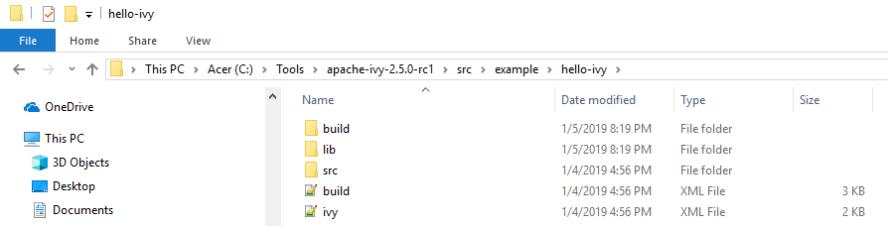
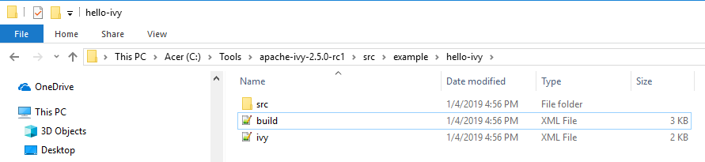
2.3 Execute Project
http://ant.apache.org/ivy/history/master/tutorial/start.html
Execute Project (2):
If lib and build folders are existed, manually remote them (lib and build).
The working directory only have ivy.xml, build.xml, and src/…/*.java

Slide 19
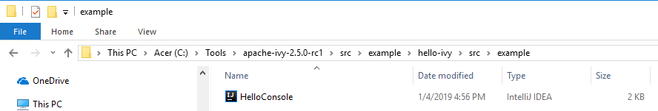
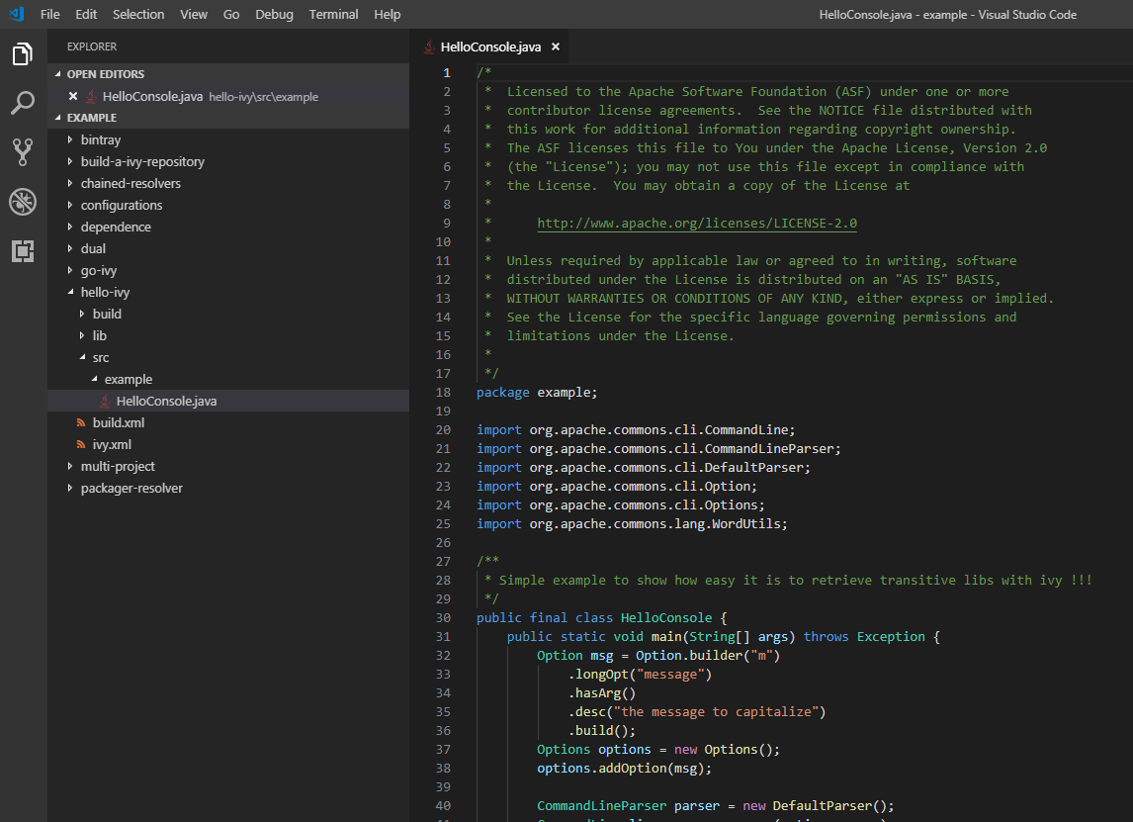
2.3 Execute Project
http://ant.apache.org/ivy/history/master/tutorial/start.html
Execute Project (3):
Examine the src/../*.java

Slide 20
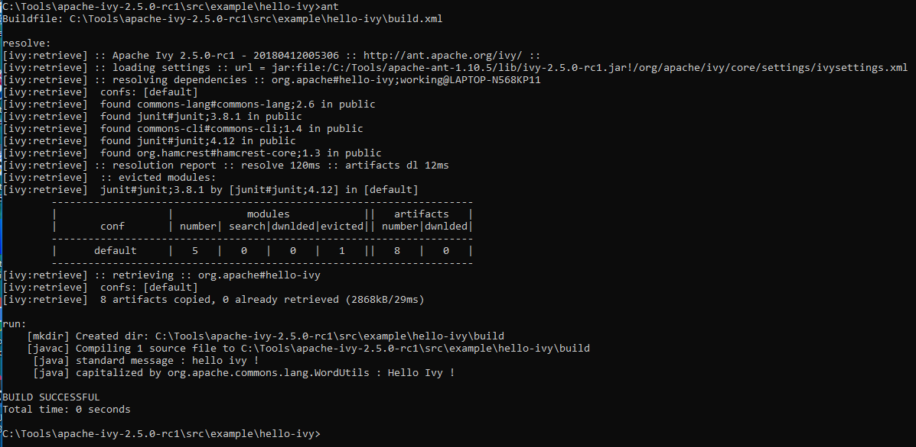
2.3 Execute Project
http://ant.apache.org/ivy/history/master/tutorial/start.html
Execute Project (4):
> cd C:\Tools\apache-x.x.x-xxx\src\sample\hello-ivy
> ant

Slide 21
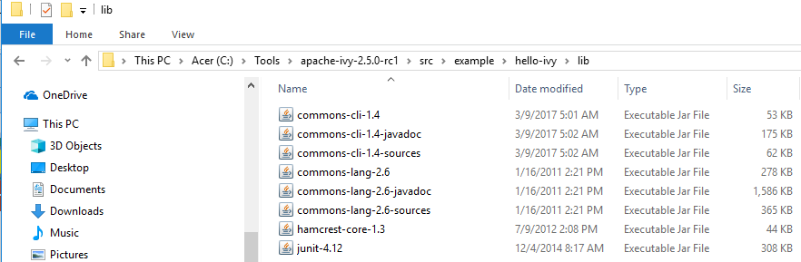
2.3 Execute Project
http://ant.apache.org/ivy/history/master/tutorial/start.html
Execute Project (5):
Examine the lib/*.jar

Slide 22

2.3 Execute Project
http://ant.apache.org/ivy/history/master/tutorial/start.html
Execute Project (6):
Examine the build/../*.class

Slide 23
2.4 Re-Execute Project

Slide 24
2.4 Re-Execute Project
http://ant.apache.org/ivy/history/master/tutorial/start.html
Re-Execute Project (1):
Without any settings, Ivy retrieves files from the Maven 2 repository.
That’s what happened here. The resolve task has found the commons-lang and commons-cli modules in the Maven 2 central repository, identified that commons-cli depends on commons-logging and so resolved it as a transitive dependency.
Then Ivy has downloaded all corresponding artifacts in its cache (by default in your user home, in a .ivy2/cache directory).
Finally, the retrieve task copies the resolved jars from the Ivy cache to the default library directory of the project: the lib dir (you can change this easily by setting the pattern attribute on the retrieve task).
You might say that the task took a long time just to write out a "Hello Ivy!" message. But remember that a lot of time was spent downloading the required files from the web.
Let’s try to run it again:

Slide 25
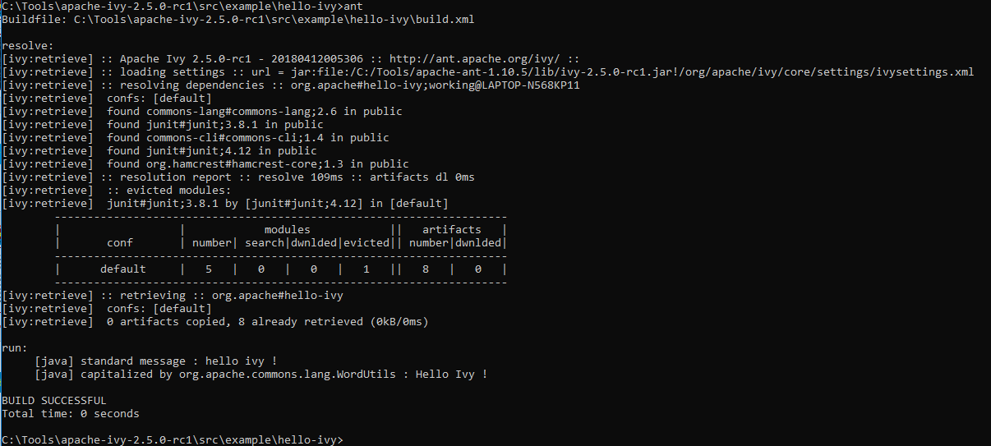
2.4 Re-Execute Project
http://ant.apache.org/ivy/history/master/tutorial/start.html
Re-Execute Project (2):
Let’s try to run it again.
No remote TIBCO/Jasper repositories/*.jar transfer
No compilation from *.java into *.class

Slide 26
2.5 Summary

Slide 27
2.5 Summary
http://ant.apache.org/ivy/history/master/tutorial/start.html
Before JasperReport 6.2.2, we need to copy the third party of *.jar into the lib folder.
ant is to compile the src/../*.java into build/../*.class.
After JasperReport 6.2.2,
we need to use ivy to copy *.jar files from the TIBCO/JasperSoft into the local lib/*.jar.
ant is to compile the src/../*.java into build/../*.class.

Slide 28
End of Chapter

