Slide 1

3 JasperReports Library Step
Peter H. Chen

Slide 2
3 JasperReports Library Step
https://community.jaspersoft.com/wiki/jasperreports-library-first-steps
The Steps of JasperReport Library
Docs: https://community.jaspersoft.com/wiki/jasperreports-library-first-steps
The primary audience of JasperReport Library is for Java developers.
The secondary audiences are: script and other software developers (PHP, Perl, C/C++, web services)

Slide 3
3.1 Download JasperReport Project

Slide 4
3.1 Download JasperReport Project
https://community.jaspersoft.com/wiki/jasperreports-library-first-steps
Download the files of JasperReport Project (1):
JasperReports is a library that you embed in another application.
Note:
Before 6.2.2 the lib/*.jar come with JasperReport Project. Install JasperReports means including the JasperReport "jar" file in the classpath of your application along with other required jar files.
After 6.2.2, the ib/*jar do not come with JasperReport Project. We have to use ant/ivy and ivy.xml to get lib/*jar from TIBCO/JasperSoft repozitory.
Environment | Commands
Linux | Download and extract jasperreports-{ver}-project.tar.gz to a new folder, e.g.: /opt/jasperreports-{ver}
Windows | Download and extract jasperreports-{ver}-project.zip to a new folder, e.g.: c:\program files\jasperreports-{ver}

Slide 5
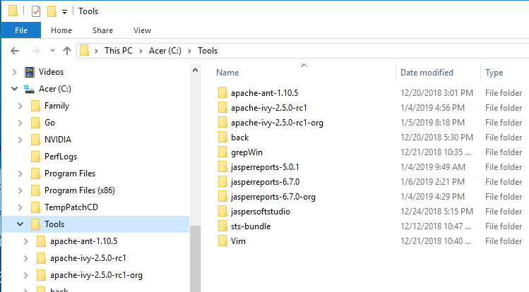
3.1 Download JasperReport Project
https://community.jaspersoft.com/wiki/jasperreports-library-first-steps
Download the files of JasperReport Project (2):
Download and extract jasperreports-6.7.0.zip to a new folder, for example, C:\Tools\jasperreports-6.7.0

Slide 6
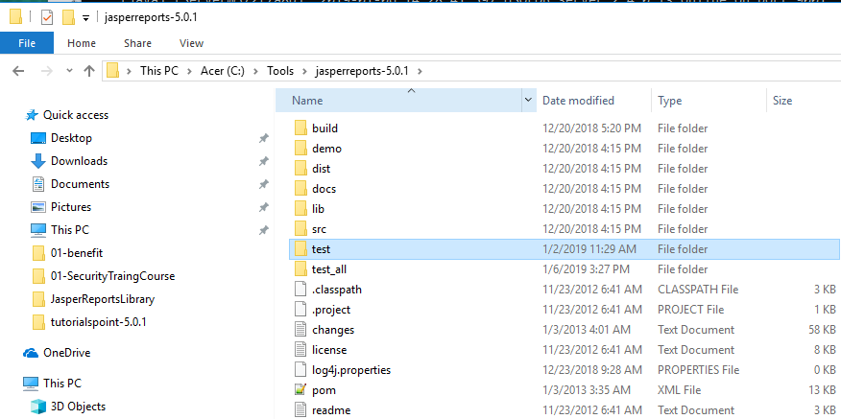
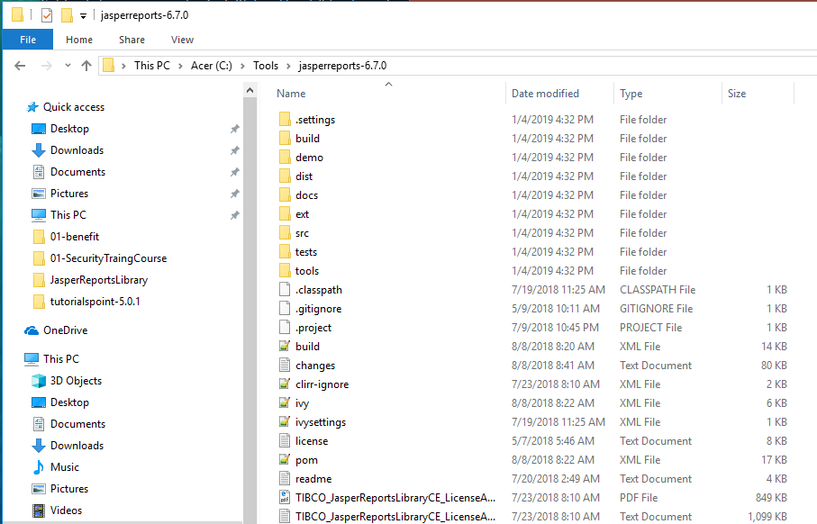
3.1 Download JasperReport Project
https://community.jaspersoft.com/wiki/jasperreports-library-first-steps
Download the files of JasperReport Project (3):
Folder structure before 6.2.2 (e.g., 5.0.1) vs. after 6.2.2 (e.g., 6.7.0)
Before 6.2.2 (e.g., 5.0.1), the third party lib/*jar come with JasperReport Project files.
After 6.2.2 (e.g., 6.7.0), there is no lib/*jar in the JasperReport project files.
The users have to use ant/ivy and ivy.xml to generate lib/*.jar for their applications from TIBCO/JasperSoft repositories.

Slide 7
3.2 Start Database Server

Slide 8
3.2 Install Ant and Ivy
https://community.jaspersoft.com/wiki/jasperreports-library-first-steps
Install Ant
JasperReports uses the Ant build tool from the Apache Foundation to compile source files, build the distribution files, generate the JavaDoc documentation, and run the samples.
Download Ant from http://ant.apache.org.
For installation instructions, visit http://ant.apache.org/manual/index.html.
Install Ivy
Ivy is used for copy the Jasper report lib/*.jar from TIBCO/JasperSoft repository to your local lib/*.jar.
http://ant.apache.org/ivy/history/latest-milestone/tutorial/start.html

Slide 9
3.3 Start Database Server

Slide 10
3.3 Start Database Server
https://community.jaspersoft.com/wiki/jasperreports-library-first-steps
Start Database Server
http://jasperreports.sourceforge.net/sample.reference/query/index.html
Environment | Commands
Linux | prompt> cd /opt prompt> cd jasperreports-{ver}/demo/hsqldb prompt> ant runServer
Windows | prompt> cd \program files prompt> cd jasperreports-{ver}\demo\hsqldb prompt> ant runServer

Slide 11
3.4 Run JasperReport API

Slide 12
3.4 Run JasperReport API
https://community.jaspersoft.com/wiki/jasperreports-library-first-steps
Run JasperReport API (1)
The JasperReports project files include a complete set of sample applications and reports that show how individual JasperReports features can be used.
In the next following chapters, use ant -p command to check available commands for each application example.

Slide 13
3.4 Run JasperReport API
https://community.jaspersoft.com/wiki/jasperreports-library-first-steps
Run JasperReport API (2)
Environment | Commands
Linux | prompt> cd /opt prompt> cd jasperreports-{ver}\demo\samples prompt> dir prompt> cd barbecue prompt> ant -p prompt> ant javac prompt> ant compile prompt> ant fill prompt> ant view prompt> ant viewDesign prompt> ant run prompt> dir build\reports prompt> ant clean
Environment | Commands
Windows | prompt> cd \program files prompt> cd jasperreports-{ver}\demo\samples prompt> dir prompt> cd barbecue prompt> ant -p prompt> ant javac prompt> ant compile prompt> ant fill prompt> ant view prompt> ant viewDesign prompt> ant run prompt> dir build\reports prompt> ant clean

Slide 14
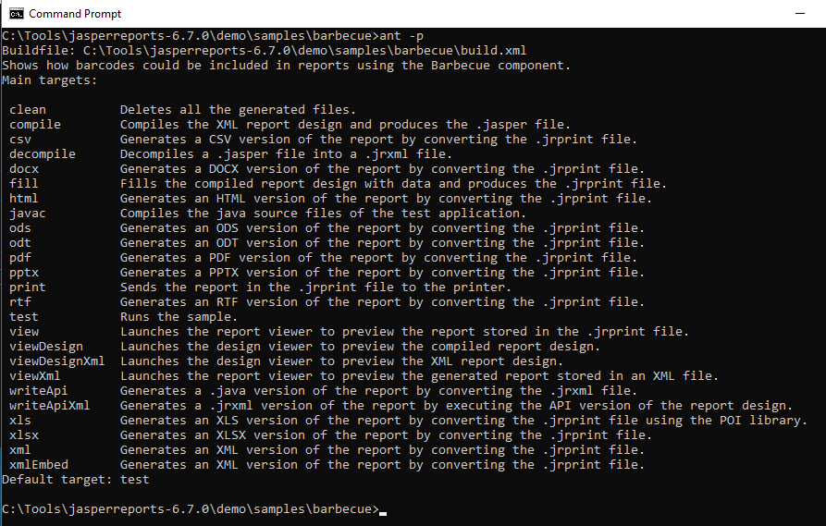
3.4 Run JasperReport API
https://community.jaspersoft.com/wiki/jasperreports-library-first-steps
Run JasperReport API (3)
> cd \Tools\jaspers-6.7.0\demo\samples\barbecue
> ant -p

Slide 15
3.5 Commands

Slide 16
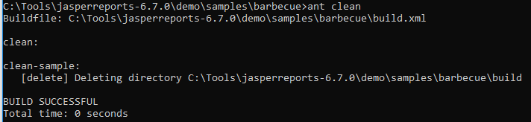
3.5 Commands
https://community.jaspersoft.com/wiki/jasperreports-library-first-steps
Commands (1):
> ant clean: Deletes all the generated files (and build folder).

Slide 17
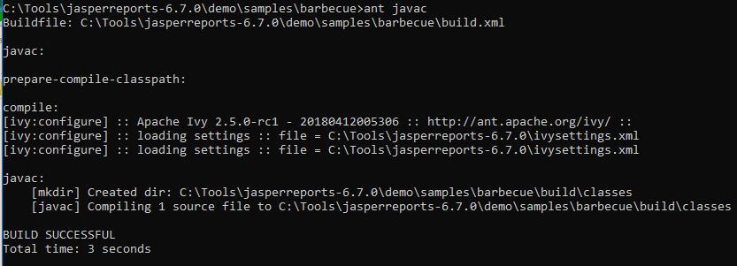
3.5 Commands
https://community.jaspersoft.com/wiki/jasperreports-library-first-steps
Commands (2):
> ant javac: Compiles the java source files of the src/../*.java into build/classes/*.class

Slide 18
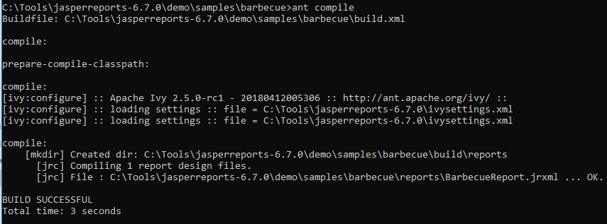
3.5 Commands
https://community.jaspersoft.com/wiki/jasperreports-library-first-steps
Commands (3):
> ant compile: Compiles the Jasper XML report (reports/*jrxml) into the build/reports/*.jasper file.

Slide 19
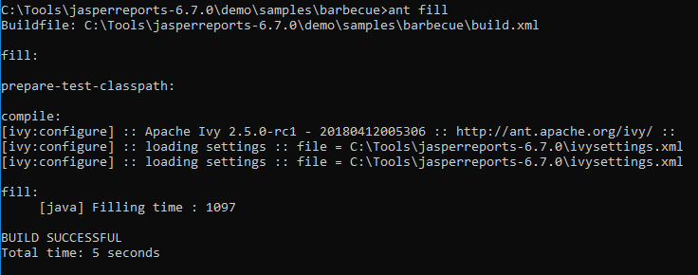
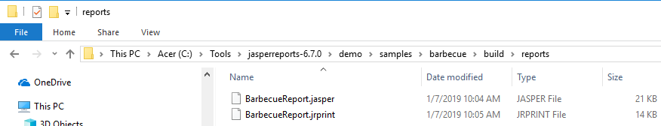
3.5 Commands
https://community.jaspersoft.com/wiki/jasperreports-library-first-steps
Commands (4):
> ant fill: Fill data build/reports/*.jasper file and produce the build/reports/*. jrprint.

Slide 20
3.5 Commands
https://community.jaspersoft.com/wiki/jasperreports-library-first-steps
Commands (5):
> ant fill: Fill data build/reports/*.jasper file and produce the build/reports/*. jrprint.

Slide 21
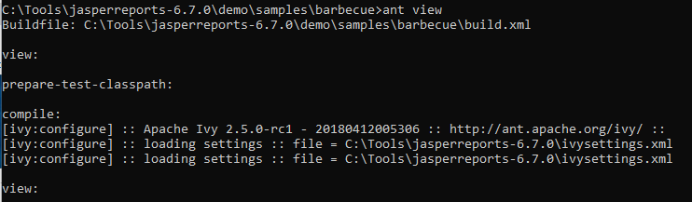
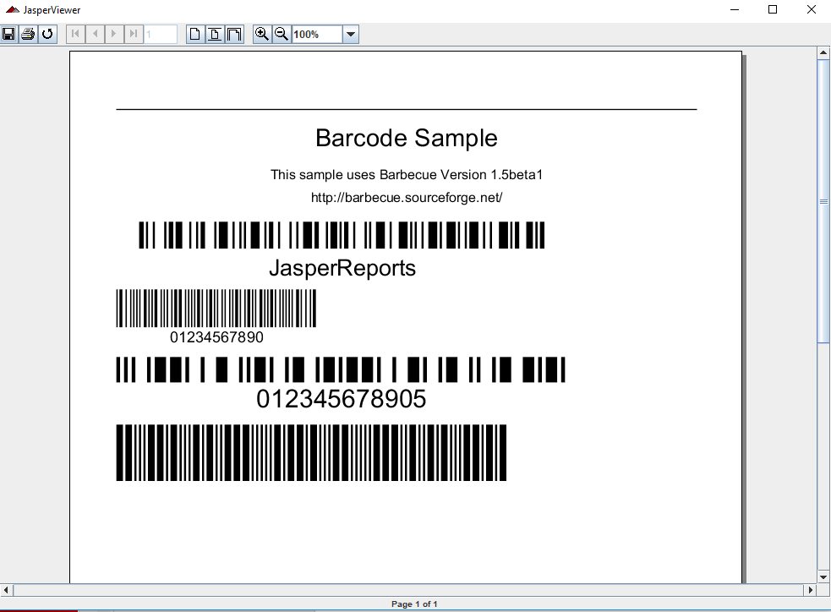
3.5 Commands
https://community.jaspersoft.com/wiki/jasperreports-library-first-steps
Commands (5):
> ant view: User Report Viewer to View the build/reports/*.jrprint

Slide 22
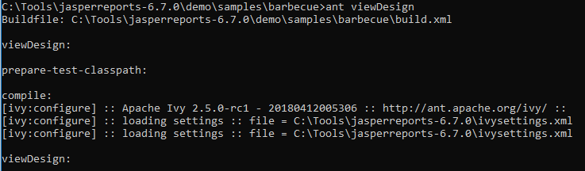
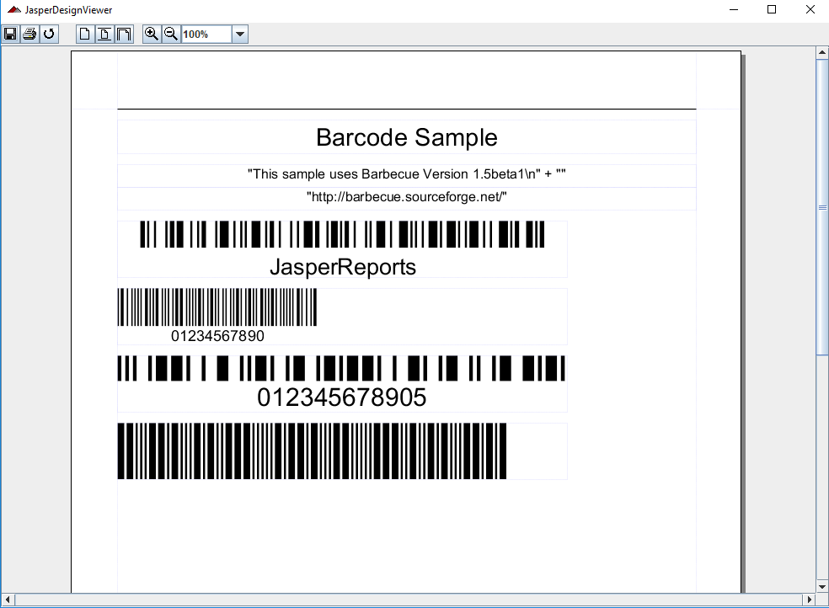
3.5 Commands
https://community.jaspersoft.com/wiki/jasperreports-library-first-steps
Commands (6):
> ant viewDesign: Use Design Viewer to View the build/reports/*.jrprint

Slide 23
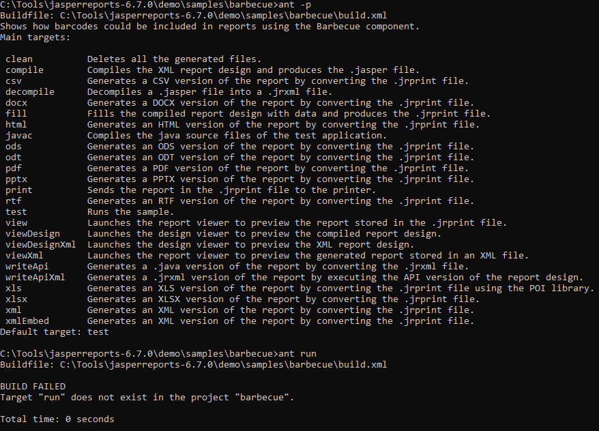
3.5 Commands
https://community.jaspersoft.com/wiki/jasperreports-library-first-steps
Commands (6):
> ant clean: Deletes all the generated files.

Slide 24
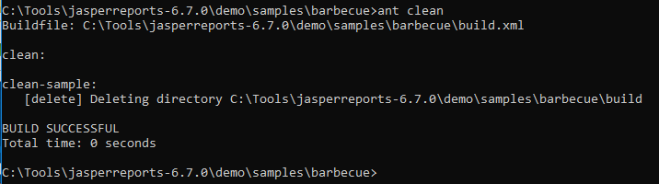
3.5 Commands
https://community.jaspersoft.com/wiki/jasperreports-library-first-steps
Commands (7):
> ant clean:

Slide 25
3.6 Summary

Slide 26
3.6 Summary
https://community.jaspersoft.com/wiki/jasperreports-library-first-steps
Summary:
JasperReport 5.0.1 (Before 6.2.2) needs ant to build API.
JasperReport 6.7.0 (After 6.2.2) needs ivy for lib/*.jar and ant to build API.
JasperReport have 79 API and script examples under demo/samples.

Slide 27
End of Chapter

