Slide 1

4 JasperReports API: a
Peter H. Chen

Slide 2
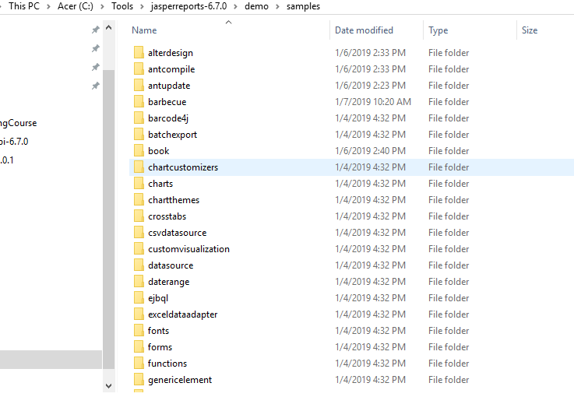
4 JasperReports API: a
https://community.jaspersoft.com/project/jasperreports-library
JasperReport API:
demo/samples/a*

Slide 3
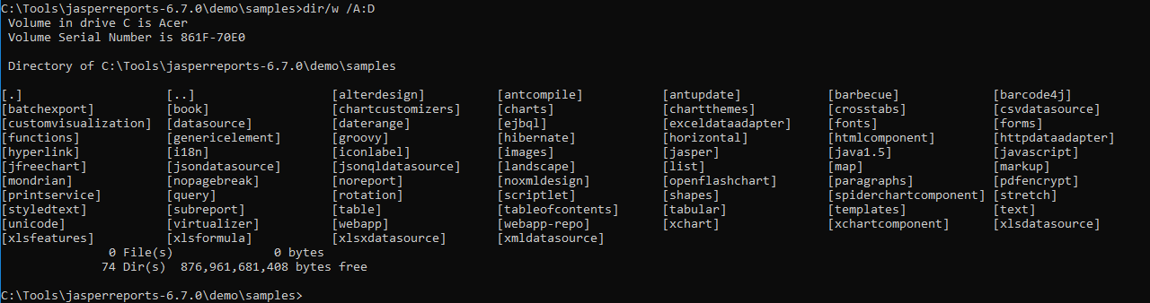
4 JasperReports API: a
https://community.jaspersoft.com/project/jasperreports-library
JasperReport API:
> dir/w /A:D # totally, we have 74 examples in Jasper Report 6.7.0

Slide 4
4.1 API: alterdesign

Slide 5
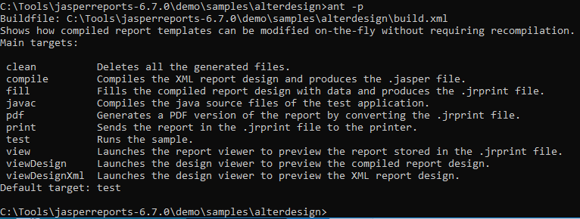
4.1 API: alterdesign
https://community.jaspersoft.com/wiki/jasperreports-library-first-steps
API: alterdesign
Available command: ant -p

Slide 6
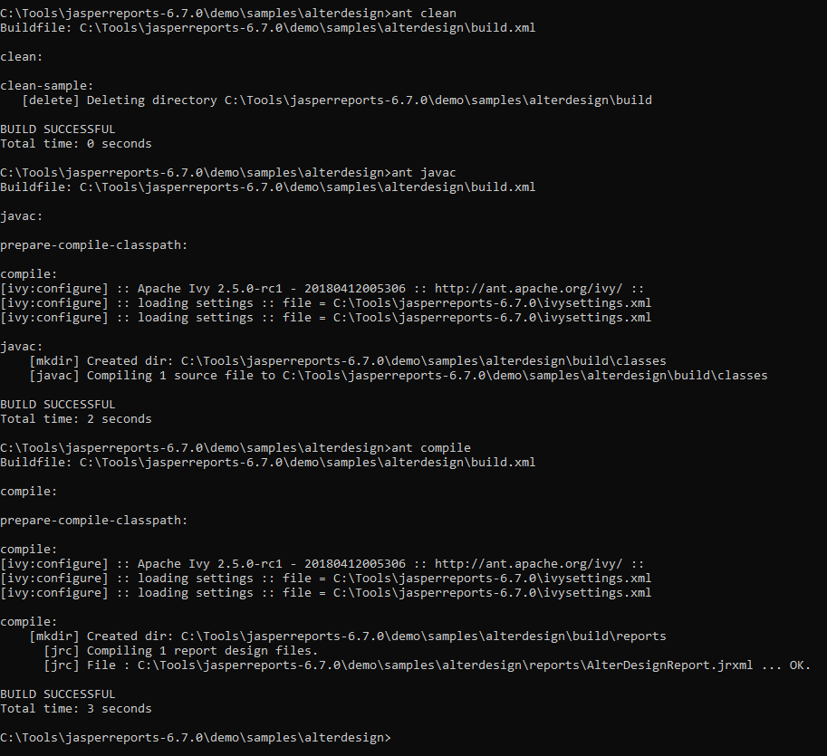
4.1 API: alterdesign
https://community.jaspersoft.com/wiki/jasperreports-library-first-steps
API: alterdesign
> ant clean, ant javac, ant compile

Slide 7
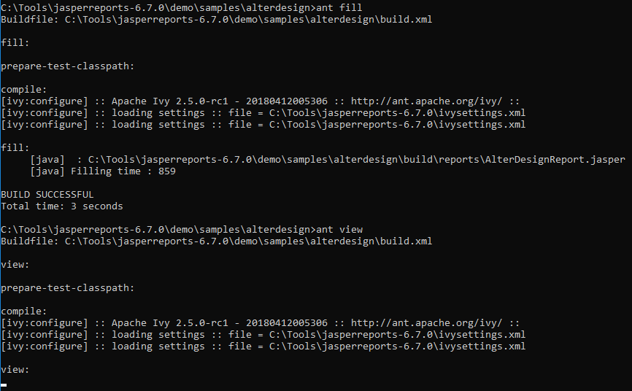
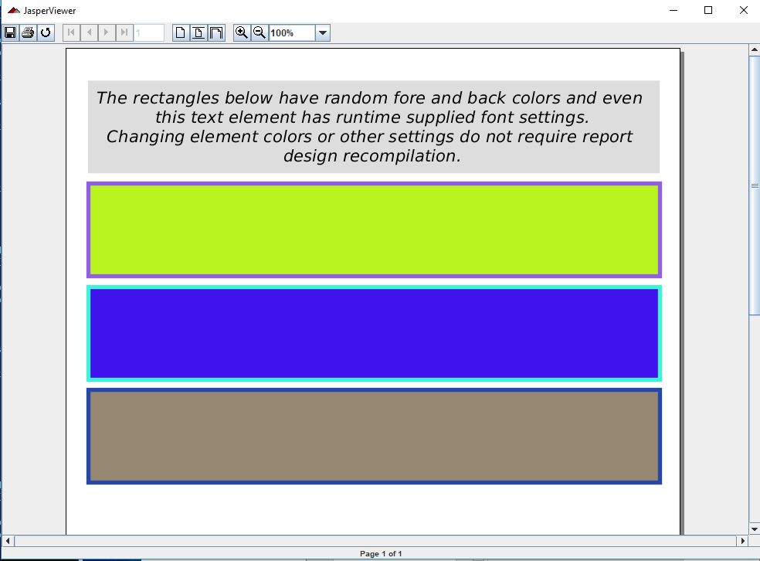
4.1 JasperReport API: alterdesign
https://community.jaspersoft.com/wiki/jasperreports-library-first-steps
API: alterdesign
> ant fill, ant view # Fill the report, display the report

Slide 8
4.2 API: antcompile

Slide 9
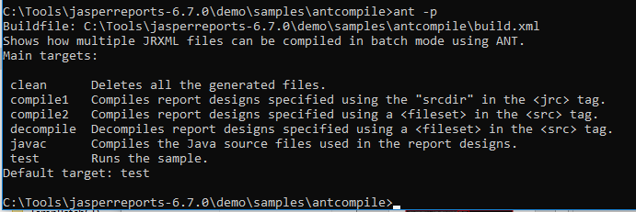
4.2 API: antcompile
https://community.jaspersoft.com/wiki/jasperreports-library-first-steps
API: antcompile
Available command: ant -p

Slide 10
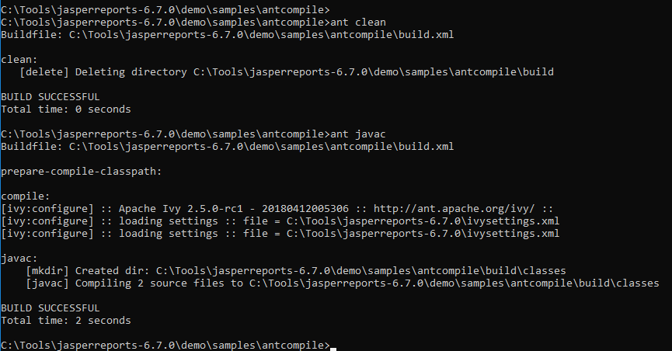
4.2 API: antcompile
https://community.jaspersoft.com/wiki/jasperreports-library-first-steps
API: antcompile
> ant clean, ant javac

Slide 11
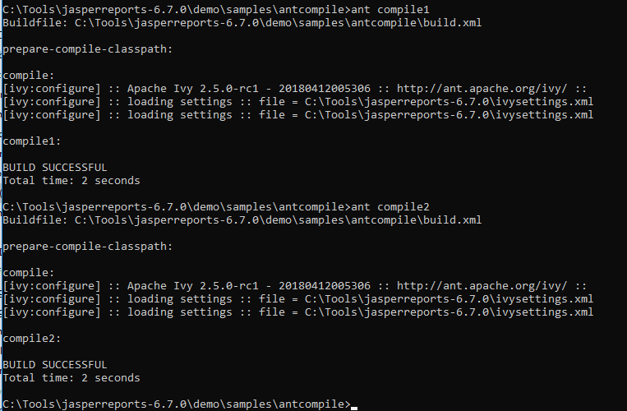
4.2 API: antcompile
https://community.jaspersoft.com/wiki/jasperreports-library-first-steps
API: antcompile
> ant compile1, ant compile2

Slide 12
4.3 API: antupdate

Slide 13
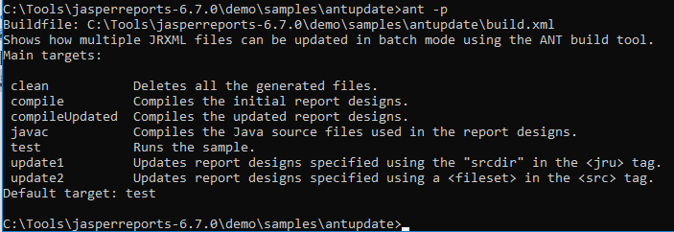
4.3 API: antupdate
https://community.jaspersoft.com/wiki/jasperreports-library-first-steps
API: antupdate
Available command: ant -p

Slide 14
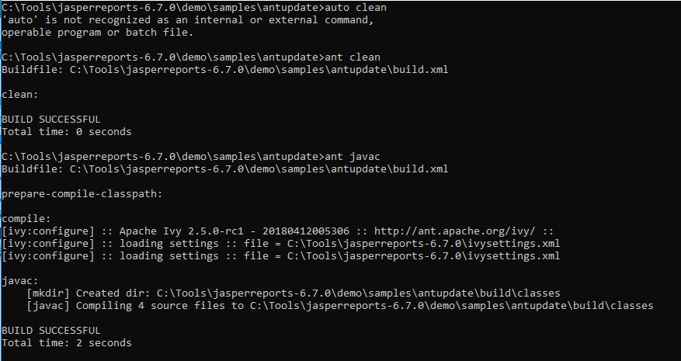
4.3 API: antupdate
https://community.jaspersoft.com/wiki/jasperreports-library-first-steps
API: antupdate
> ant clean, ant javac

Slide 15
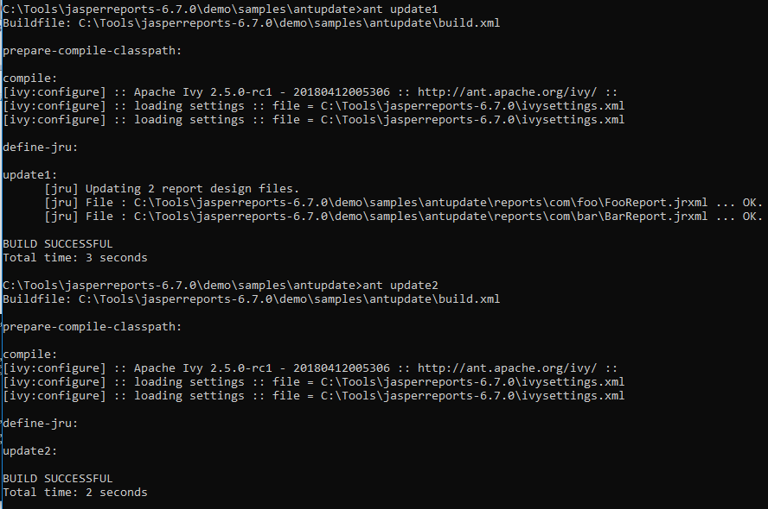


4.3 API: antupdate
https://community.jaspersoft.com/wiki/jasperreports-library-first-steps
API: antupdate
> ant update1, ant update2

Slide 16
End of Chapter

