Slide 1

8 JasperReports API: e
Peter H. Chen

Slide 2
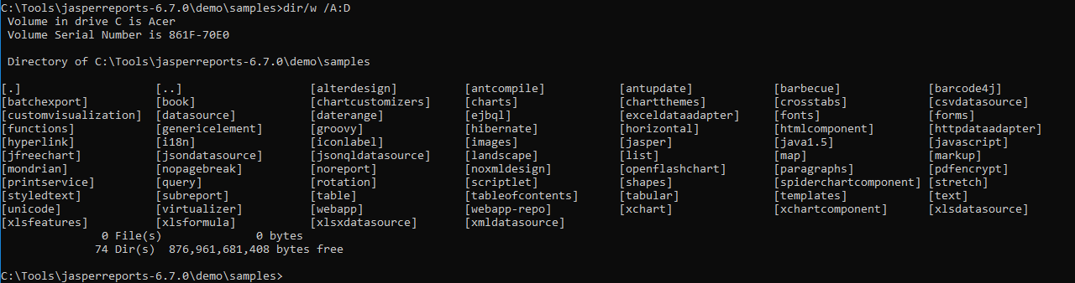
8 JasperReports API: e
https://community.jaspersoft.com/project/jasperreports-library
JasperReport API:
> dir/w /A:D # totally, we have 74 examples in Jasper Report 6.7.0

Slide 3
8.1 API: ejbql

Slide 4
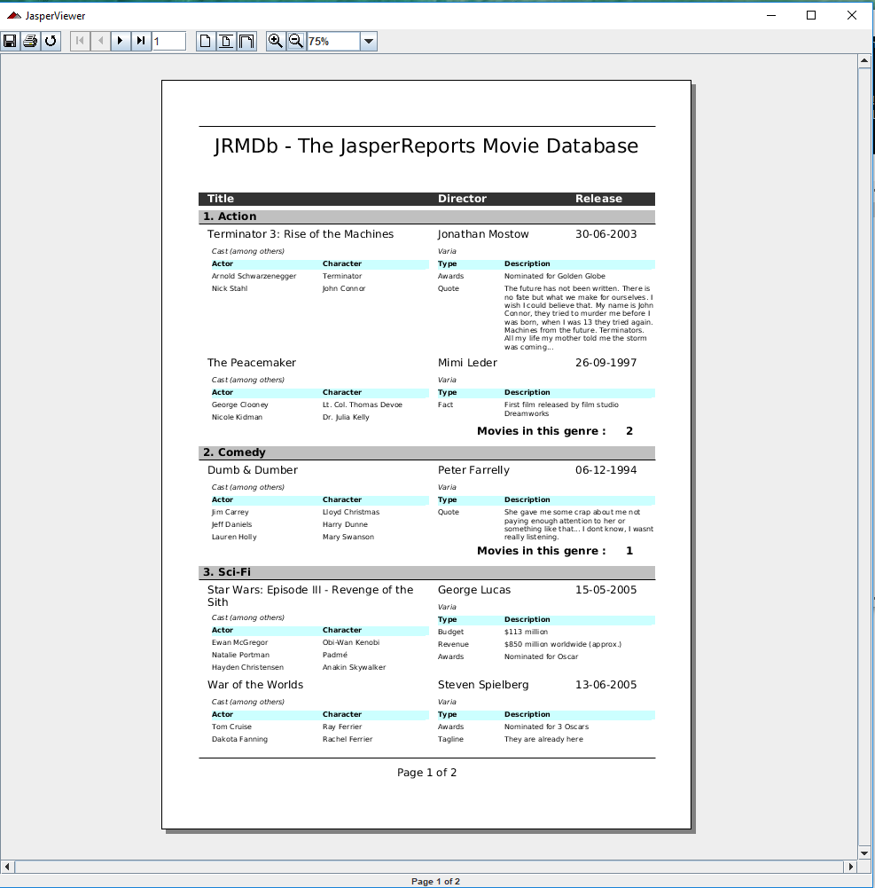
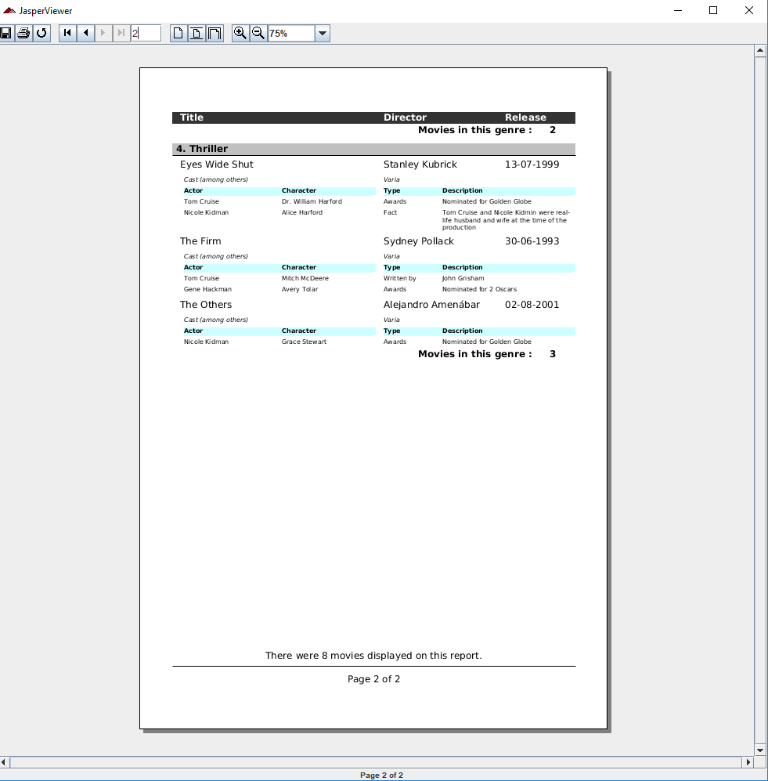
8.1 API: ejbql
https://community.jaspersoft.com/wiki/jasperreports-library-first-steps
API: ejbql (Enterprise Java Bean Query Language)
> ant -p, ant clean, ant javac, ant compile, ant fill, ant view

Slide 5
8.2 API: exceldataadapter

Slide 6
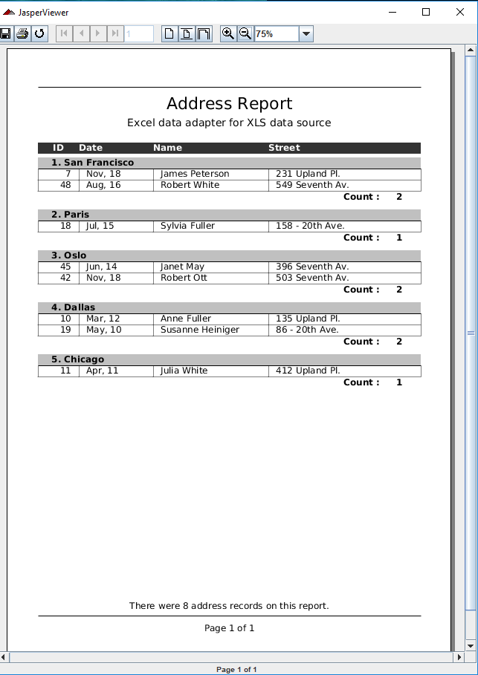
8.2 API: exceldataadapter
https://community.jaspersoft.com/wiki/jasperreports-library-first-steps
API: exceldataadpter
> ant -p, ant clean, ant javac, ant compile, ant fill, ant view

Slide 7
8.3 Summary

Slide 8
8.3 Summary
https://community.jaspersoft.com/wiki/jasperreports-library-first-steps
Summary:
ejbql: API for Enterprise Java Bean Query Language
dxceldataadpter: API for Excel Data Adapter

Slide 9
End of Chapter

