Slide 1

16 JasperReports API: n
Peter H. Chen

Slide 2
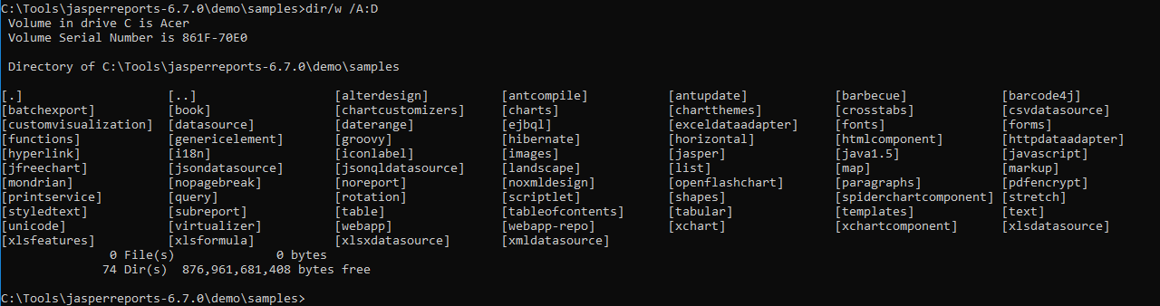
16 JasperReports API: n
https://community.jaspersoft.com/project/jasperreports-library
JasperReport API:
> dir/w /A:D # totally, we have 74 examples in Jasper Report 6.7.0

Slide 3
16.1 API: nopagebreak

Slide 4
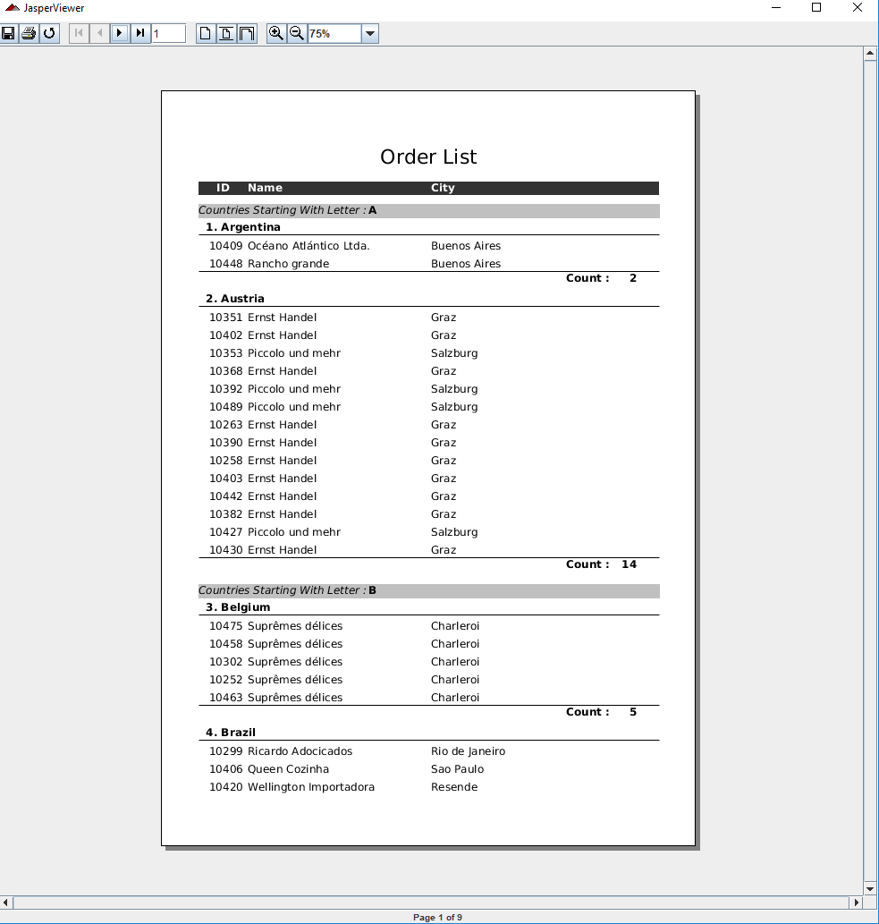
16.1 API: nopagebreak
https://community.jaspersoft.com/wiki/jasperreports-library-first-steps
API: nopagebreak (No Page break in report)
> ant -p, ant clean, ant javac, ant compile, ant fill, ant view

Slide 5
16.2 API: noreport

Slide 6
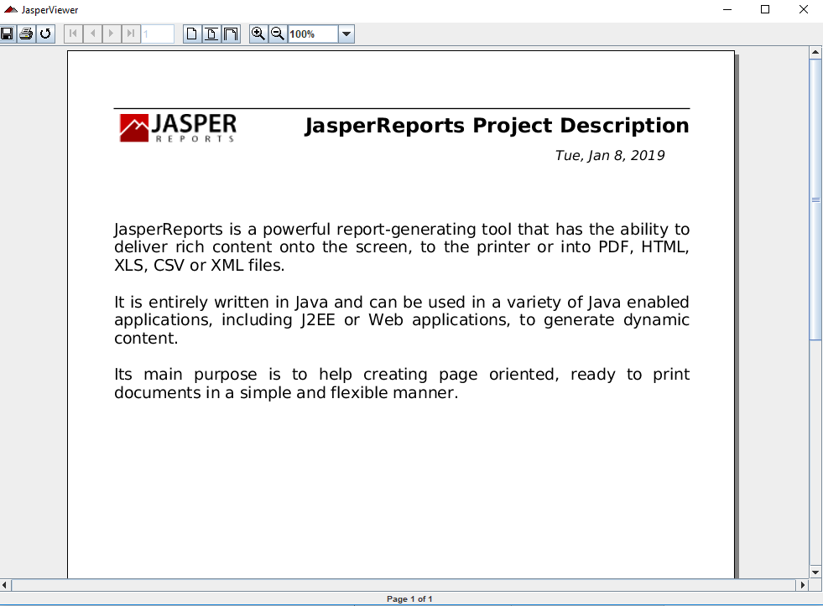
16.2 API: noreport
https://community.jaspersoft.com/wiki/jasperreports-library-first-steps
API: noreport
> ant -p, ant clean, ant javac, ant compile, ant fill, ant view

Slide 7
16.3 API: noxmldesign

Slide 8
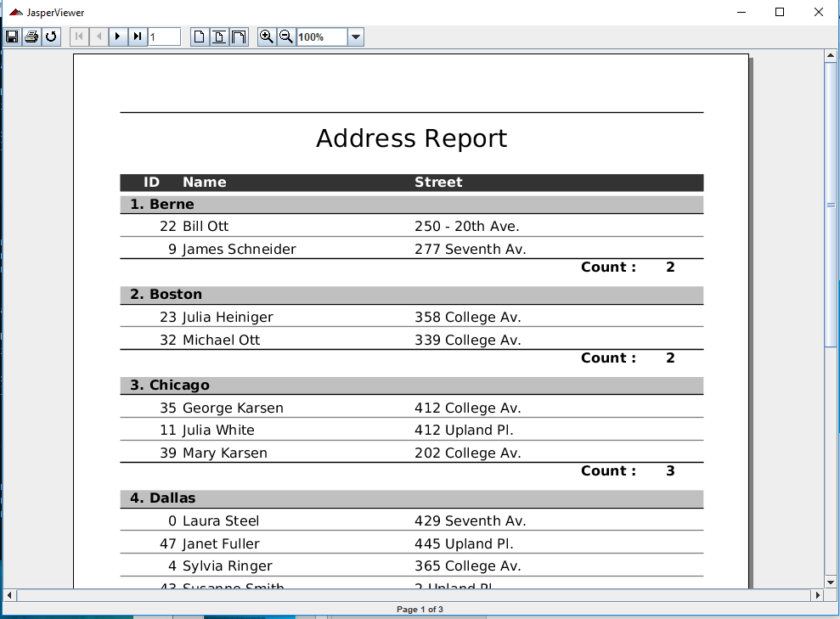
16.3 API: noxmldesign
https://community.jaspersoft.com/wiki/jasperreports-library-first-steps
API: noxmldesign
> ant -p, ant clean, ant javac, ant compile, ant fill, ant view

Slide 9
End of Chapter

