Slide 1

21 JasperReports API: s
Peter H. Chen

Slide 2
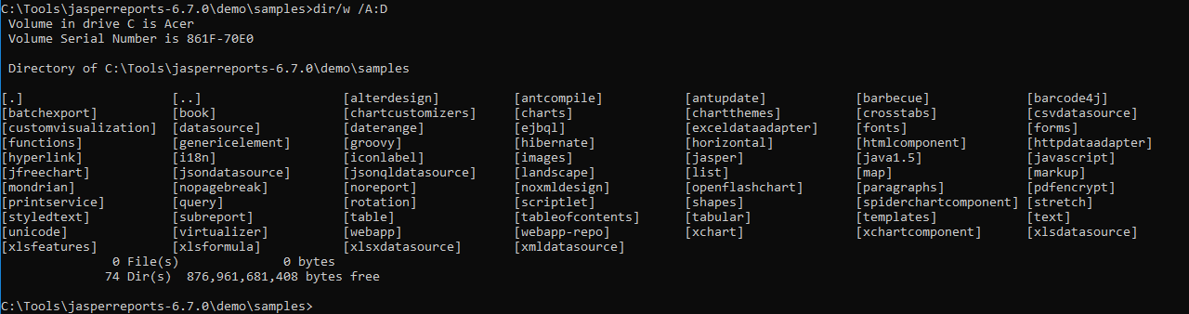
21 JasperReports API: s
https://community.jaspersoft.com/project/jasperreports-library
JasperReport API:
> dir/w /A:D # totally, we have 74 examples in Jasper Report 6.7.0

Slide 3
21.1 API: scriptlet

Slide 4
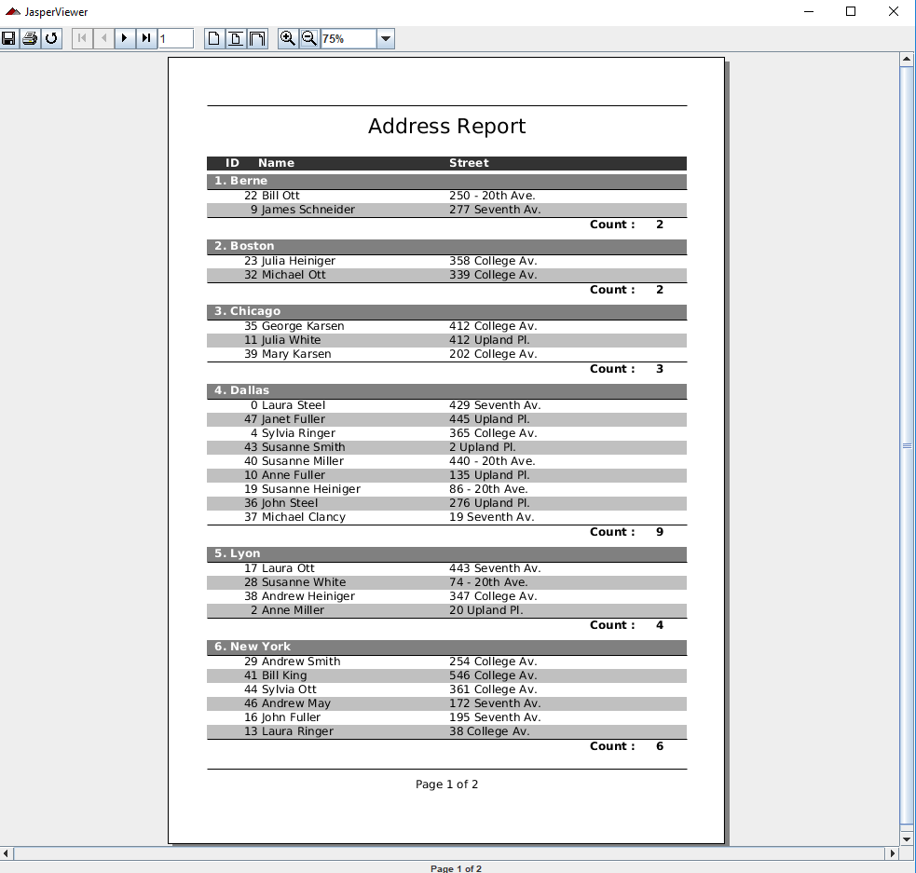
21.1 API: scriptlet
https://community.jaspersoft.com/wiki/jasperreports-library-first-steps
API: scriptlet (Start server first ‘ant runServer’)
> ant -p, ant clean, ant javac, ant compile, ant fill, ant view

Slide 5
21.2 API: shapes

Slide 6
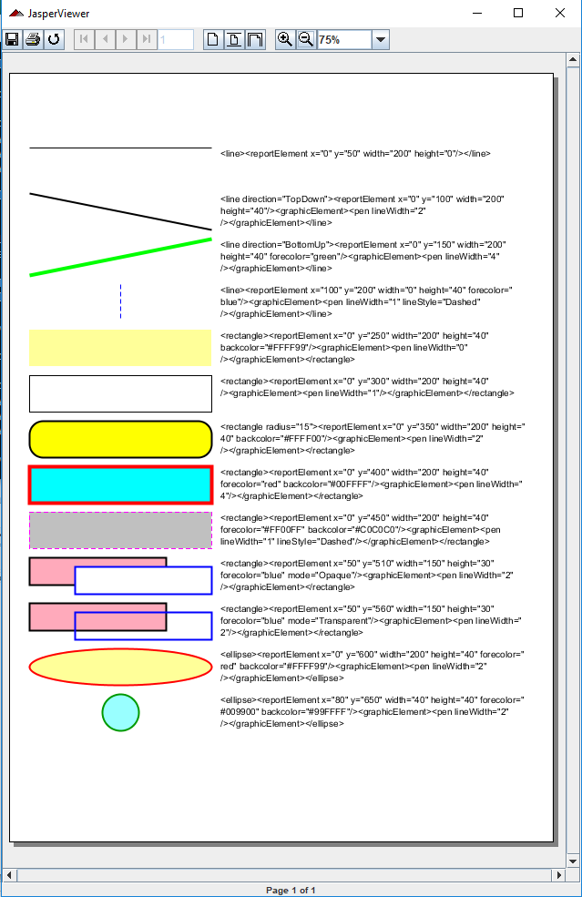
21.2 API: shapes
https://community.jaspersoft.com/wiki/jasperreports-library-first-steps
API: shape (Start server first ‘ant runServer’)
> ant -p, ant clean, ant javac, ant compile, ant fill, ant view

Slide 7
21.3 API: spiderchartcomponent

Slide 8
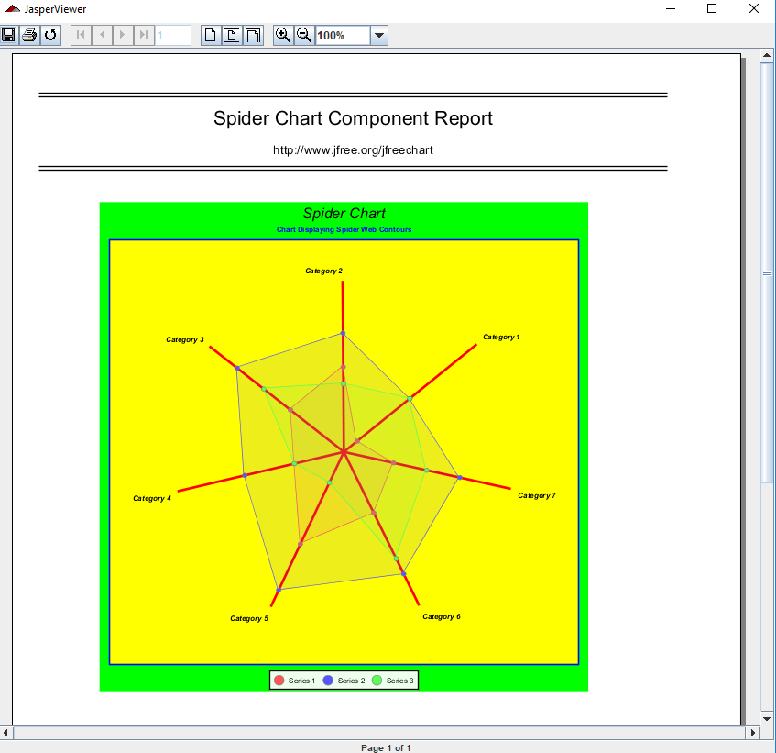
21.3 API: spiderchartcomponent
https://community.jaspersoft.com/wiki/jasperreports-library-first-steps
API: spider chart (Start server first ‘ant runServer’)
> ant -p, ant clean, ant javac, ant compile, ant fill, ant view

Slide 9
21.4 API: stretch

Slide 10
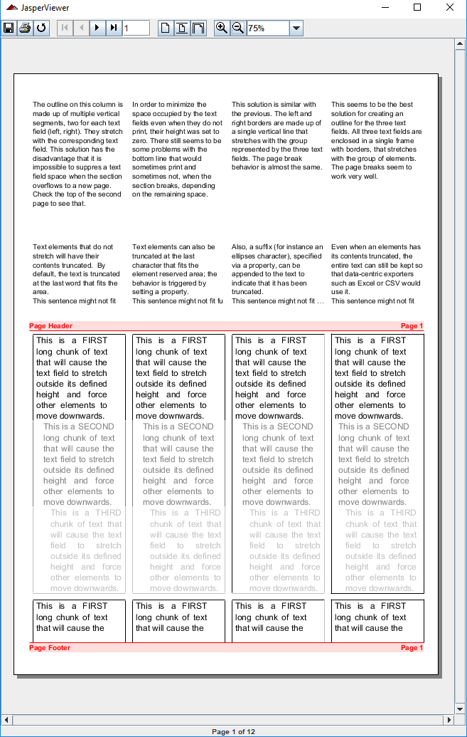
21.4 API: stretch
https://community.jaspersoft.com/wiki/jasperreports-library-first-steps
API: stretch (Start server first ‘ant runServer’)
> ant -p, ant clean, ant javac, ant compile, ant fill, ant view

Slide 11
21.5 API: style

Slide 12
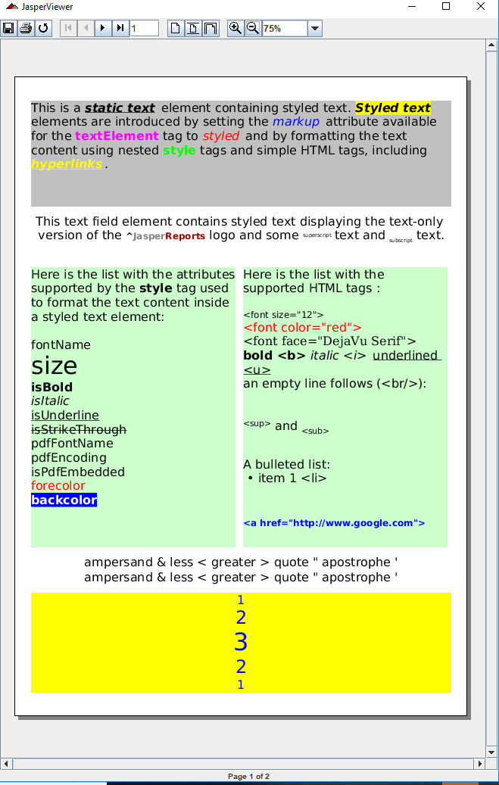
21.5 API: style
https://community.jaspersoft.com/wiki/jasperreports-library-first-steps
API: style (Start server first ‘ant runServer’)
> ant -p, ant clean, ant javac, ant compile, ant fill, ant view

Slide 13
21.6 API: subreport

Slide 14
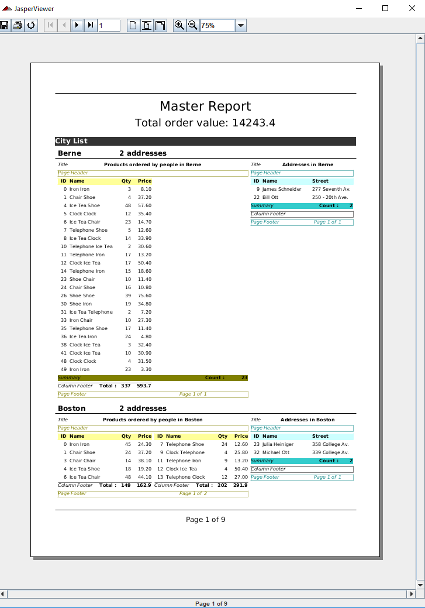
21.6 API: subreport
https://community.jaspersoft.com/wiki/jasperreports-library-first-steps
API: subreport (Start server first ‘ant runServer’)
> ant -p, ant clean, ant javac, ant compile, ant fill, ant view

Slide 15
End of Chapter

