Slide 1

11 JasperReports API: h
Peter H. Chen

Slide 2
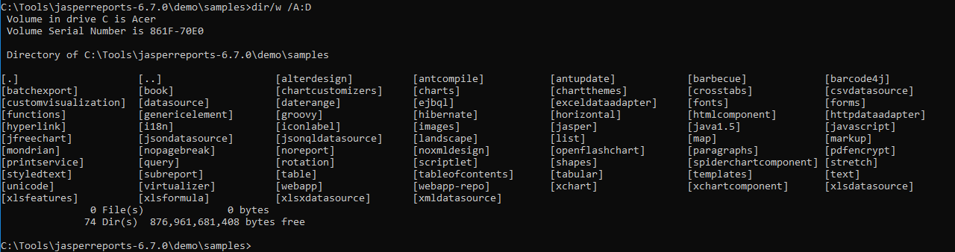
11 JasperReports API: h
https://community.jaspersoft.com/project/jasperreports-library
JasperReport API:
> dir/w /A:D # totally, we have 74 examples in Jasper Report 6.7.0

Slide 3
11.1 API: hibernate

Slide 4
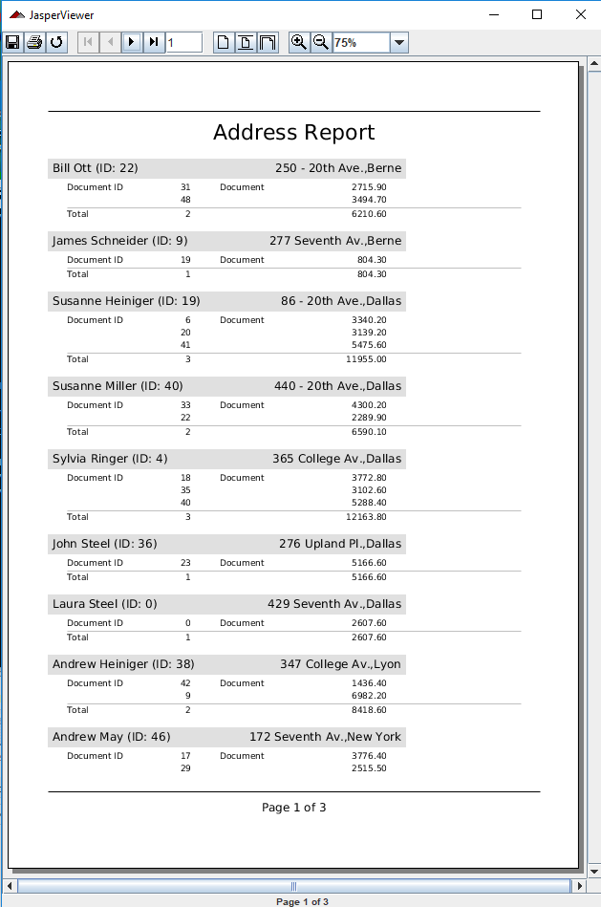
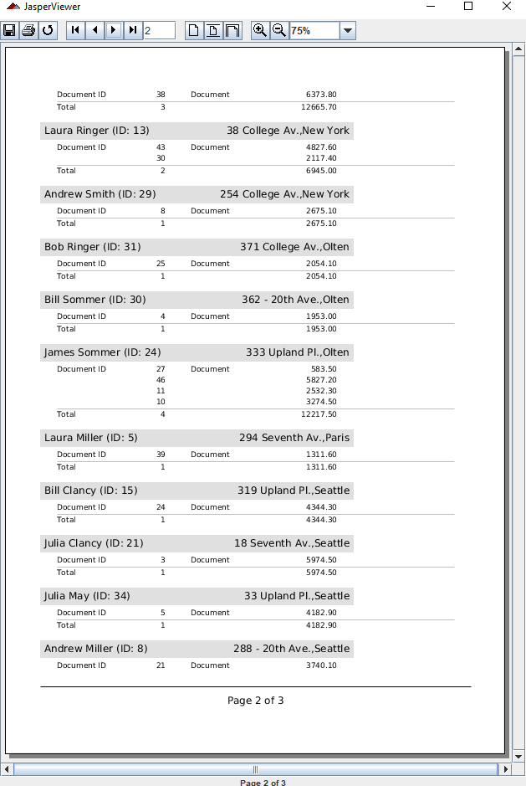
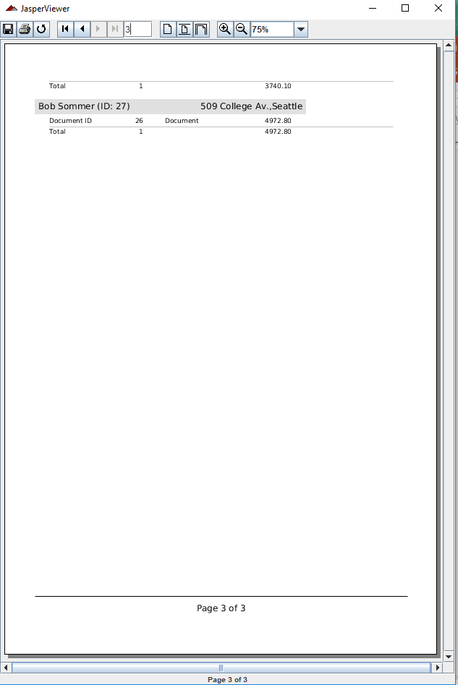
11.1 API: hibernate
https://community.jaspersoft.com/wiki/jasperreports-library-first-steps
API: hibernate (Require database server when ‘ant fill’)
> ant runServer
> ant -p, ant clean, ant javac, ant compile, ant fill, ant view

Slide 5
11.2 API: horizontal

Slide 6
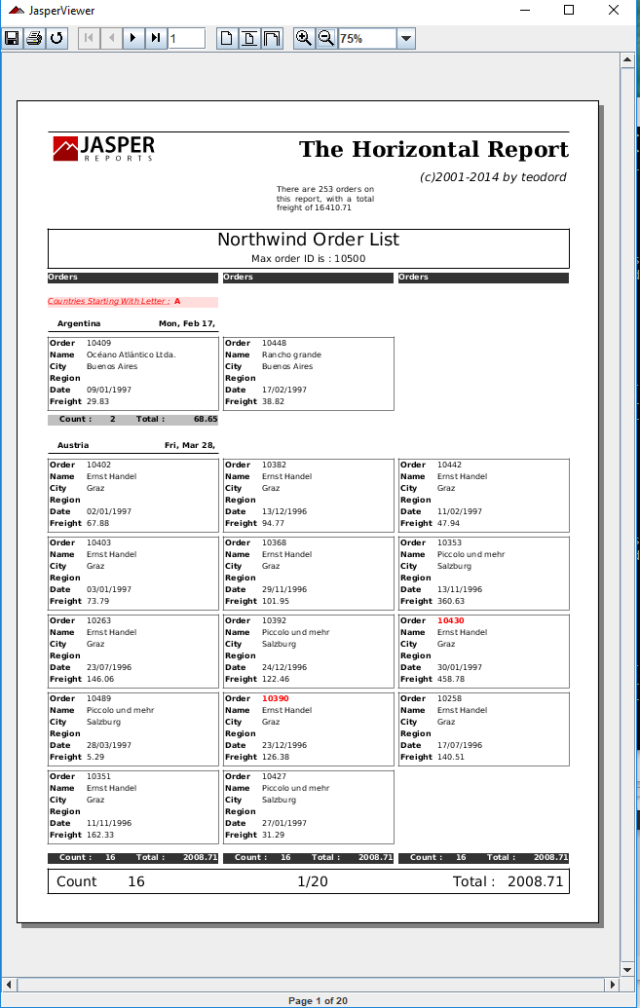
11.2 API: horizontal
https://community.jaspersoft.com/wiki/jasperreports-library-first-steps
API: hibernate (Require database server when ‘ant fill’)
> ant runServer
> ant -p, ant clean, ant javac, ant compile, ant fill, ant view

Slide 7
11.3 API: htmlcomponent

Slide 8
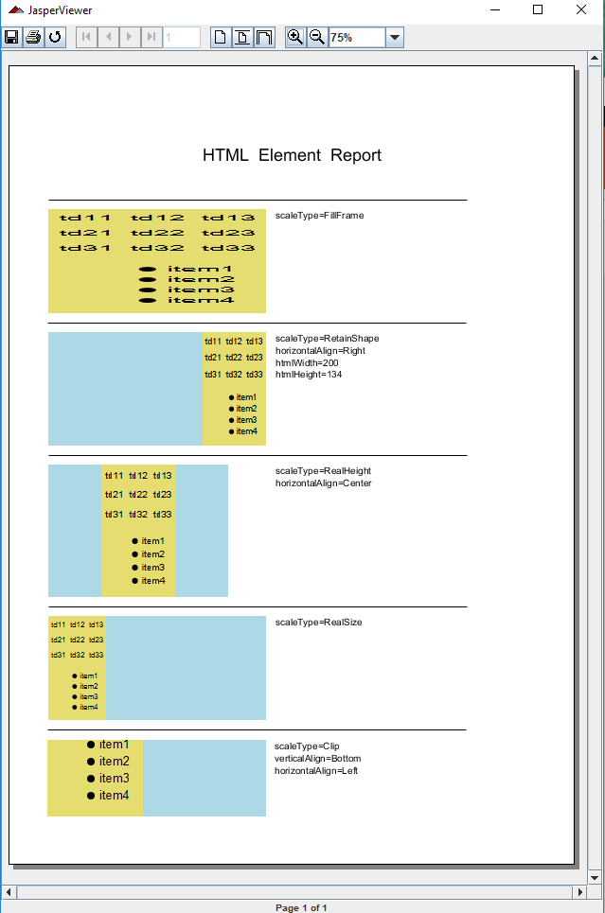
11.3 API: htmlcomponebnt
https://community.jaspersoft.com/wiki/jasperreports-library-first-steps
API: htmlcomponent
> ant -p, ant clean, ant javac, ant compile, ant fill, ant view

Slide 9
11.4 API: httpdataadapter

Slide 10
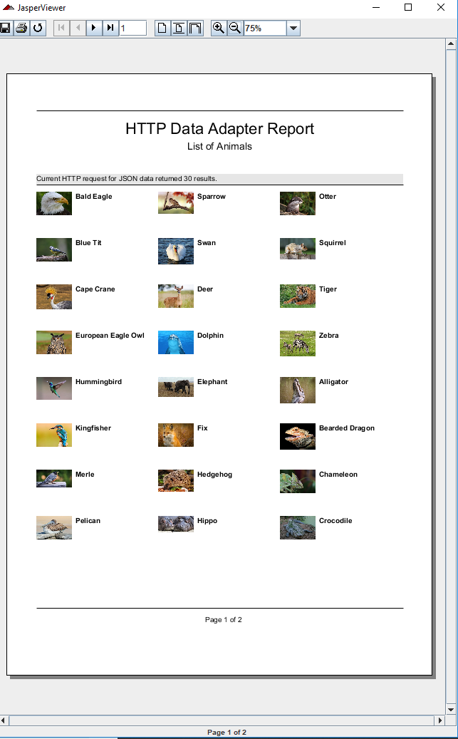
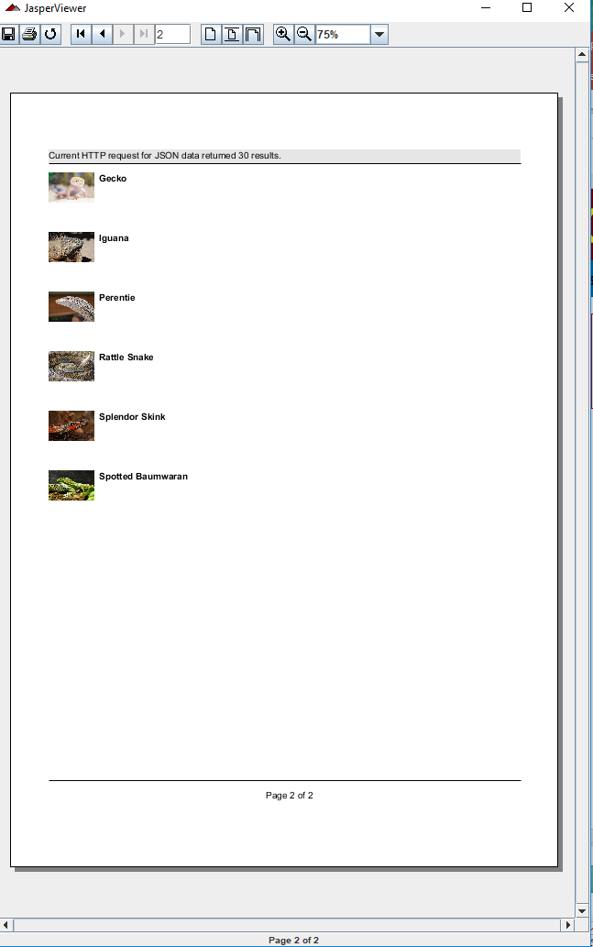
11.4 API: httpdataadapter
https://community.jaspersoft.com/wiki/jasperreports-library-first-steps
API: httpdataadapter (This API requires database server ‘ant runServer’)
> ant runServer
> ant -p, ant clean, ant javac, ant compile, ant fill, ant view

Slide 11
11.5 API: hyperlink

Slide 12
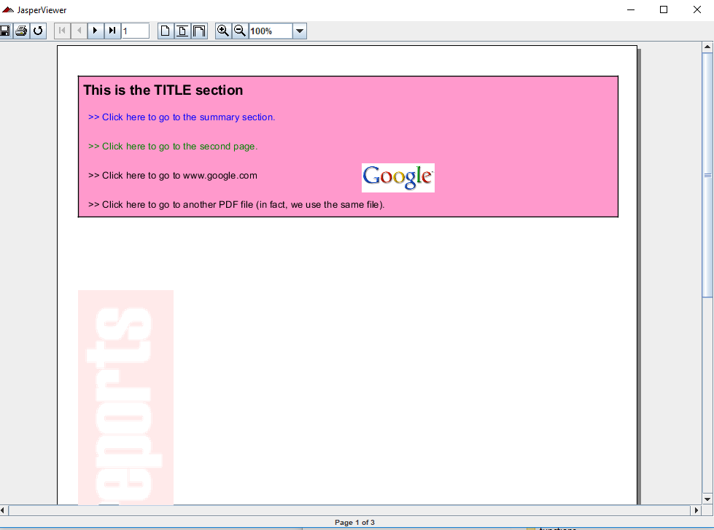
11.5 API: hyperlink
https://community.jaspersoft.com/wiki/jasperreports-library-first-steps
API: hyperlink
> ant -p, ant clean, ant javac, ant compile, ant fill, ant view

Slide 13
11.5 Summary

Slide 14
11.5 Summary
https://community.jaspersoft.com/wiki/jasperreports-library-first-steps
Summary
Hibernate: ORM mapping from class to Table.
Horizontal: Horizontal table display
Html component: HTML
Http Data Adapter:
Hyperlink:

Slide 15
End of Chapter

