Slide 1

12 JasperReports API: i
Peter H. Chen

Slide 2
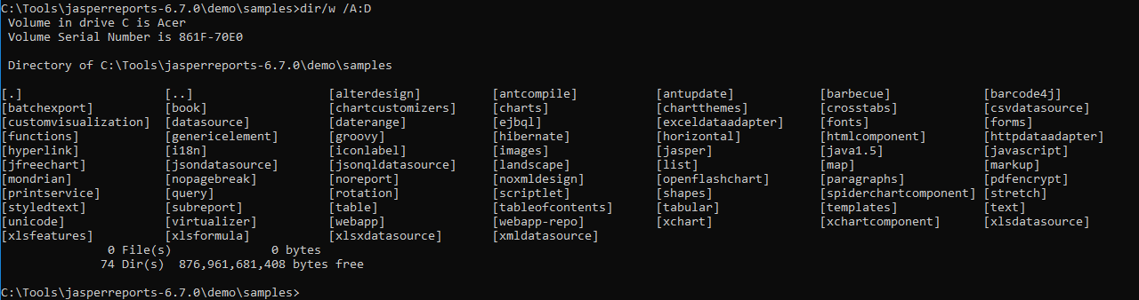
12 JasperReports API: i
https://community.jaspersoft.com/project/jasperreports-library
JasperReport API:
> dir/w /A:D # totally, we have 74 examples in Jasper Report 6.7.0

Slide 3
11.1 API: i18n

Slide 4
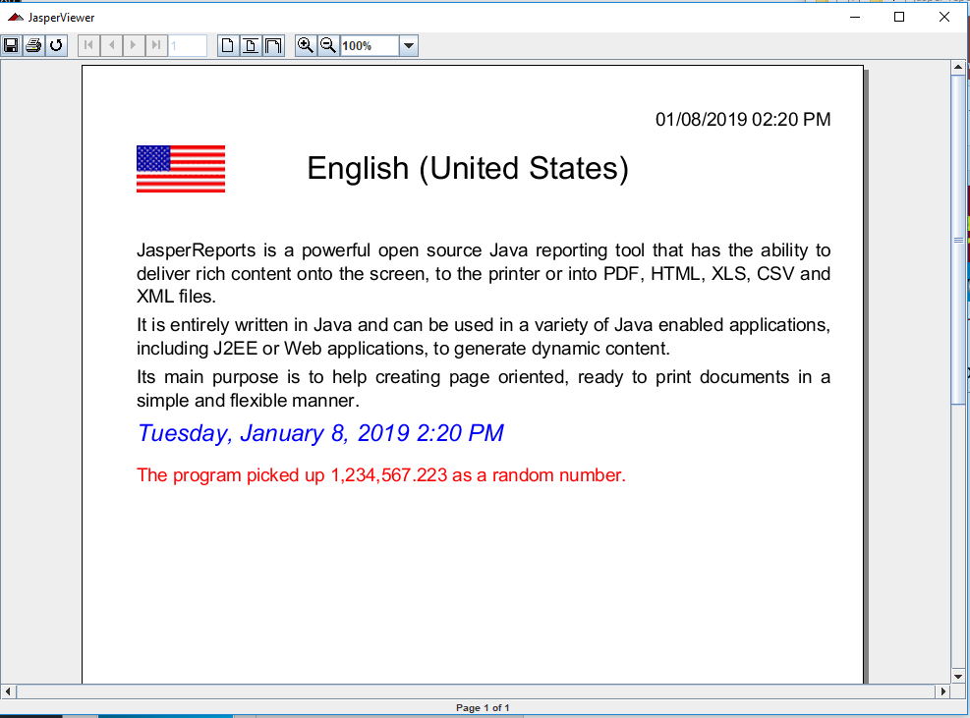
10.1 API: iconlabel
https://community.jaspersoft.com/wiki/jasperreports-library-first-steps
API: i11n
> ant -p, ant clean, ant javac, ant compile, ant fill, ant view

Slide 5
11.2 API: iconlabel

Slide 6
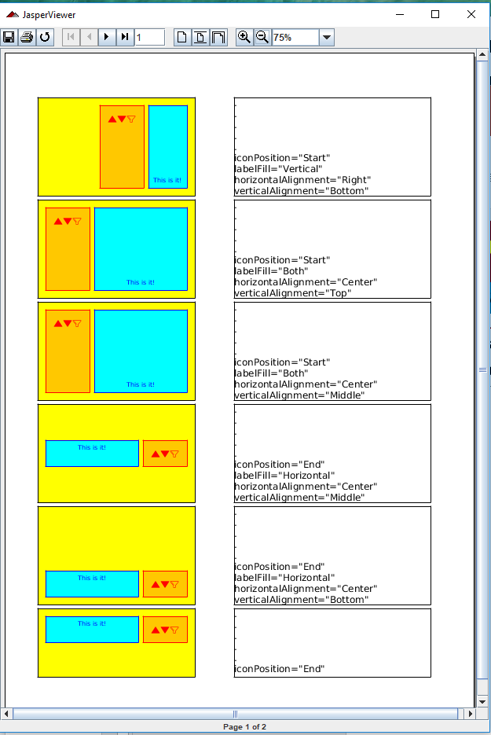
10.2 API: iconlabel
https://community.jaspersoft.com/wiki/jasperreports-library-first-steps
API: iconlabel
> ant -p, ant clean, ant javac, ant compile, ant fill, ant view

Slide 7
11.3 API: images

Slide 8
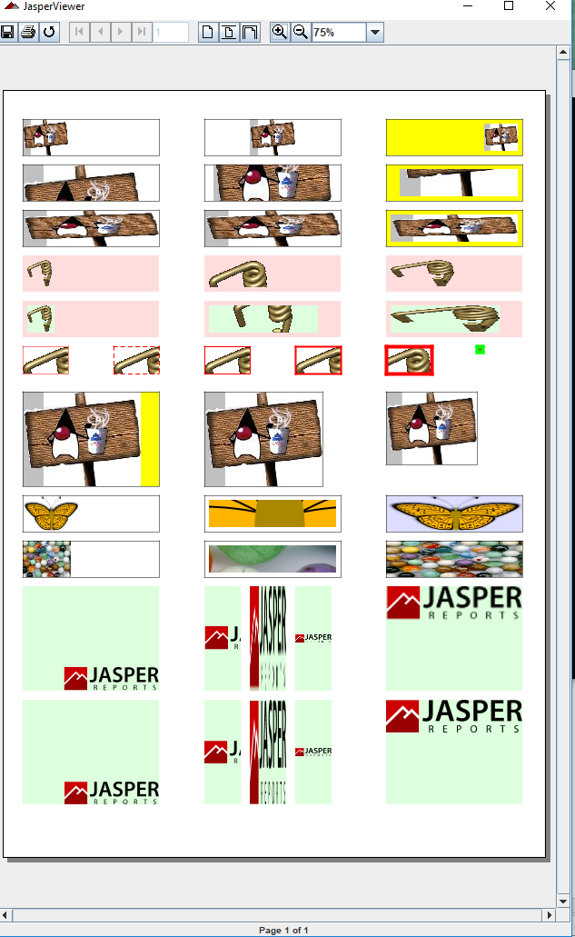
10.3 API: images
https://community.jaspersoft.com/wiki/jasperreports-library-first-steps
API: images
> ant -p, ant clean, ant javac, ant compile, ant fill, ant view

Slide 9
End of Chapter

