Slide 1

6 JasperReports API: c
Peter H. Chen

Slide 2
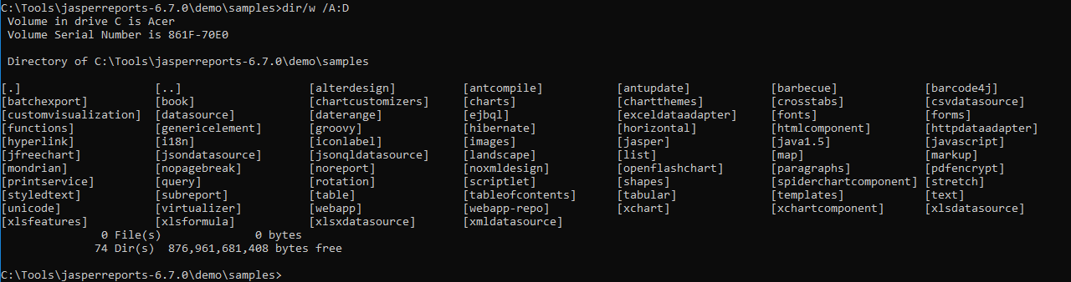
6 JasperReports API: c
https://community.jaspersoft.com/project/jasperreports-library
JasperReport API:
> dir/w /A:D # totally, we have 74 examples in Jasper Report 6.7.0

Slide 3
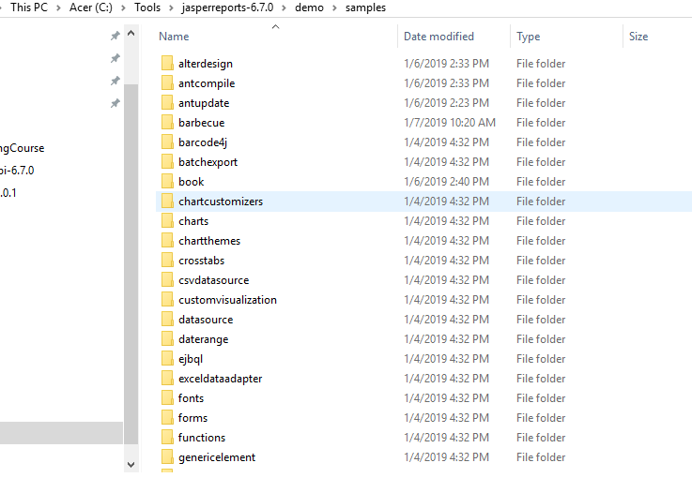
6 JasperReports API: c
https://community.jaspersoft.com/project/jasperreports-library
JasperReport API:
demo/samples/c*

Slide 4
6.1 API: chartcustomizers

Slide 5
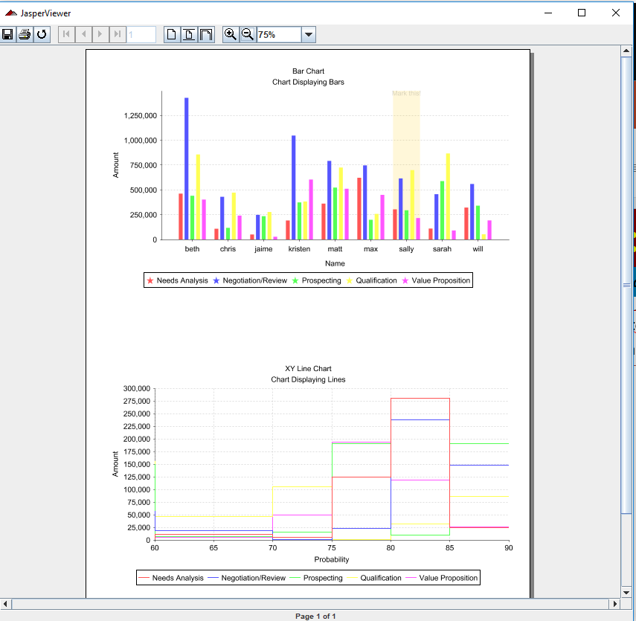
6.1 API: chartcustomizers
https://community.jaspersoft.com/wiki/jasperreports-library-first-steps
API: chartcustomizers
> ant -p, ant clean, ant javac, ant compile, ant fill, ant view

Slide 6
6.2 API: charts

Slide 7
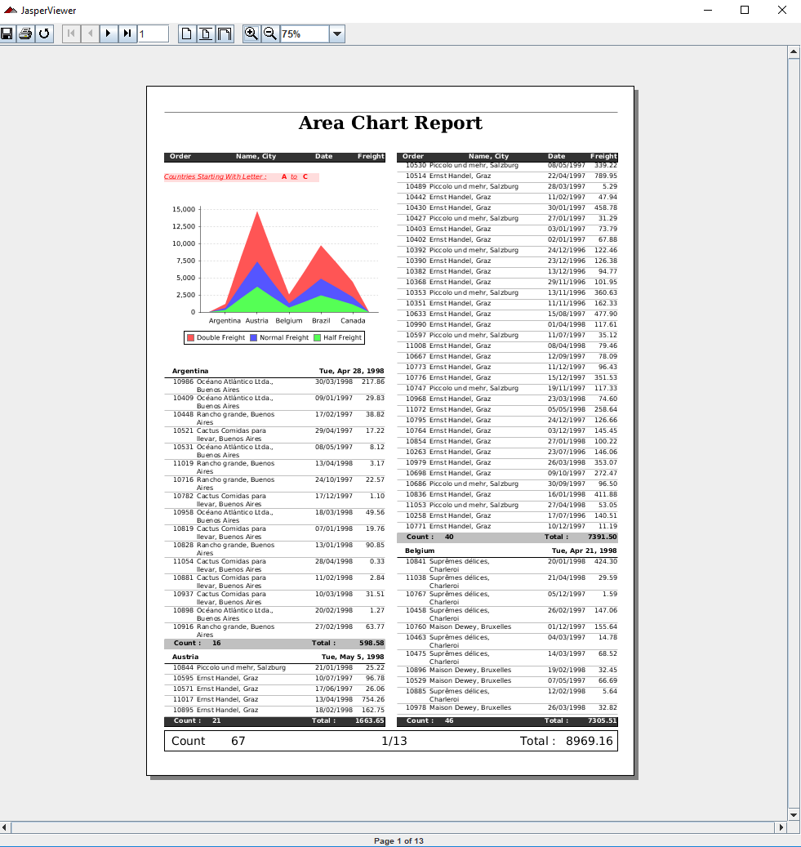
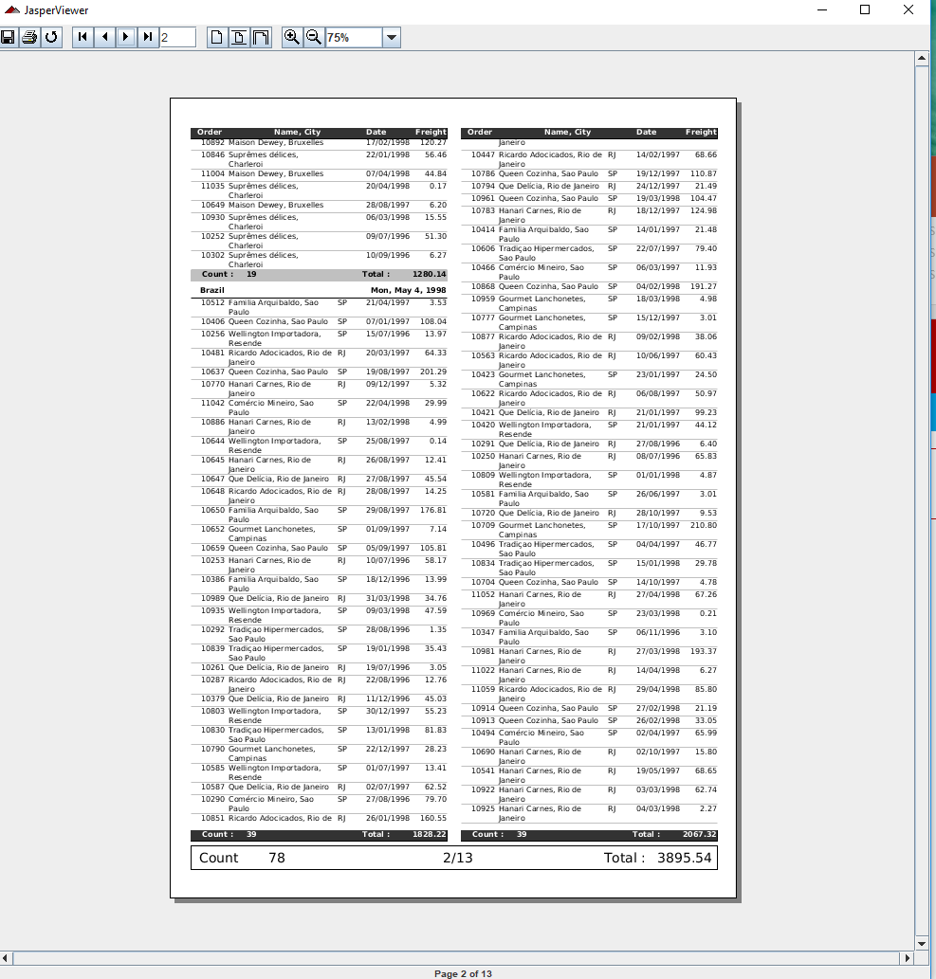
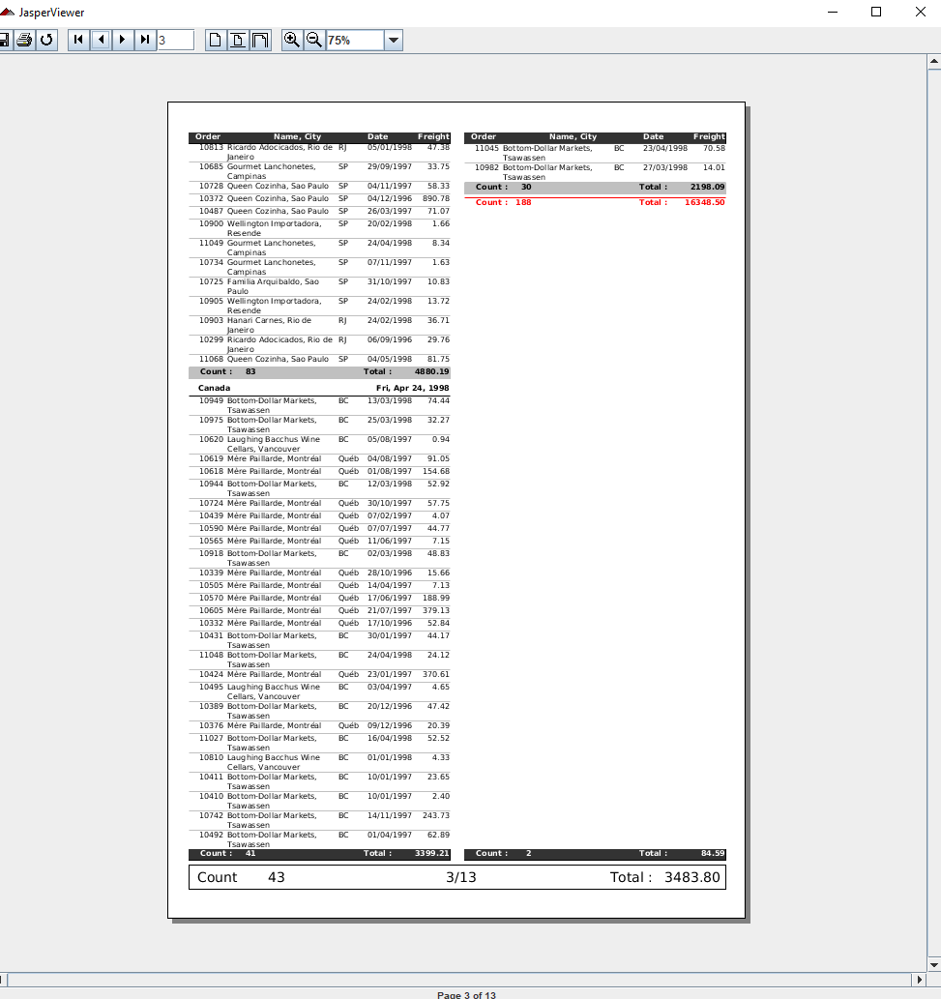
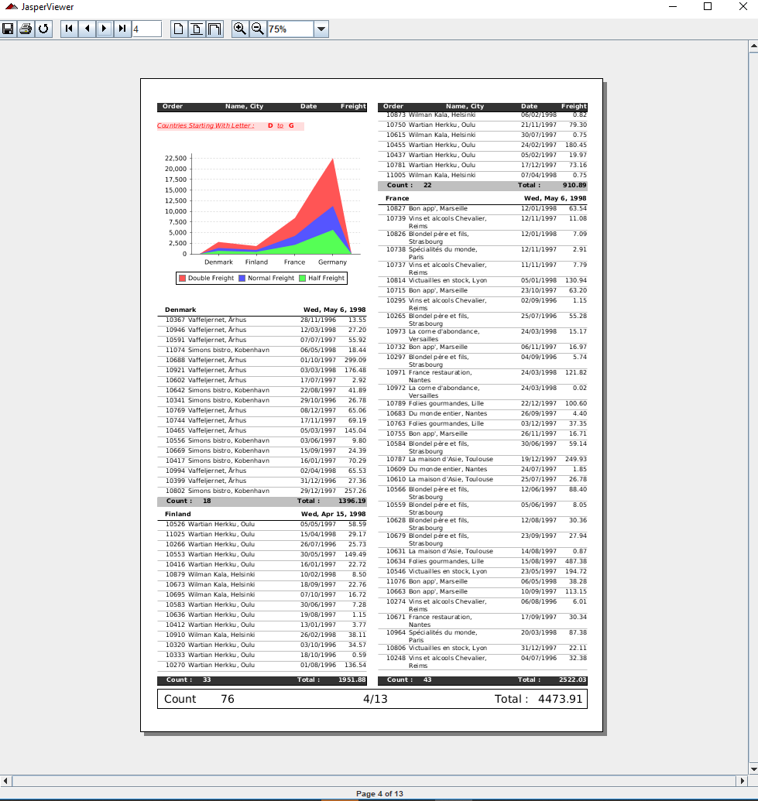
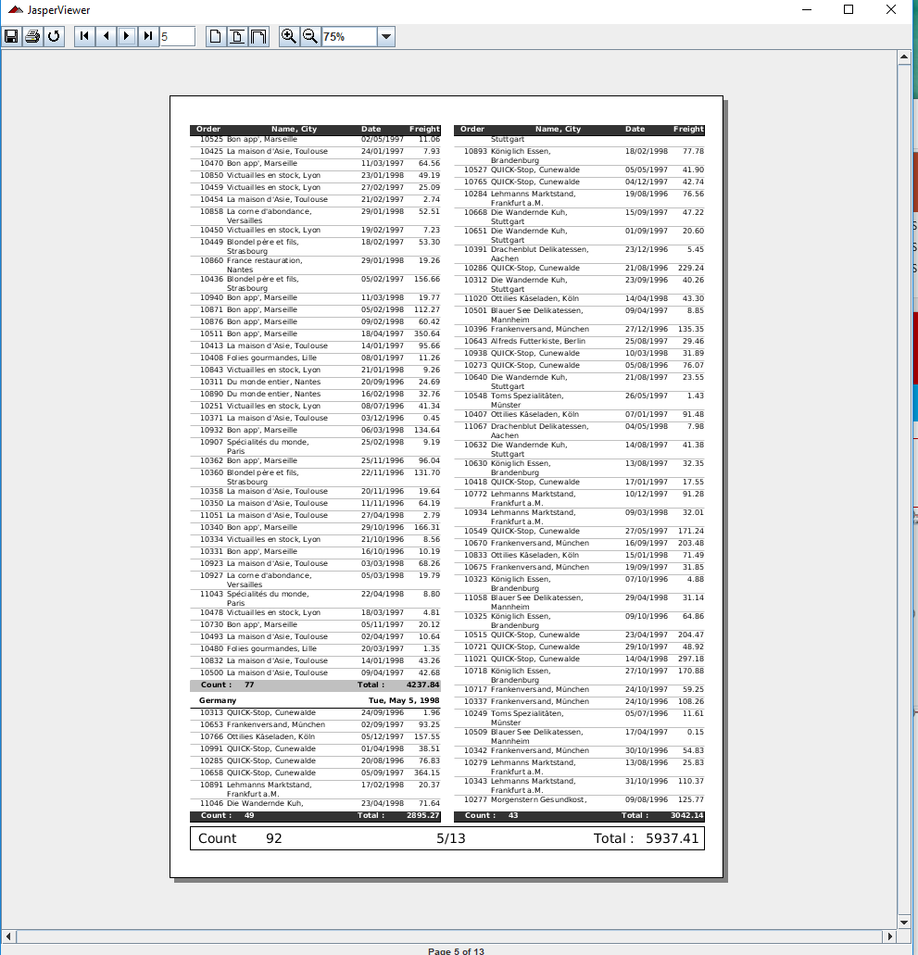
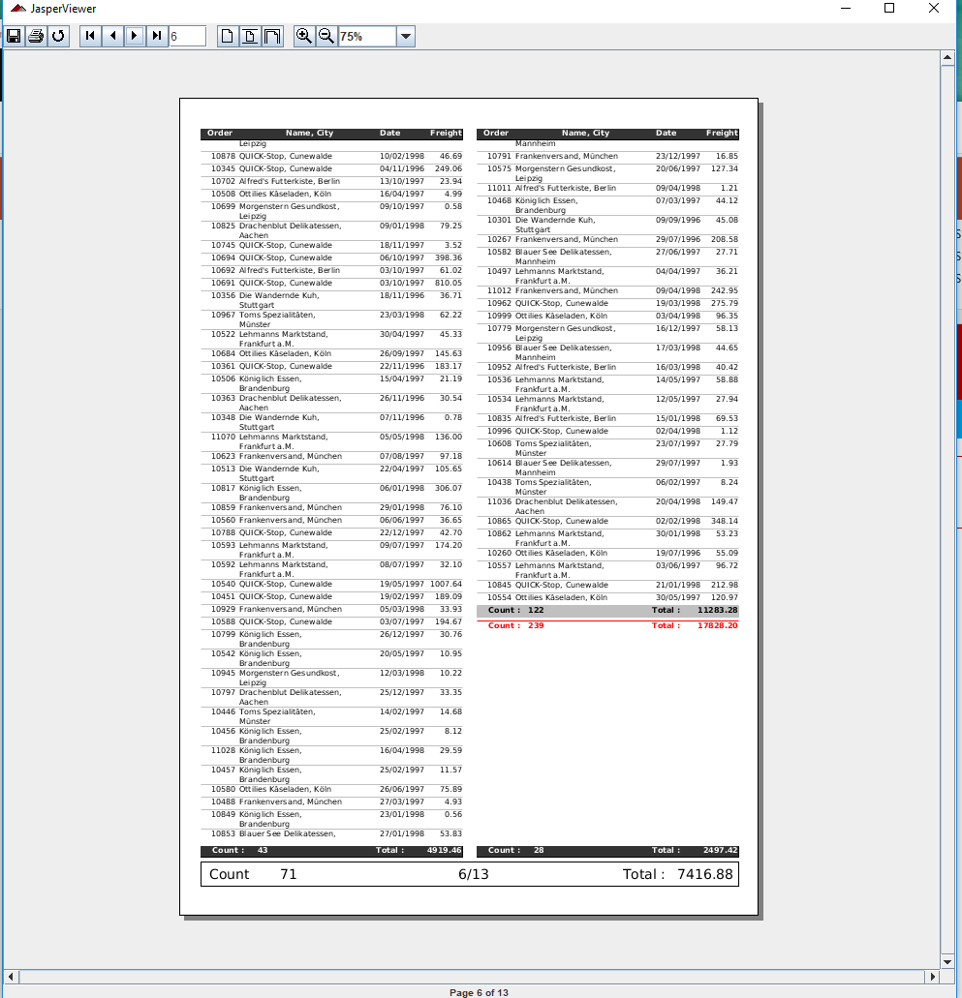
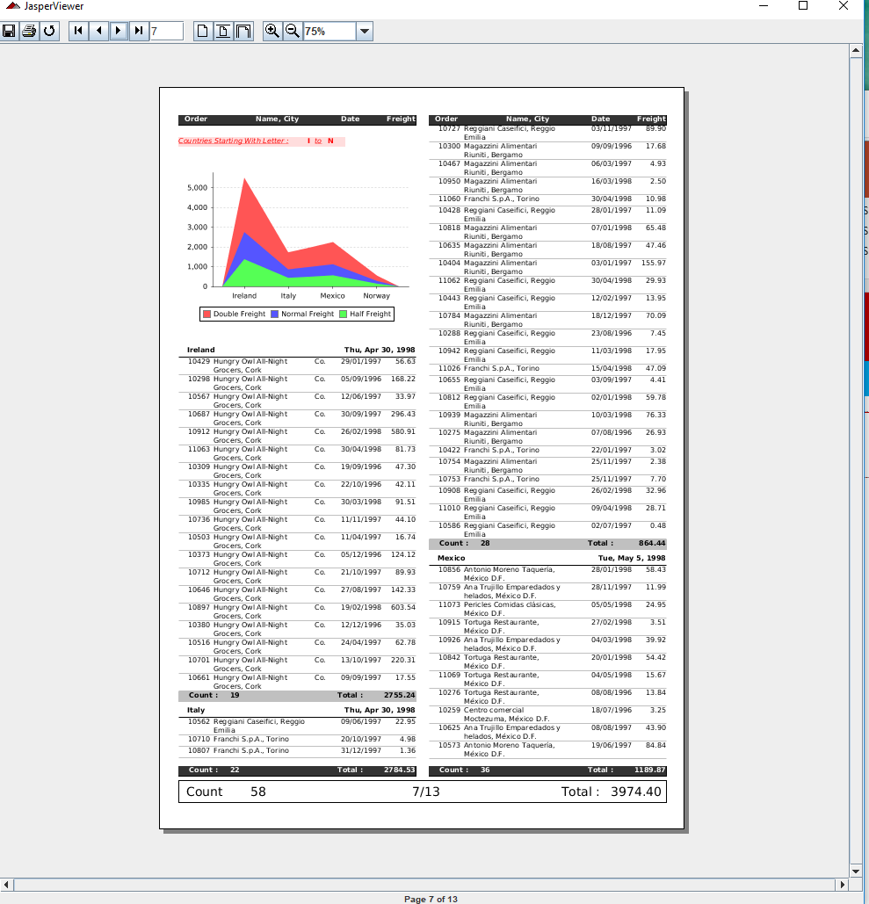
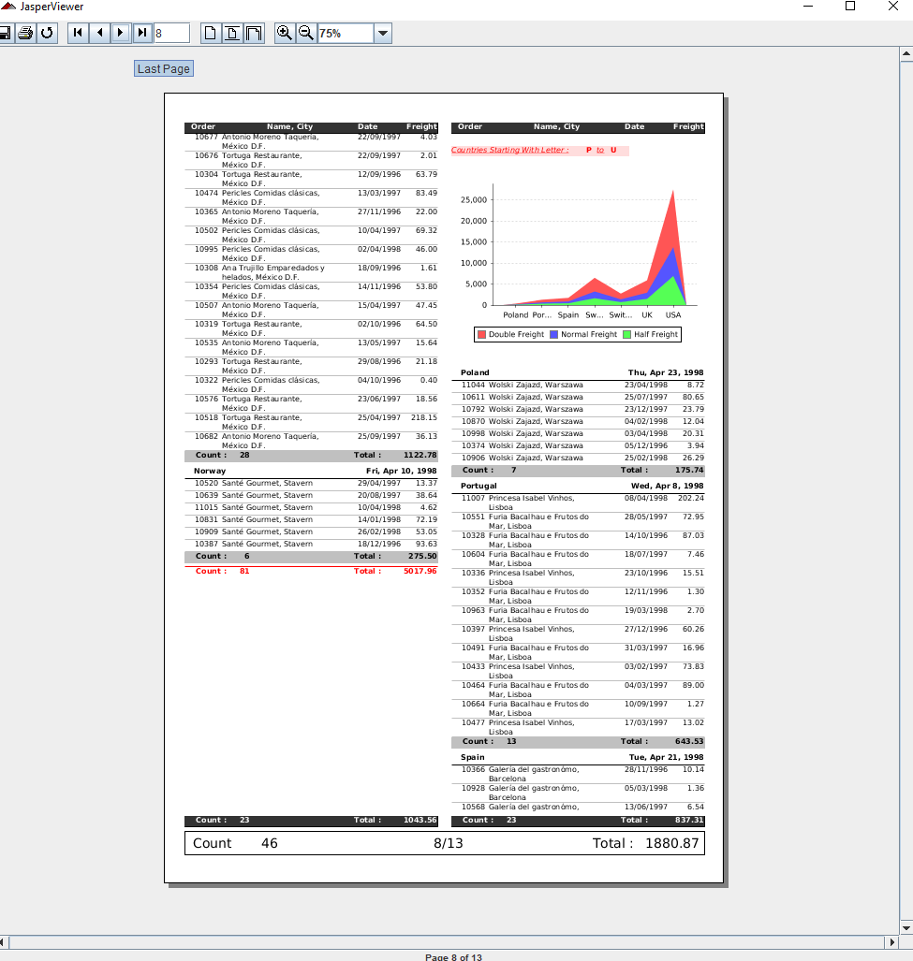
6.2 API: charts
https://community.jaspersoft.com/wiki/jasperreports-library-first-steps
API: charts (1)
> ant -p, ant clean, ant javac, ant compile, ant fill, ant view

Slide 8
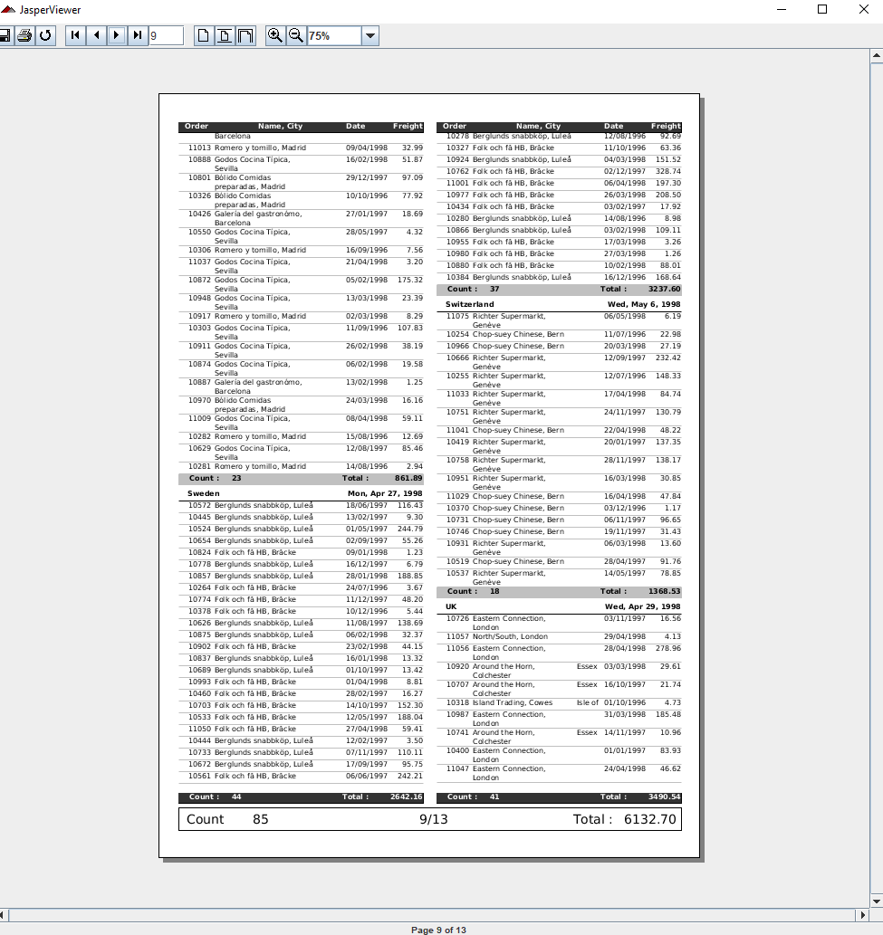
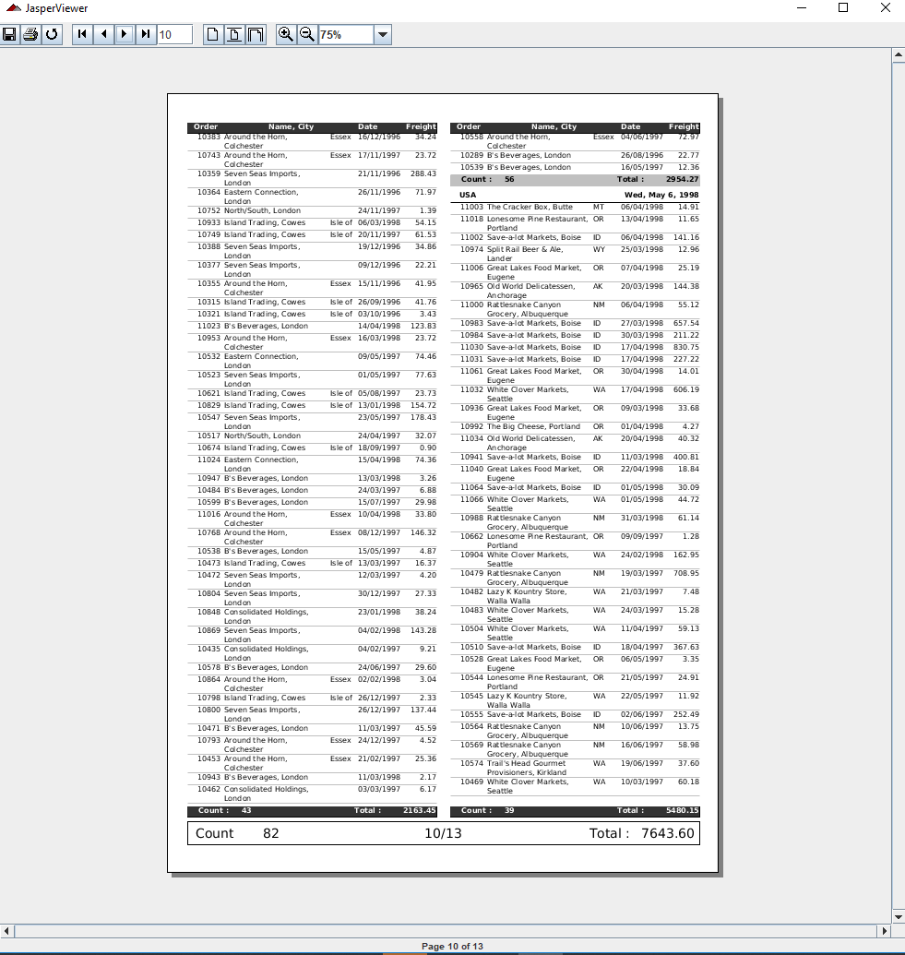
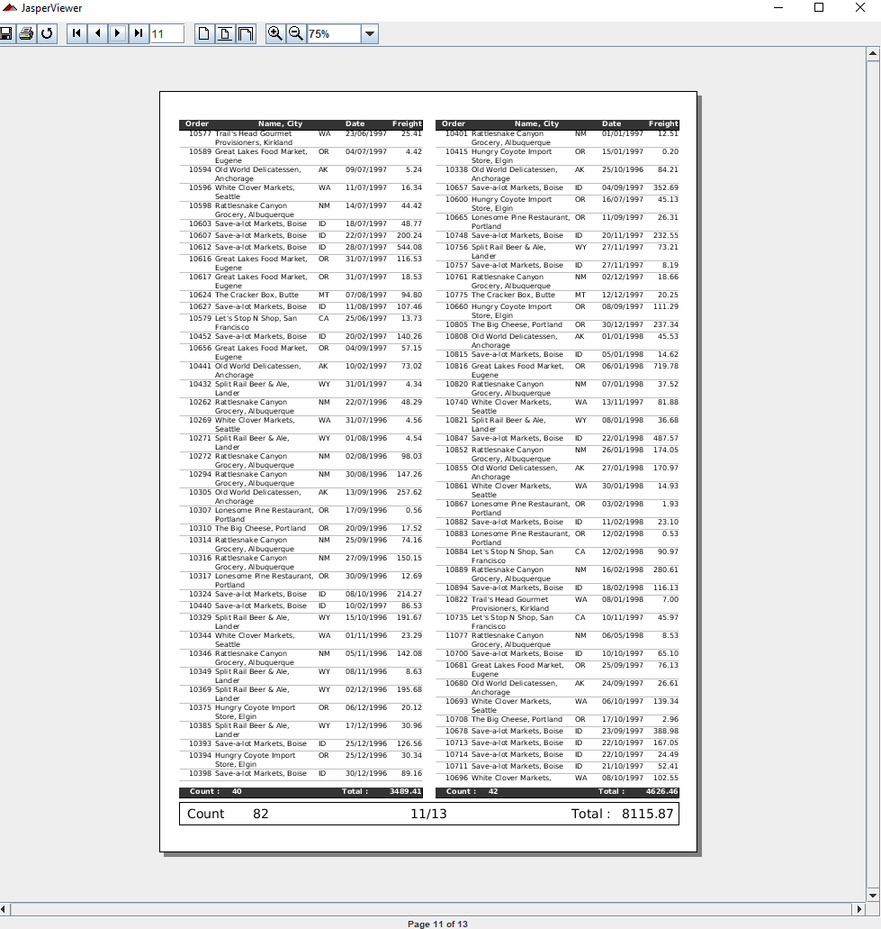
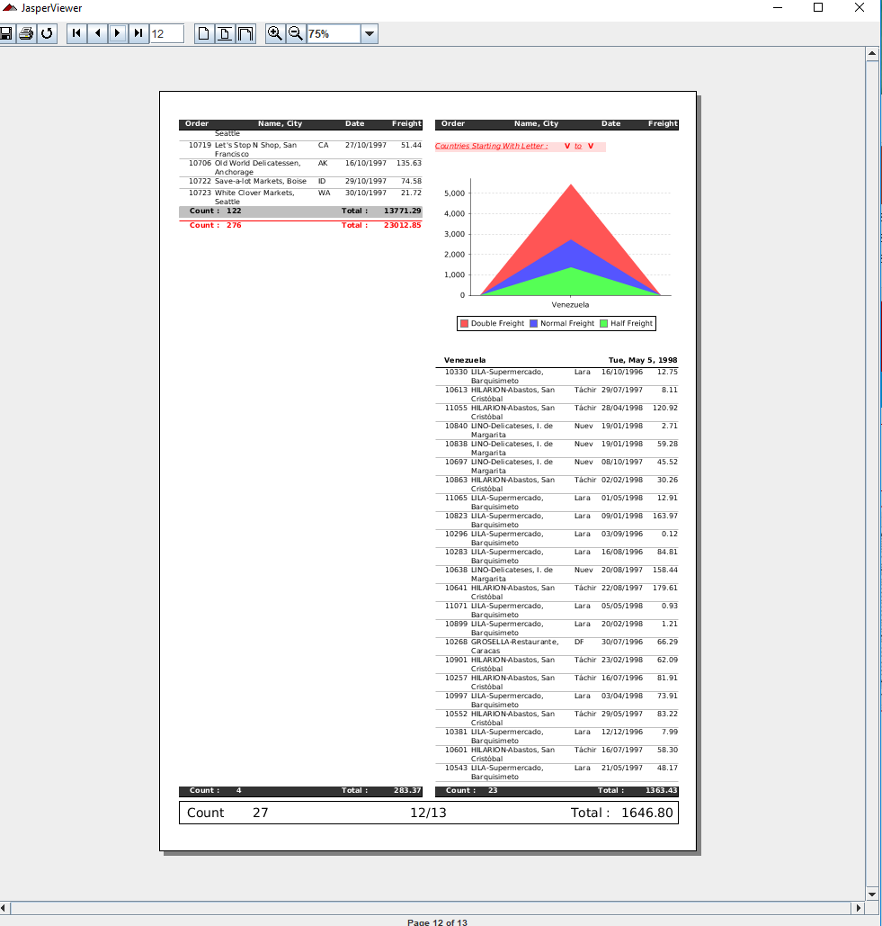
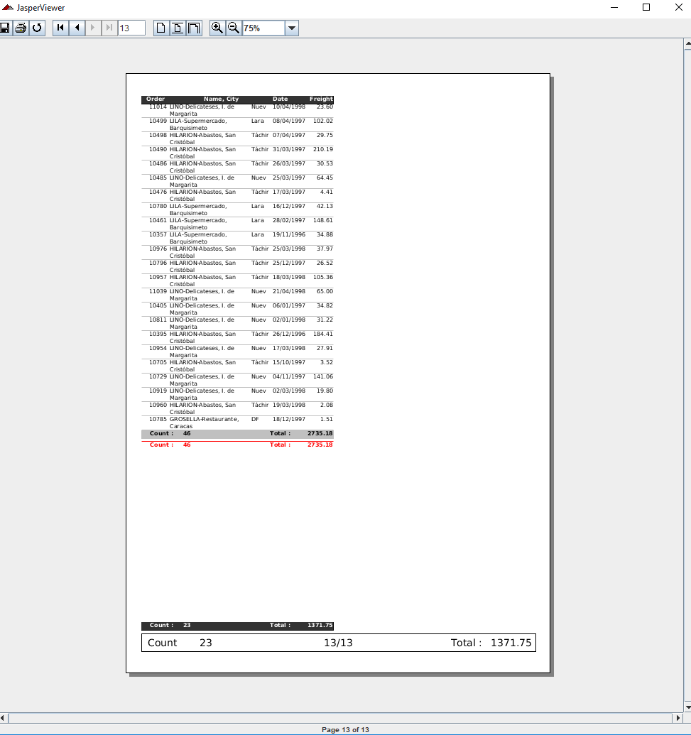
6.2 API: charts
https://community.jaspersoft.com/wiki/jasperreports-library-first-steps
API: charts (2)
> ant -p, ant clean, ant javac, ant compile, ant fill, ant view

Slide 9
6.3 API: chartthemes

Slide 10
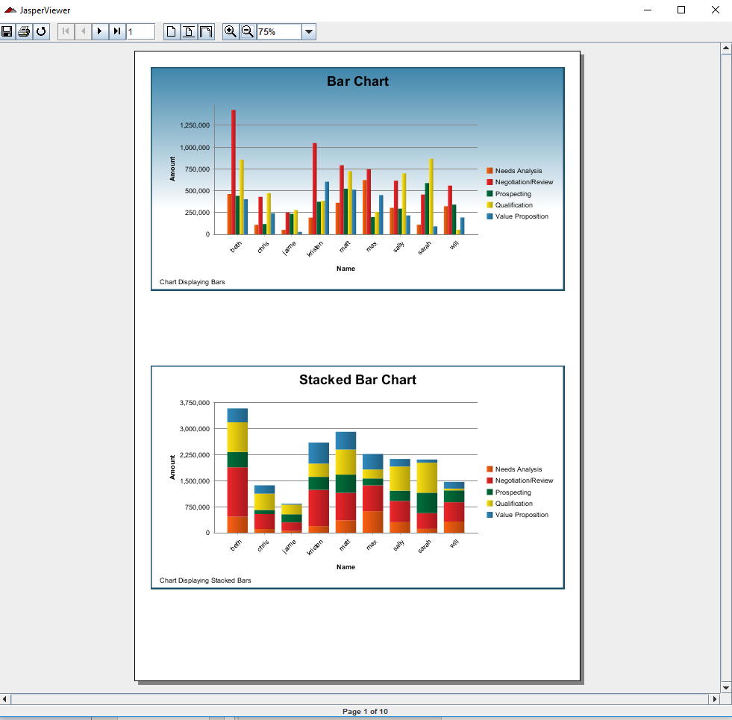
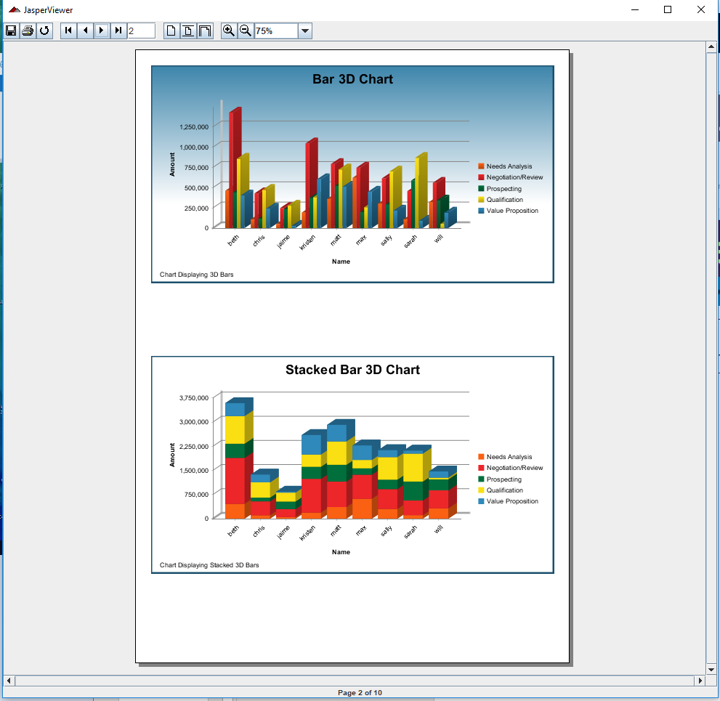
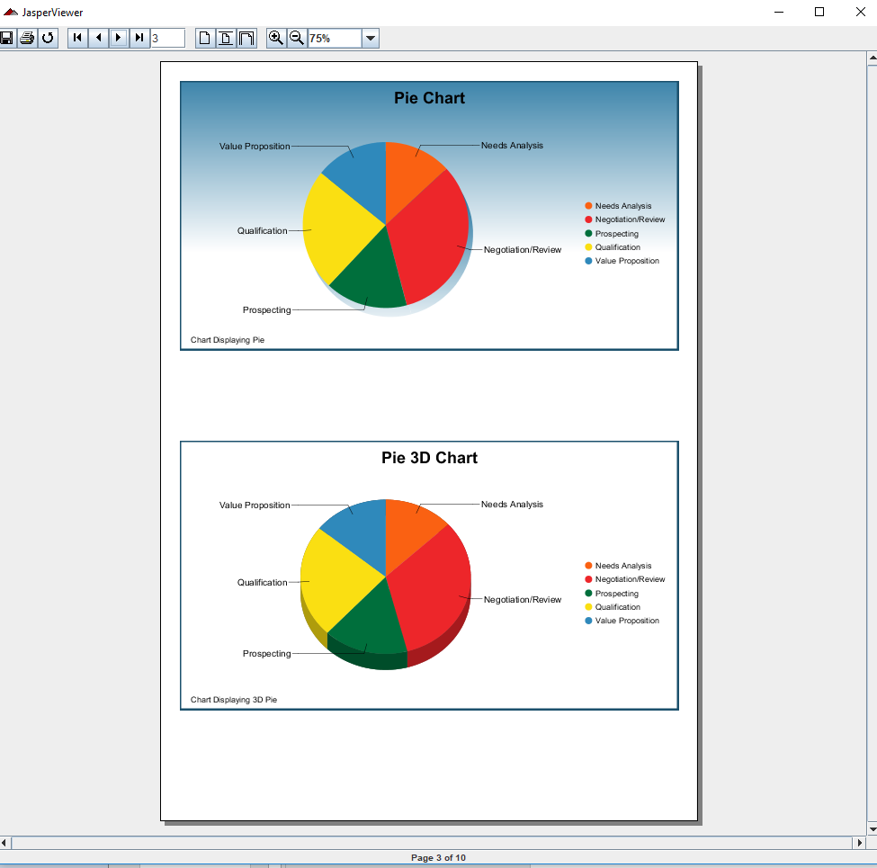
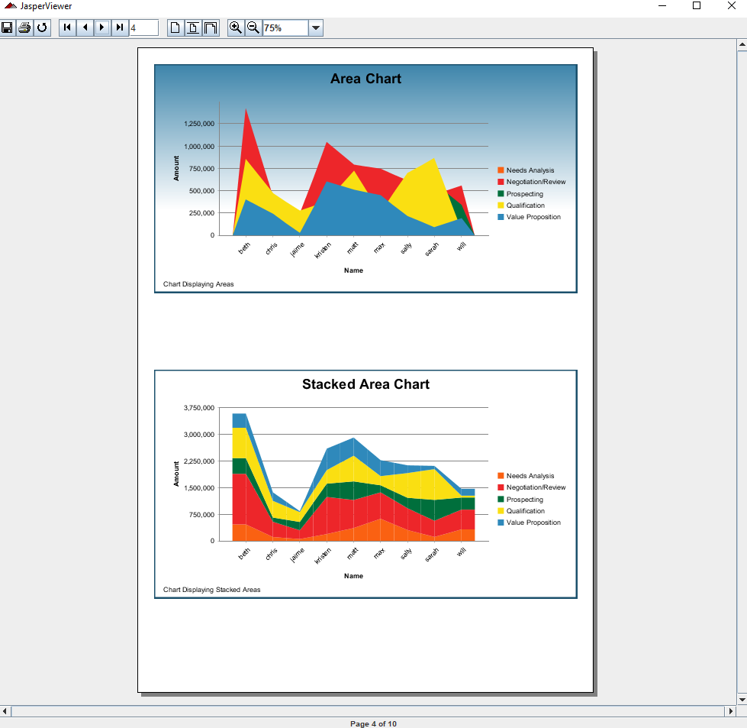
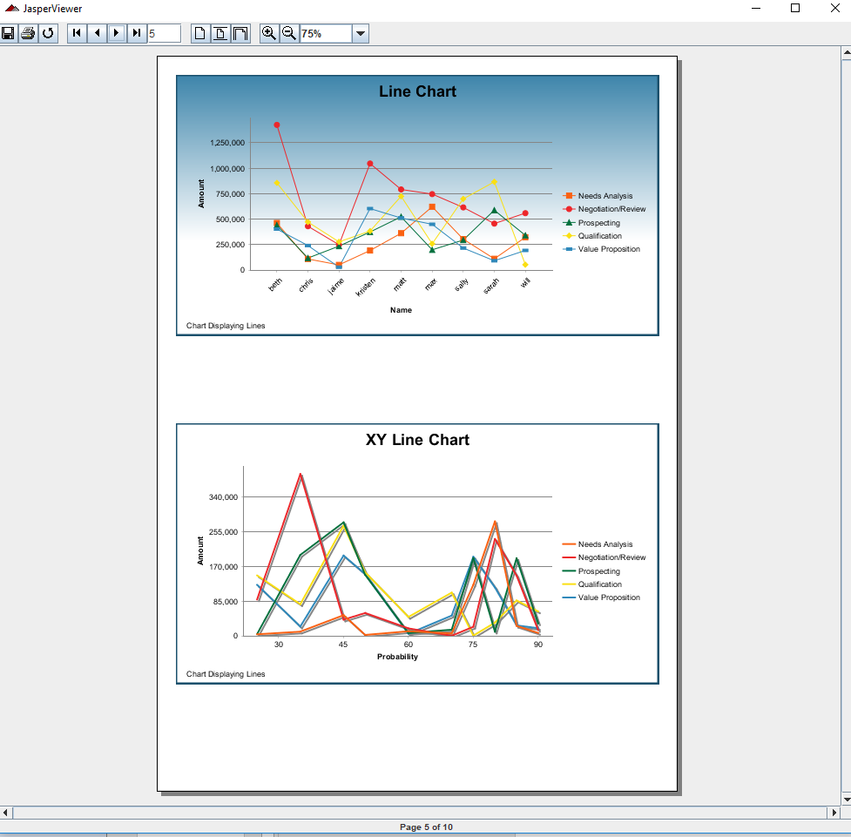
6.3 API: chartthemes
https://community.jaspersoft.com/wiki/jasperreports-library-first-steps
API: chartthemes (1):
> ant -p, ant clean, ant javac, ant compile, ant fill, ant view

Slide 11
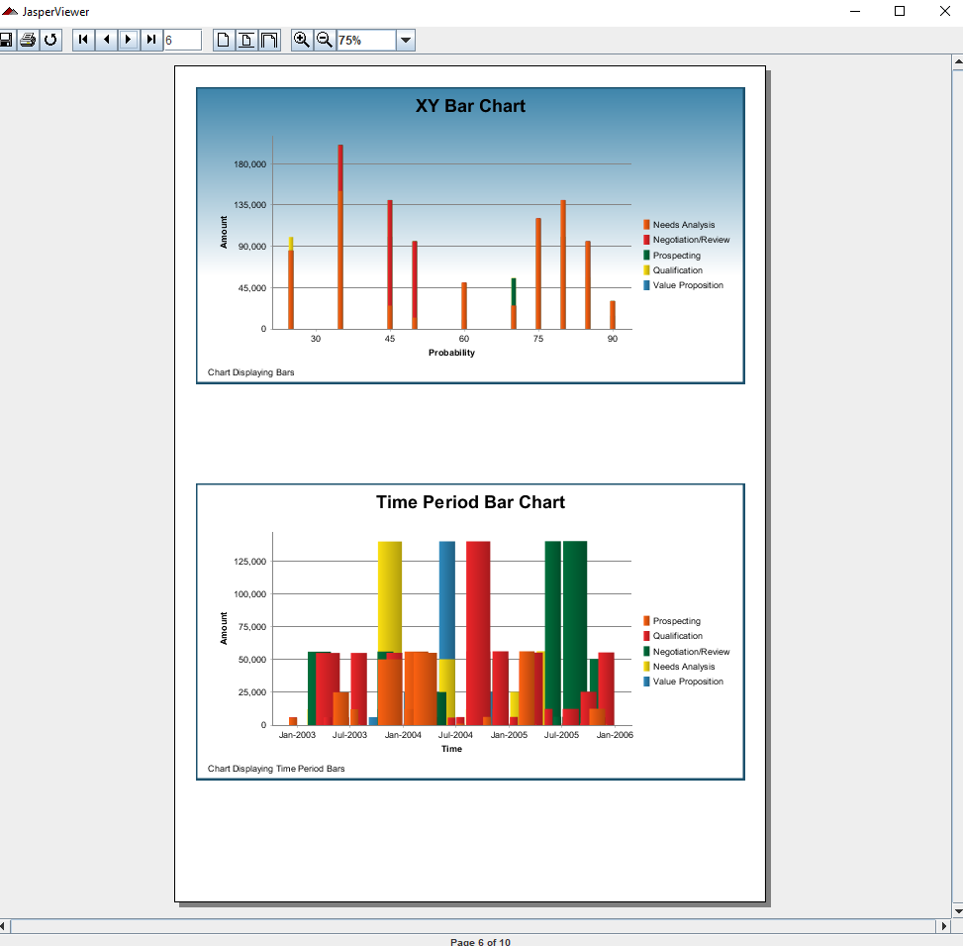
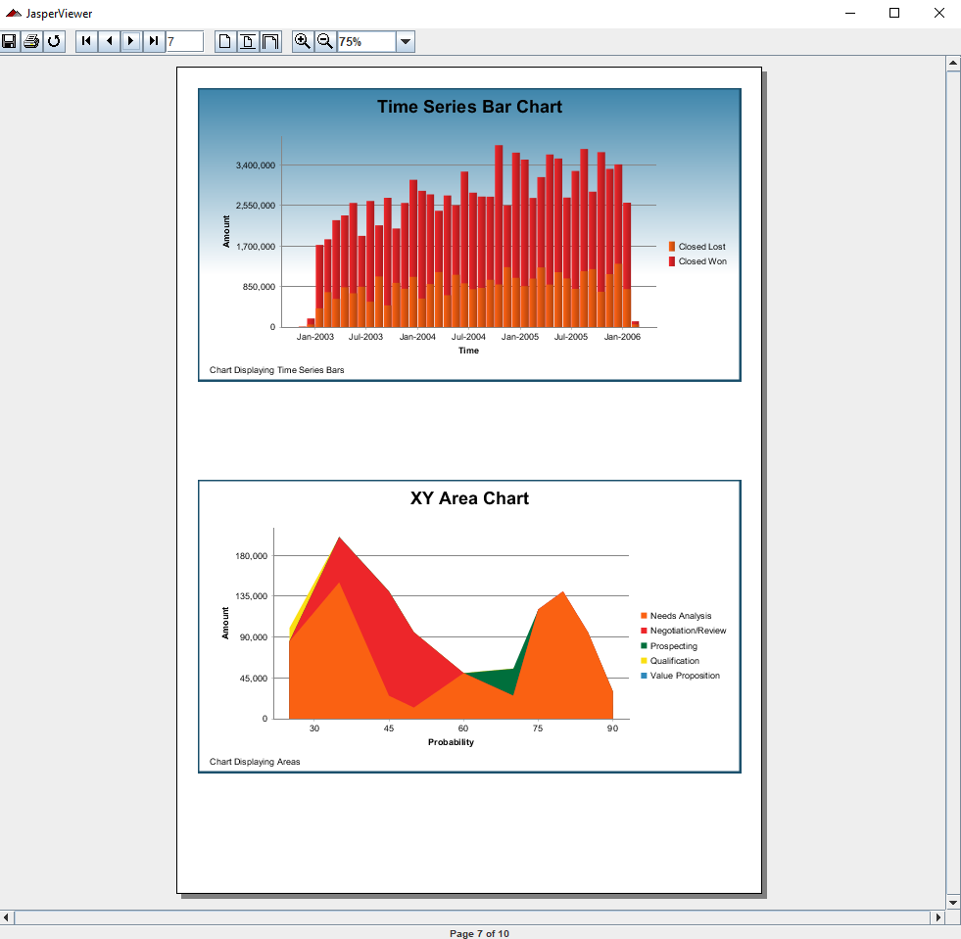
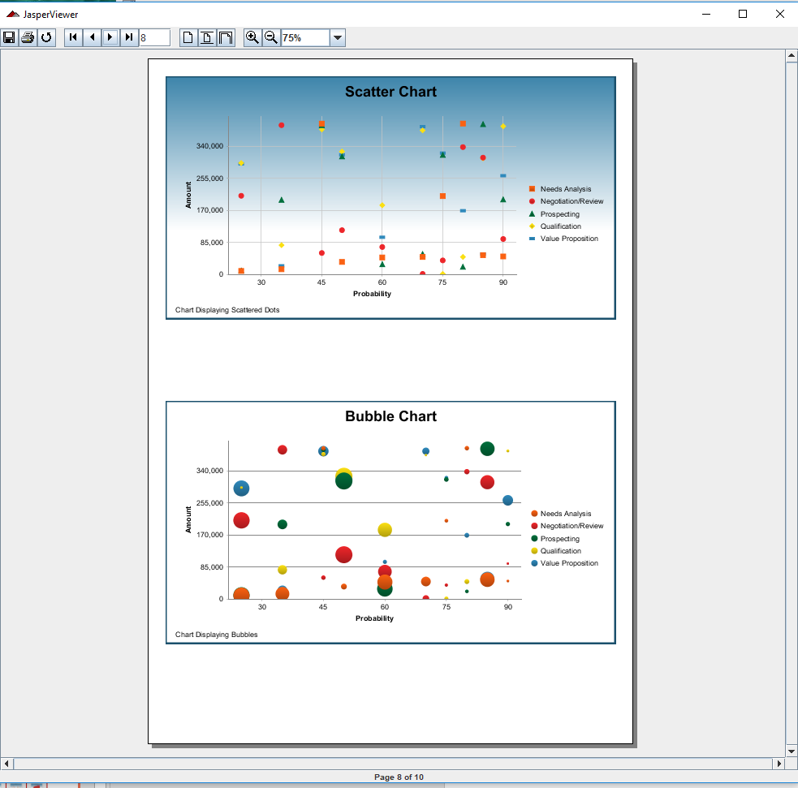
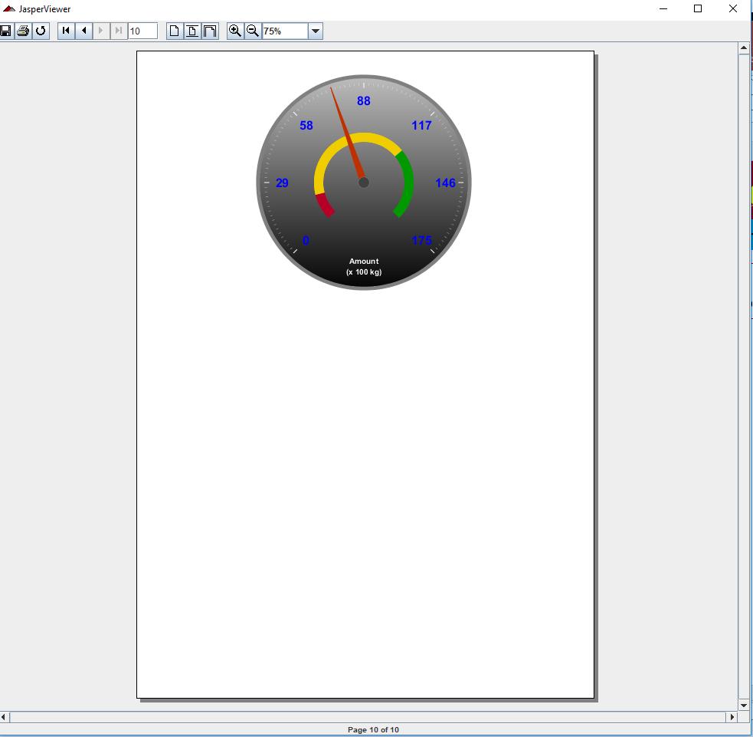
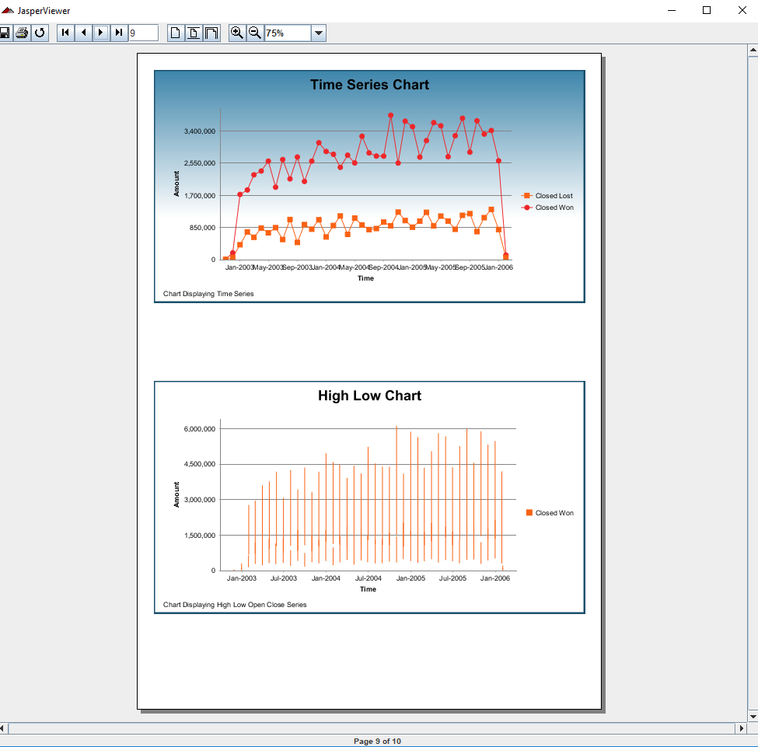
6.3 API: chartthemes
https://community.jaspersoft.com/wiki/jasperreports-library-first-steps
API: chartthemes (2):
> ant -p, ant clean, ant javac, ant compile, ant fill, ant view

Slide 12
6.4 API: crosstabs

Slide 13
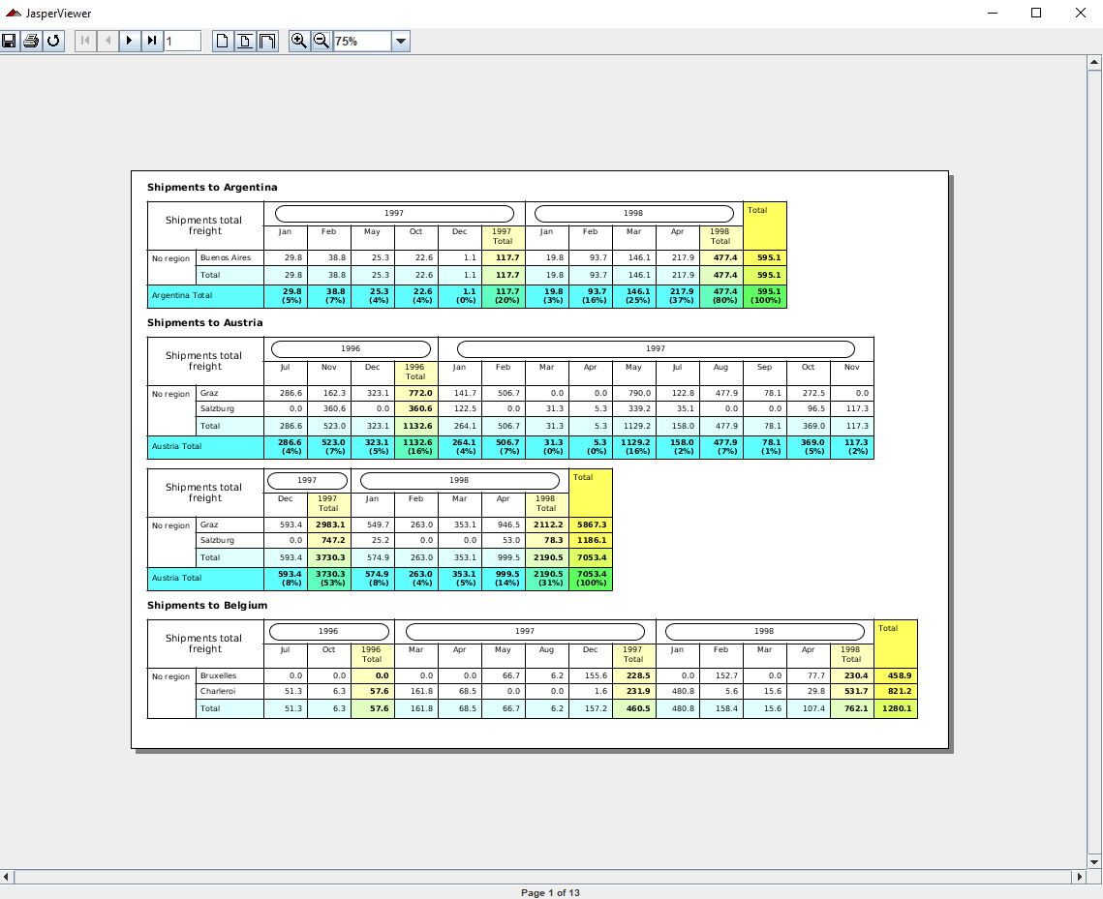
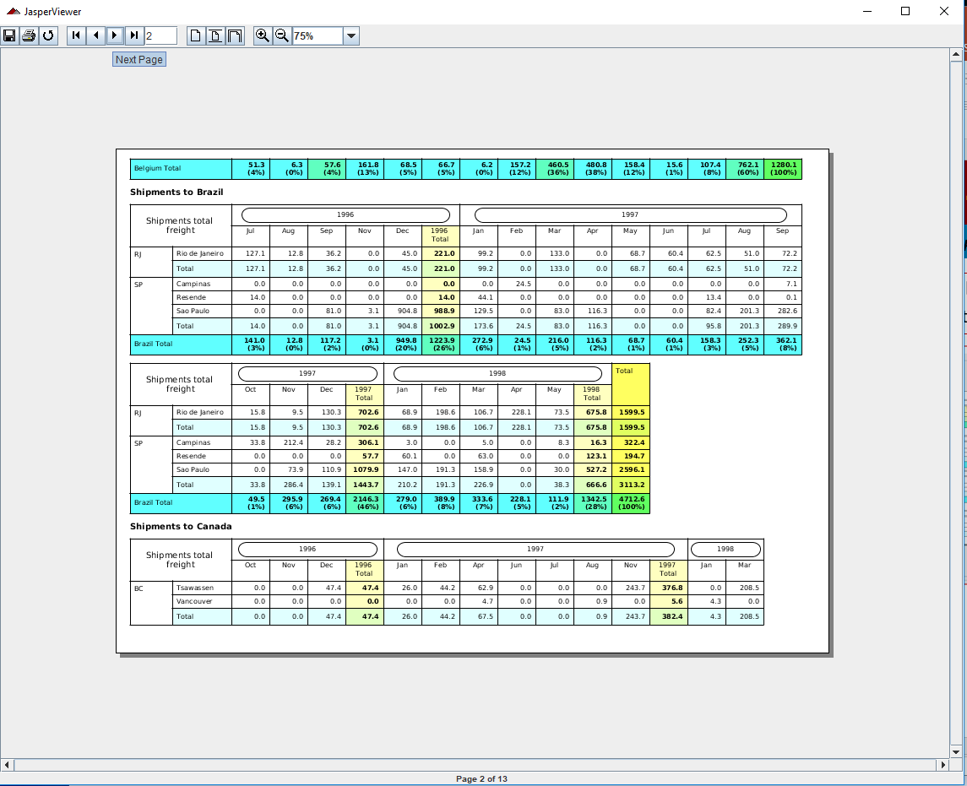
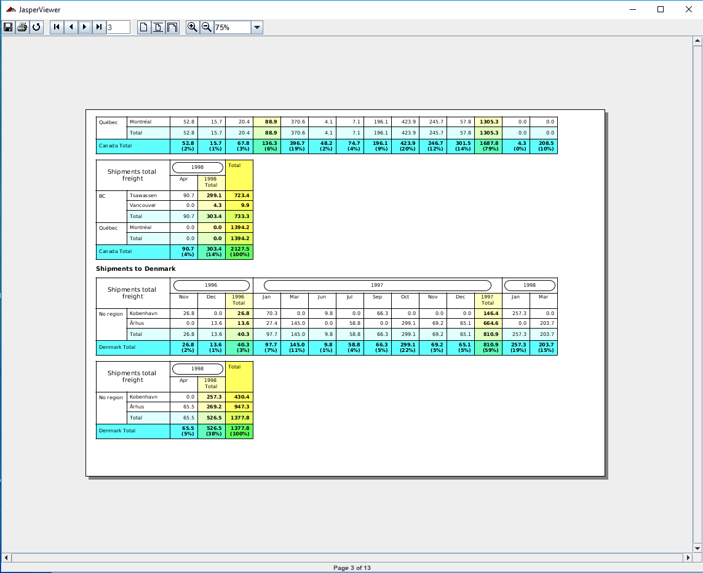
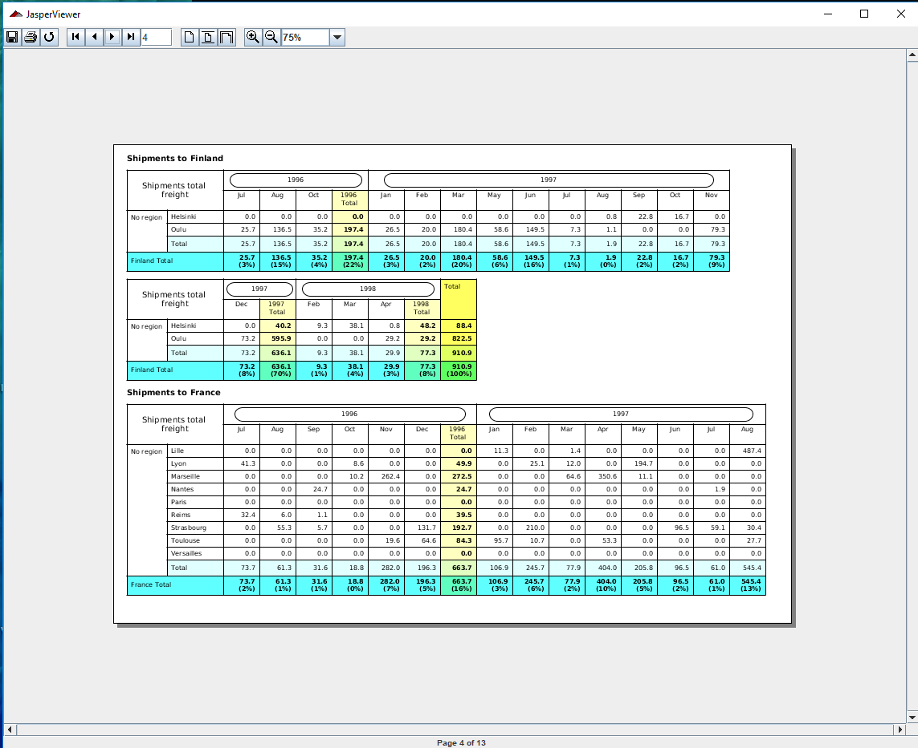
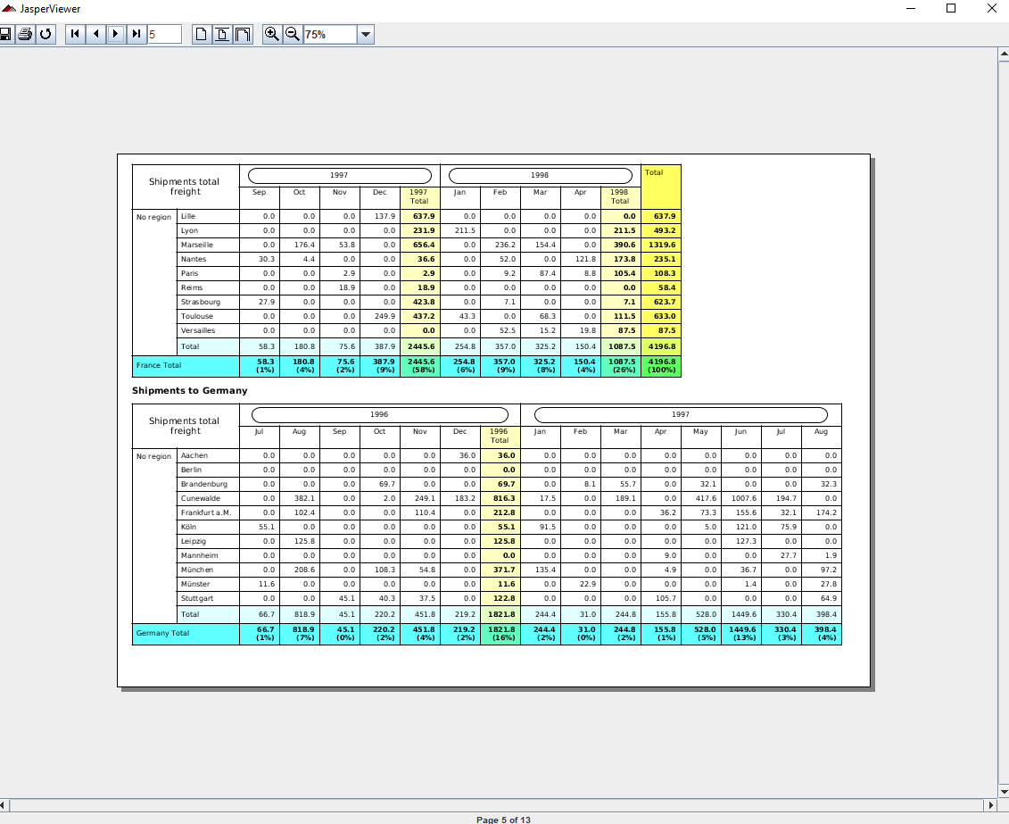
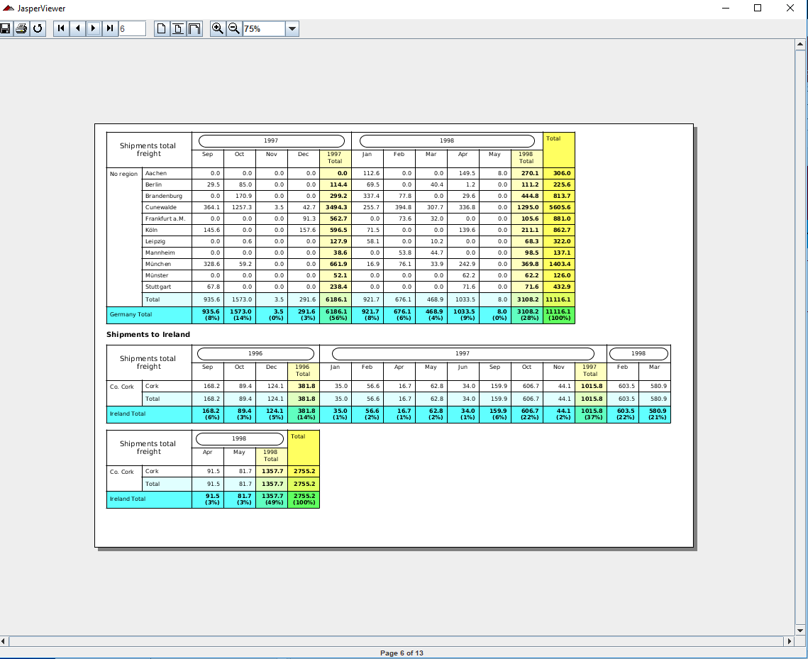
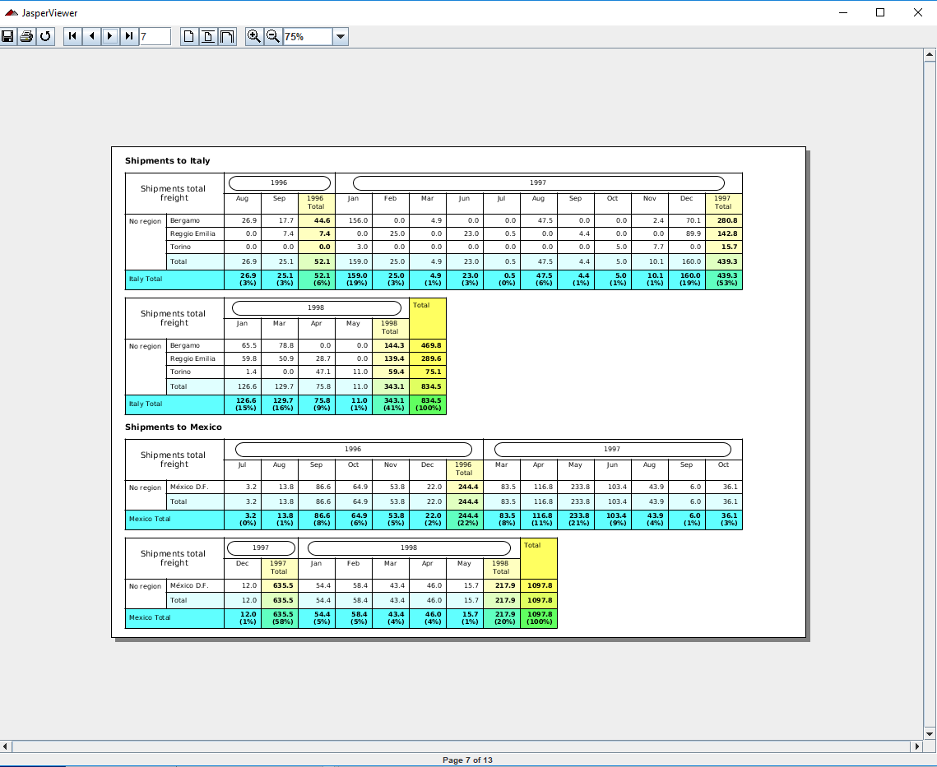
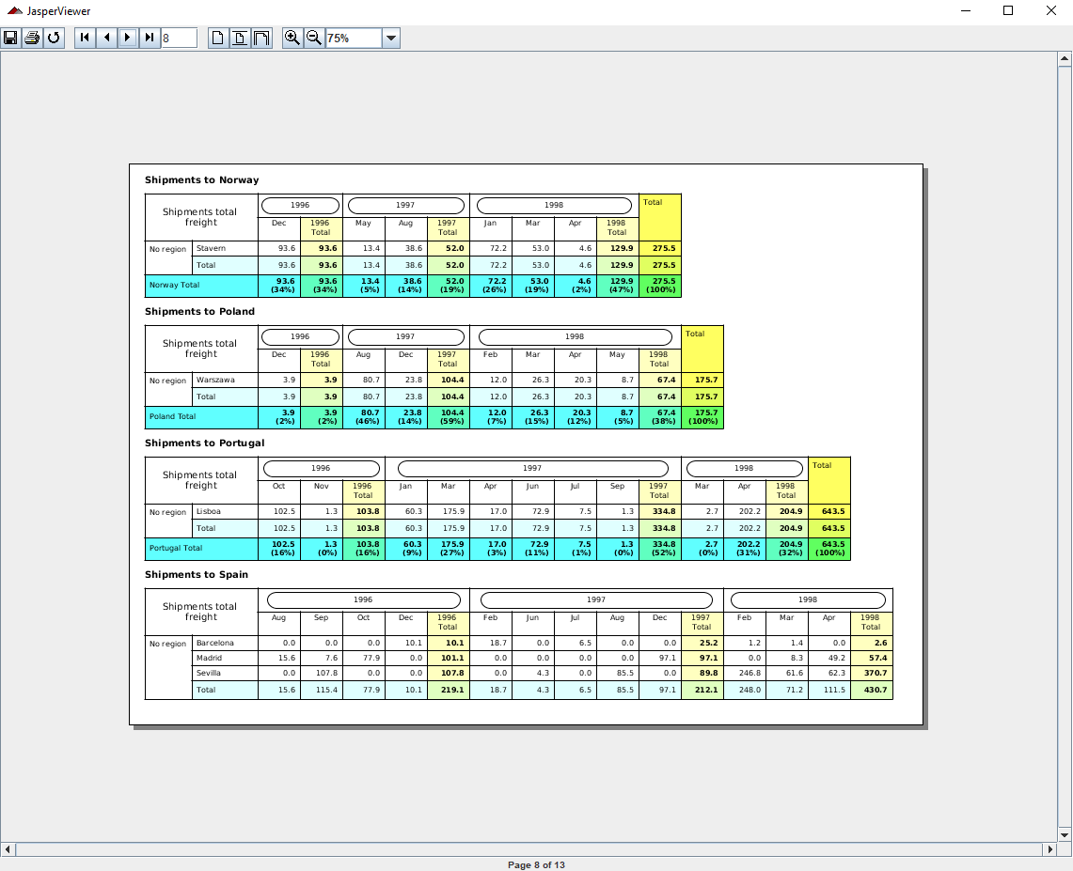
6.4 API: crosstabs
https://community.jaspersoft.com/wiki/jasperreports-library-first-steps
API: crosstabs (1):
> ant -p, ant clean, ant javac, ant compile, ant fill, ant view

Slide 14
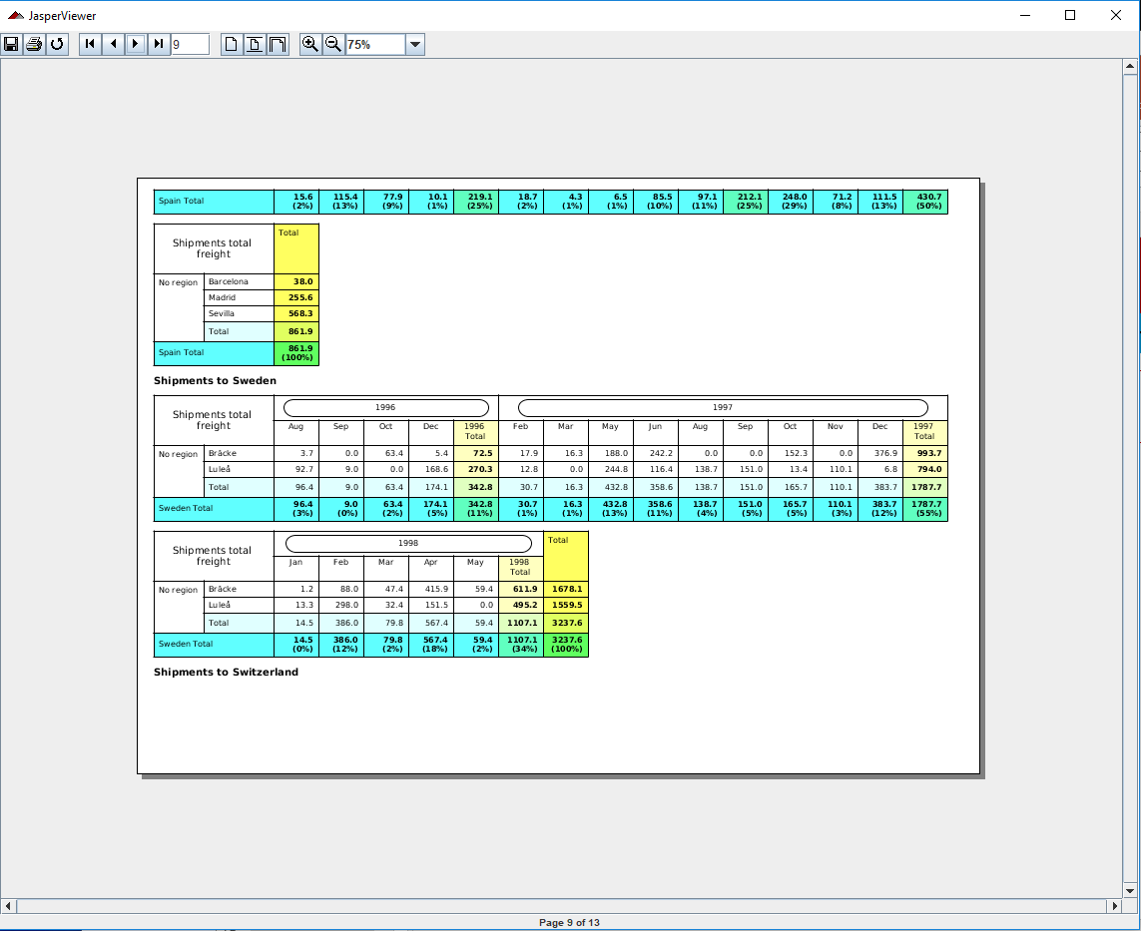
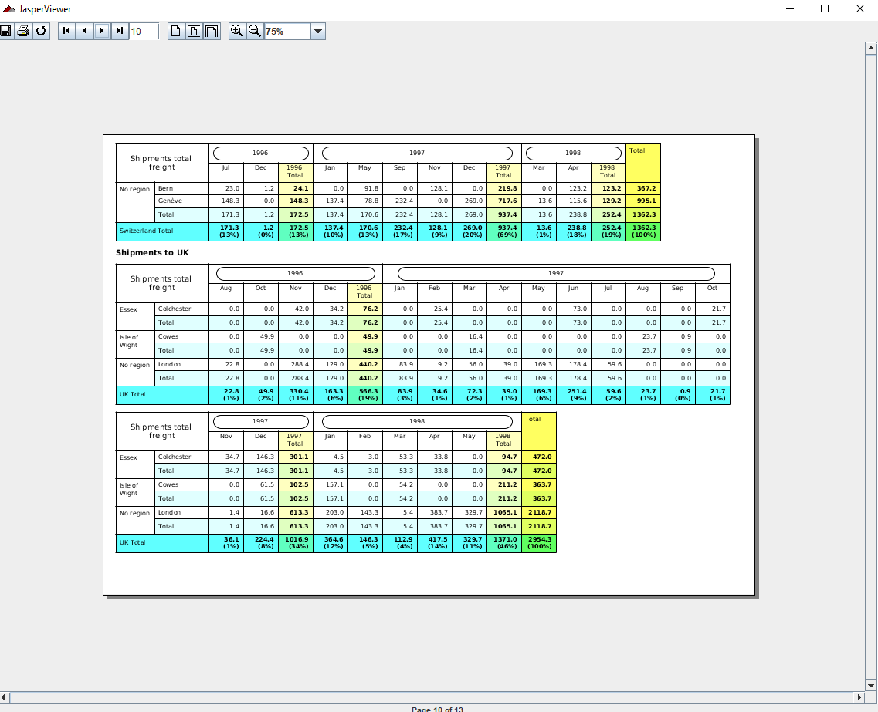
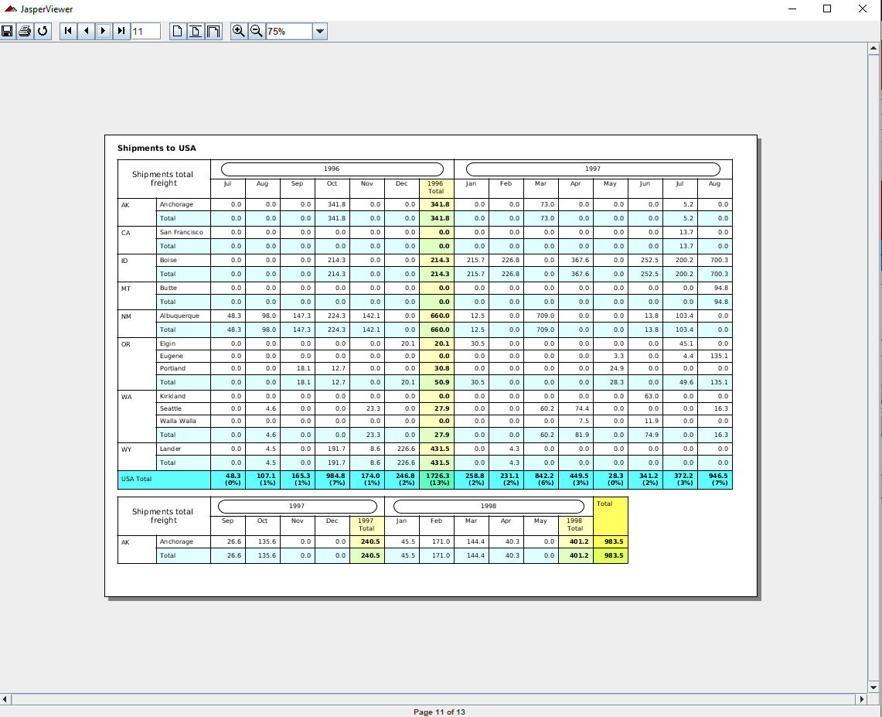
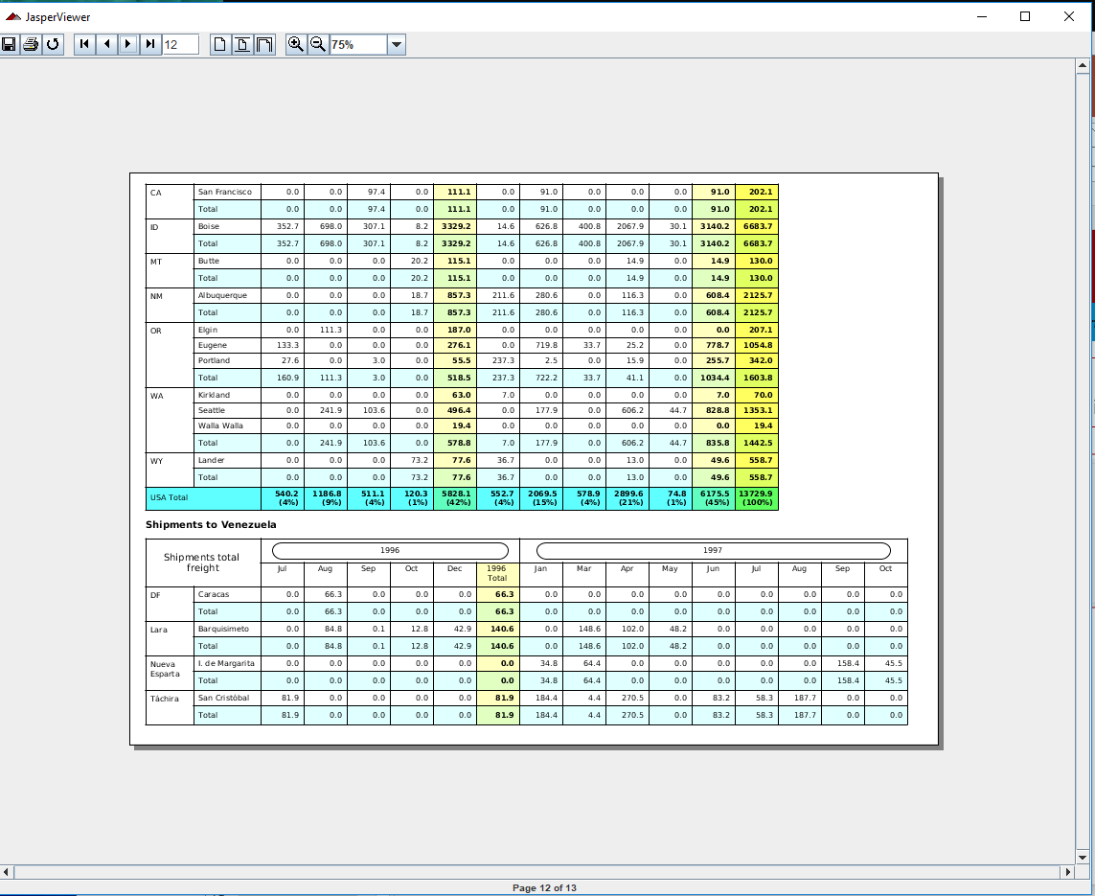
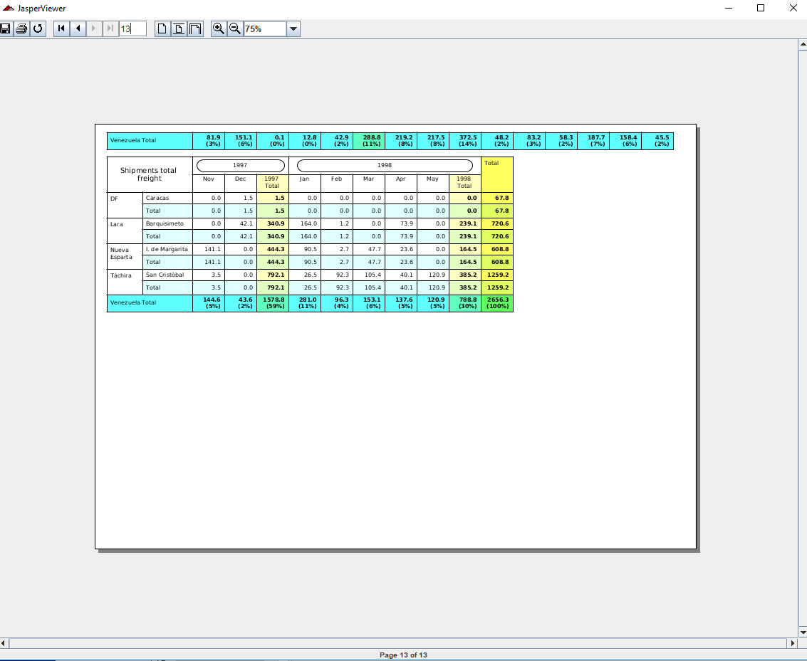
6.4 API: crosstabs
https://community.jaspersoft.com/wiki/jasperreports-library-first-steps
API: crosstabs (2):
> ant -p, ant clean, ant javac, ant compile, ant fill, ant view

Slide 15
6.6 API: customization

Slide 16
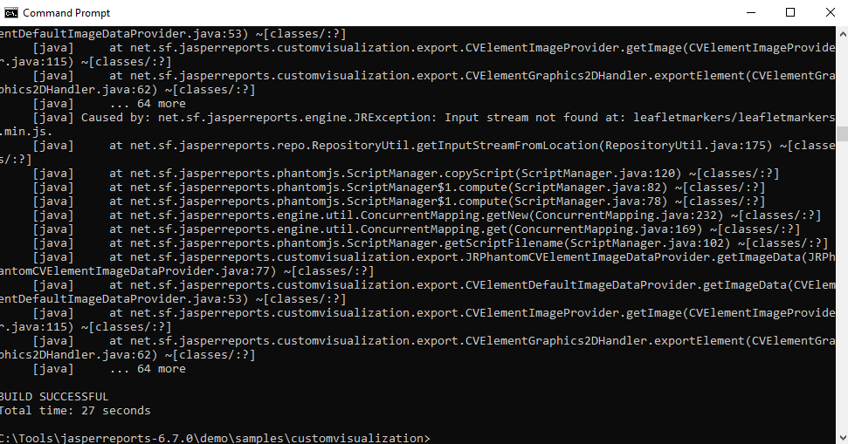
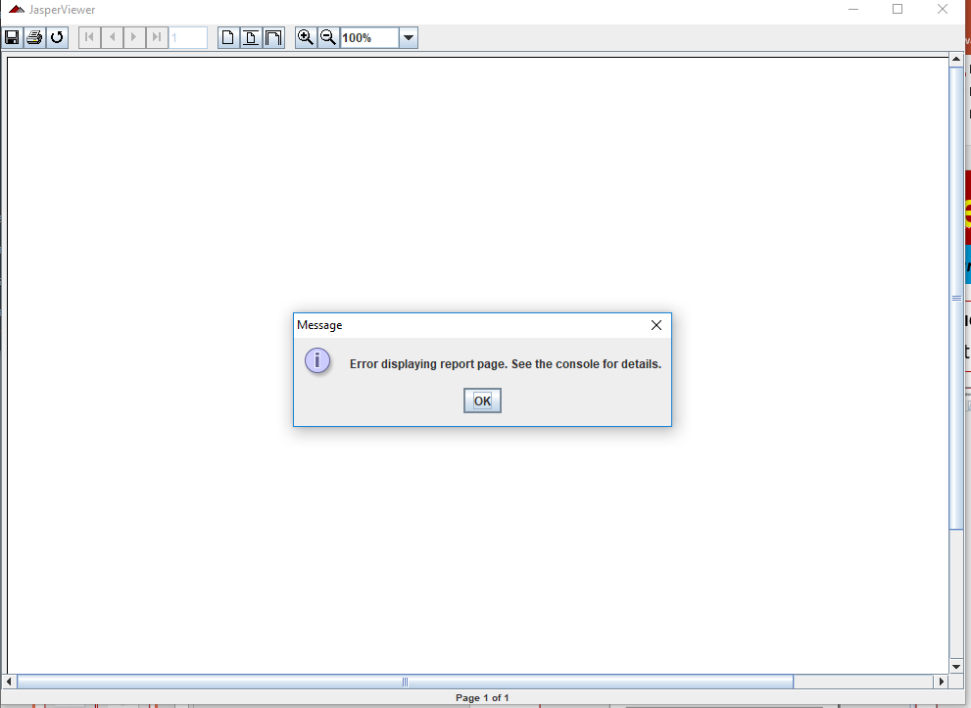
6.6 API: customization
https://community.jaspersoft.com/wiki/jasperreports-library-first-steps
API: customization
> ant -p, ant clean, ant javac, ant compile, ant components, ant fill, ant view

Slide 17
6.7 Summary

Slide 18
6.7 Summary
https://community.jaspersoft.com/wiki/jasperreports-library-first-steps
Summary:
Chartcustomerizers: display two different chars in one page.
Charts: display area chart with table.
Chartthemes: Display bar chart, 3D bar chart, Pie Chart, Line Chart, Scatter Chart
Crosstabs: Display cross function and variables table.
Csvdatasource: Display chart for CSV (Command separate Value) data source.
Customization: NG

Slide 19
End of Chapter

