Slide 1

15 JasperReports API: m
Peter H. Chen

Slide 2
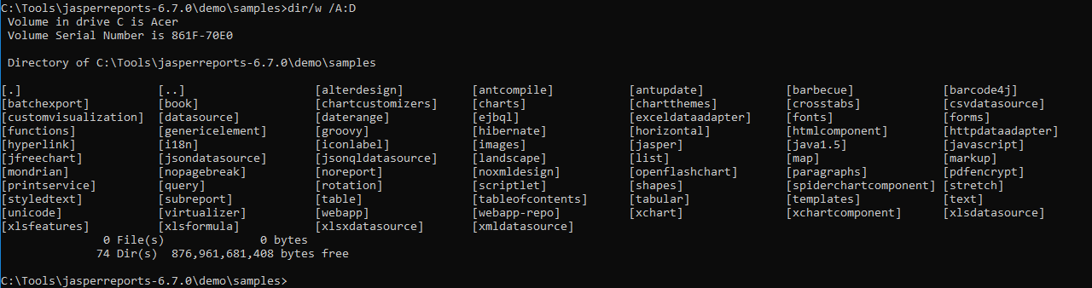
15 JasperReports API: m
https://community.jaspersoft.com/project/jasperreports-library
JasperReport API:
> dir/w /A:D # totally, we have 74 examples in Jasper Report 6.7.0

Slide 3
15.1 API: map

Slide 4
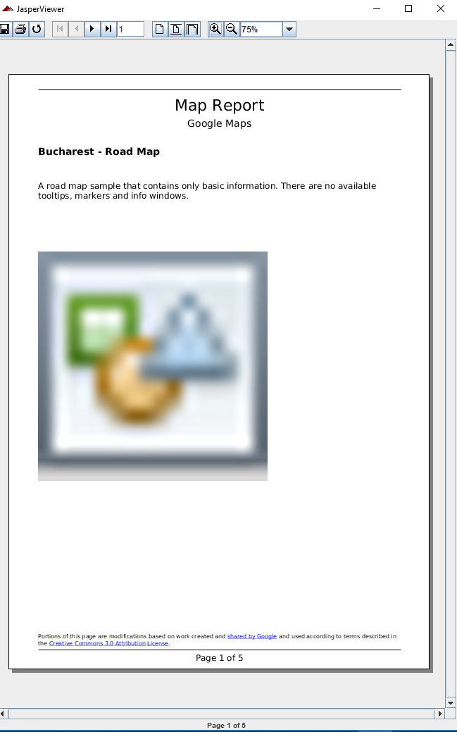
15.1 API: map
https://community.jaspersoft.com/wiki/jasperreports-library-first-steps
API: map
> ant -p, ant clean, ant javac, ant compile, ant fill, ant view

Slide 5
15.2 API: markup

Slide 6
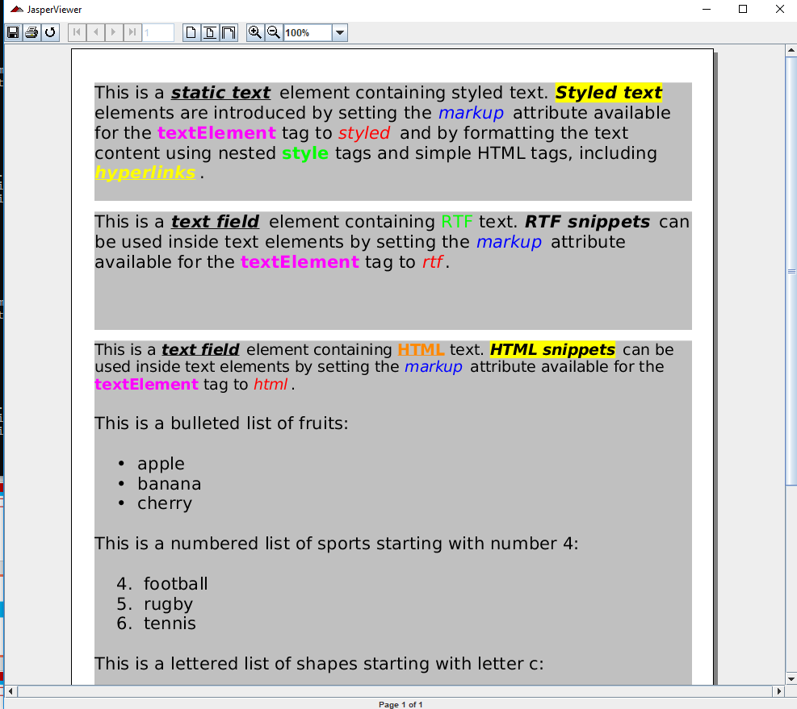
15.2 API: markup
https://community.jaspersoft.com/wiki/jasperreports-library-first-steps
API: markup
> ant -p, ant clean, ant javac, ant compile, ant fill, ant view

Slide 7
15.3 API: mondrian

Slide 8
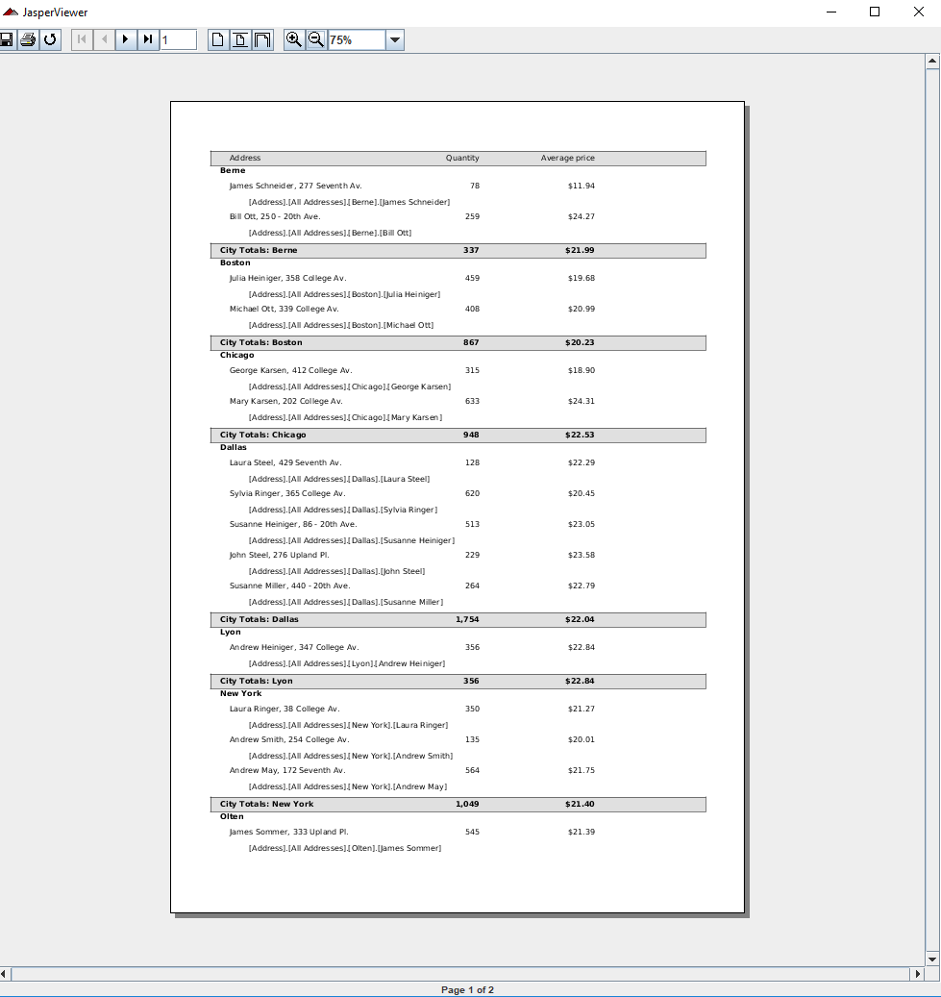
15.2 API: mondrian
https://community.jaspersoft.com/wiki/jasperreports-library-first-steps
API: mondrian
> ant -p, ant clean, ant javac, ant compile, ant fill, ant view

Slide 9
End of Chapter

