Slide 1

22 JasperReports API: t
Peter H. Chen

Slide 2
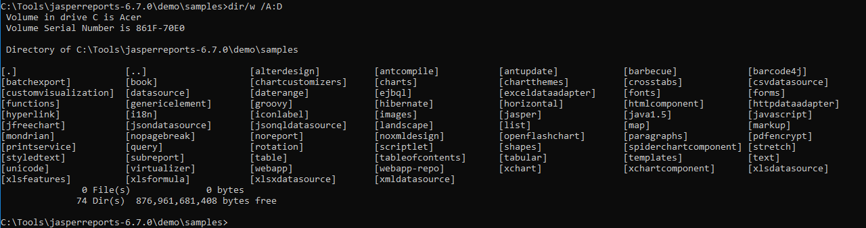
22 JasperReports API: t
https://community.jaspersoft.com/project/jasperreports-library
JasperReport API:
> dir/w /A:D # totally, we have 74 examples in Jasper Report 6.7.0

Slide 3
22.1 API: table

Slide 4
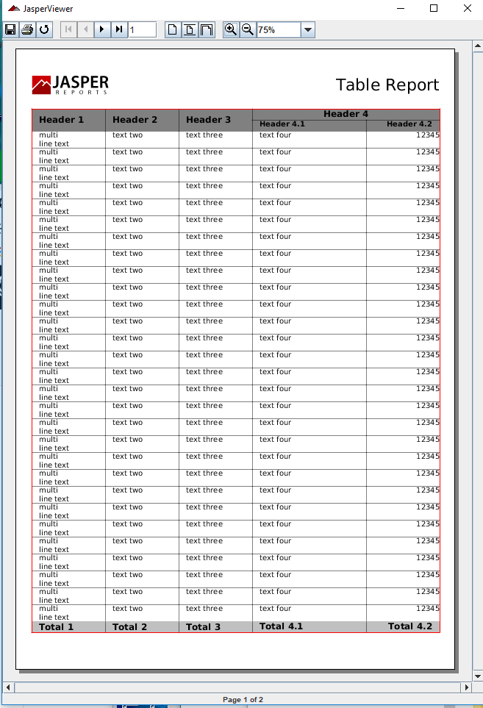
22.1 API: table
https://community.jaspersoft.com/wiki/jasperreports-library-first-steps
API: table (Start server first ‘ant runServer’)
> ant -p, ant clean, ant javac, ant compile, ant fill, ant view

Slide 5
22.2 API: tableofcontent

Slide 6
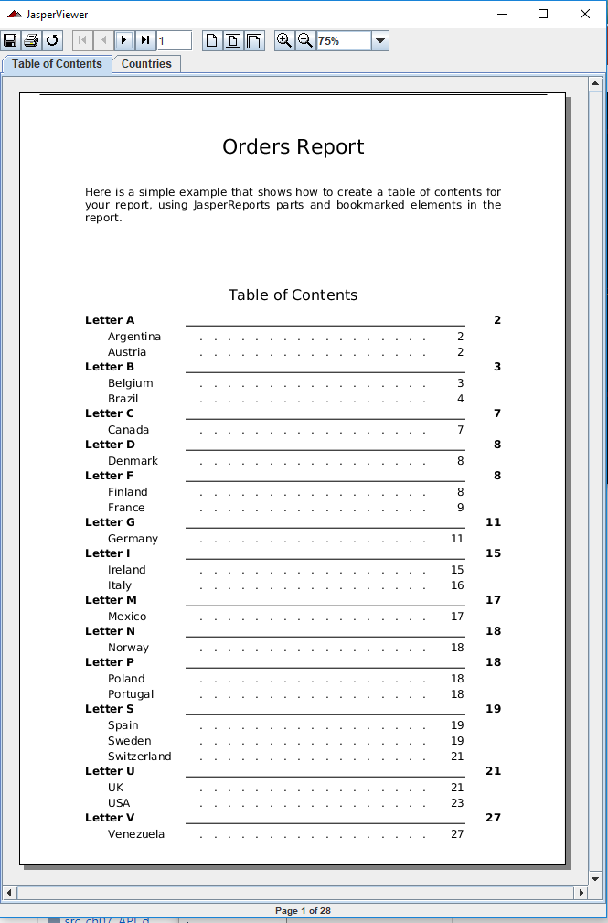
22.2 API: tableofcontent
https://community.jaspersoft.com/wiki/jasperreports-library-first-steps
API: table of content (Start server first ‘ant runServer’)
> ant -p, ant clean, ant javac, ant compile, ant fill, ant view

Slide 7
22.3 API: tabular

Slide 8
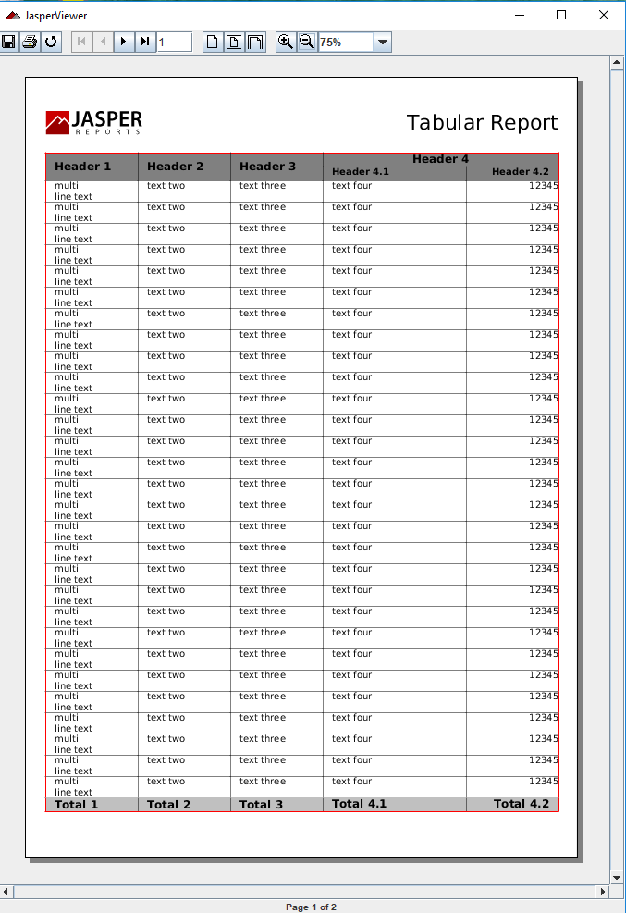
22.3 API: tabular
https://community.jaspersoft.com/wiki/jasperreports-library-first-steps
API: tabular report (Start server first ‘ant runServer’)
> ant -p, ant clean, ant javac, ant compile, ant fill, ant view

Slide 9
22.4 API: templates

Slide 10
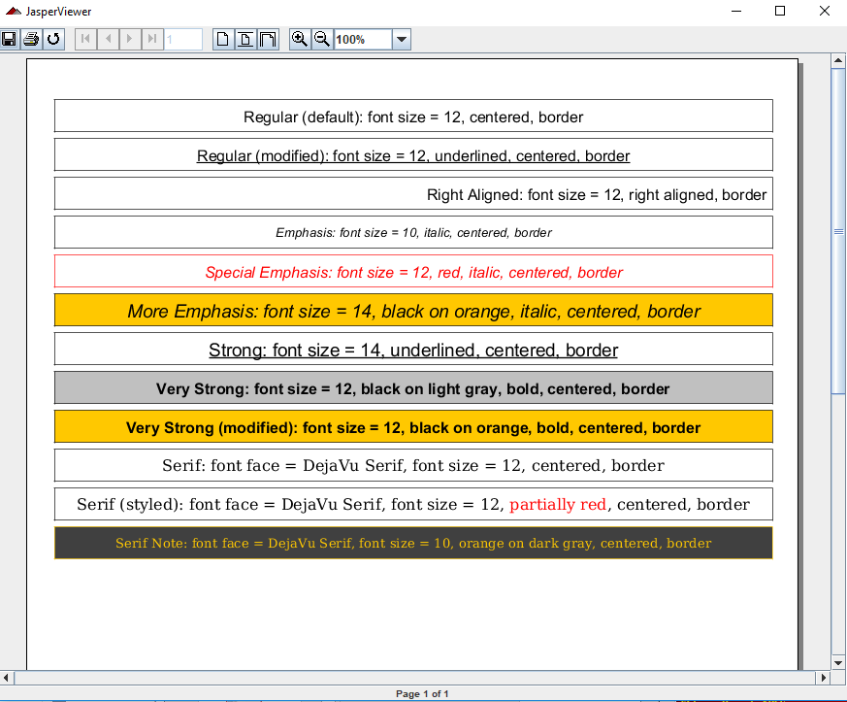
22.4 API: templates
https://community.jaspersoft.com/wiki/jasperreports-library-first-steps
API: templates (Start server first ‘ant runServer’)
> ant -p, ant clean, ant javac, ant compile, ant fill, ant view

Slide 11
22.5 API: text

Slide 12
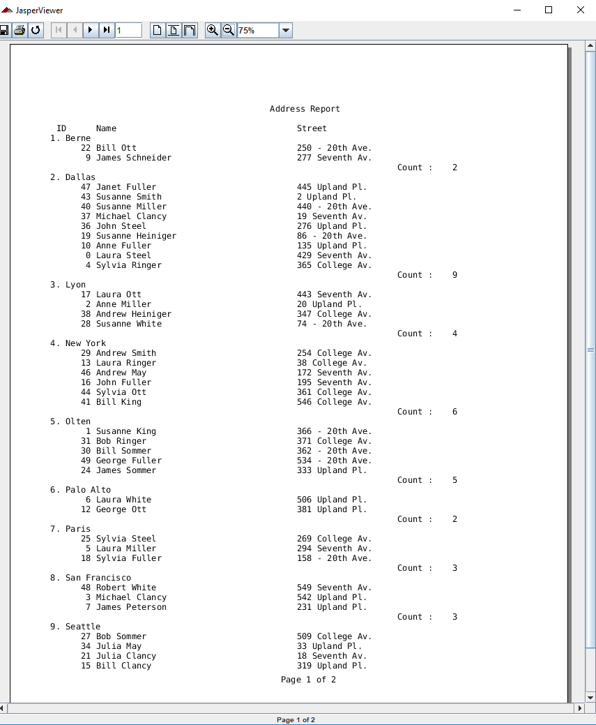
22.5 API: text
https://community.jaspersoft.com/wiki/jasperreports-library-first-steps
API: text (Start server first ‘ant runServer’)
> ant -p, ant clean, ant javac, ant compile, ant fill, ant view

Slide 13
22.6 Summary

Slide 14
22.5 Summary
https://community.jaspersoft.com/wiki/jasperreports-library-first-steps
Summary
Table: table
Tableofcontent: Table of content
Tabular: same as table
Templates: different style and background colors
Text: Text report

Slide 15
End of Chapter

