Slide 1

23 JasperReports API: u
Peter H. Chen

Slide 2
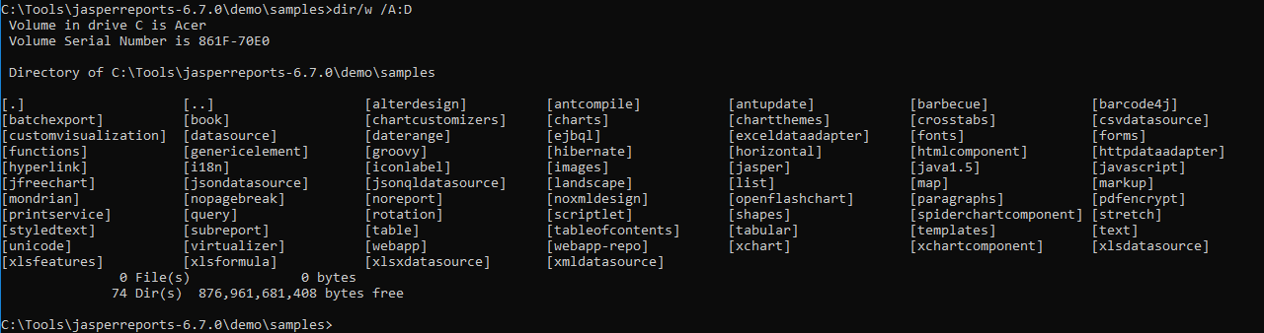
23 JasperReports API: u
https://community.jaspersoft.com/project/jasperreports-library
JasperReport API:
> dir/w /A:D # totally, we have 74 examples in Jasper Report 6.7.0

Slide 3
23.1 API: unicode

Slide 4
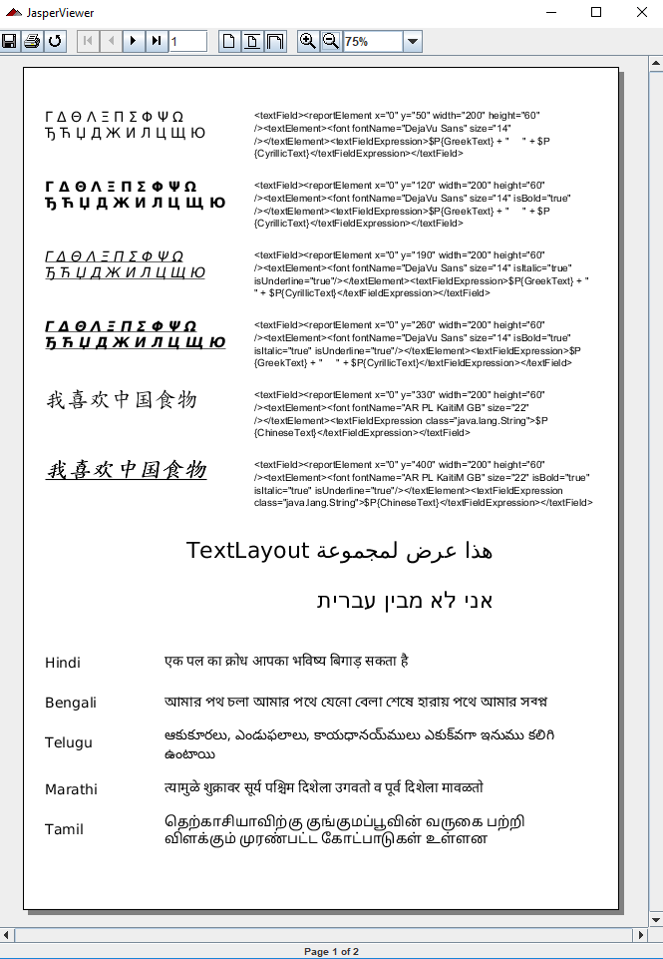
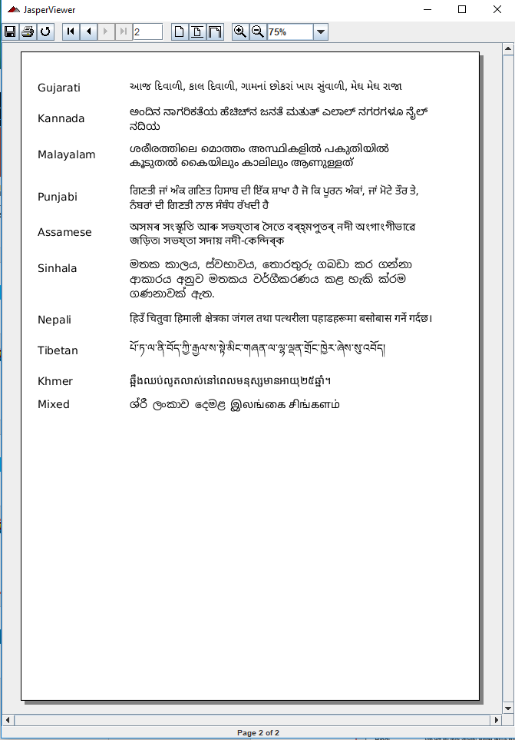
23.1 API: unicode
https://community.jaspersoft.com/wiki/jasperreports-library-first-steps
API: unicode (Start server first ‘ant runServer’)
> ant -p, ant clean, ant javac, ant compile, ant fill, ant view

Slide 5
End of Chapter

