Slide 1

9 JasperReports API: f
Peter H. Chen

Slide 2
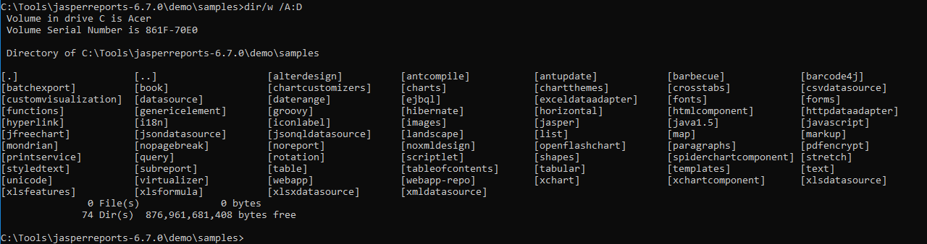
9 JasperReports API: f
https://community.jaspersoft.com/project/jasperreports-library
JasperReport API:
> dir/w /A:D # totally, we have 74 examples in Jasper Report 6.7.0

Slide 3
9.1 API: fonts

Slide 4
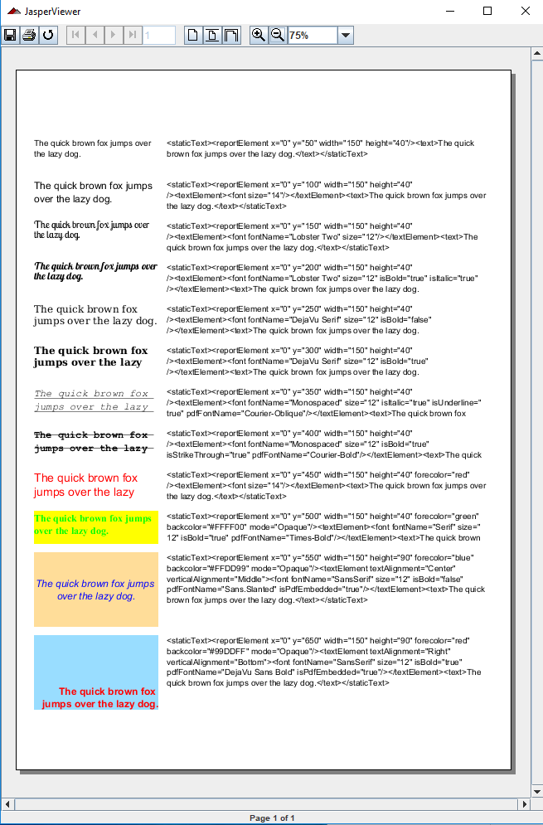
9.1 API: fonts
https://community.jaspersoft.com/wiki/jasperreports-library-first-steps
API: fonts
> ant -p, ant clean, ant javac, ant compile, ant fill, ant view

Slide 5
9.2 API: forms

Slide 6
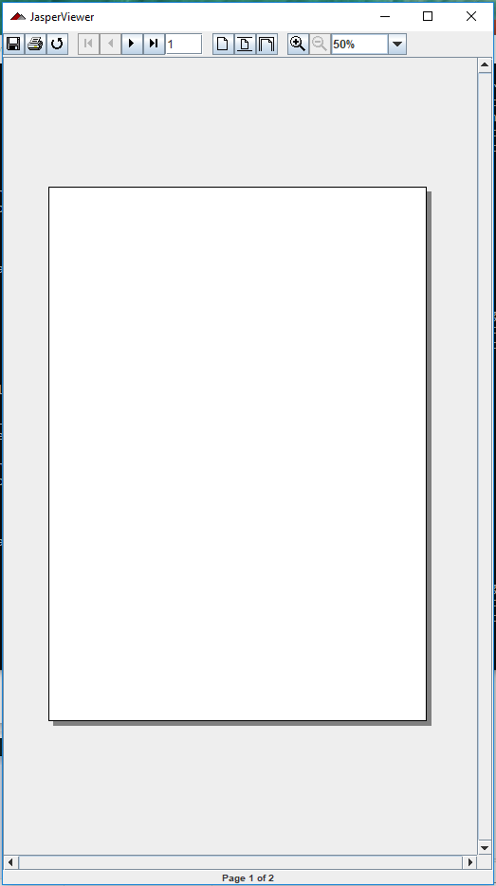
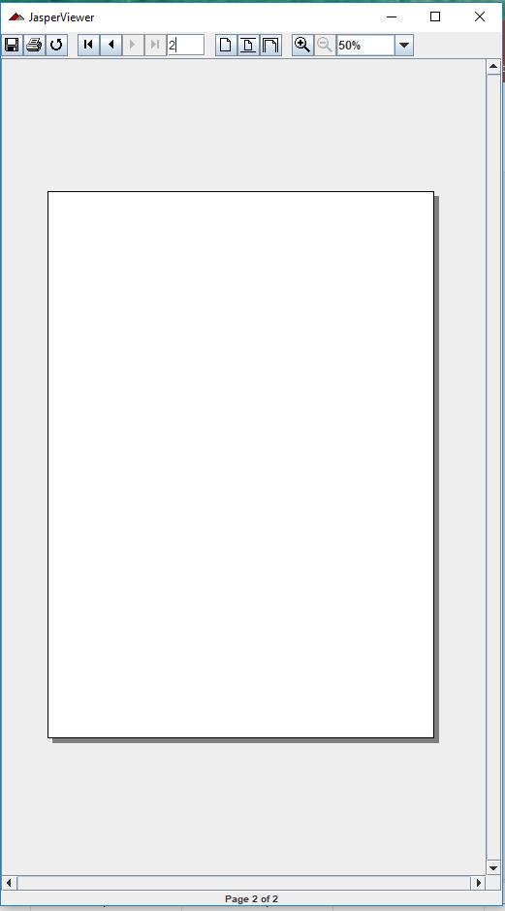
9.2 API: forms
https://community.jaspersoft.com/wiki/jasperreports-library-first-steps
API: forms
> ant -p, ant clean, ant javac, ant compile, ant fill, ant view

Slide 7
9.3 API: funcitons

Slide 8
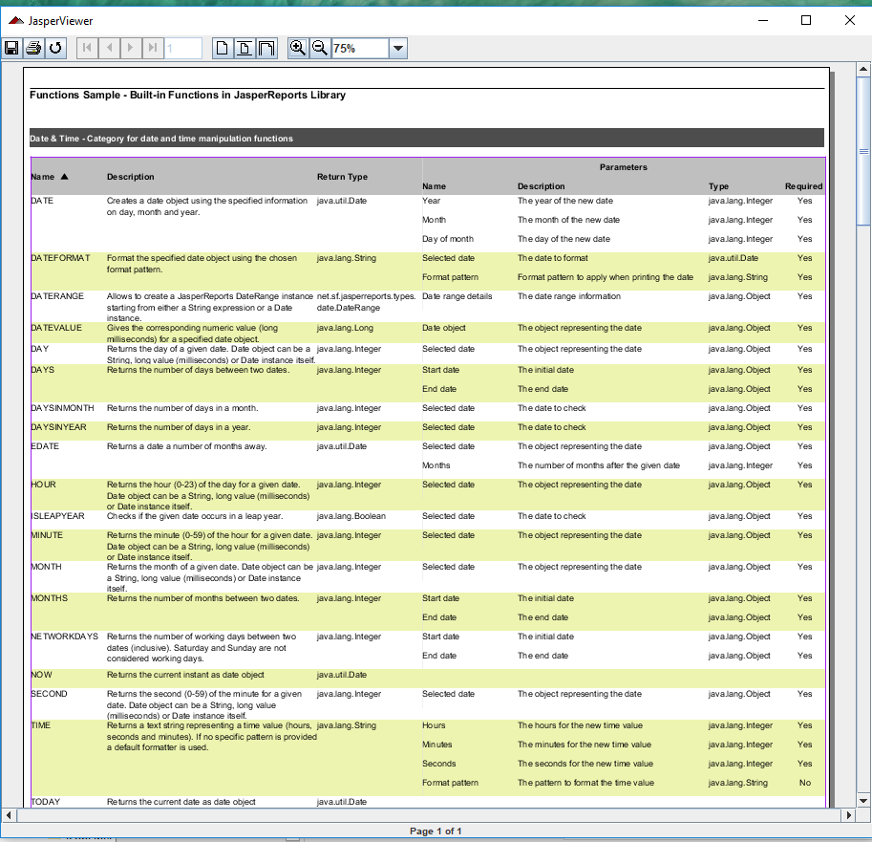
9.3 API: functions
https://community.jaspersoft.com/wiki/jasperreports-library-first-steps
API: functions: Functions require database server.
> ant runServer
> ant -p, ant clean, ant javac, ant compile, ant fill, ant view

Slide 9
End of Chapter

