Slide 1

18 JasperReports API: p
Peter H. Chen

Slide 2
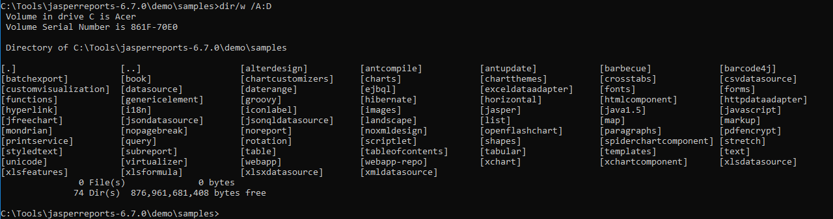
18 JasperReports API: o
https://community.jaspersoft.com/project/jasperreports-library
JasperReport API:
> dir/w /A:D # totally, we have 74 examples in Jasper Report 6.7.0

Slide 3
18.1 API: openflashchart

Slide 4
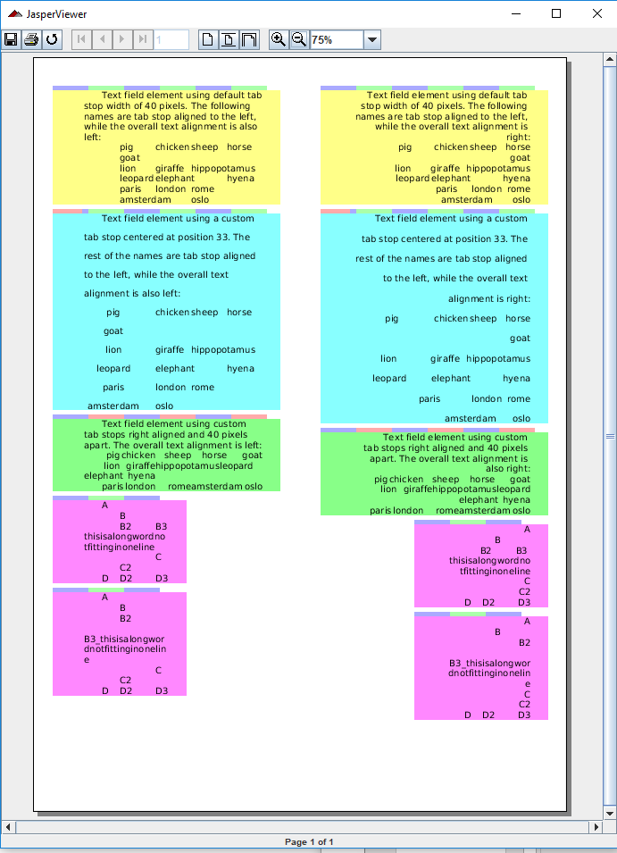
18.1 API: paragraph
https://community.jaspersoft.com/wiki/jasperreports-library-first-steps
API: paragraph
> ant -p, ant clean, ant javac, ant compile, ant fill, ant view

Slide 5
18.2 API: pdfencrypt

Slide 6
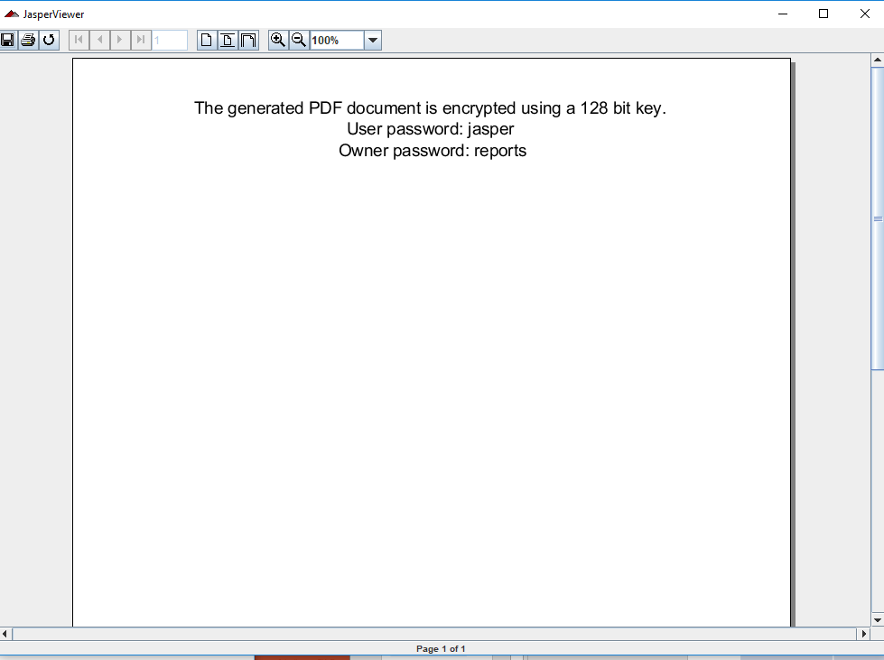
18.2 API: pdfencrypt
https://community.jaspersoft.com/wiki/jasperreports-library-first-steps
API: pdfencrypt
> ant -p, ant clean, ant javac, ant compile, ant fill, ant view

Slide 7
18.3 API: printservice

Slide 8
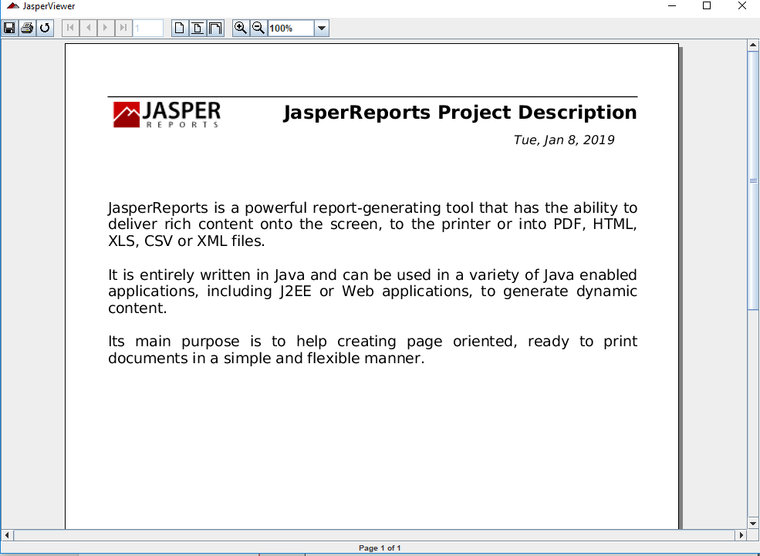
18.3 API: printservice
https://community.jaspersoft.com/wiki/jasperreports-library-first-steps
API: printservice
> ant -p, ant clean, ant javac, ant compile, ant fill, ant view

Slide 9
End of Chapter

