Slide 1

19 JasperReports API: q
Peter H. Chen

Slide 2
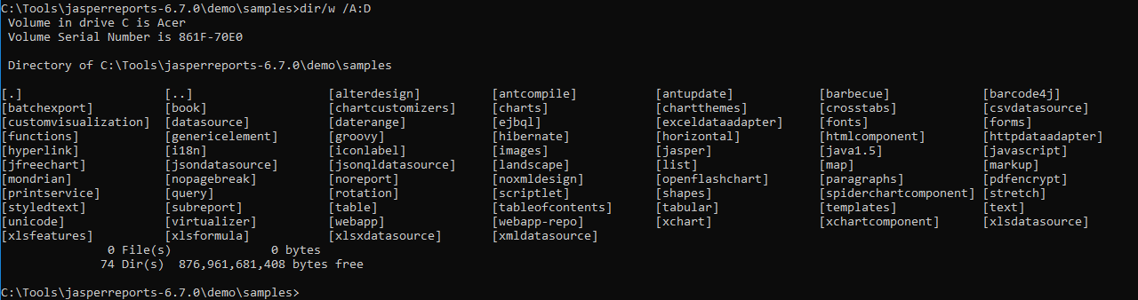
19 JasperReports API: o
https://community.jaspersoft.com/project/jasperreports-library
JasperReport API:
> dir/w /A:D # totally, we have 74 examples in Jasper Report 6.7.0

Slide 3
19.1 API: query

Slide 4
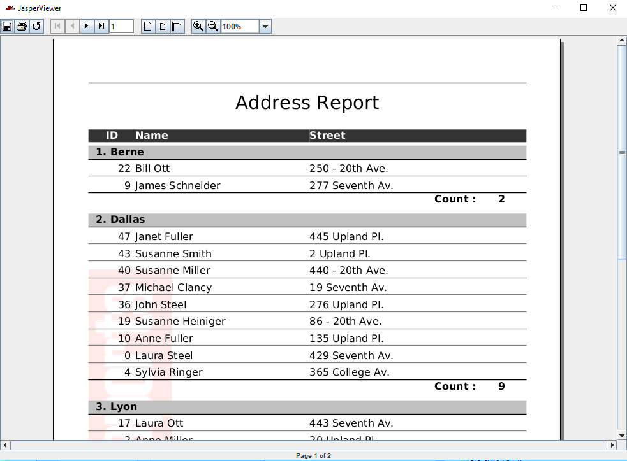
19.1 API: query
https://community.jaspersoft.com/wiki/jasperreports-library-first-steps
API: query (Start server first ‘ant runServer’)
> ant -p, ant clean, ant javac, ant compile, ant fill, ant view

Slide 5
End of Chapter

