Slide 1

10 JasperReports API: g
Peter H. Chen

Slide 2
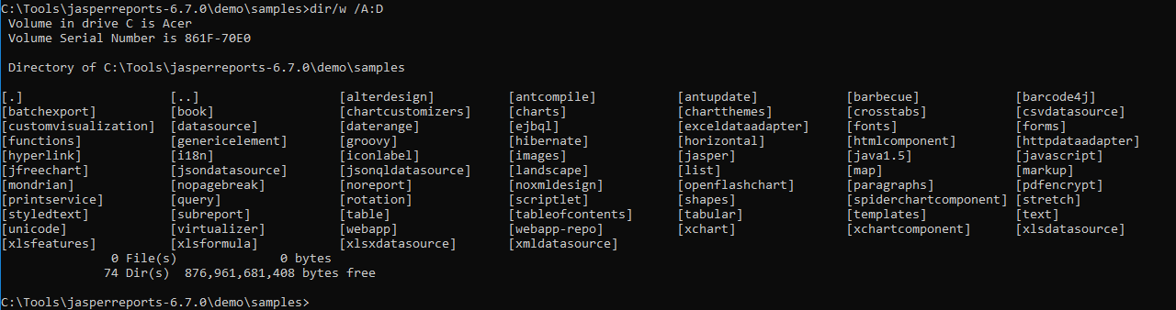
10 JasperReports API: g
https://community.jaspersoft.com/project/jasperreports-library
JasperReport API:
> dir/w /A:D # totally, we have 74 examples in Jasper Report 6.7.0

Slide 3
10.1 API: genericelement

Slide 4
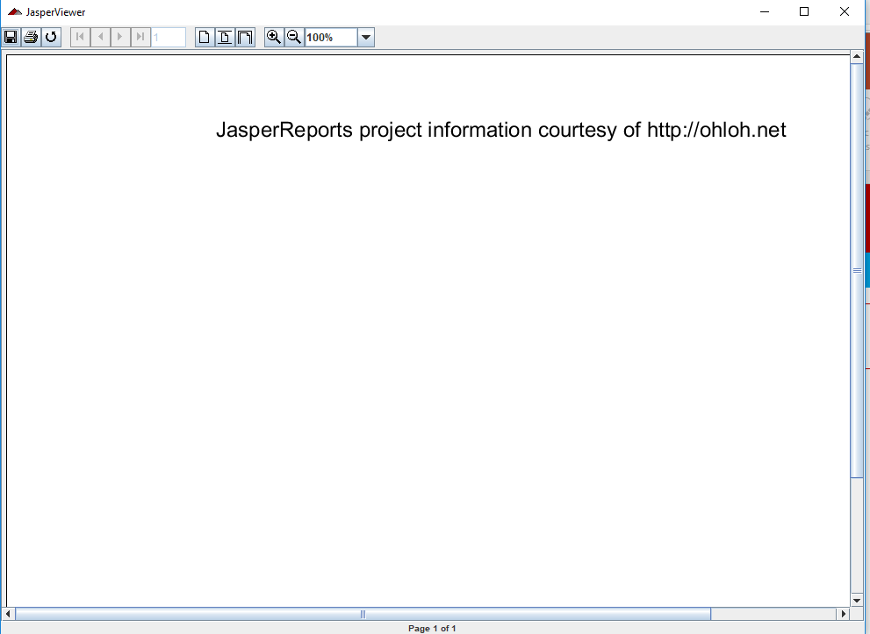
10.1 API: genericelement
https://community.jaspersoft.com/wiki/jasperreports-library-first-steps
API: genericelement
> ant -p, ant clean, ant javac, ant compile, ant fill, ant view

Slide 5
10.2 API: genericelement

Slide 6
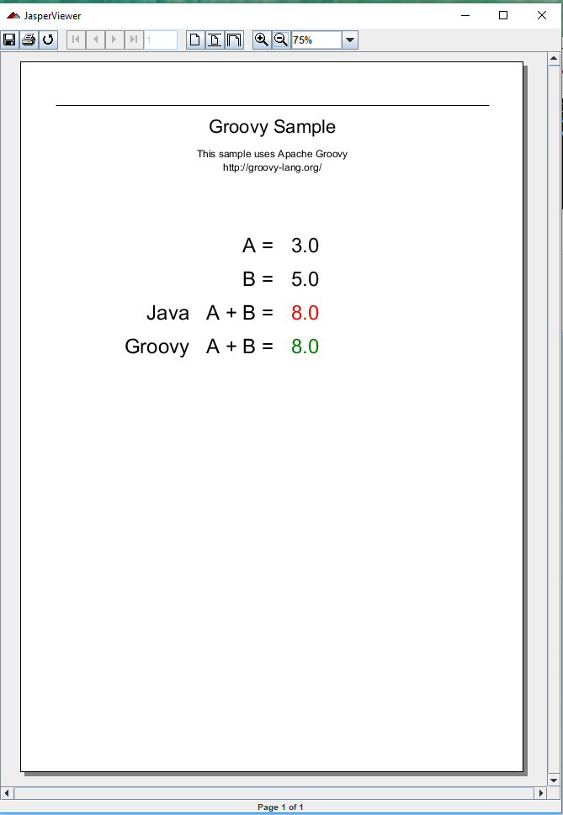
10.1 API: genericelement
https://community.jaspersoft.com/wiki/jasperreports-library-first-steps
API: groovy
> ant -p, ant clean, ant javac, ant compile, ant fill, ant view

Slide 7
End of Chapter

