Slide 1

73 JasperReports API 6.7.0
Peter H. Chen

Slide 2
73 JasperReports API: Overall
https://community.jaspersoft.com/project/jasperreports-library
JasperReport Project Version Comparison (2):
Download Version 0.x.x to 4.x.x: https://sourceforge.net/projects/jasperreports/files/archive/
Download Version 5.0.0 to 6.7.0: https://sourceforge.net/projects/jasperreports/files/jasperreports/
Description | 6.7.0 | 5.5.1 | 5.0.1 | 5.0.0
pass | 71/72 | 68/68 | 63/65 | 63/65
Pass percentage | 98% | 100% | 96% | 96%

Slide 3
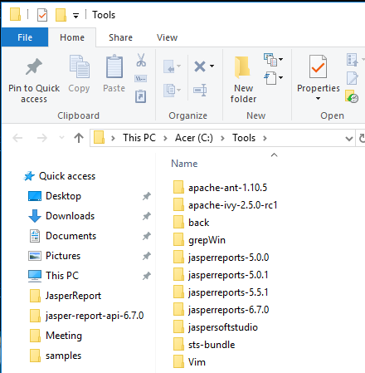
73 JasperReports API Summary
https://community.jaspersoft.com/project/jasperreports-library
JasperReport API:
Install JasperReport 5.0.0 (first release), 5.0.1 (tutorialspoint.com), 5.5.1 (birst.com), 6.7.0 (newest release) under C:\Tools

Slide 4
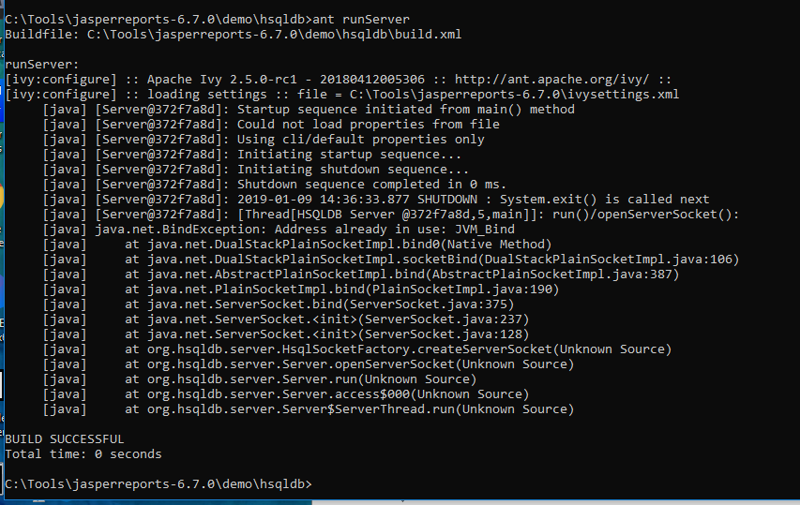
73 JasperReports API Summary
https://community.jaspersoft.com/project/jasperreports-library
Start JasperReport Server:
Go to C:\Tools\jasperreports-6.7.0\demo\hsqldb
> ant runServer

Slide 5
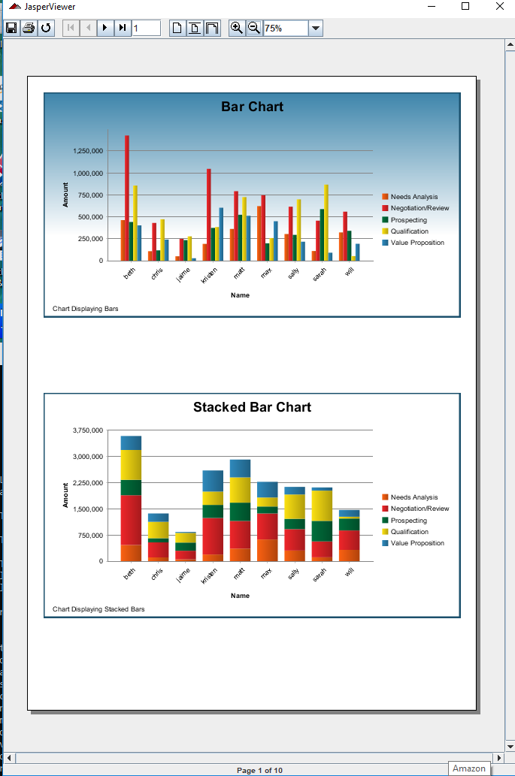
73 JasperReports API Summary
https://community.jaspersoft.com/project/jasperreports-library
Verify JasperReport API Samples:
Go to sample, e.g. C:\Tools\jasperreports-6.7.0\demo\samples\chartthemes
> ant javac
> ant compile
> ant fill
> ant view
> ant clean

Slide 6
73 JasperReports API Summary
https://community.jaspersoft.com/project/jasperreports-library
JasperReport Project Version Comparison (1):
OK: Pass, NG: Not Good, NA: Not Available
id | Name | 6.7.0 | 5.5.1 | 5.0.1 | 5.0.0 | Comment
1 | alterdesign | OK | OK | OK | OK | Change design report color
2 | antcompile | OK | OK | OK | OK | compile1 (compile)/compile2 (re-compile).
3 | antupdate | OK | OK | OK | OK | Update report design update1 and update 2.
4 | barbecue | OK | OK | OK | OK | Demo Bar code
5 | barcode4j | OK | OK | OK | OK | Display Bar code
6 | batchexport | OK | OK | OK | OK | Display view1-3. Print PDF, HTML, XLS, etc.
7 | book | OK | NA | NA | NA | Book Table of Content, Tab, charts, and etc.
8 | chartcustomizers | OK | NA | NA | NA | Compose Bar and line chart.
9 | charts | OK | OK | OK | OK | ant runServer. Area Chart with Table
10 | chartthemes | OK | OK | OK | OK | 3D bar, Pie, bar, area, dot, line, meter chart

Slide 7
73 JasperReports API Summary
https://community.jaspersoft.com/project/jasperreports-library
JasperReport Project Version Comparison (2):
id | Name | 6.7.0 | 5.5.1 | 5.0.1 | 5.0.0 | Comment
11 | crosstabs | OK | OK | OK | OK | ant runServer. Multiple Tables
12 | csvdatasource | OK | OK | OK | OK | Address report
13 | customvisualization | OK | NA | NA | NA | Prompt error message
14 | datasource | OK | OK | OK | OK | fill1-3 data source.
15 | daterange | OK | NA | NA | NA | Date range report
16 | ejbql | OK | OK | OK | OK | Display Movie Database
17 | exceldataadapter | OK | NA | NA | NA | Excel Data Adapter
18 | fonts | OK | OK | OK | OK | Font Size.
19 | forms | OK | OK | NA | NA | Empty forms
20 | functions | OK | OK | NA | NA | Display built-in function

Slide 8
73 JasperReports API Summary
https://community.jaspersoft.com/project/jasperreports-library
JasperReport Project Version Comparison (3):
id | Name | 6.7.0 | 5.5.1 | 5.0.1 | 5.0.0 | Comment
21 | genericelement | OK | OK | OK | OK | Generic element
22 | groovy | OK | OK | OK | OK | Groovy language
23 | hibernate | OK | OK | OK | OK | ant runServer; use hibernate to get data.
24 | horizontal | OK | OK | OK | OK | ant runServer; display horizontal report
25 | htmlcomponent | OK | OK | OK | OK | Hrnl component
26 | httpdataadapter | OK | NA | NA | NA | http data adapter
27 | hyperlink | OK | OK | OK | OK | hyperlink
28 | i18n | OK | OK | OK | OK | Prompt a dialog for language selection and display
29 | iconlabel | OK | OK | NA | NA
30 | images | OK | OK | OK | OK | View the image

Slide 9
73 JasperReports API Summary
https://community.jaspersoft.com/project/jasperreports-library
JasperReport Project Version Comparison (4):
id | Name | 6.7.0 | 5.5.1 | 5.5.0 | 5.0.0 | Comment
31 | Jasper | OK | OK | OK | OK | ant runServer; Multiple Tables report
32 | Java1.5 | OK | OK | OK | OK | Java 1.5
33 | Javascript | OK | OK | OK | OK | JavaScript
 | jcharts | OK | OK | OK | OK | Chart Report (Same as xchart in 6.7.0)
 | jchartcomponent | OK | OK | OK | OsK | Chart Component (xchartcomponent in 6.7.0)
34 | jfreechart | OK | OK | OK | OK | 3D pie Chart
35 | jsondatasource | OK | OK | NG | NG | Good table format
36 | jsonqldatasource | OK | NA | NA | NA | Output: HTML, PDF
37 | landscape | OK | OK | OK | OK | landscape
38 | list | OK | OK | OK | OK | Address report
39 | map | OK | OK | NG | NG | Display Road Map
40 | makeup | OK | OK | OK | OK | Markup text

Slide 10
73 JasperReports API Summary
https://community.jaspersoft.com/project/jasperreports-library
JasperReport Project Version Comparison (5):
id | Name | 6.7.0 | 5.5.1 | 5.5.0 | 5.0.0 | Comment
41 | mondrian | OK | OK | OK | OK | Mondrian type of report
42 | nopagebreak | OK | OK | OK | OK | All tables without page break
43 | noreport | OK | OK | OK | OK | No report compile.
44 | noxmldesign | OK | OK | OK | OK | Address report
45 | openflashchart | OK | OK | OK | OK | Display empty
46 | Paragraphs | OK | OK | OK | OK | Multiple Paragraphs with different colors
47 | Pdfencrypt | OK | OK | OK | OK | Encrypt pdf
48 | Printservice | OK | OK | OK | OK | Print only. No design compilation.
49 | Query | OK | OK | OK | OK | Query: Address report
50 | Rotation | OK | OK | OK | OK | Paragraph text rotation

Slide 11
73 JasperReports API Summary
https://community.jaspersoft.com/project/jasperreports-library
JasperReport Project Version Comparison (6):
id | Name | 6.7.0 | 5.5.1 | 5.5.0 | 5.0.0 | Comment
51 | scriptlet | OK | OK | OK | OK | Group of Script: Address Report
52 | shapes | OK | OK | OK | OK | Draw different shapes
53 | spiderchartcomponent | OK | OK | OK | OK | Spider web chart
54 | stretch | OK | OK | OK | OK | Composite table
55 | styledtext | OK | OK | OK | OK | Styled of text
56 | subreport | OK | OK | OK | OK | Sub-report under master report
57 | table | OK | OK | OK | OK | Table (same as tabular)
58 | tableofcontents | OK | OK | OK | OK | Table of content of order report
59 | tabular | OK | OK | OK | OK | Tabular (same as table)
60 | templates | OK | OK | OK | OK | Varied styles and backgrounds

Slide 12
73 JasperReports API Summary
https://community.jaspersoft.com/project/jasperreports-library
JasperReport Project Version Comparison (7):
id | Name | 6.7.0 | 5.5.1 | 5.0.1 | 5.0.0 | Comment
61 | Text | OK | OK | OK | OK | Display pure text
62 | unicode | OK | OK | OK | OK | Unicode/Internationalization
63 | virtualizer | OK | OK | OK | OK | Parse very long string (virtualizer)
64 | webapp | OK | OK | OK | OK | Prepare the war file
65 | Webapp-repo | OK | OK | OK | OK | Prepare the war file
66 | xchart | OK | OK | OK | OK | chart report (Same as jcharts in 5.x.x)
67 | xchartcomponent | OK | OK | OK | OK | chart component (jchartcompnent in 5.x.x)
68 | xlsdatasource | NG | OK | OK | OK | Use xlsxdatasource instead
69 | xlsfeatures | OK | OK | OK | OK | Parse xls format and display: Customer report
70 | xlsformula | OK | OK | OK | OK | Math formula

Slide 13
73 JasperReports API Summary
https://community.jaspersoft.com/project/jasperreports-library
JasperReport Project Version Comparison (8):
id | Name | 6.7.0 | 5.5.1 | 5.0.1 | 5.0.0 | Comment
71 | xlsxdatasource | OK | OK | OK | OK | Parse/display xlsx (Excel format): Address report
72 | xmldatasource | OK | OK | OK | OK | Parse/display xml format: Customer Report

Slide 14
End of Chapter

