Slide 1

73 JasperReports API 6.7.0
Peter H. Chen

Slide 2
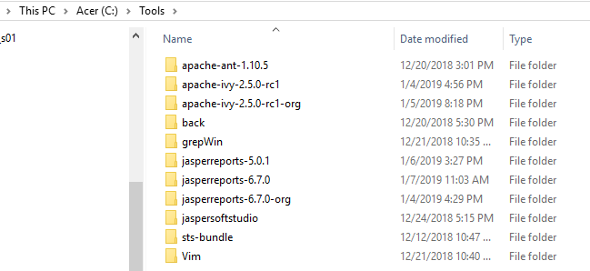
73 JasperReports API Summary
https://community.jaspersoft.com/project/jasperreports-library
JasperReport API:
Install JasperReport 6.7.0 under C:\Tools

Slide 3
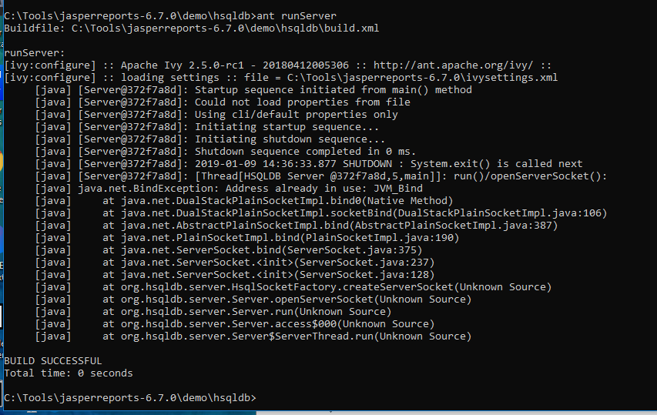
73 JasperReports API Summary
https://community.jaspersoft.com/project/jasperreports-library
Start JasperReport Server:
Go to C:\Tools\jasperreports-6.7.0\demo\hsqldb
> ant runServer

Slide 4
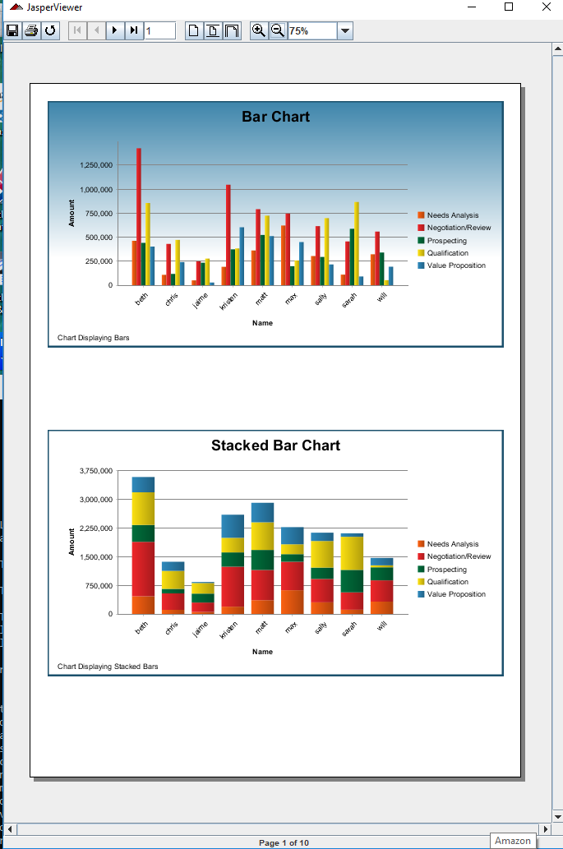
73 JasperReports API Summary
https://community.jaspersoft.com/project/jasperreports-library
Verify JasperReport API Samples:
Go to sample, e.g. C:\Tools\jasperreports-6.7.0\demo\samples\chartthemes
> ant javac
> ant compile
> ant fill
> ant view
> ant clean

Slide 5
73 JasperReports API Summary
https://community.jaspersoft.com/project/jasperreports-library
JasperReport Project Version Comparison (1):
OK: Pass, NG: Not Good, NA: Not Available
S. No | Item | 7.6.0 | 5.5.1 | Comment
1 | alterdesign | OK | OK | Change design report color
2 | antcompile | OK | OK | compile1 (compile)/compile2 (re-compile).
3 | antupdate | OK | OK | Update report design update1 and update 2.
4 | barbecue | OK | OK | Demo Bar code
5 | barcode4j | OK | OK | Display Bar code
6 | batchexport | OK | OK | Display view1-3. Print PDF, HTML, XLS, etc.
7 | book | OK | NA | Book Table of Content, Tab, charts, and etc.
8 | chartcustomizers | OK | NA | Compose Bar and line chart.
9 | charts | OK | NG | Area Chart with Table
10 | chartthemes | OK | OK | 3D bar, Pie, bar, area, dot, line, meter chart

Slide 6
73 JasperReports API Summary
https://community.jaspersoft.com/project/jasperreports-library
JasperReport Project Version Comparison (2):
S. No | Item | 7.6.0 | 5.5.1 | Comment
11 | crosstabs | OK | NG | Multiple Tables
12 | csvdatasource | OK | OK | Address report
13 | customvisualization | NG | NA
14 | datasource | OK | OK | fill1-3 data source.
15 | daterange | OK | NA | Date range report
16 | ejbql | OK | OK | Display Movie Database
17 | exceldataadapter | OK | NA | Excel Data Adapter
18 | fonts | OK | OK | Font Size.
19 | forms | OK | OK | Empty forms
20 | functions | OK | OK | Display built-in function

Slide 7
73 JasperReports API Summary
https://community.jaspersoft.com/project/jasperreports-library
JasperReport Project Version Comparison (3):
S. No | Item | 7.6.0 | 5.5.1 | Comment
21 | genericelement | OK
22 | groovy | OK
23 | hibernate | OK
24 | horizontal | OK
25 | htmlcomponent | OK
26 | httpdataadapter | OK
27 | hyperlink | OK
28 | i18n | OK
29 | iconlabel | OK
30 | images | OK

Slide 8
73 JasperReports API Summary
https://community.jaspersoft.com/project/jasperreports-library
JasperReport Project Version Comparison (4):
S. No | Item | 7.6.0 | 5.5.1 | Comment
31 | Jasper | OK |  | Multiple Tabules report
32 | Java1.5 | OK
33 | Javascript | OK
34 | jfreechart | OK |  | 3D pie Chart
35 | jsondatasource | OK |  | Good table format
36 | jsonqldatasource | OK |  | Output: HTML, PDF
37 | landscape | OK
38 | list | OK
39 | map | OK
40 | makeup | OK

Slide 9
73 JasperReports API Summary
https://community.jaspersoft.com/project/jasperreports-library
JasperReport Project Version Comparison (5):
S. No | Item | 7.6.0 | 5.5.1 | Comment
41 | mondrian | OK
42 | nopagebreak | OK |  | All tables without page break
43 | noreport | OK
44 | noxmldesign | OK
45 | openflashchart | OK |  | Display empty
46 | Paragraphs | OK |  | Multiple Paragraphs with different colors
47 | Pdfencrypt | OK |  | Encrypt pdf
48 | Printservice | OK |  | Print only. No design compilation.
49 | Query | OK |  | Query
50 | Rotation | OK |  | Paragraph text rotation

Slide 10
73 JasperReports API Summary
https://community.jaspersoft.com/project/jasperreports-library
JasperReport Project Version Comparison (6):
S. No | Item | 7.6.0 | 5.5.1 | Comment
51 | scriptlet | OK |  | Group of Script
52 | shapes | OK |  | Rotate shapes
53 | spiderchartcomponent | OK |  | Spider chart
54 | stretch | OK
55 | styledtext | OK |  | Style
56 | subreport | OK |  | Sub-report
57 | table | OK |  | Table (same as tabular)
58 | tableofcontents | OK |  | Table of content
59 | tabular | OK |  | Tabular (same as table)
60 | templates | OK |  | Varied styles and backgrounds

Slide 11
73 JasperReports API Summary
https://community.jaspersoft.com/project/jasperreports-library
JasperReport Project Version Comparison (7):
S. No | Item | 7.6.0 | 5.5.1 | Comment
61 | Text | OK |  | Display pure text
62 | unicode | OK |  | Unicode/Internationalization
63 | virtualizer | OK |  | Parse very long string (virtualizer)
64 | webapp | NG |  | Prepare the jar file
65 | Webapp-repo | NG |  | Prepare the jar file
66 | xchart | OK |  | Sample chart
67 | xchartcomponent | OK |  | Sample chart component report
68 | xlsdatasource | NG |  | Use xlsxdatasource instead
69 | xlsfeatures | OK |  | Parse xls format and display
70 | xlsformula | OK |  | Math formula

Slide 12
73 JasperReports API Summary
https://community.jaspersoft.com/project/jasperreports-library
JasperReport Project Version Comparison (8):
S. No | Item | 7.6.0 | 5.5.1 | Comment
71 | xlsxdatasource | OK |  | Parse/display xlsx (Excel format)
72 | xmldatasource | OK |  | Parse/display xml format

Slide 13
End of Chapter

