Slide 1

25 JasperReports API: x
Peter H. Chen

Slide 2
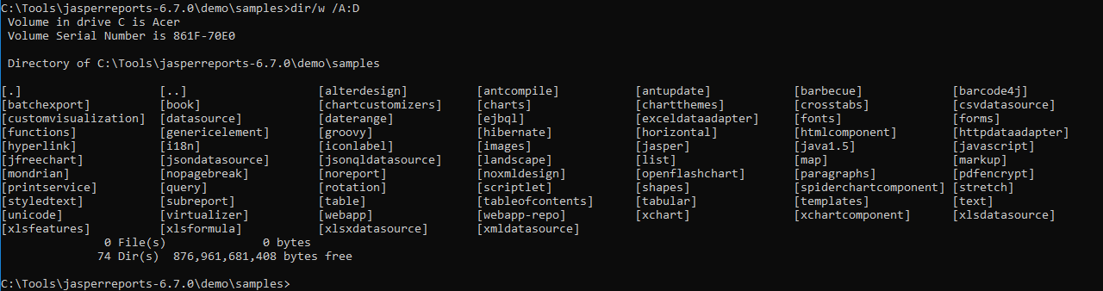
25 JasperReports API: x
https://community.jaspersoft.com/project/jasperreports-library
JasperReport API:
> dir/w /A:D # totally, we have 74 examples in Jasper Report 6.7.0

Slide 3
25.1 API: xchart

Slide 4
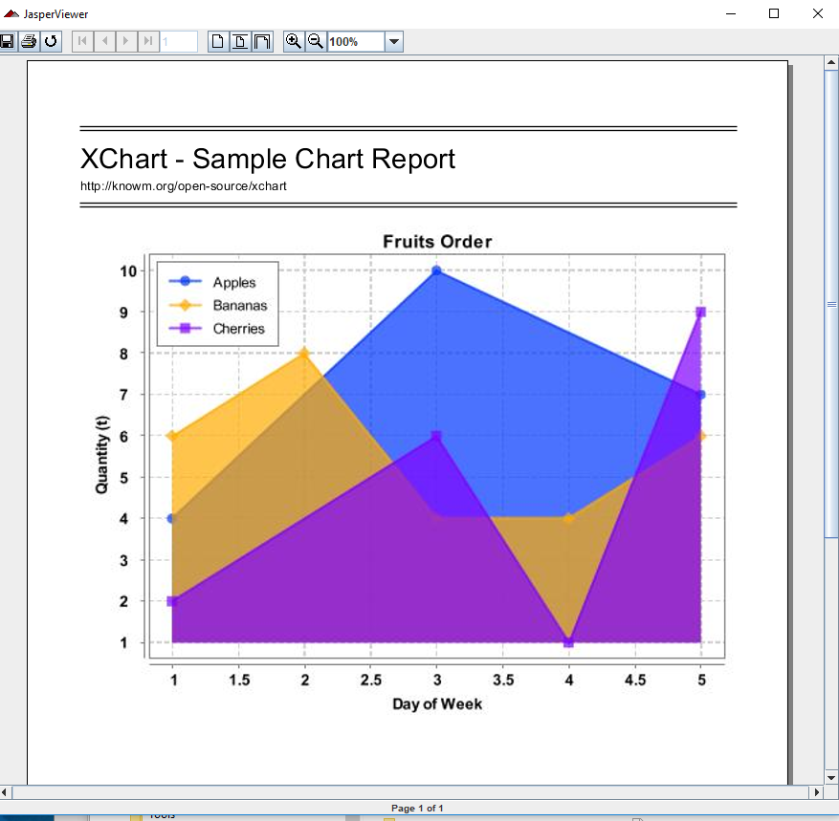
25.1 API: xchart
https://community.jaspersoft.com/wiki/jasperreports-library-first-steps
API: sample chart (Start server first ‘ant runServer’)
> ant -p, ant clean, ant javac, ant compile, ant fill, ant view

Slide 5
25.2 API: xchartcomponent

Slide 6
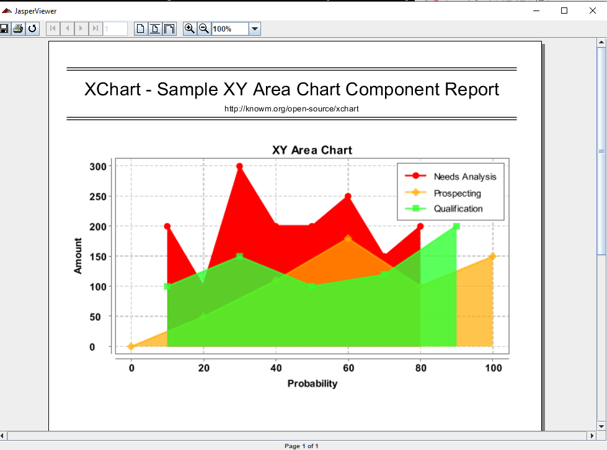
25.2 API: xchartcomponent
https://community.jaspersoft.com/wiki/jasperreports-library-first-steps
API: sample chart componebnt report (Start server first ‘ant runServer’)
> ant -p, ant clean, ant javac, ant compile, ant fill, ant view

Slide 7
25.3 API: xlsdatasource

Slide 8
25.3 API: xlsdatasource
https://community.jaspersoft.com/wiki/jasperreports-library-first-steps
API: xlsdatasource (Start server first ‘ant runServer’)
> ant -p, ant clean, ant javac, ant compile, ant fill, ant view
Result: NG (Use xlsxdatasource)

Slide 9
25.4 API: xlsfeature

Slide 10
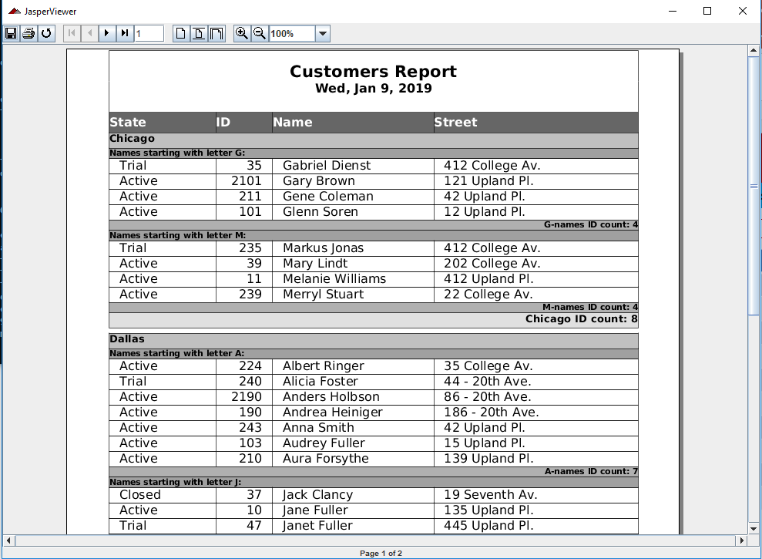
25.4 API: xlsfeature
https://community.jaspersoft.com/wiki/jasperreports-library-first-steps
API: xlsfeature (Start server first ‘ant runServer’)
> ant -p, ant clean, ant javac, ant compile, ant fill, ant view

Slide 11
25.5 API: xlsformula

Slide 12
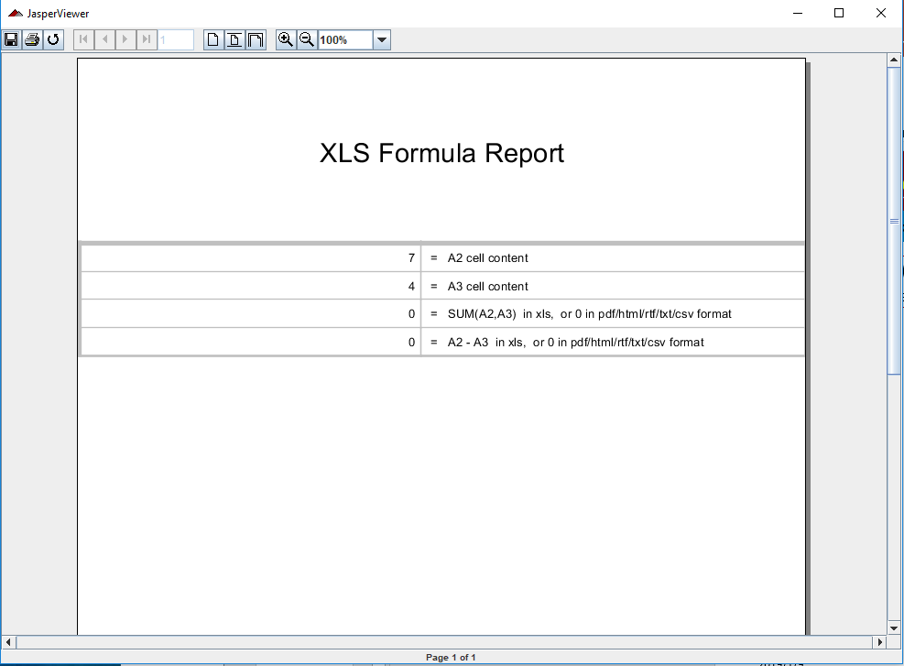
25.5 API: xlsformula
https://community.jaspersoft.com/wiki/jasperreports-library-first-steps
API: xlsformula (Start server first ‘ant runServer’)
> ant -p, ant clean, ant javac, ant compile, ant fill, ant view

Slide 13
25.6 API: xlsformula

Slide 14
25.6 API: xlsformula
https://community.jaspersoft.com/wiki/jasperreports-library-first-steps
API: xlsformula (Start server first ‘ant runServer’)
> ant -p, ant clean, ant javac, ant compile, ant fill, ant view

Slide 15
25.7 API: xlsxdaatsource

Slide 16
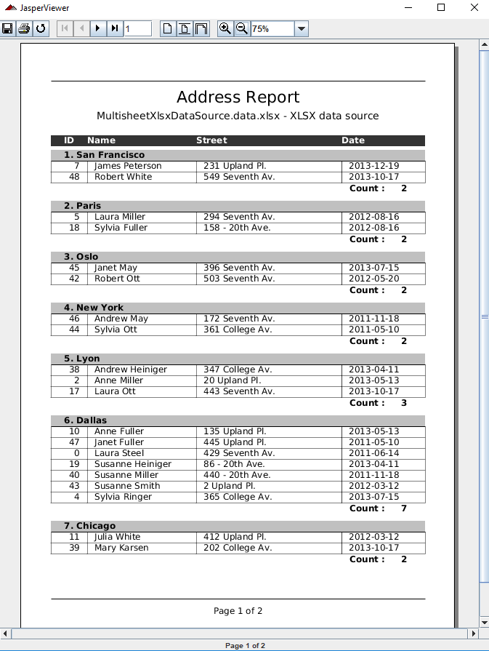
25.7 API: xlsxdatasource
https://community.jaspersoft.com/wiki/jasperreports-library-first-steps
API: xlsxdatasource (Start server first ‘ant runServer’)
> ant -p, ant clean, ant javac, ant compile, ant fill, ant view

Slide 17
25.8 API: xlsxdaatsource

Slide 18
25.8 API: xlsxdatasource
https://community.jaspersoft.com/wiki/jasperreports-library-first-steps
API: xlsxdatasource (Start server first ‘ant runServer’)
> ant -p, ant clean, ant javac, ant compile, ant fill, ant view

Slide 19
25.9 API: xmldaatsource

Slide 20
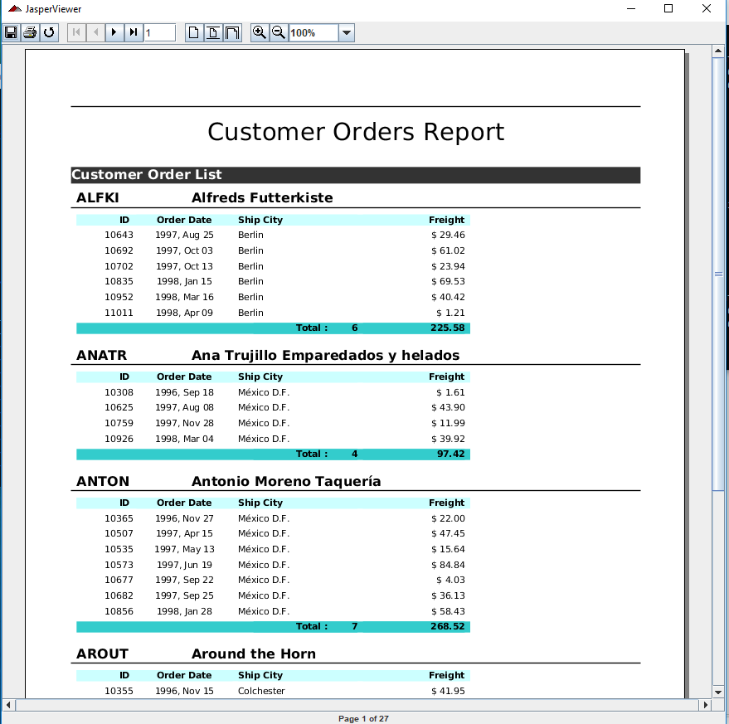
25.9 API: xmldatasource
https://community.jaspersoft.com/wiki/jasperreports-library-first-steps
API: xldatasource (Start server first ‘ant runServer’)
> ant -p, ant clean, ant javac, ant compile, ant fill, ant view

Slide 21
End of Chapter

