Slide 1

7 JasperReports API: d
Peter H. Chen

Slide 2
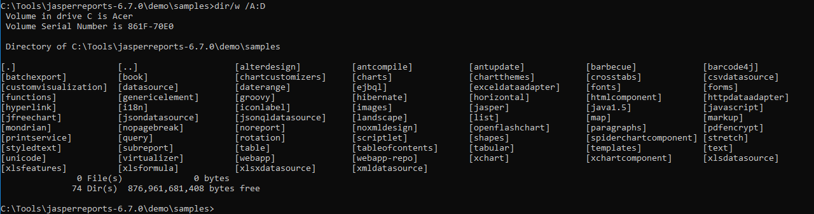
7 JasperReports API: d
https://community.jaspersoft.com/project/jasperreports-library
JasperReport API:
> dir/w /A:D # totally, we have 74 examples in Jasper Report 6.7.0

Slide 3
7.1 API: datasource

Slide 4
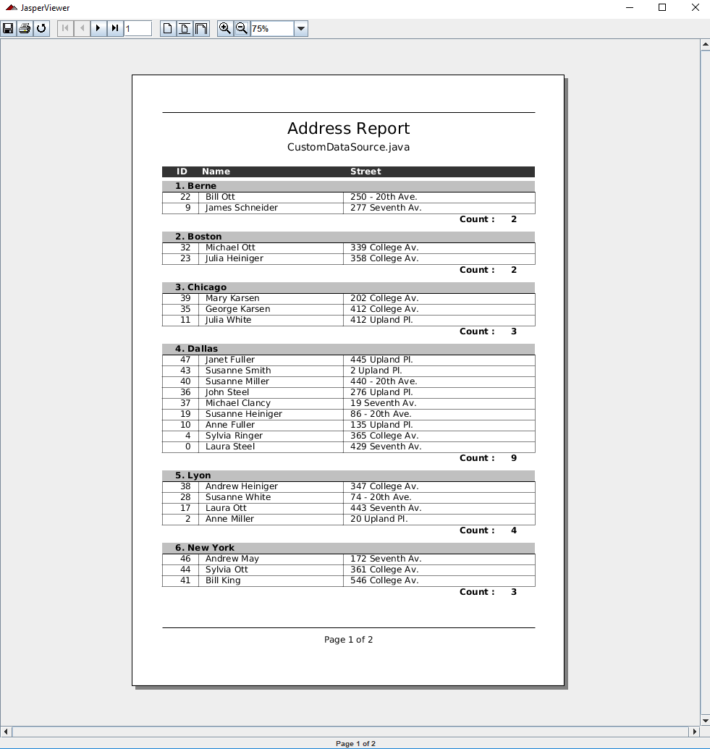
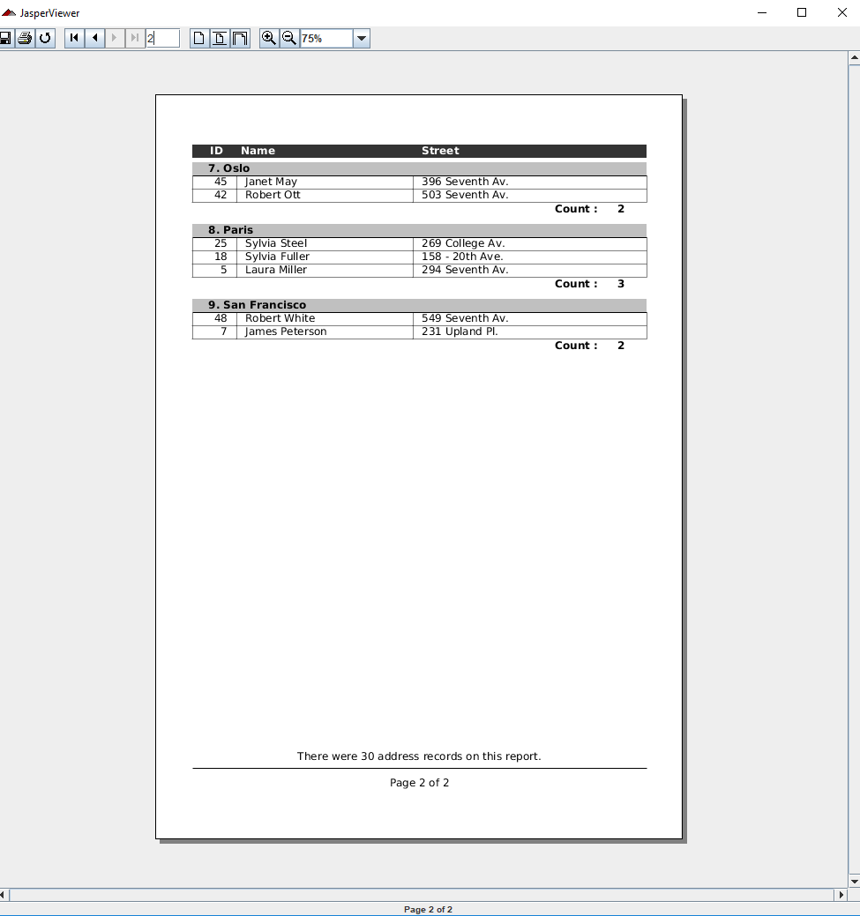
7.1 API: datasource
https://community.jaspersoft.com/wiki/jasperreports-library-first-steps
API: datasource
> ant -p, ant clean, ant javac, ant compile, ant fill1, ant view

Slide 5
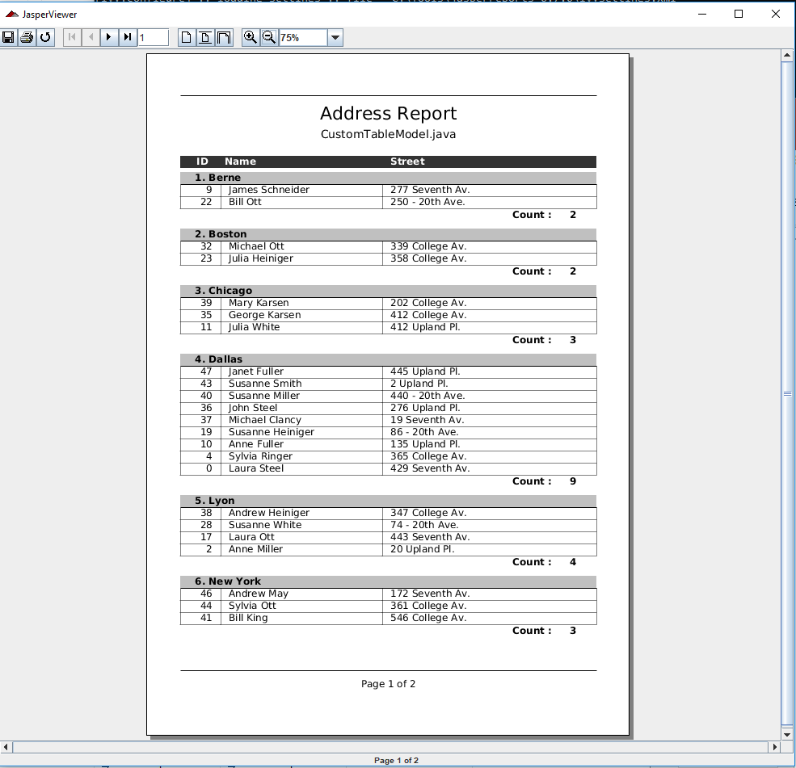
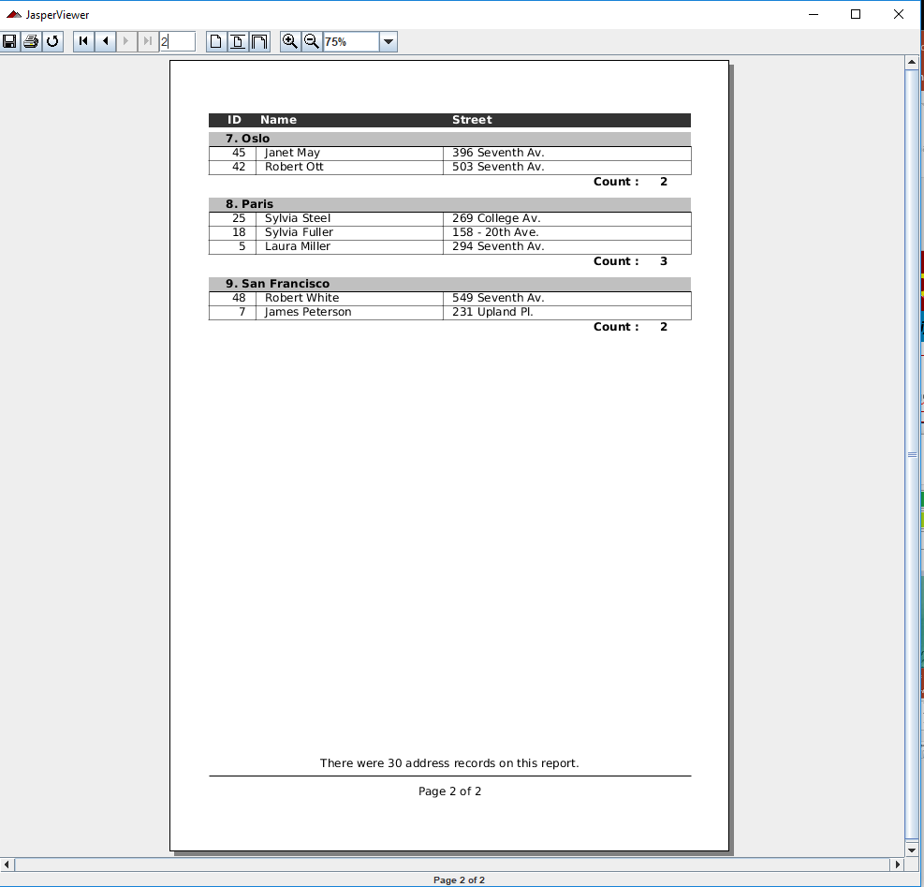
7.1 API: datasource
https://community.jaspersoft.com/wiki/jasperreports-library-first-steps
API: datasource
> ant -p, ant clean, ant javac, ant compile, ant fill2, ant view

Slide 6
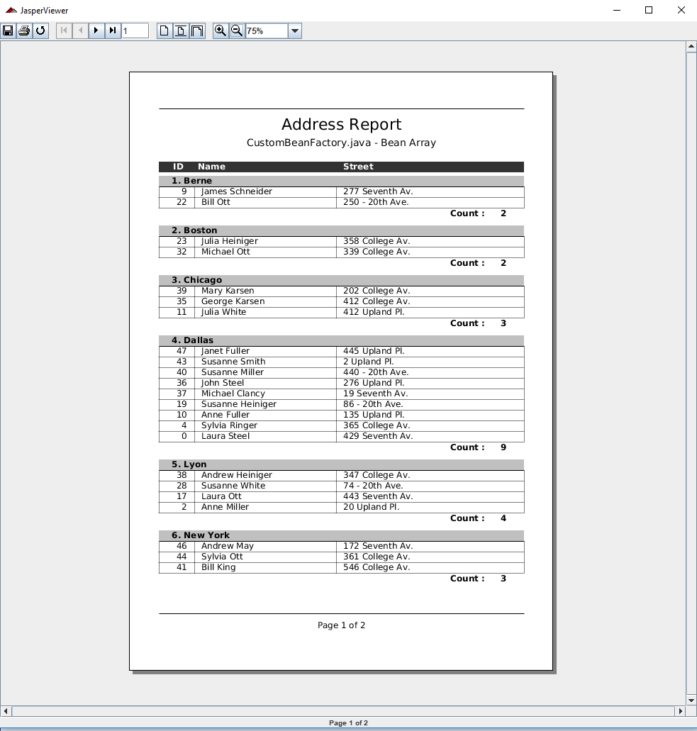
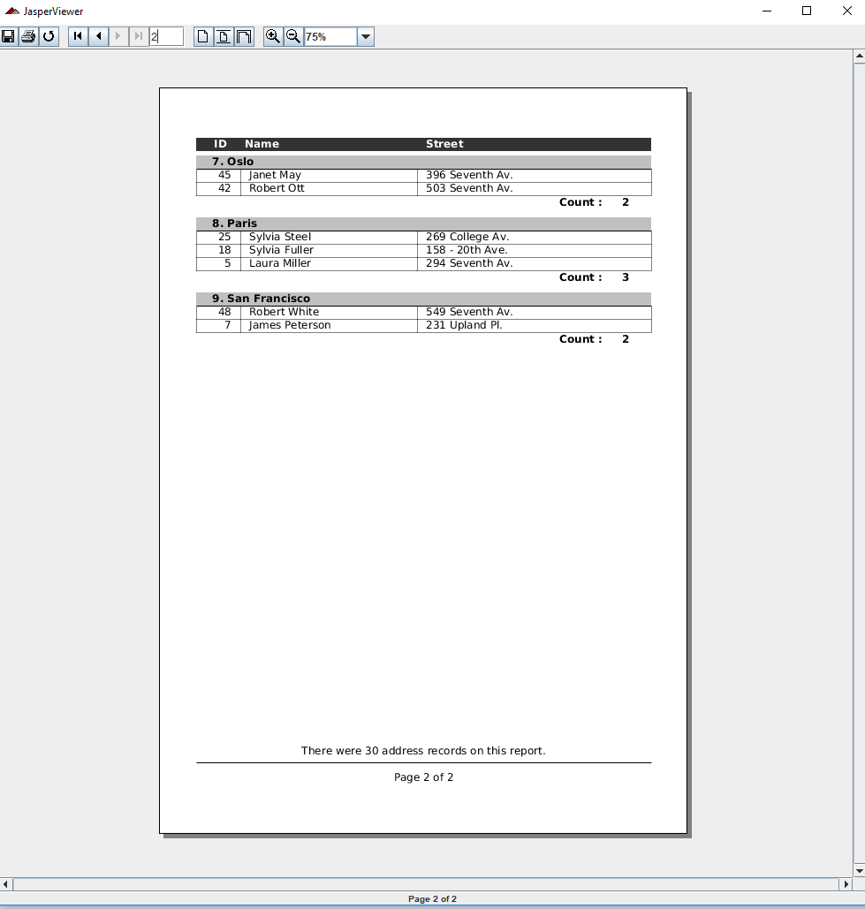
7.1 API: datasource
https://community.jaspersoft.com/wiki/jasperreports-library-first-steps
API: datasource
> ant -p, ant clean, ant javac, ant compile, ant fill3, ant view

Slide 7
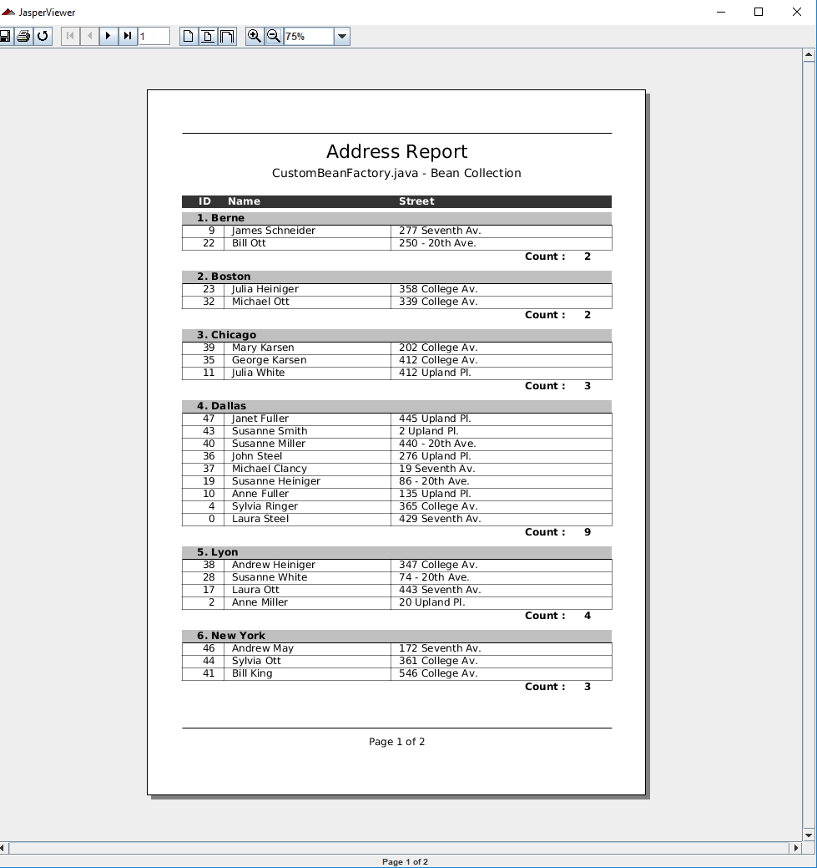
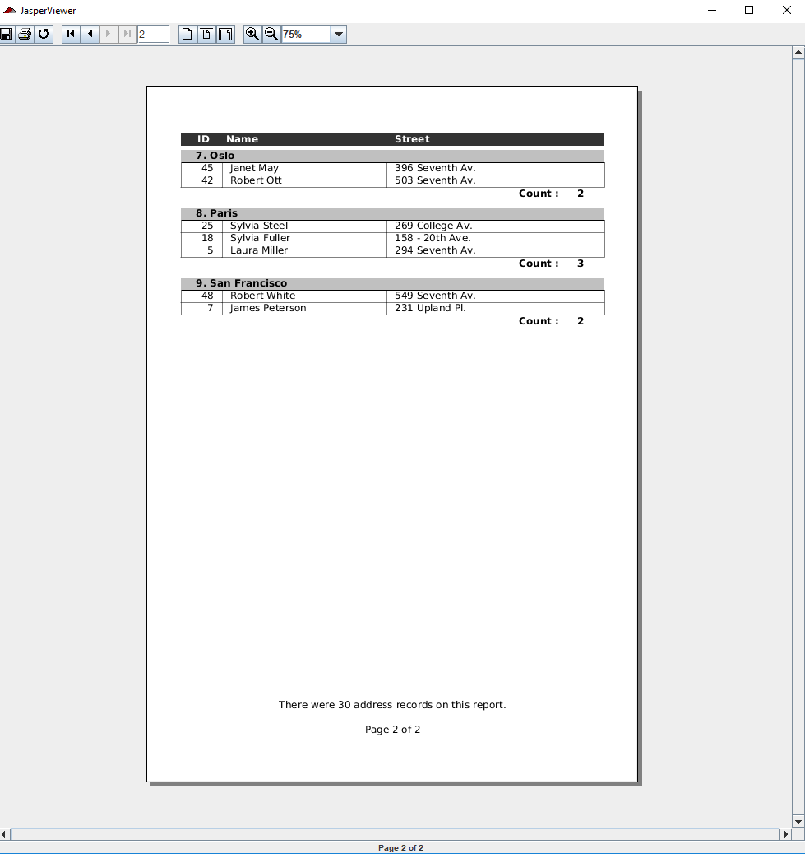
7.1 API: datasource
https://community.jaspersoft.com/wiki/jasperreports-library-first-steps
API: datasource
> ant -p, ant clean, ant javac, ant compile, ant fill4, ant view

Slide 8
7.2 API: daterange

Slide 9
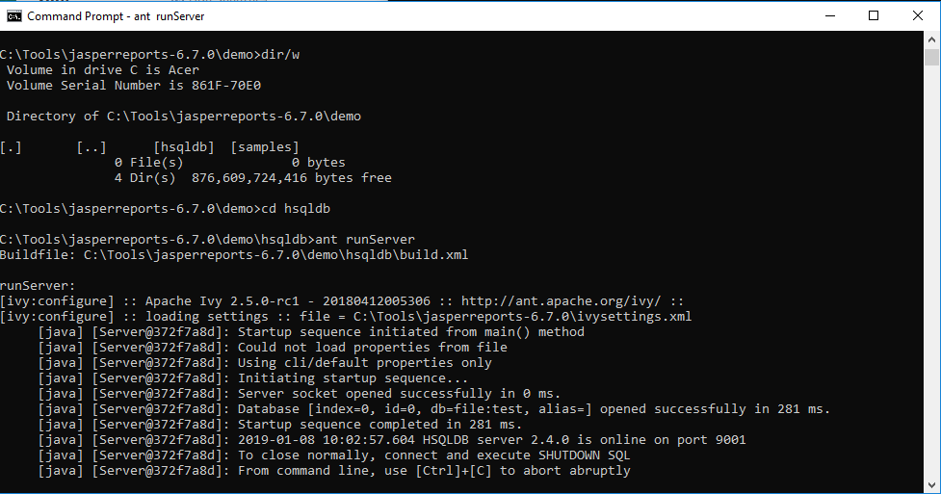
7.2 API: datarange
https://community.jaspersoft.com/wiki/jasperreports-library-first-steps
API: daterange
This API requires database server to fill data:
> ant runServer

Slide 10
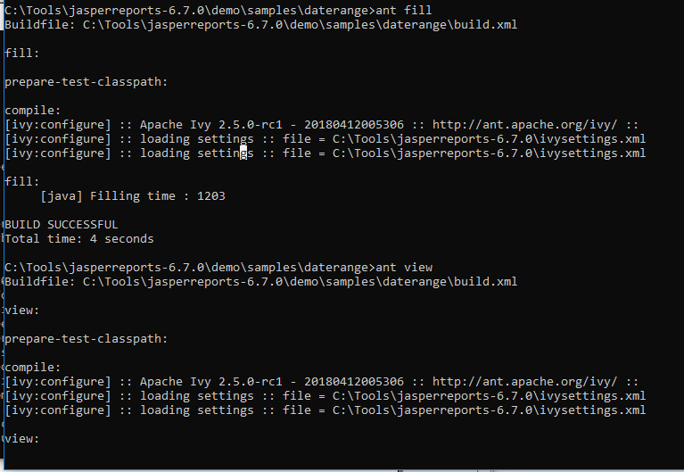
7.2 API: datarange
https://community.jaspersoft.com/wiki/jasperreports-library-first-steps
API: daterange
The ‘ant fill’ require external database server
> ant -p, ant clean, ant javac, ant compile, ant fill, ant view

Slide 11
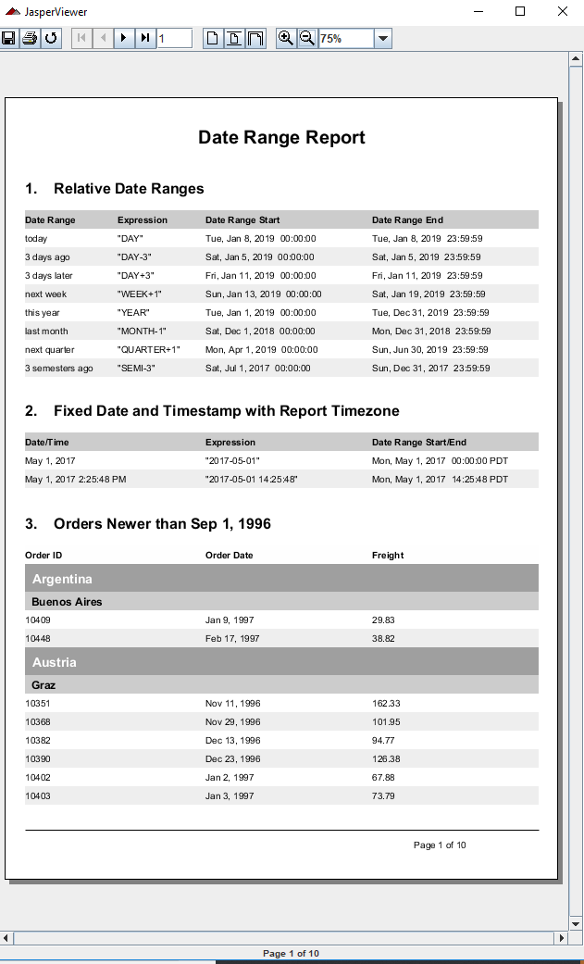
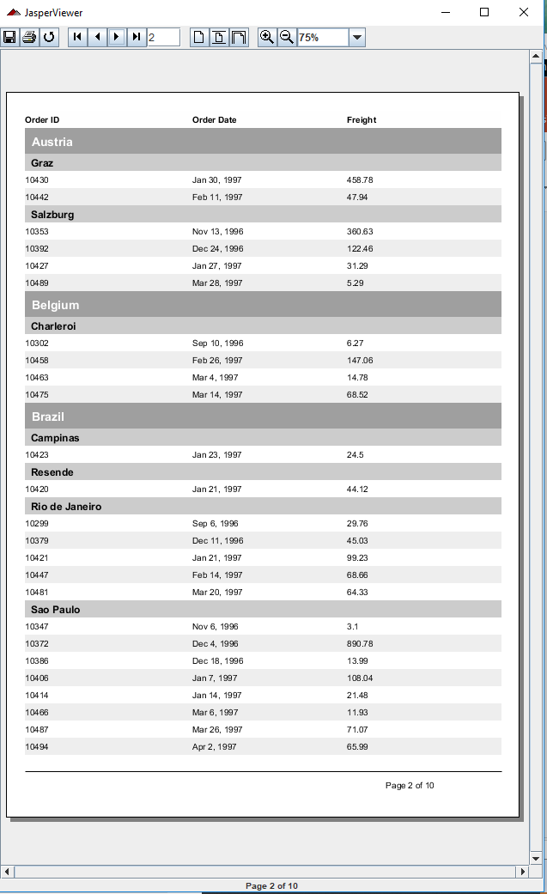
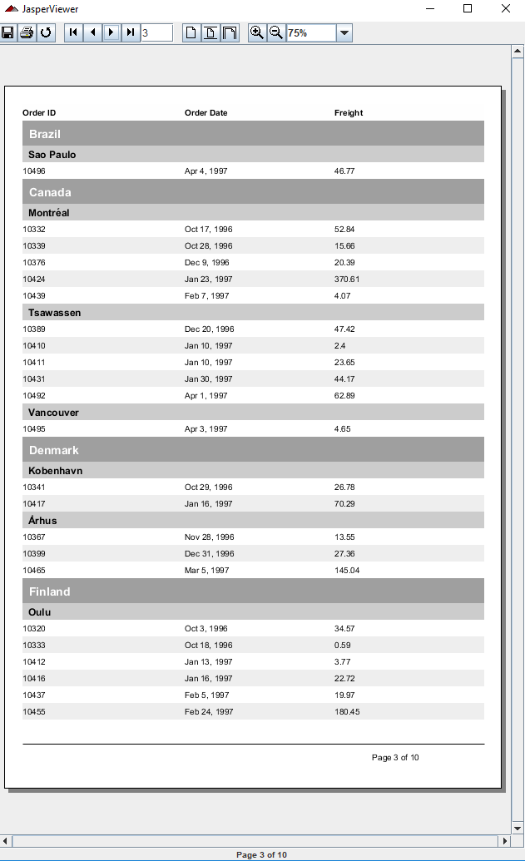
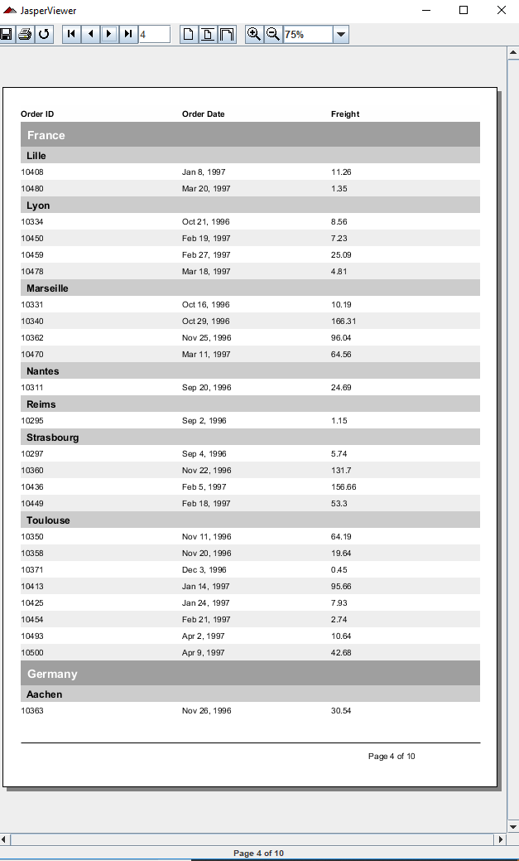
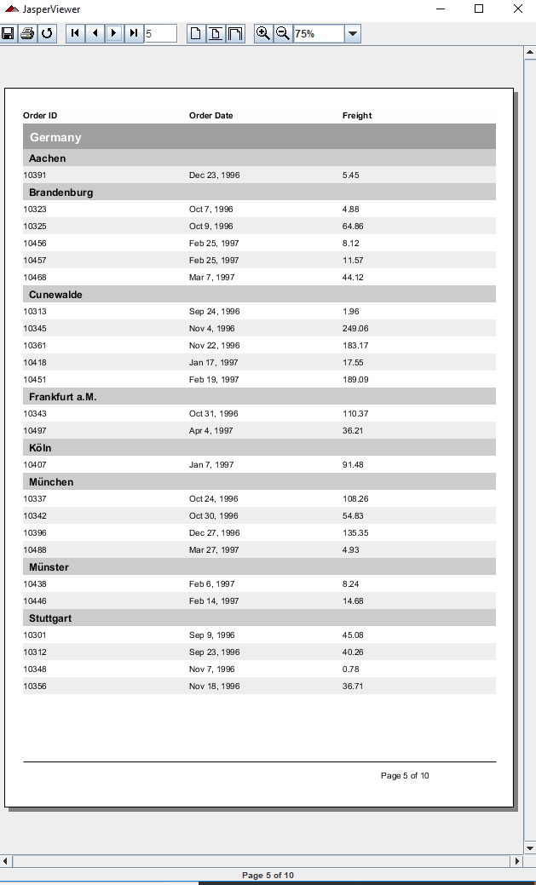
7.2 API: datarange
https://community.jaspersoft.com/wiki/jasperreports-library-first-steps
API: daterange
The ‘ant fill’ require external database server
> ant -p, ant clean, ant javac, ant compile, ant fill, ant view

Slide 12
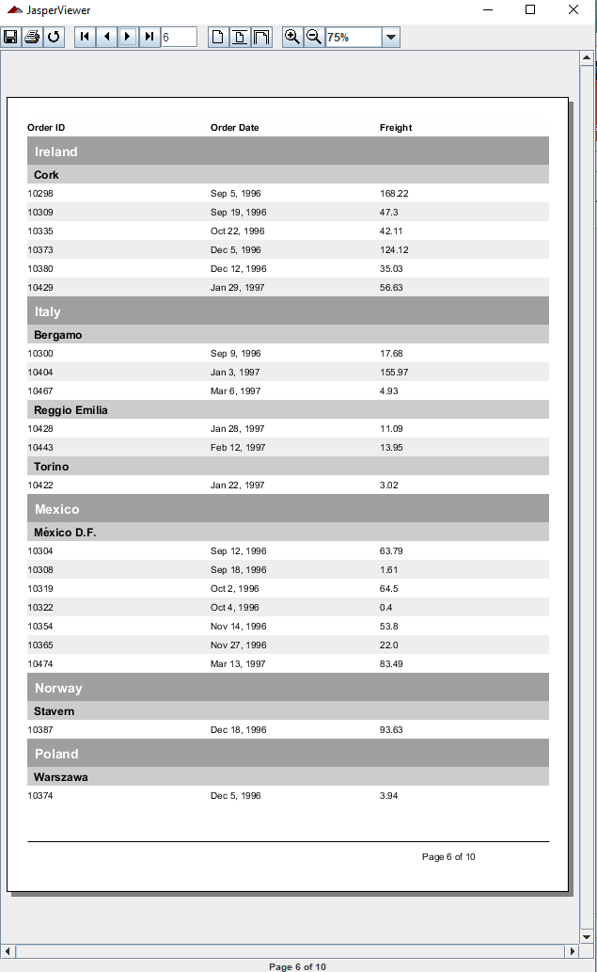
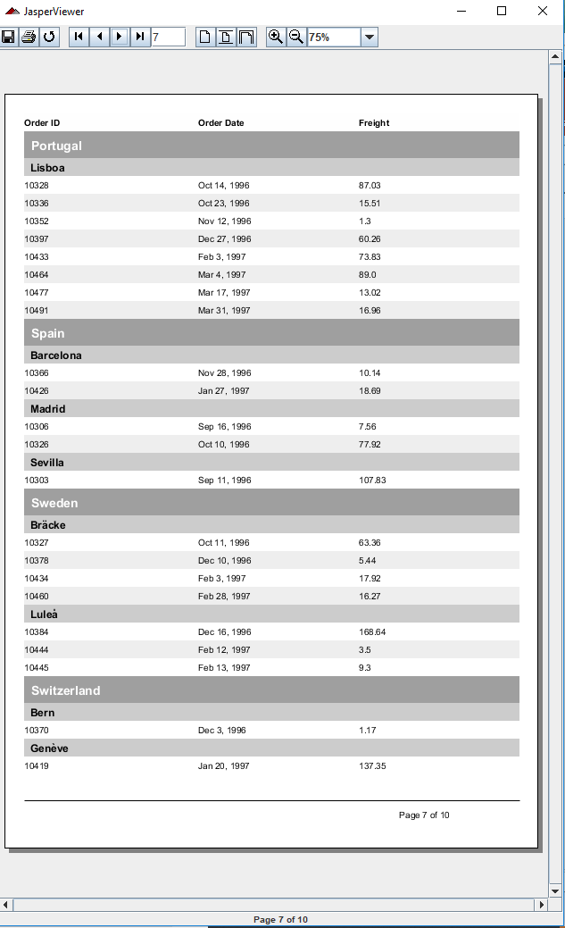
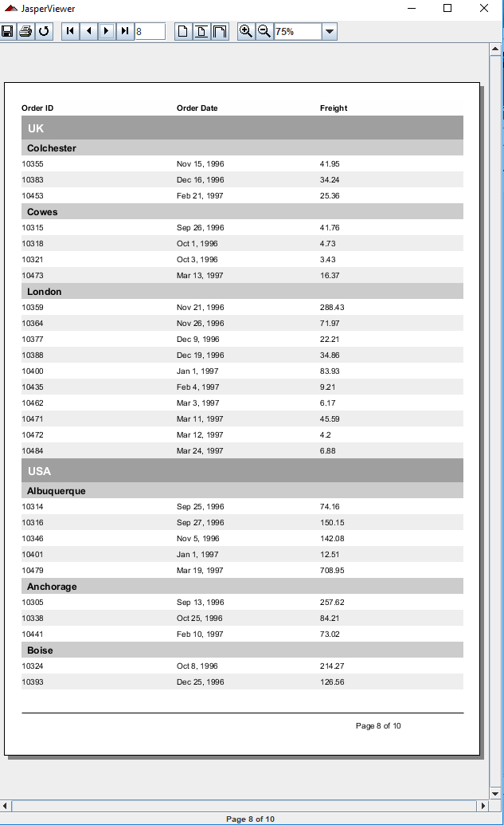
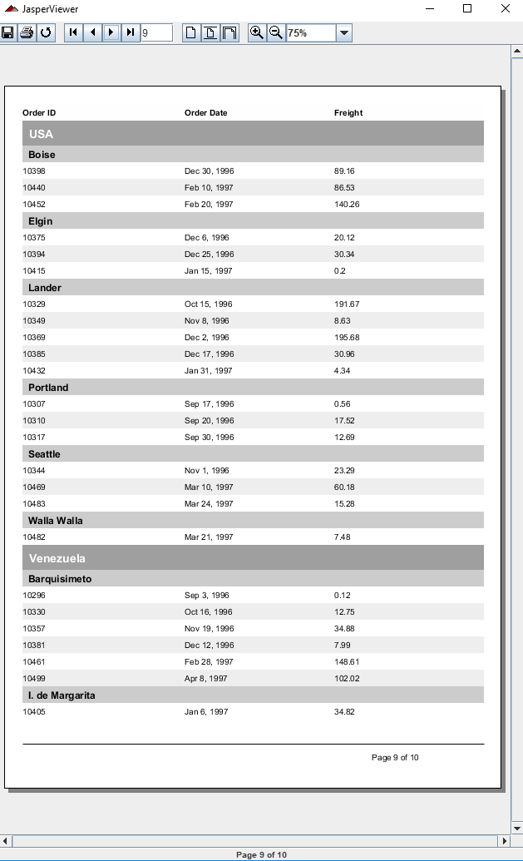
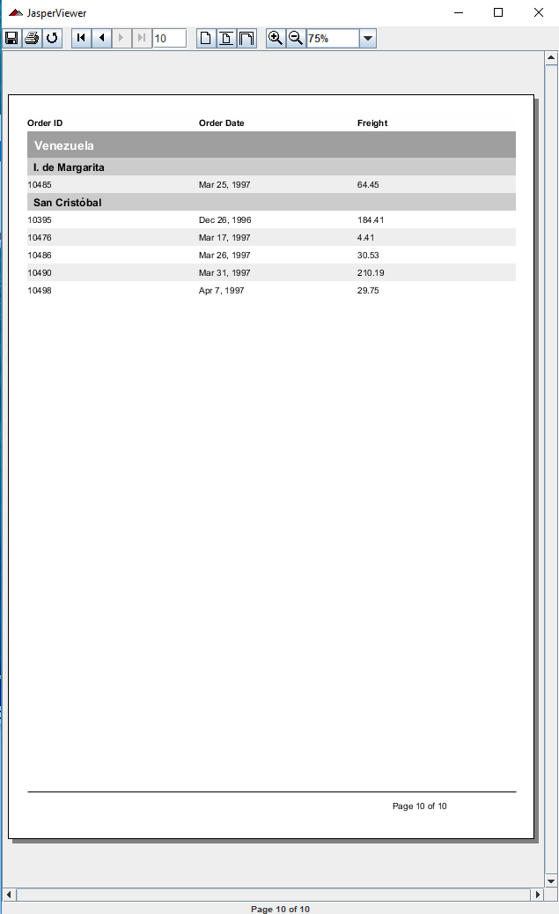
7.2 API: datarange
https://community.jaspersoft.com/wiki/jasperreports-library-first-steps
API: daterange
The ‘ant fill’ require external database server
> ant -p, ant clean, ant javac, ant compile, ant fill, ant view

Slide 13
7.3 Summary

Slide 14
7.3 Summary
https://community.jaspersoft.com/wiki/jasperreports-library-first-steps
Summary:
Data Source: Get data from
CustomDataSource
CustomTableModel
Bean Array CustomBeanFactory
Bean Collection of CustomBeanFactory.
Date Range: This API requires to run the database server ‘ant runServer’ to get the data.

Slide 15
End of Chapter

