Slide 1

5 JasperReports API: b
Peter H. Chen

Slide 2
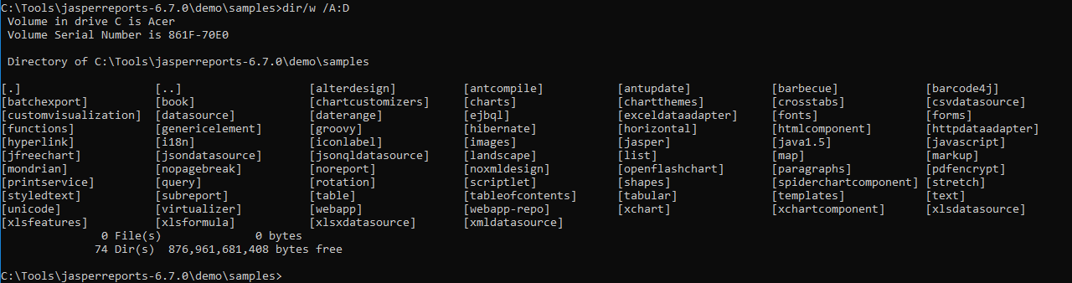
5 JasperReports API: b
https://community.jaspersoft.com/project/jasperreports-library
JasperReport API:
> dir/w /A:D # totally, we have 74 examples in Jasper Report 6.7.0

Slide 3
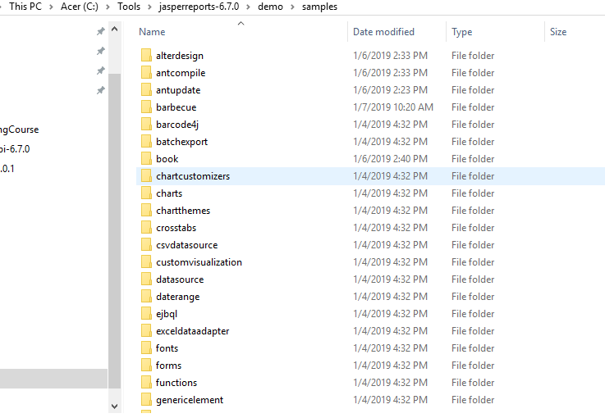
5 JasperReports API: b
https://community.jaspersoft.com/project/jasperreports-library
JasperReport API:
demo/samples/b*

Slide 4
5.1 API: barbecue

Slide 5
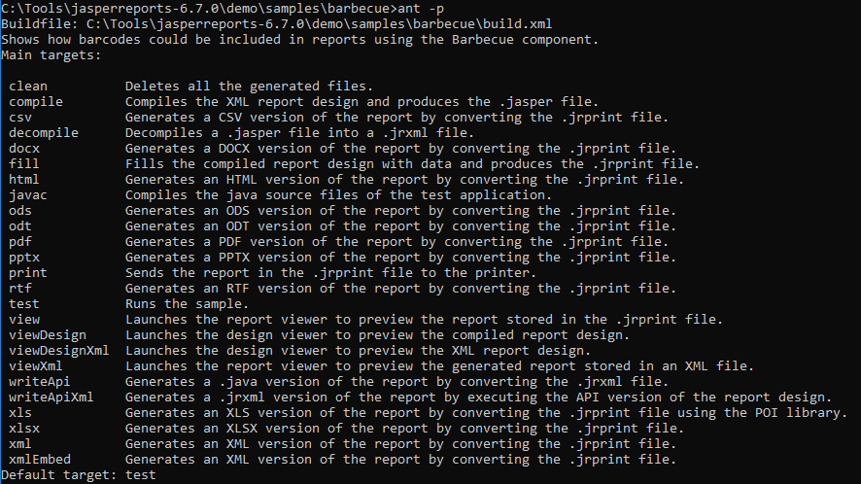
5.1 API: barbecue
https://community.jaspersoft.com/wiki/jasperreports-library-first-steps
API: barbecue
Available command: ant -p

Slide 6
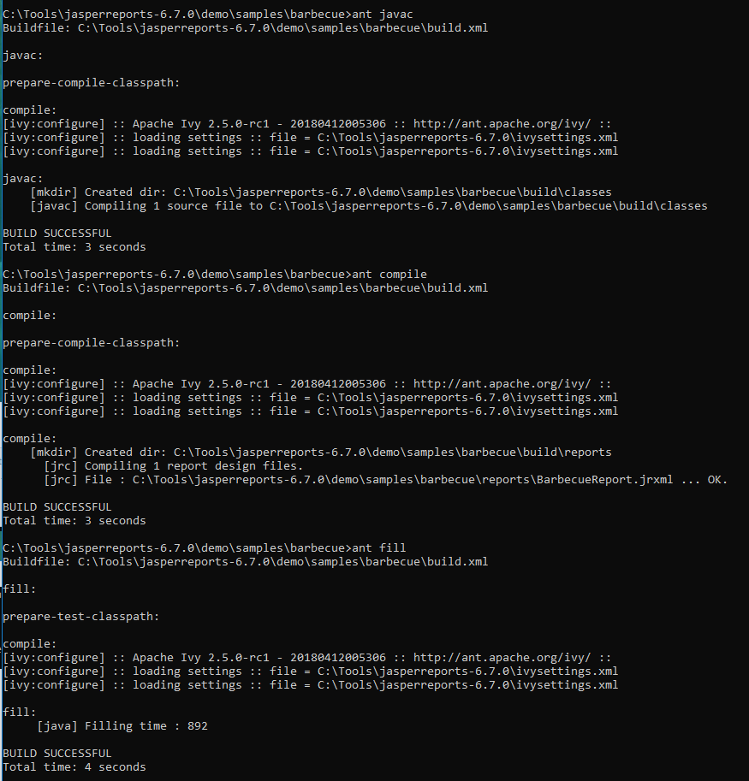
5.1 API: barbecue
https://community.jaspersoft.com/wiki/jasperreports-library-first-steps
API: barbecue
> ant clean, ant javac, ant compile, ant fill

Slide 7
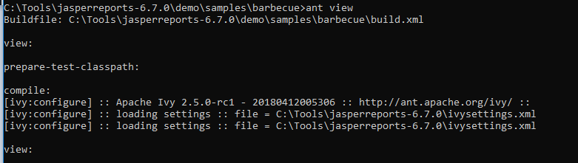
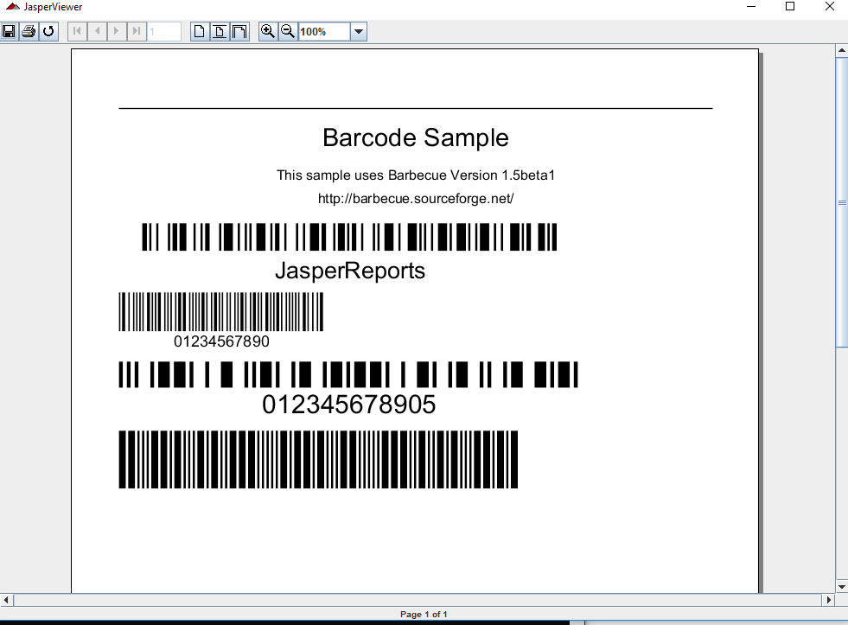
5.1 API: barbecue
https://community.jaspersoft.com/wiki/jasperreports-library-first-steps
API: barbecue
> ant view

Slide 8
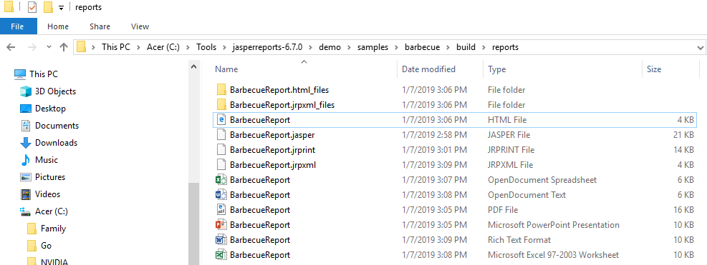
5.1 API: barbecue
https://community.jaspersoft.com/wiki/jasperreports-library-first-steps
API: barbecue
> ant html, ant xml, ant ods, ant odt, ant pdf, ant pptx, ant rtf, ant xls

Slide 9
5.2 API: barcode4j

Slide 10
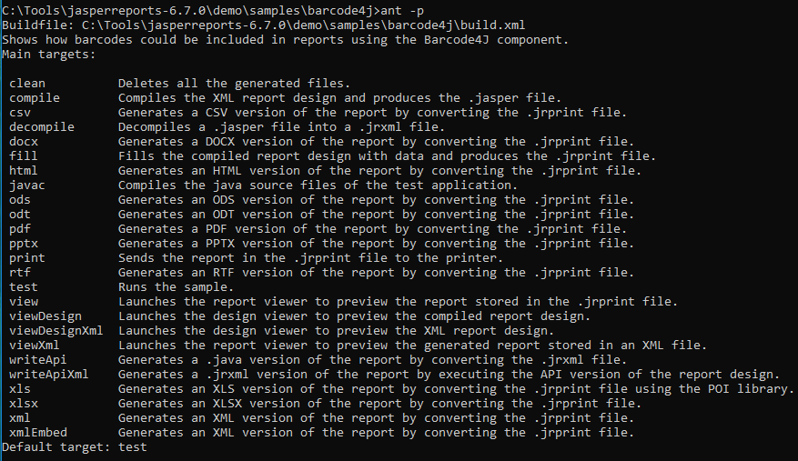
5.2 API: barcode4j
https://community.jaspersoft.com/wiki/jasperreports-library-first-steps
API: barcode4j
> ant -p

Slide 11
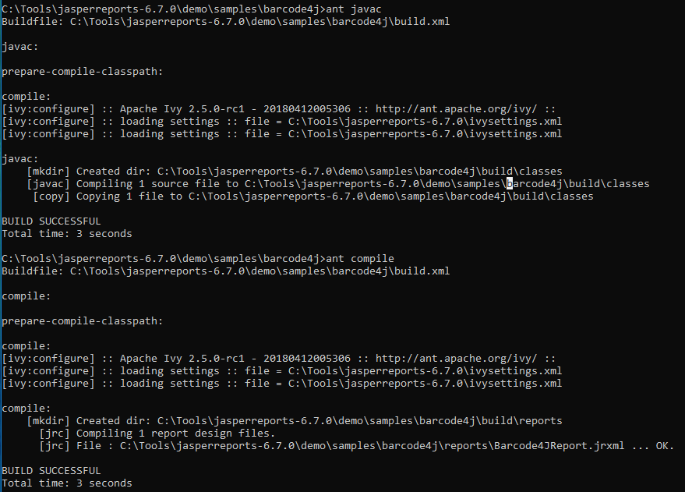
5.2 API: barcode4j
https://community.jaspersoft.com/wiki/jasperreports-library-first-steps
API: barcode4j
> ant clean, ant javac, ant compile

Slide 12
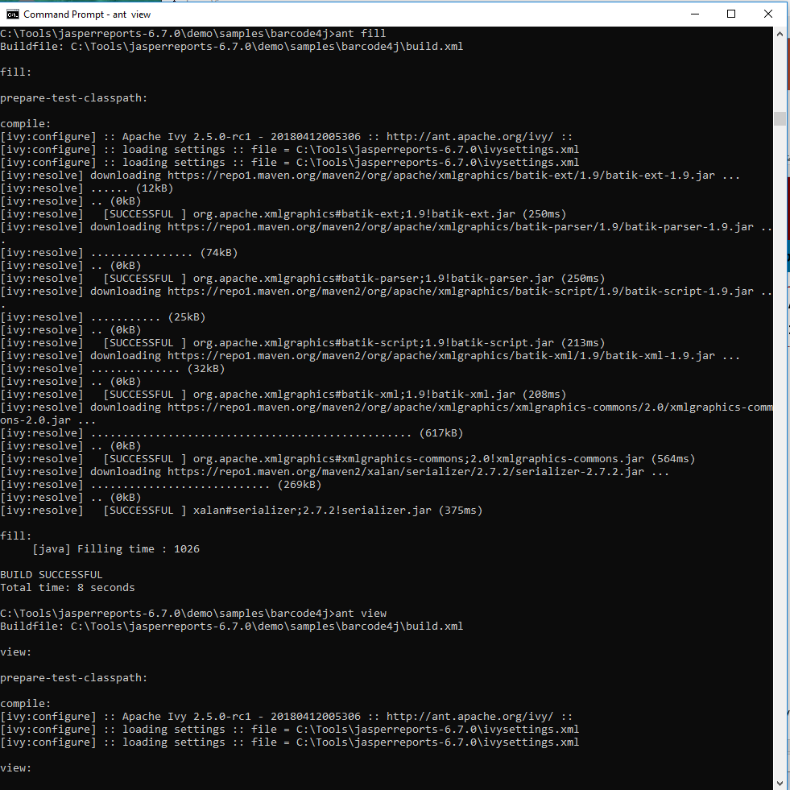
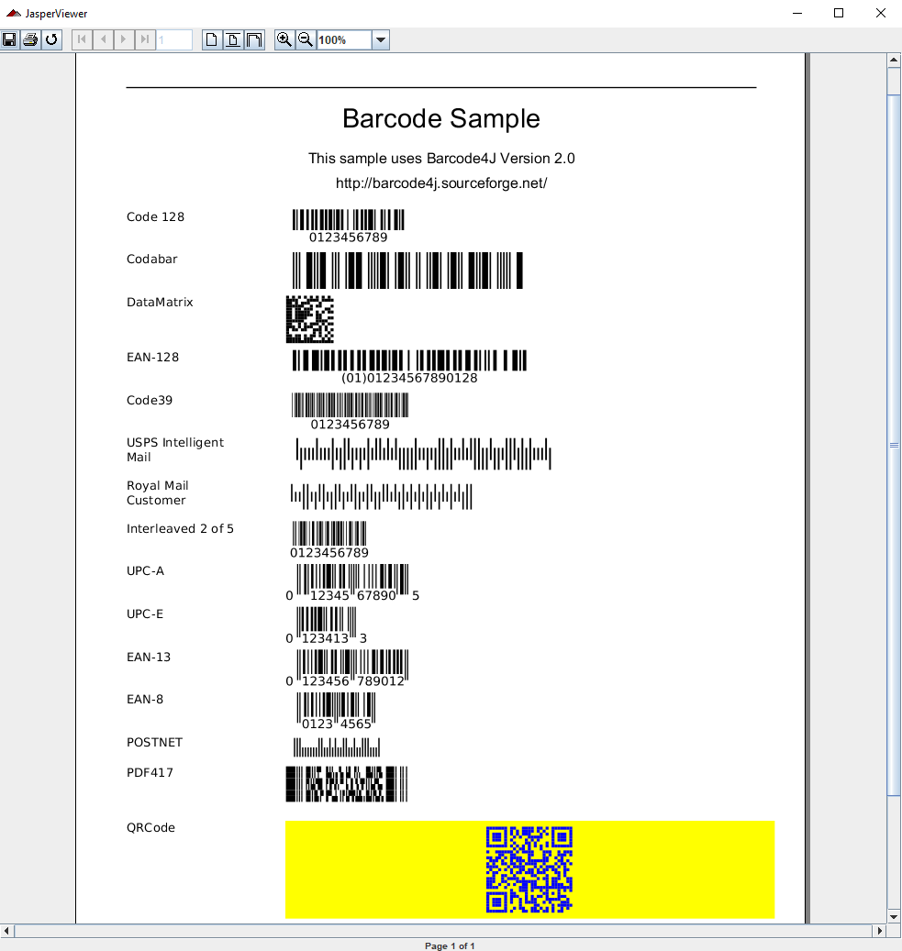
5.2 API: barcode4j
https://community.jaspersoft.com/wiki/jasperreports-library-first-steps
API: barcode4j
> ant fill, ant view

Slide 13
5.3 API: batchexport

Slide 14
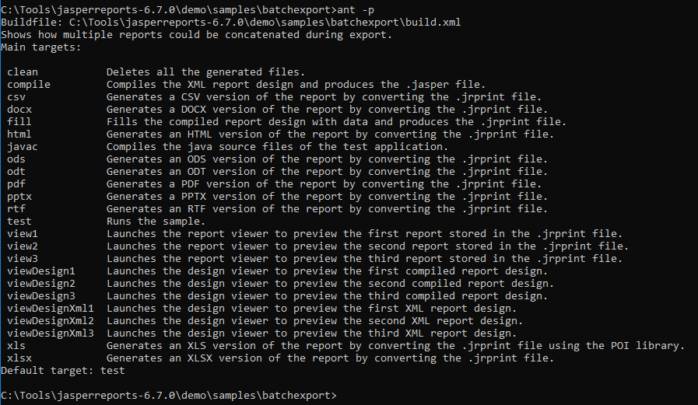
5.3 API: batchexport
https://community.jaspersoft.com/wiki/jasperreports-library-first-steps
API: batchexport
> ant -p

Slide 15
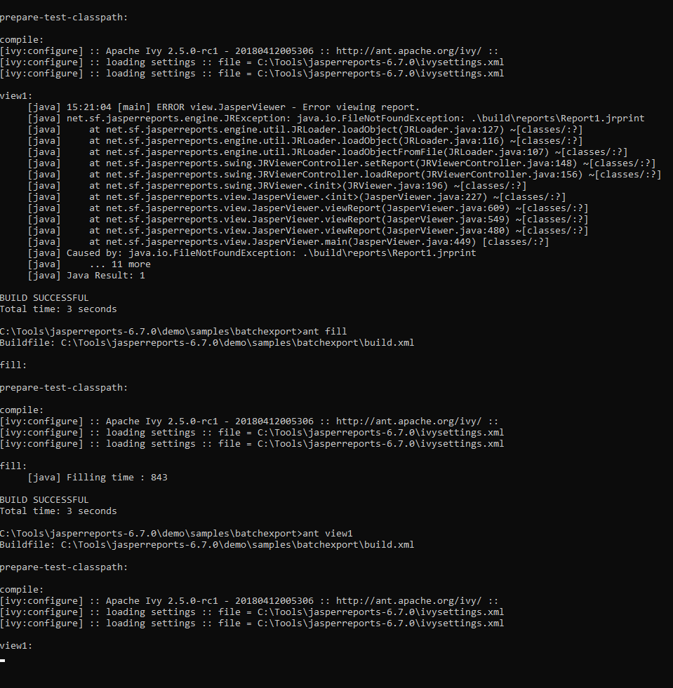
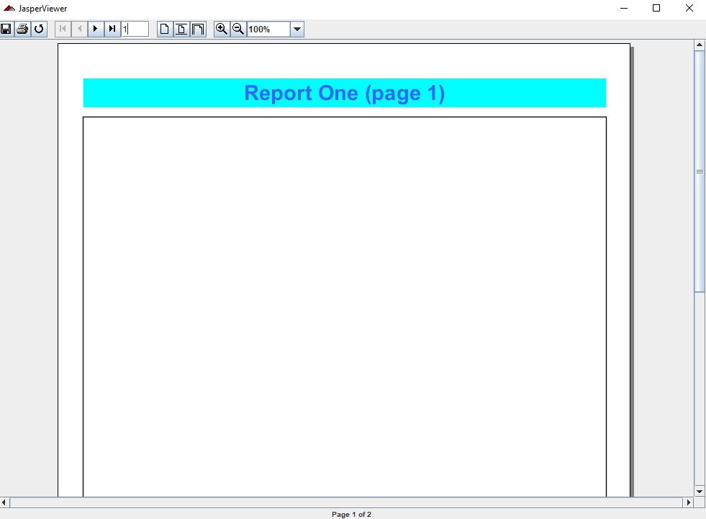
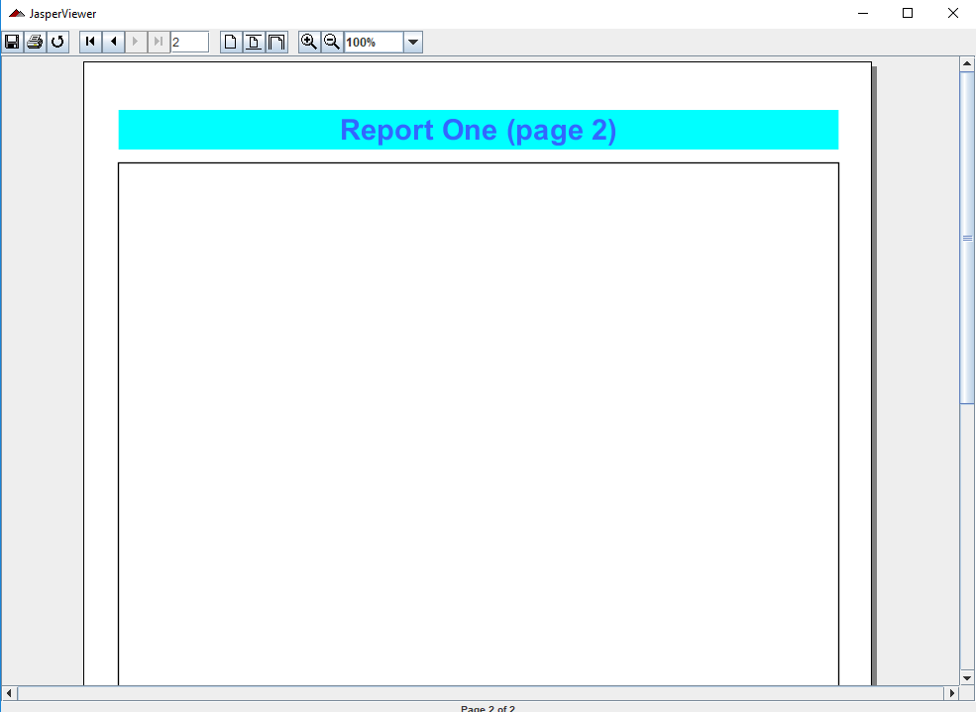
5.3 API: barcode4j
https://community.jaspersoft.com/wiki/jasperreports-library-first-steps
API: batchexport
> ant clean, ant javac, ant compile, ant fill, ant view1

Slide 16
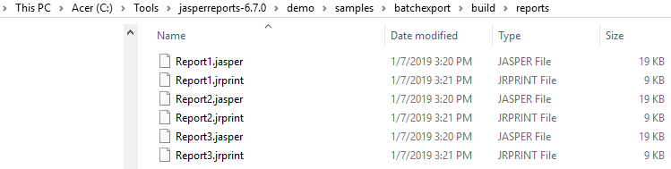
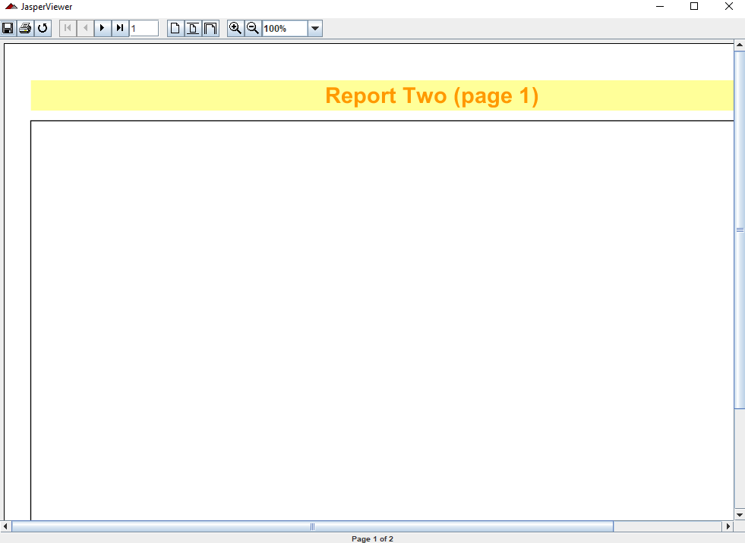
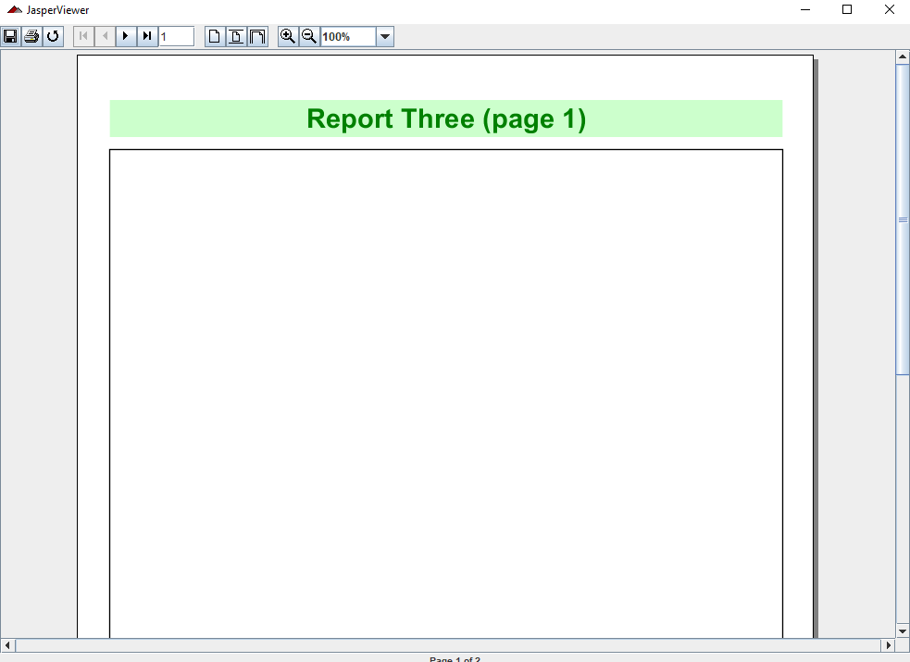
5.3 API: barcode4j
https://community.jaspersoft.com/wiki/jasperreports-library-first-steps
API: barcode4j
> ant view1, ant view2, ant view3

Slide 17
5.4 API: book

Slide 18
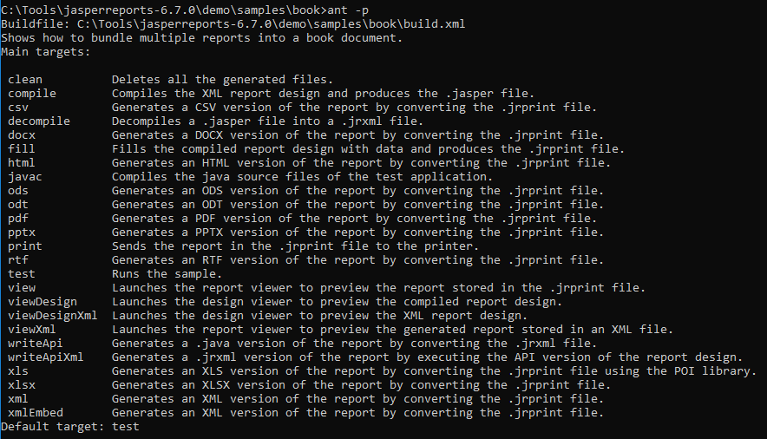
5.4 API: book
https://community.jaspersoft.com/wiki/jasperreports-library-first-steps
API: book
> ant -p

Slide 19
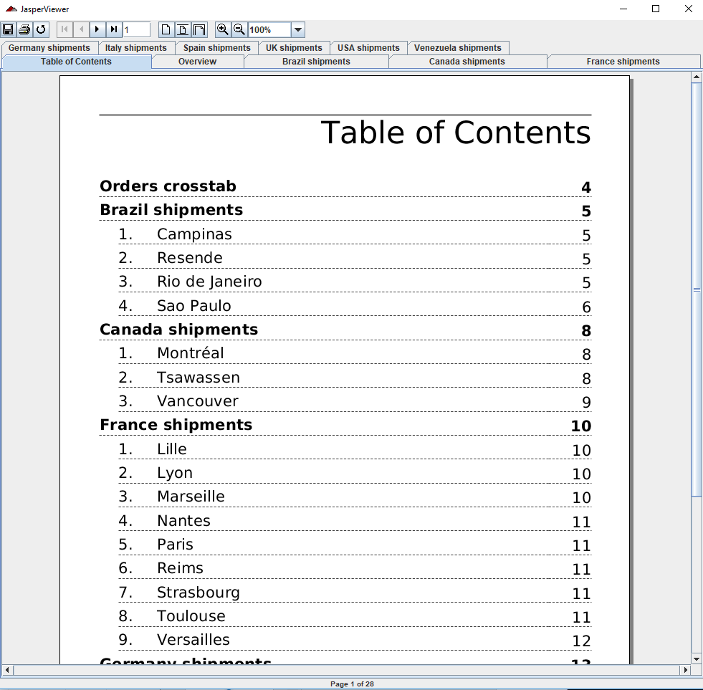
5.4 API: book
https://community.jaspersoft.com/wiki/jasperreports-library-first-steps
API: book
> ant –p, ant clean, ant javac, ant compile, ant fill, ant view

Slide 20
5.5 Summary

Slide 21
5.5 Summary
https://community.jaspersoft.com/wiki/jasperreports-library-first-steps
This chapter go through the API:
Barbecue: Generate PDF, XML, XLS, PPTX, and etc format.
Barcode4j: Generate different barcode formats:
Batchexport: Generate different colors of in different reports.
Book: Display Table of Content for a book.

Slide 22
End of Chapter

