Slide 1

13 JasperReports API: j
Peter H. Chen

Slide 2
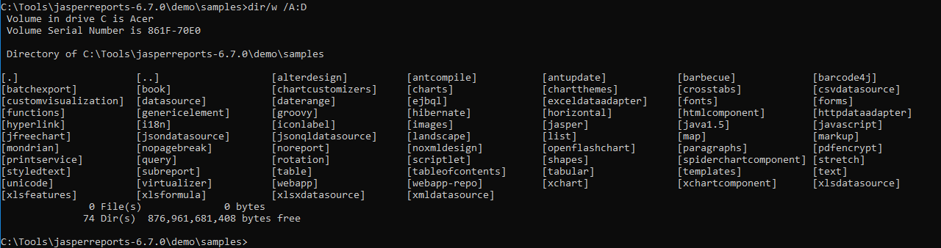
13 JasperReports API: j
https://community.jaspersoft.com/project/jasperreports-library
JasperReport API:
> dir/w /A:D # totally, we have 74 examples in Jasper Report 6.7.0

Slide 3
13.1 API: jasper

Slide 4
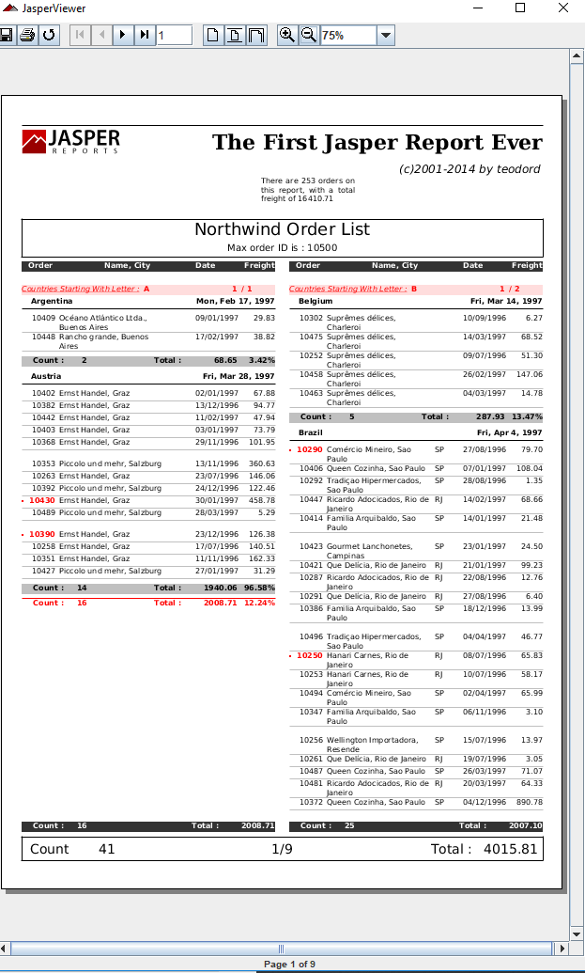
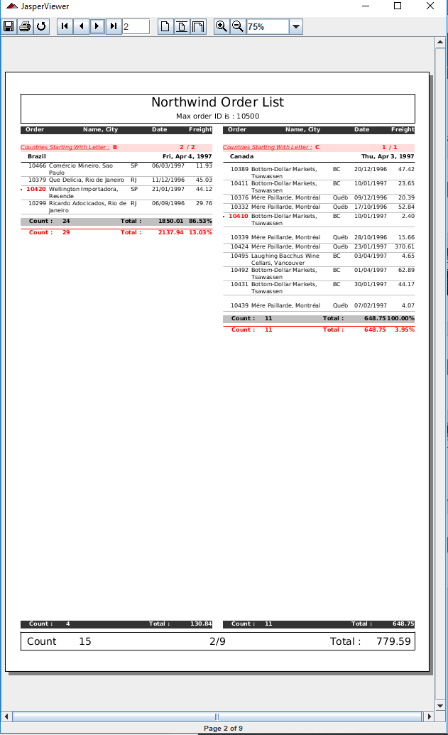
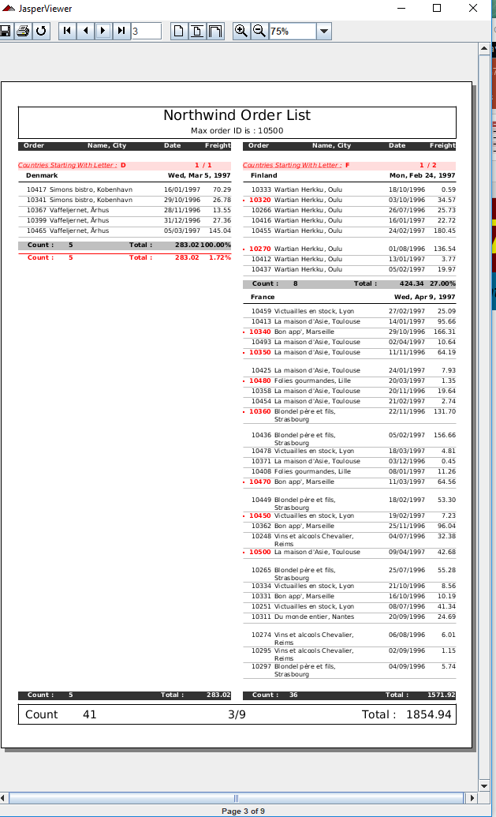
13.1 API: jaspers
https://community.jaspersoft.com/wiki/jasperreports-library-first-steps
API: Jasper
> ant -p, ant clean, ant javac, ant compile, ant fill, ant view

Slide 5
13.2 API: java 1.5

Slide 6
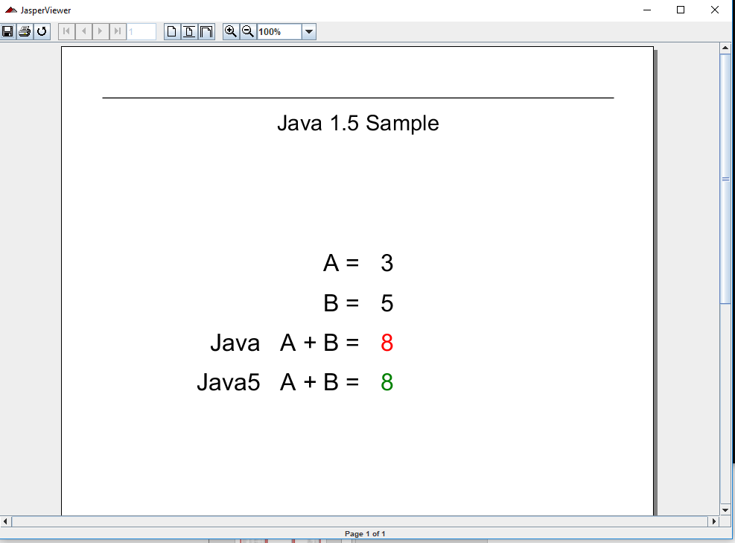
13.2 API: java 1.5
https://community.jaspersoft.com/wiki/jasperreports-library-first-steps
API: Java 1.5
> ant -p, ant clean, ant javac, ant compile, ant fill, ant view

Slide 7
13.3 API: javascript

Slide 8
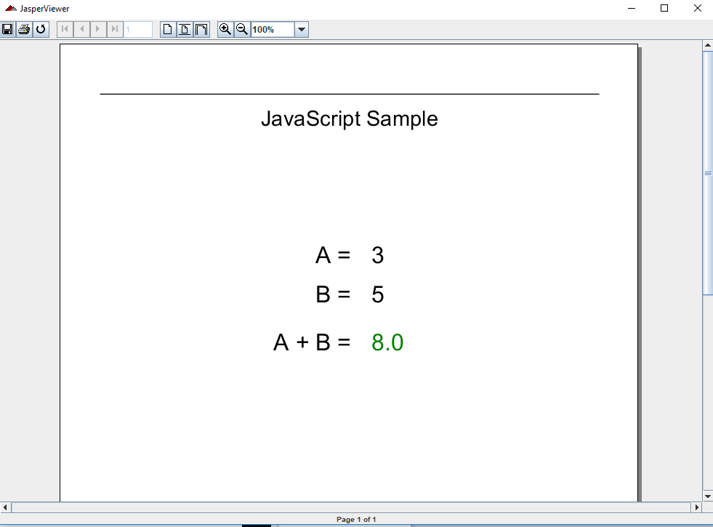
13.3 API: javascrpt
https://community.jaspersoft.com/wiki/jasperreports-library-first-steps
API: Javascript
> ant -p, ant clean, ant javac, ant compile, ant fill, ant view

Slide 9
13.4 API: jfreechart

Slide 10
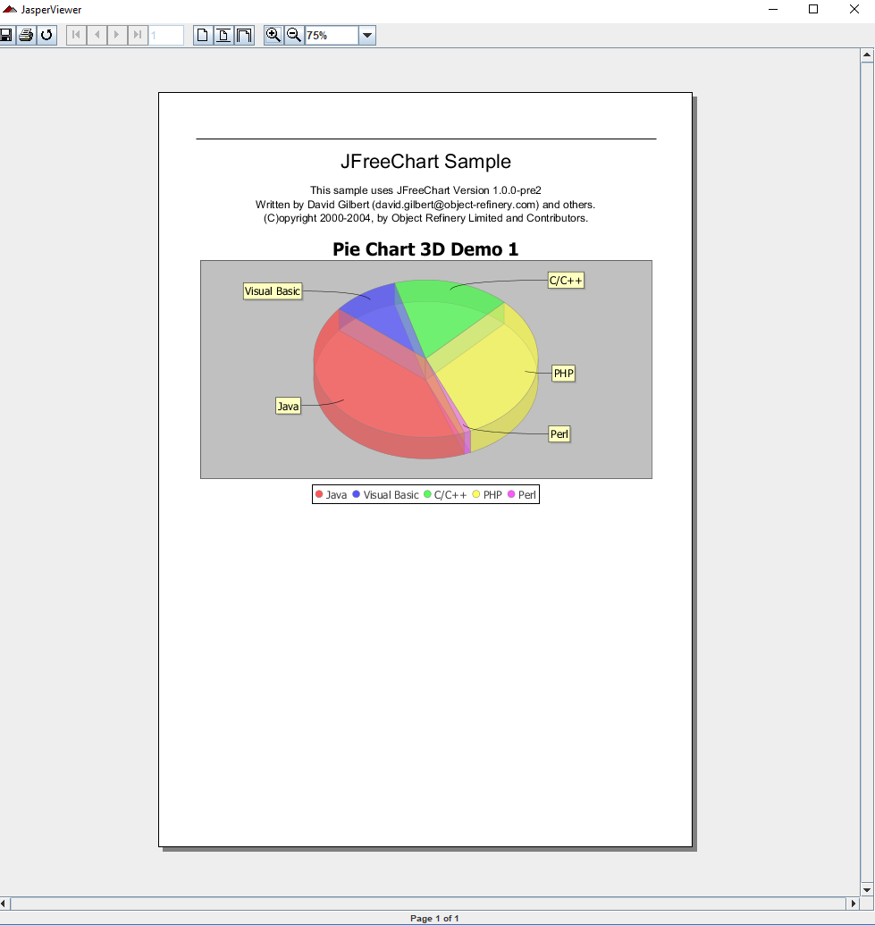
13.4 API: jfreechart
https://community.jaspersoft.com/wiki/jasperreports-library-first-steps
API: jfreechart
> ant -p, ant clean, ant javac, ant compile, ant fill, ant view

Slide 11
13.5 API: jfreechart

Slide 12
13.5 API: jfreechart
https://community.jaspersoft.com/wiki/jasperreports-library-first-steps
API: jfreechart
> ant -p, ant clean, ant javac, ant compile, ant fill, ant view

Slide 13
13.6 API: jsondatasource

Slide 14
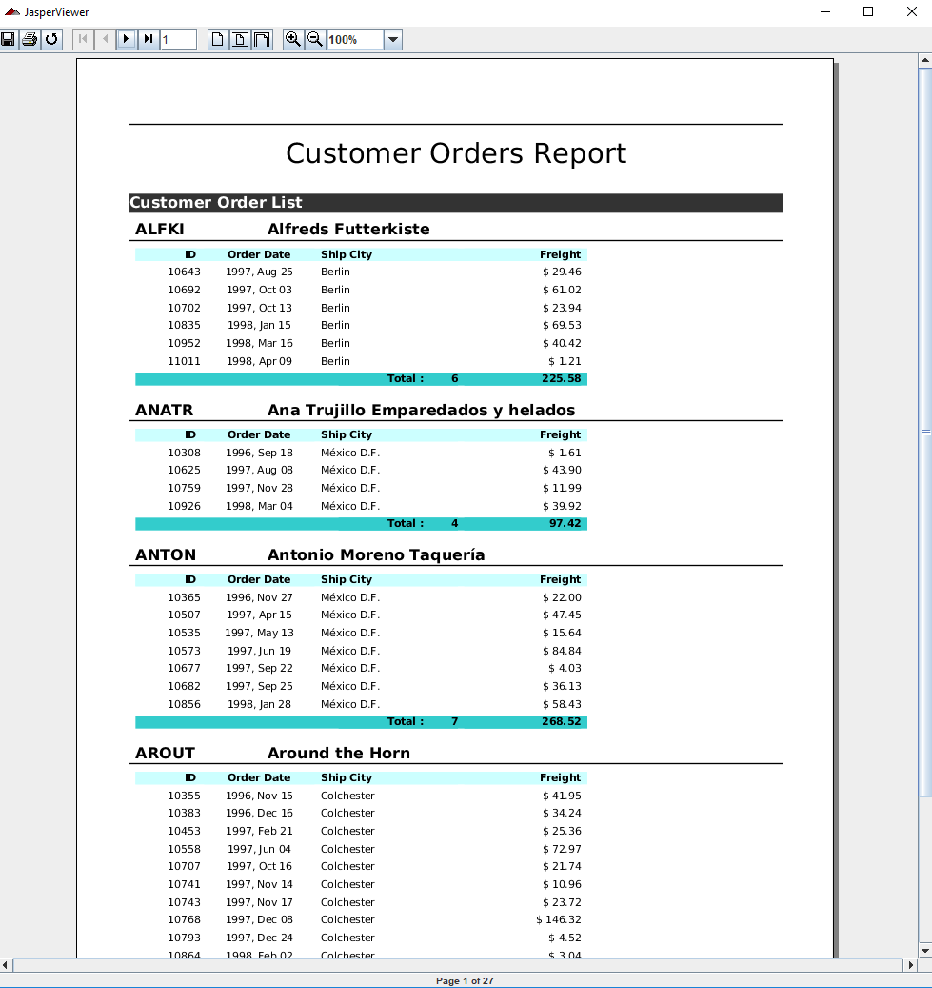
13.5 API: jsondatasource
https://community.jaspersoft.com/wiki/jasperreports-library-first-steps
API: jsondatasource
> ant -p, ant clean, ant javac, ant compile, ant fill, ant view

Slide 15
End of Chapter

