Slide 1

23 Crosstab
Peter H. Chen

Slide 2
23 Crosstab
https://www.tutorialspoint.com/jasper_reports/index.htm
This chapter discusses the Style.
Design Phase
(Create JRXML File)
Execute Phase
[Fill Jasper Template with Data to Generate Jasper Print File (xxx.jrprint)]
Compile Phase
(Compile JRXML to Jasper Template)
Export Phase
[Export the Report to Any Specified Format]

Slide 3
23 Crosstab
https://www.tutorialspoint.com/jasper_reports/index.htm
Crosstab (cross-tabulation) reports are the reports containing tables that arrange data across rows and columns in a tabular form.
Crosstab object is used for inserting a crosstab report within the main report. Crosstabs can be used with any level of data (nominal, ordinal, interval, or ratio), and usually display the summarized data, contained in the report variables, in the form of a dynamic table.
Variables are used to display aggregate data such as sums, counts, average values.
Crosstab Properties
JRXML element <crosstab> is used to insert a crosstab into a report.

Slide 4
23 Crosstab
https://www.tutorialspoint.com/jasper_reports/index.htm
Attribute
Following is a list of attribute of a <crosstab> element −
isRepeatColumnHeaders − Indicates whether the column headers should be reprinted after a page break. The default value is true.
isRepeatRowHeaders − Indicates whether the row headers should be reprinted after a crosstab column break. The default value is true.
columnBreakOffset − When a column break occurs, indicates the amount of vertical space, measured in pixels, before the subsequent crosstab piece to be placed below the previous one on the same page. The default value is 10.
runDirection − Indicates whether the crosstab data should be filled from left to right (LTR) or from right to left (RTL). The default value is LTR.
ignoreWidth − Indicates whether the crosstab will stretch beyond the initial crosstab width limit and don't generate column breaks. Else it will stop rendering columns within the crosstab width limit and continue with the remaining columns only after all rows have started rendering. The default value is false.

Slide 5
23 Crosstab
https://www.tutorialspoint.com/jasper_reports/index.htm
Sub Elements (1)
A <crosstab> element has following sub elements −
<reportElement> − This element defines the position, width, and height of the crosstab within its enclosing. Attributes for this element include all standard <reportElement> attributes.
<crosstabParameter> − This element is used to access report variables and parameters from within the crosstab. Attributes for this element include
name − This defines the parameter name.
class − This indicates the parameter class.
<parametersMapExpression> − This element is used to pass a report variable or parameter containing an instance of java.util.Map, as a set of parameters for the crosstab. This element contains no attributes.

Slide 6
23 Crosstab
https://www.tutorialspoint.com/jasper_reports/index.htm
Sub Elements (2)
<crosstabDataset> − This element defines the dataset to use to populate the crosstab (see next section for a detailed explanation). Attributes for this element include −
isDataPreSorted − This indicates whether the data in the dataset is pre-sorted. Default value is false.
<crosstabHeaderCell> − This element defines the content of the region found at the upper-left corner of the crosstab where column headers and row headers meet. The size of this cell is calculated automatically based on the defined row and column widths and heights.

Slide 7
23 Crosstab
https://www.tutorialspoint.com/jasper_reports/index.htm
Sub Elements (3)
<rowGroup> − This element defines a group used to split the data into rows. Attributes for this element include −
name − This defines the name of the row group.
width − This defines the width of the row group.
headerPosition − This defines the position of the header contents (Top, Middle, Bottom, Stretch).
totalPosition − This defines the position of the entire column (Start, End, None).
This element contains the following sub elements −
<bucket>
<crosstabRowHeader>
<crosstabTotalRowHeader>

Slide 8
23 Crosstab
https://www.tutorialspoint.com/jasper_reports/index.htm
Sub Elements (4)
<columnGroup> − This element defines a group used to split the data into columns. Attributes for this element include −
name − This defines the column group name.
height − This defines the height of the column group header.
headerPosition − This defines the position of the header contents (Right, Left, Center, Stretch).
totalPosition − This defines the position of the entire column (Start, End, None).
This element contains the following sub elements −
<bucket>
<crosstabColumnHeader>
<crosstabTotalColumnHeader>

Slide 9
23 Crosstab
https://www.tutorialspoint.com/jasper_reports/index.htm
Sub Elements (5)
<measure> − This element defines the calculation to be performed across rows and columns. Attributes for this element include −
name − This defines the measure name.
class − This indicates the measure class.
calculation − This indicates the calculation to be performed between crosstab cell values. Its values could be any of these - Nothing, Count, DistinctCount, Sum, Average, Lowest, Highest, StandardDeviation, Variance, and First. Default value is Nothing.
<crosstabCell> − This element defines how data in non-header cells will be laid out. Attributes for this element include −
columnTotalGroup − This indicates the group to use to calculate the column total.
height − This defines the height of the cell.
rowTotalGroup − This indicates the group to use to calculate the row total.
width − This defines the width of the cell.

Slide 10
23 Crosstab
https://www.tutorialspoint.com/jasper_reports/index.htm
Sub Elements (6)
<whenNoDataCell> − This element defines what to display on an empty crosstab cell. This element contains no attributes.

Slide 11
23 Crosstab
https://www.tutorialspoint.com/jasper_reports/index.htm
Data Grouping in Crosstab
The crosstab calculation engine aggregates data by iterating through the associated dataset records. In order to aggregate data, one needs to group them first. In a crosstab, rows and columns are based on specific group items, called buckets. A bucket definition should contain −
bucketExpression − The expression to be evaluated in order to obtain data group items.
comparatorExpression − Needed in the case the natural ordering of the values is not the best choice.
orderByExpression − Indicates the value used to sort data.
Row and column groups (defined above) in a crosstab rely on buckets.

Slide 12
23 Crosstab
https://www.tutorialspoint.com/jasper_reports/index.htm
Built-In Crosstab Total Variables
Below is a list of current value of measure and totals of different levels corresponding to the cell can be accessed through variables named according to the following scheme −
The current value of a measure calculation is stored in a variable having the same name as the measure.
<Measure>_<Column Group>_ALL − This yields the total for all the entries in the column group from the same row.
<Measure>_<Row Group>_ALL − This yields the total for all the entries in the row group from the same column.
<Measure>_<Row Group>_<Column Group>_ALL − This yields the combined total corresponding to all the entries in both row and column groups.

Slide 13
23.1 jasper_report_template.jrxml

Slide 14
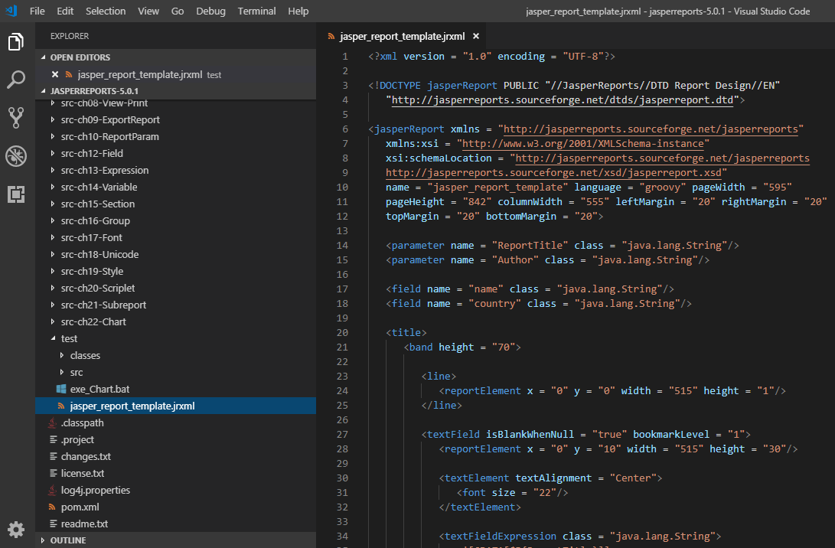
23.1 jasper_report_template.jrxml
https://www.tutorialspoint.com/jasper_reports/index.htm
Write jasper_report_template.jrxml. Add the crosstab to summary section.
Save jasper_report_template.jrxml to the directory C:\tools\jasperreports-5.0.1\test. The contents of the file are as given below

Slide 15
23.1 jasper_report_template.jrxml
https://www.tutorialspoint.com/jasper_reports/index.htm
The details of the above file are as follows (1) −
Crosstab is defined by the <crosstab> element.
<rowGroup> element defines a group to split the data into rows. Here, each row will display data for a different name.
The <bucket> and <bucketExpression> elements define what report expression to use as a group delimiter for <rowGroup>. Here, we used the name field as a delimiter, in order to split the rows by name.
The <crosstabRowHeader> element defines the expression to be used as a row header. It contains a single sub-element, namely <cellContents>, which acts like an inner band inside crosstab. Instead of defining variable name for the text field inside <crosstabRowHeader>, we have assigned the name to <rowGroup> (via its name attribute), hence it creates an implicit variable. The <crosstabRowHeader> element defines the contents of the header cell for the entire row. It takes a single <cellContents> element as its only sub-element.

Slide 16
23.1 jasper_report_template.jrxml
https://www.tutorialspoint.com/jasper_reports/index.htm
The details of the above file are as follows (2) −
The <columnGroup> element as well as its sub-elements is analogous to the <rowGroup> element, except that it influences columns instead of rows.
The <measure> element defines the calculation to be performed across rows and columns. The calculation attribute is set to Count.
The <crosstabCell> element defines how data in non-header cells will be laid out. This element also contains a single <crosstabCell> element as its only sub-element.

Slide 17
23.2 JasperReportFill.java

Slide 18
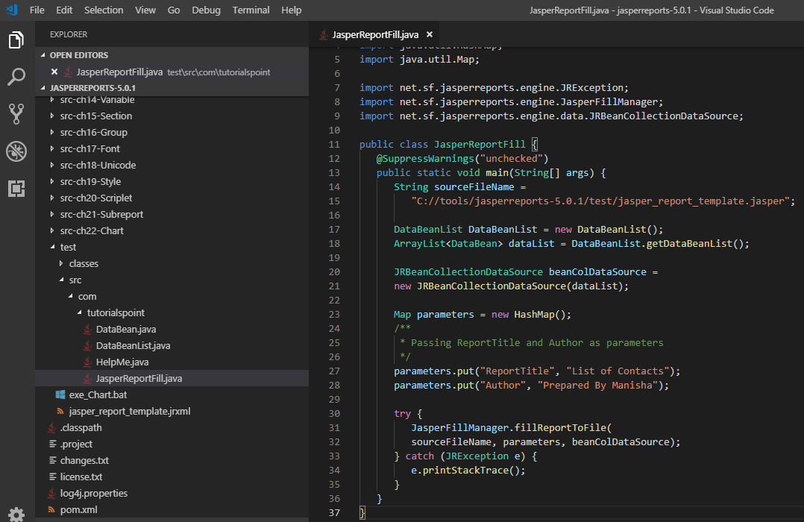
23.2 JasperReportFill.java
https://www.tutorialspoint.com/jasper_reports/index.htm
The java codes for report filling remains unchanged.
The contents of the file C:\tools\jasperreports-5.0.1\test\src\com\tutorialspoint\JasperReportFill.java are as given below

Slide 19
23.3 POJO DataBean.java

Slide 20
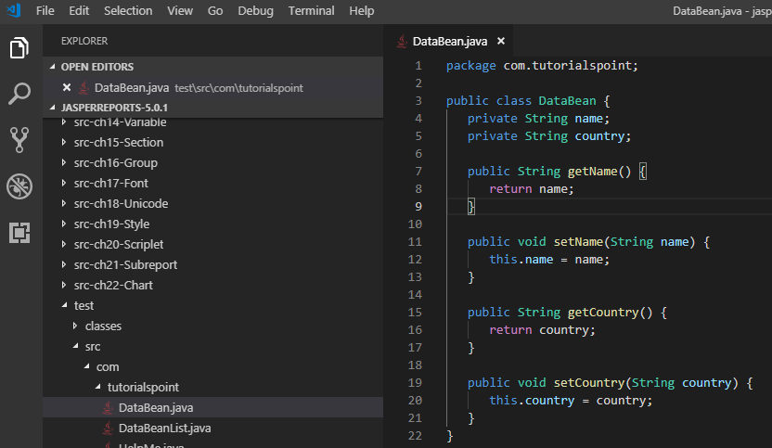
23.3 DataBean.java
https://www.tutorialspoint.com/jasper_reports/index.htm
DataBean.java

Slide 21
23.4 DataBeanList.java

Slide 22
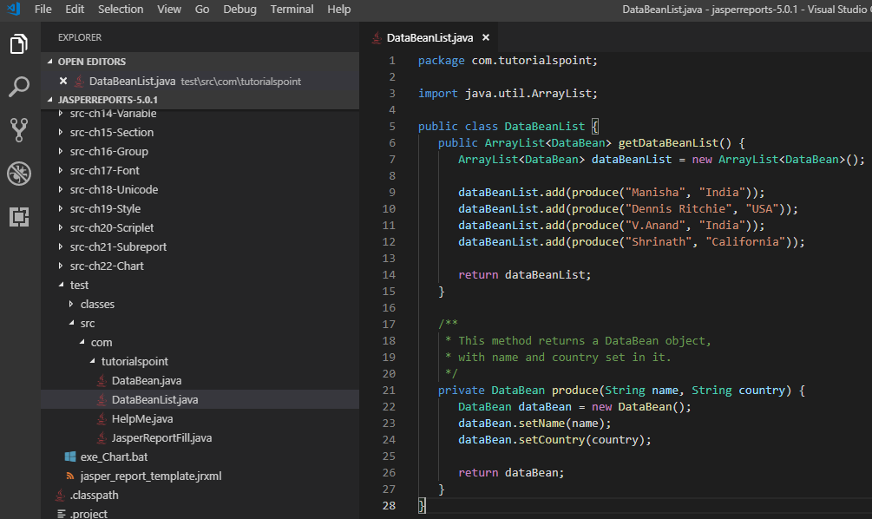
23.4 DataBeanList.java
https://www.tutorialspoint.com/jasper_reports/index.htm
DataBeanList.java

Slide 23
23.5 buid_Crosstab.xml

Slide 24
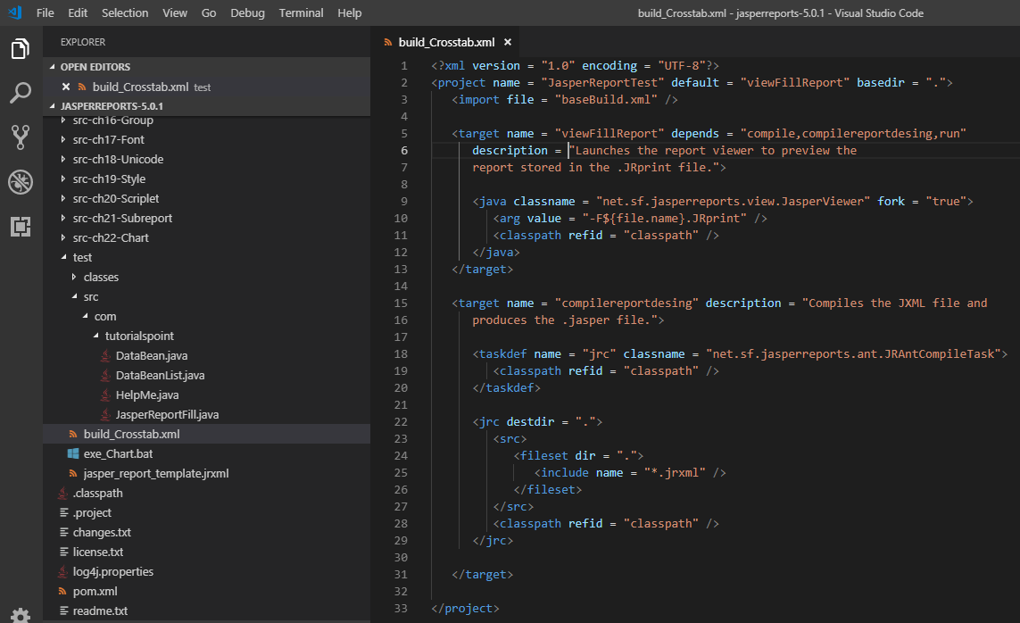
23.5 build_Crosstab.xml
https://www.tutorialspoint.com/jasper_reports/index.htm
Build_Crosstab.xml

Slide 25
23.6 exe_Crosstab.bat

Slide 26
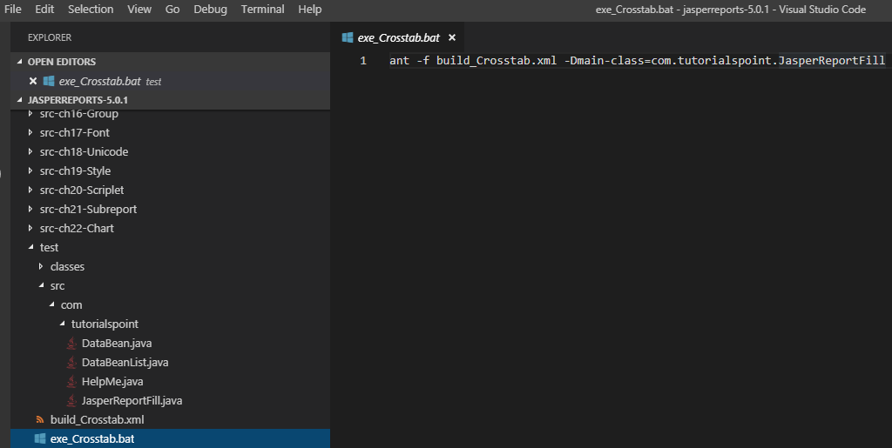
23.6 exe_Crosstab.bat
https://www.tutorialspoint.com/jasper_reports/index.htm
Exe_Crosstab.bat

Slide 27
23.7 Run exe_Crosstab.bat

Slide 28
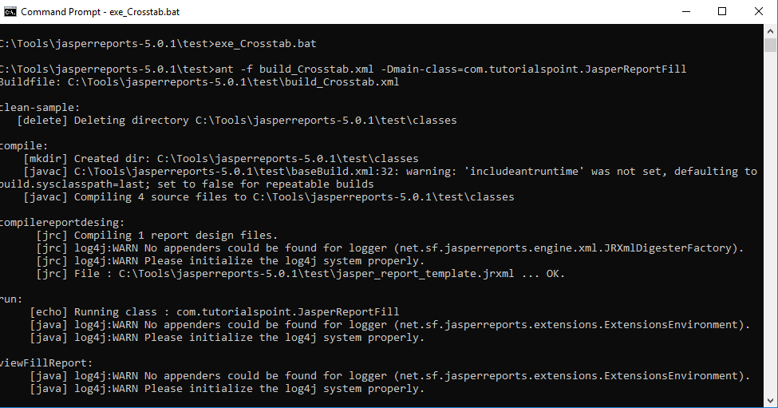
23.7 Run exe_Crosstab.bat
https://www.tutorialspoint.com/jasper_reports/index.htm
Run exe_Crosstab.bat

Slide 29
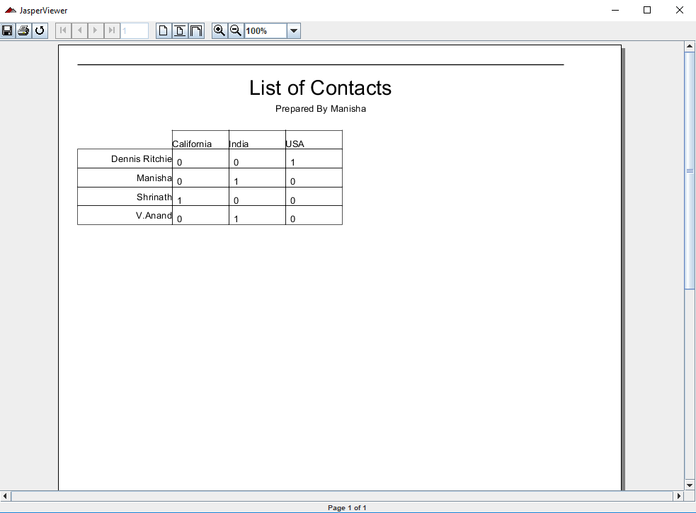
23.7 Run exe_Crosstab.bat
https://www.tutorialspoint.com/jasper_reports/index.htm
Run exe_Crosstab.bat

Slide 30
End of Chapter

