Slide 1

24 Internationalization
Peter H. Chen

Slide 2
24 Internationalization
https://www.tutorialspoint.com/jasper_reports/index.htm
This chapter discusses the Style.
Design Phase
(Create JRXML File)
Execute Phase
[Fill Jasper Template with Data to Generate Jasper Print File (xxx.jrprint)]
Compile Phase
(Compile JRXML to Jasper Template)
Export Phase
[Export the Report to Any Specified Format]

Slide 3
24 Internationalization
https://www.tutorialspoint.com/jasper_reports/index.htm
The purpose of the report internationalization. Internationalized reports, once written can run everywhere.
In the following steps, we have listed how to generate a report in different languages and also some other features of report internationalization −
Associate a resource bundle java.util.ResourceBundle with the report template. There are two ways to associate the java.util.ResourceBundle object with the report template.
At design time, by setting the resourceBundle attribute of the report template object to the base name of the target resource bundle.
A dynamic/runtime association can be made by supplying a java.util.ResourceBundle object as the value for the REPORT_RESOURCE_BUNDLE parameter at report-filling time.
If the report needs to be generated in a locale that is different from the current one, the built-in REPORT_LOCALE parameter can be used to specify the runtime locale when filling the report.

Slide 4
24 Internationalization
https://www.tutorialspoint.com/jasper_reports/index.htm
To facilitate report internationalization, a special syntax $R{} is available inside report expressions to reference java.lang.Stringresources placed inside a java.util.ResourceBundle object associated with the report.
The $R{} character syntax extracts the locale-specific resource from the resource bundle based on the key that must be put between the brackets −
<textFieldExpression>
$R{report.title}
</textFieldExpression>

Slide 5
24 Internationalization
https://www.tutorialspoint.com/jasper_reports/index.htm
The above text field displays the title of the report by extracting the String value from the resource bundle associated with the report template based on the runtimesupplied locale and the report.title key. (1)
Formatting messages in different languages based on the report locale, there's a built-in method inside the reports net.sf.jasperreports.engine.fill.JRCalculator. This method offers functionality similar to the java.text.MessageFormat class. This method, msg(), has three convenient signatures that allow you to use up to three message parameters in the messages.
A built-in str() method (the equivalent of the $R{} syntax inside the report expressions), which gives access to the resource bundle content based on the report locale.
For date and time formatting, the built-in REPORT_TIME_ZONE parameter can be used to ensure proper time transformations.

Slide 6
24 Internationalization
https://www.tutorialspoint.com/jasper_reports/index.htm
The above text field displays the title of the report by extracting the String value from the resource bundle associated with the report template based on the runtimesupplied locale and the report.title key. (2)
In the generated output, the library keeps information about the text run direction so that documents generated in languages that have right-to-left writing (like Arabic and Hebrew) can be rendered properly.
If an application relies on the built-in Swing viewer to display generated reports, then it needs to be internationalized by adapting the button ToolTips or other texts displayed. This is very easy to do since the viewer relies on a predefined resource bundle to extract locale-specific information. The base name for this resource bundle is net.sf.jasperreports.view.viewer.

Slide 7
24.1 jasper_report_template.jrxml

Slide 8
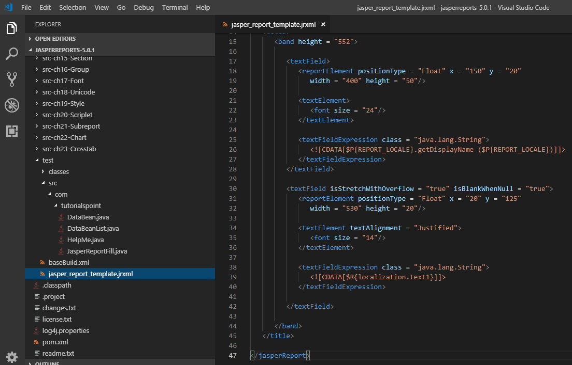
24.1 jasper_report_template.jrxml
https://www.tutorialspoint.com/jasper_reports/index.htm
Write jasper_report_template.jrxml. Add the crosstab to summary section.
Save jasper_report_template.jrxml to the directory C:\tools\jasperreports-5.0.1\test. The contents of the file are as given below

Slide 9
24.2 localizationdemo.properties

Slide 10
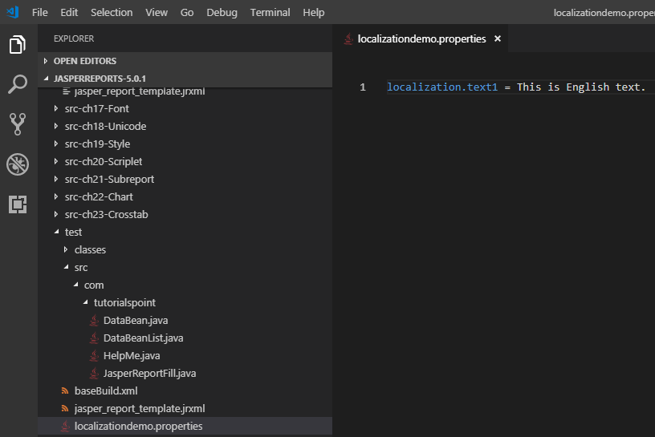
24.2 localizationdemo.properties
https://www.tutorialspoint.com/jasper_reports/index.htm
In the above file, the resourceBundle attribute of the <jasperReport> element tells JasperReports where to get the localized strings to use for the report. We need to create a property file with a root name matching the value of the attribute.
This file must exist anywhere in the CLASSPATH when filling the report. In this example, the property file localizationdemo.properties is saved under the directory C:\tools\jasperreports-5.0.1\test. The contents of this file are as follows
localization.text1 = This is English text.

Slide 11
24.2 localizationdemo.properties
https://www.tutorialspoint.com/jasper_reports/index.htm
The syntax to obtain the value for resourceBundle properties is $R{key}.
To let JasperReports know what locale we wish to use, we need to assign a value to a built-in parameter.
This parameter's name is defined as a constant called REPORT_LOCALE, and this constant is defined in the net.sf.jasperreports.engine.JRParameter class.
The constant's value must be an instance of java.util.Locale.

Slide 12
24.3 JasperReportFillI18.java

Slide 13
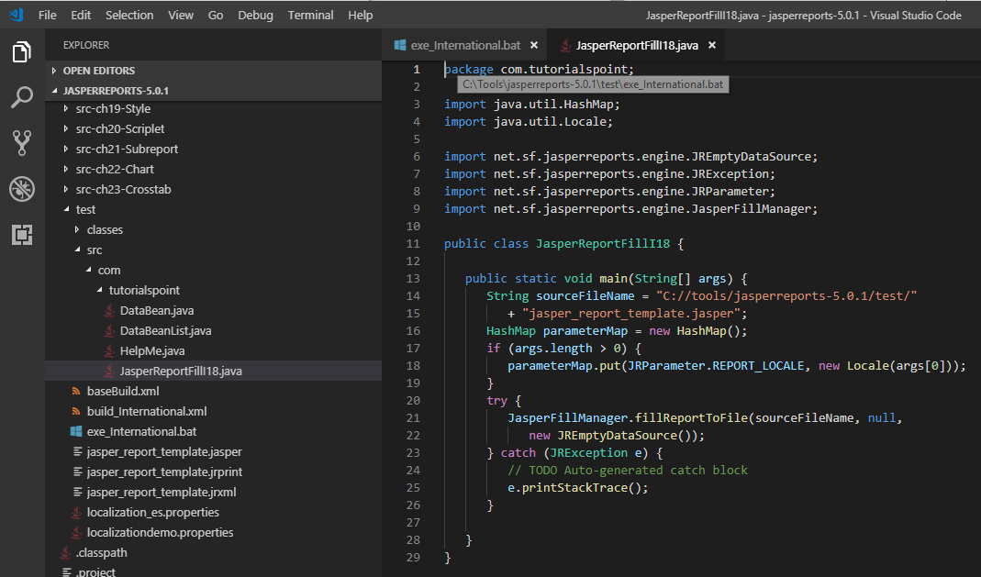
24.3 JasperReportFillI18.java
https://www.tutorialspoint.com/jasper_reports/index.htm
Let's save this file JasperReportFillI18.java to C:\tools\jasperreports-5.0.1\test\src\com\tutorialspoint directory.
The contents of the file are as follows

Slide 14
24.4 build_International.xml

Slide 15
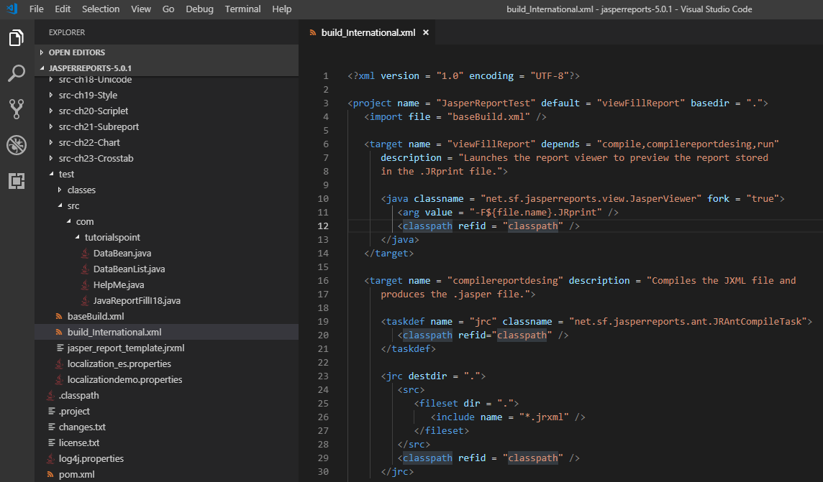
24.4 build_International.xml
https://www.tutorialspoint.com/jasper_reports/index.htm
Write build_International.xml

Slide 16
24.5 exe_International.bat

Slide 17
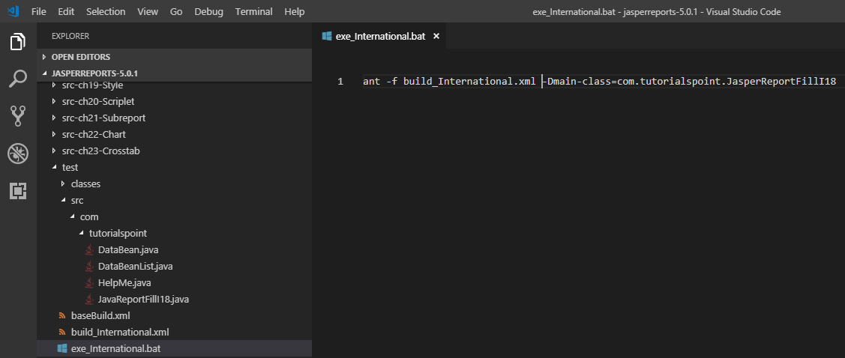
24.5 exe_International.bat
https://www.tutorialspoint.com/jasper_reports/index.htm
Write exe_International.bat

Slide 18
24.6 Run exe_International.bat

Slide 19
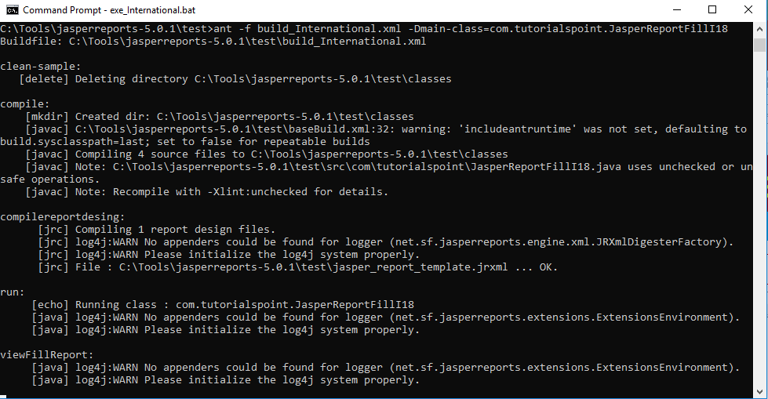
24.6 Run exe_International.bat
https://www.tutorialspoint.com/jasper_reports/index.htm
Run exe_International.bat

Slide 20
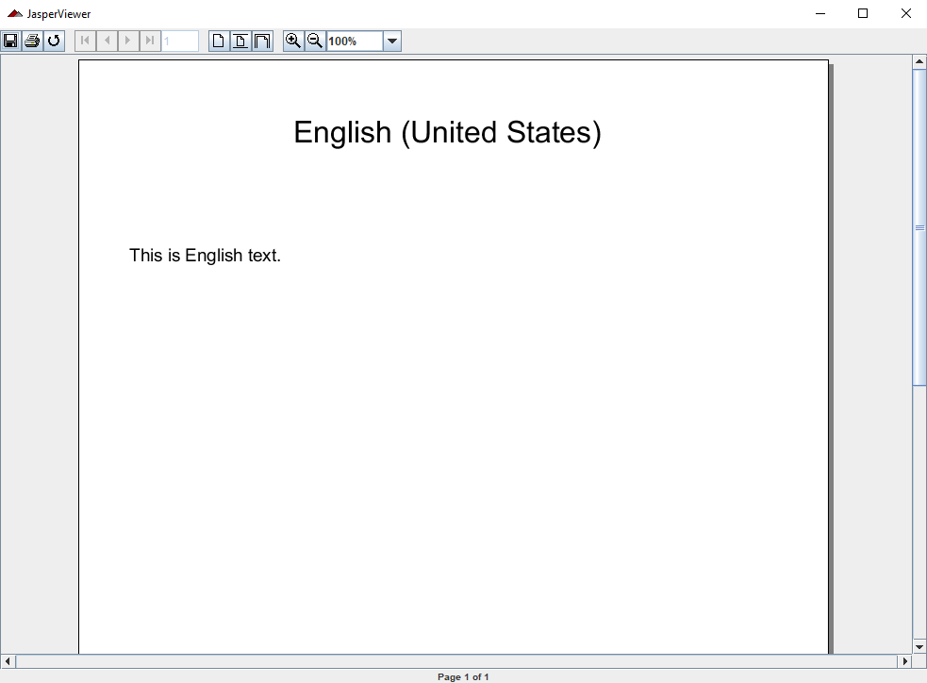
24.6 Run exe_International.bat
https://www.tutorialspoint.com/jasper_reports/index.htm
Display English

Slide 21
End of Chapter

