Slide 1

3 Setup
Peter H. Chen

Slide 2
3 Setup
https://www.tutorialspoint.com/jasper_reports/index.htm
JasperReports is a pure Java library and not a standalone application. It cannot run on its own, hence it needs to be embedded into another client or server-side Java application.
As it is Java based, it can be run on any platform that supports Java (JDK 1.3 and above).
All the JasperReport's functionalities are gathered in a single JAR file, jasperreports-5.0.1.jar (jasperreports-6.7.0.jar ). This JAR along with the required and optional libraries (.ZIP file) can be downloaded from the site: JasperReport Library Link.
Download the latest version from this link.
The ZIP file includes the JasperReports JAR file along with the JasperReports source code, dependent JARs, and a lot of examples demonstrating JasperReport's functionalities.

Slide 3
3.1 Setup JasperReport Environment

Slide 4
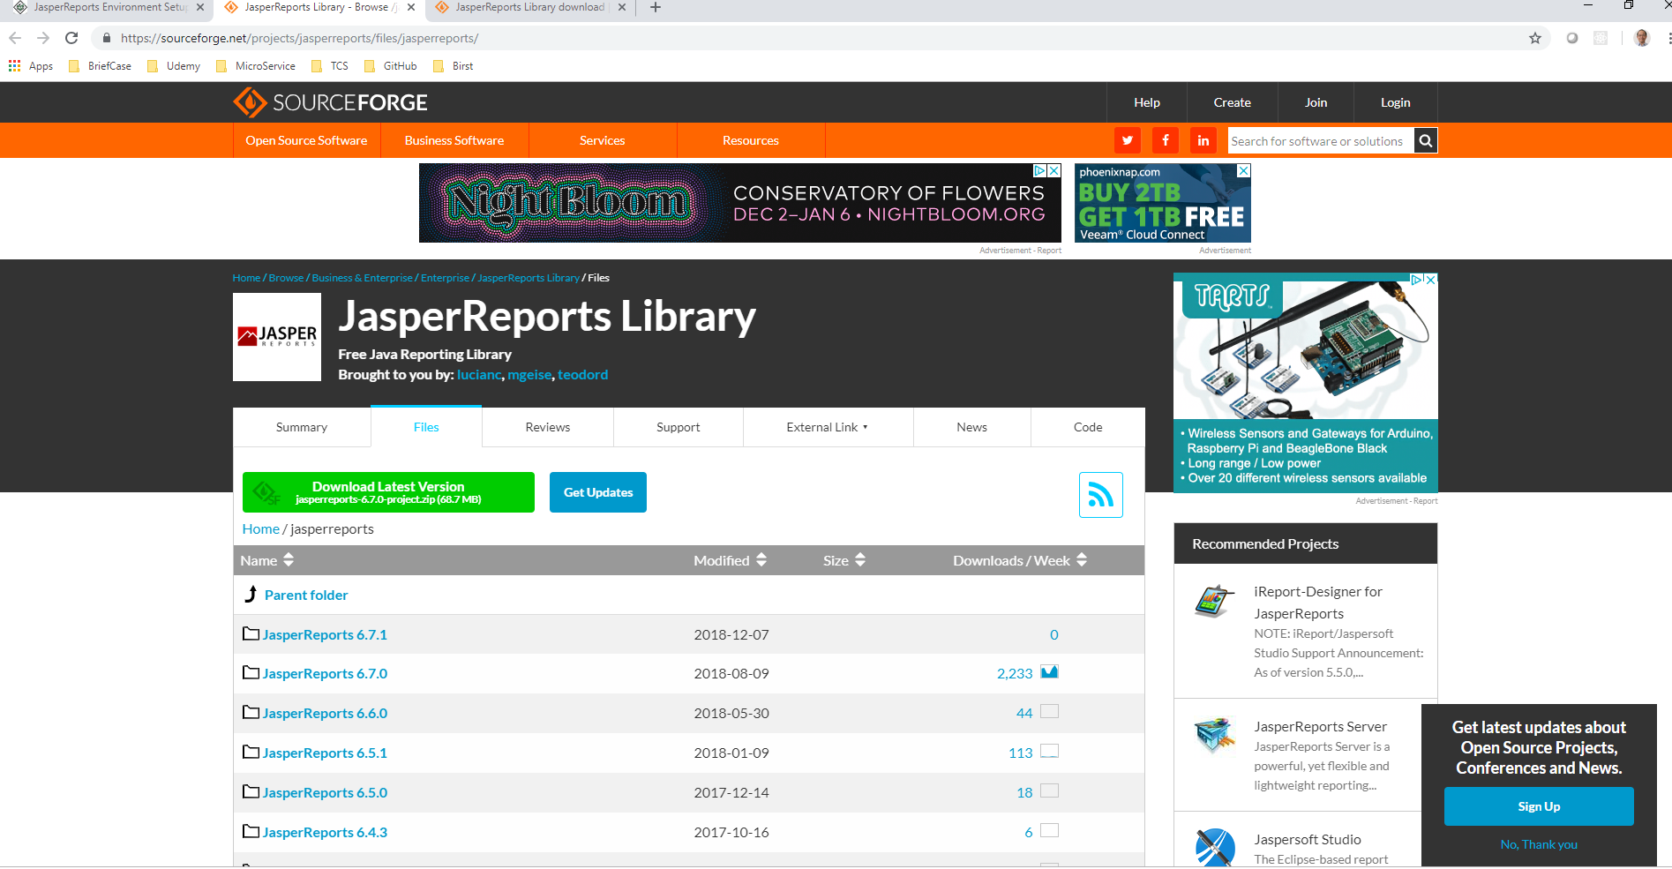
3.1 Setup Jasper Report Environment
https://www.tutorialspoint.com/jasper_reports/index.htm
Go to: https://sourceforge.net/projects/jasperreports/files/jasperreports/
Download 5.0.1 (for this document) and 6.7.0 for comparison. (The latest is 6.7.1 without anyone download)

Slide 5
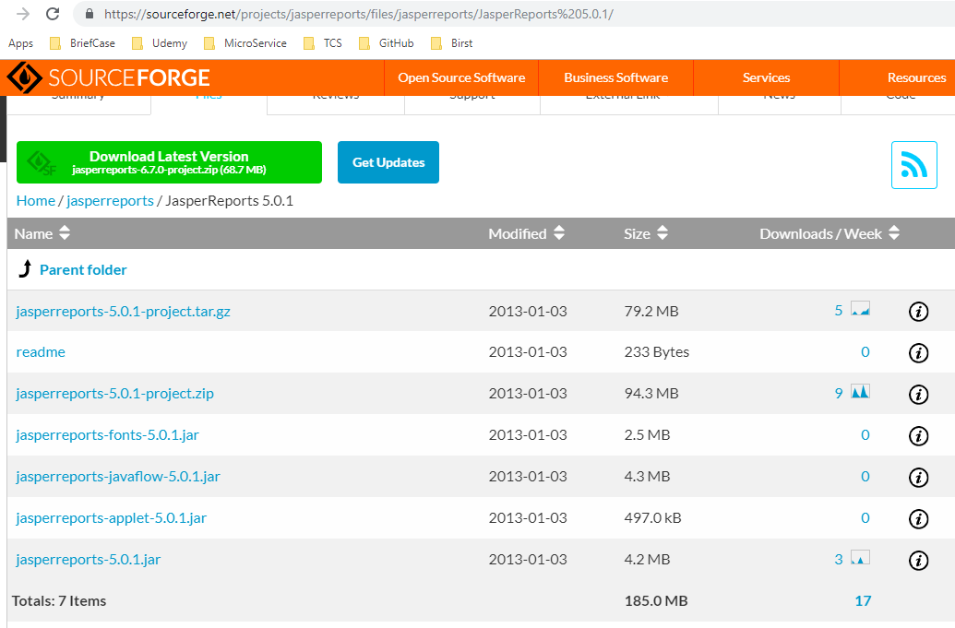
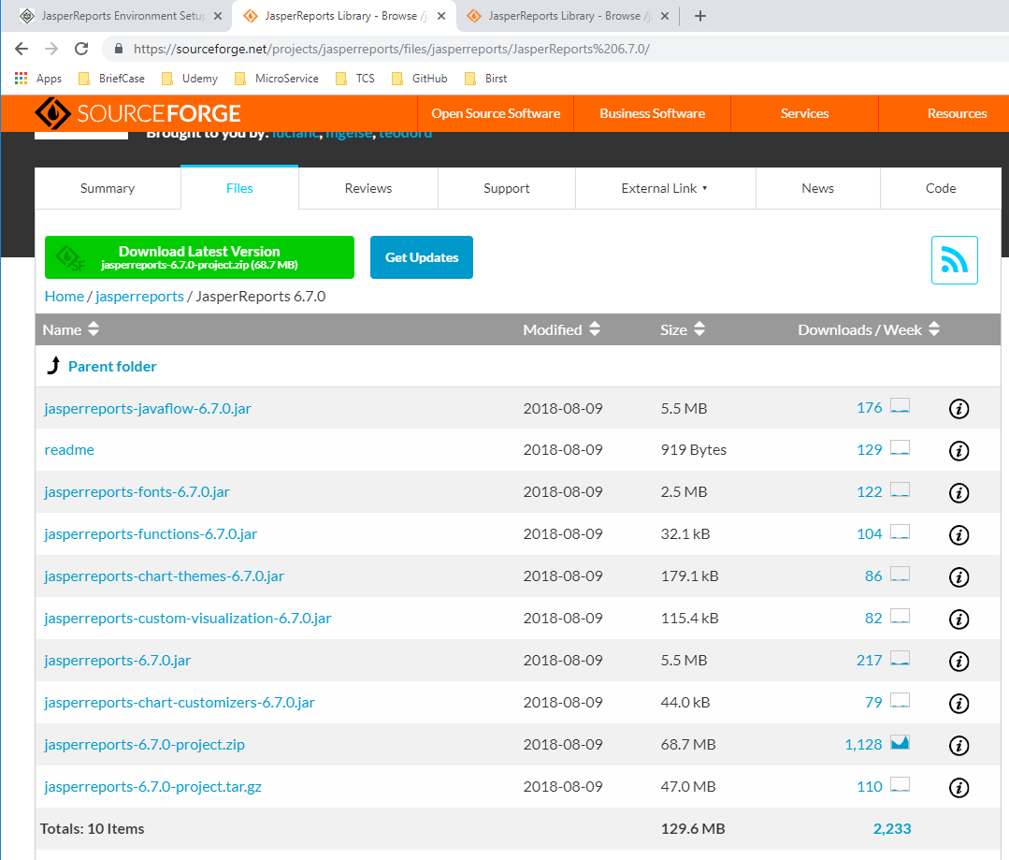
3.1 Setup Jasper Report Environment
https://www.tutorialspoint.com/jasper_reports/index.htm
Difference between 5.0.1 and 6.7.0.
We only need to download and extract the *.zip file. When you extract the Zip file, the dist folder already included the “jasperreport-x.x.x.jar”, “jasperreport-fonts-x.x.x.jar”, and “jasperreport-javaflow-x.x.x.jar”, and etc.

Slide 6
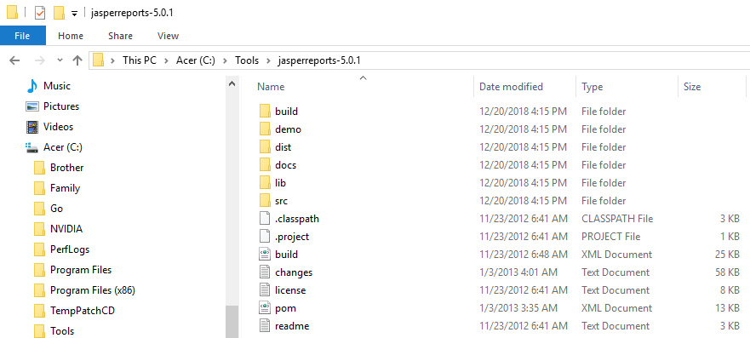
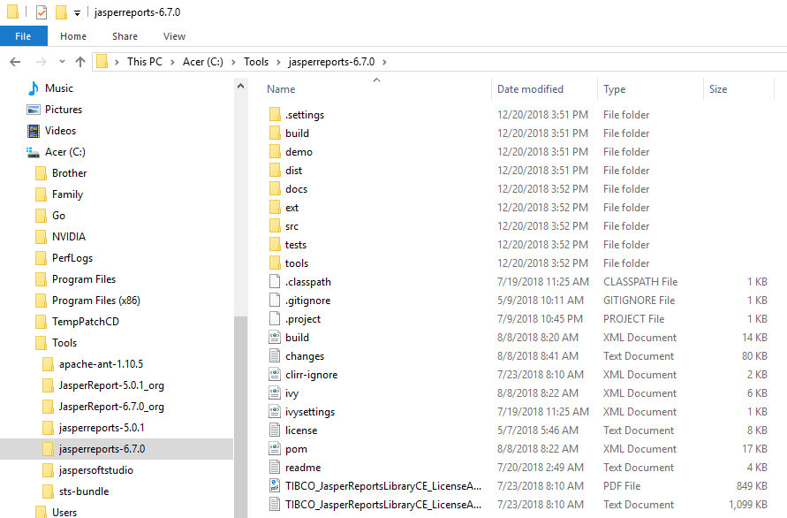
3.1 Setup Jasper Report Environment
https://www.tutorialspoint.com/jasper_reports/index.htm
JasperReport Environment
To start creating the reports, we need to set up the environment ready.
Extract the downloaded JasperReport.ZIP file to any location C:\tools\jasperreports-5.0.1). The directory structure of the extracted file is same as shown below.

Slide 7
3.1 Setup Jasper Report Environment
https://www.tutorialspoint.com/jasper_reports/index.htm
Note:
JasperReport after 6.2.2, the lib library is remove and download from repository by ant: https://stackoverflow.com/questions/37516468/i-have-downloaded-jasper-report-6-2-2-but-it-doesnt-have-lib-folder-should-i-d

Slide 8
3.1 Setup Jasper Report Environment
https://www.tutorialspoint.com/jasper_reports/index.htm
Here is the detail of all the directories −
build − Contains the compiled JasperReport class files.
demo − Contains various examples, demonstrating several aspects of JasperReports functionality.
dist − Contains jasperreports-x.x.x.jar file. We shall add this JAR file to our CLASSPATH to take advantage of JasperReports.
docs − Contains a local copy of the JasperReports documentation.
lib − Contains all JARs needed, both to build JasperReports and to use it in our applications.
src − Contains the JasperReports source code.
build.xml − An ANT build file to build the JasperReports source code. If we don't intend to modify JasperReports, we don't need to use this file since JasperReports is distributed in the compiled form.

Slide 9
3.1 Setup Jasper Report Environment
https://www.tutorialspoint.com/jasper_reports/index.htm
Here is the detail of all the directories (cont)−
changes.txt − A text document, explaining the differences between the current and previous versions of the JasperReports class library.license.txt − A text document that contains the full text of the LGPL (Lesser General Public License) license.
readme.txt − A text document, containing instructions on how to build and execute the supplied examples.
Basically, we only use the jasperreports-x.x.x.jar under the dist and JARs under the lib directory for generating reports.
As JasperReports being an open source tool, if any defect or bug is recognized during execution in the jasperreports-x.x.x.jar, we can fix it and build the JAR again using the build.xml file.

Slide 10
3.1 Setup Jasper Report Environment
https://www.tutorialspoint.com/jasper_reports/index.htm
Set the CLASSPATH
To use JasperReport, we need to set the following files to our CLASSPATH −
jasperreports-x.x.x.jar, where x.x.x is the JasperReports version. This found under directory C:\tools\jasperreports-x.x.x\dist).
All the JAR files under the lib subdirectory (C:\tools\jasperreports-x.x.x\lib).
At the time of installation, we used JasperReport version 5.0.1. Right-click on 'My Computer' and select 'Properties', click on the 'Environment variables' button under the 'Advanced' tab. Now update the 'Path' variable with this C:\tools\jasperreports-5.0.1\dist\jasperreports-5.0.1.jar:C:\tools\jasperreports-5.0.1\lib. Now you are ready to create your reports.
In all the examples in this tutorial, we have used ANT tasks to generate reports. The build file takes care of importing all the required JARs for generating reports. Hence, setting CLASSPATH as mentioned above will only help those who wish to generate reports without using ANT.

Slide 11
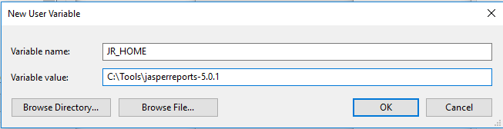
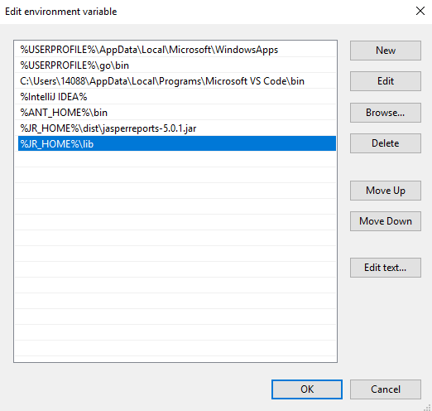
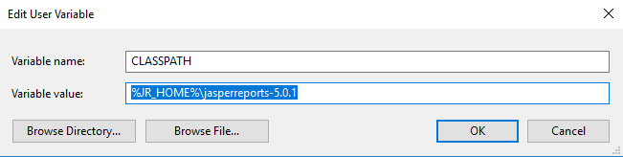
3.1 Setup Jasper Report Environment
https://www.tutorialspoint.com/jasper_reports/index.htm
Set the CLASSPATH
Note: Define
%JR_HOME% = “C:\Tools\jasperreports-5.0.1”,
CLASSPATH = “%JR_HOME%\dist”, and
PATH=%JR_HOME%\dist\jasperreports-5.0.1.jar; =%JR_HOME%\lib

Slide 12

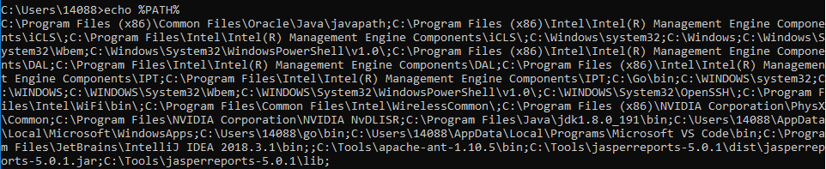
3.1 Setup Jasper Report Environment
https://www.tutorialspoint.com/jasper_reports/index.htm
Verify the %CLASSPATH%.
Verify the %CLASSPATH% and %PATH% setup.

Slide 13
3.2 Setup Ant

Slide 14
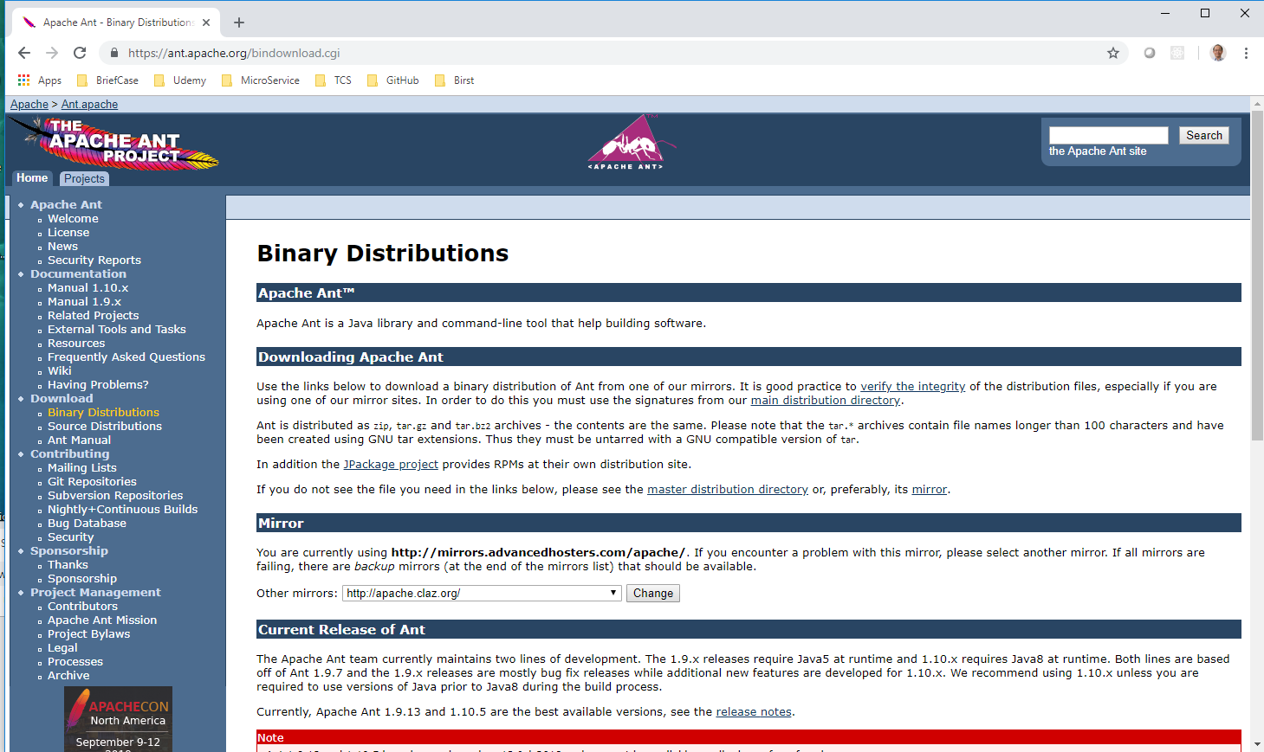
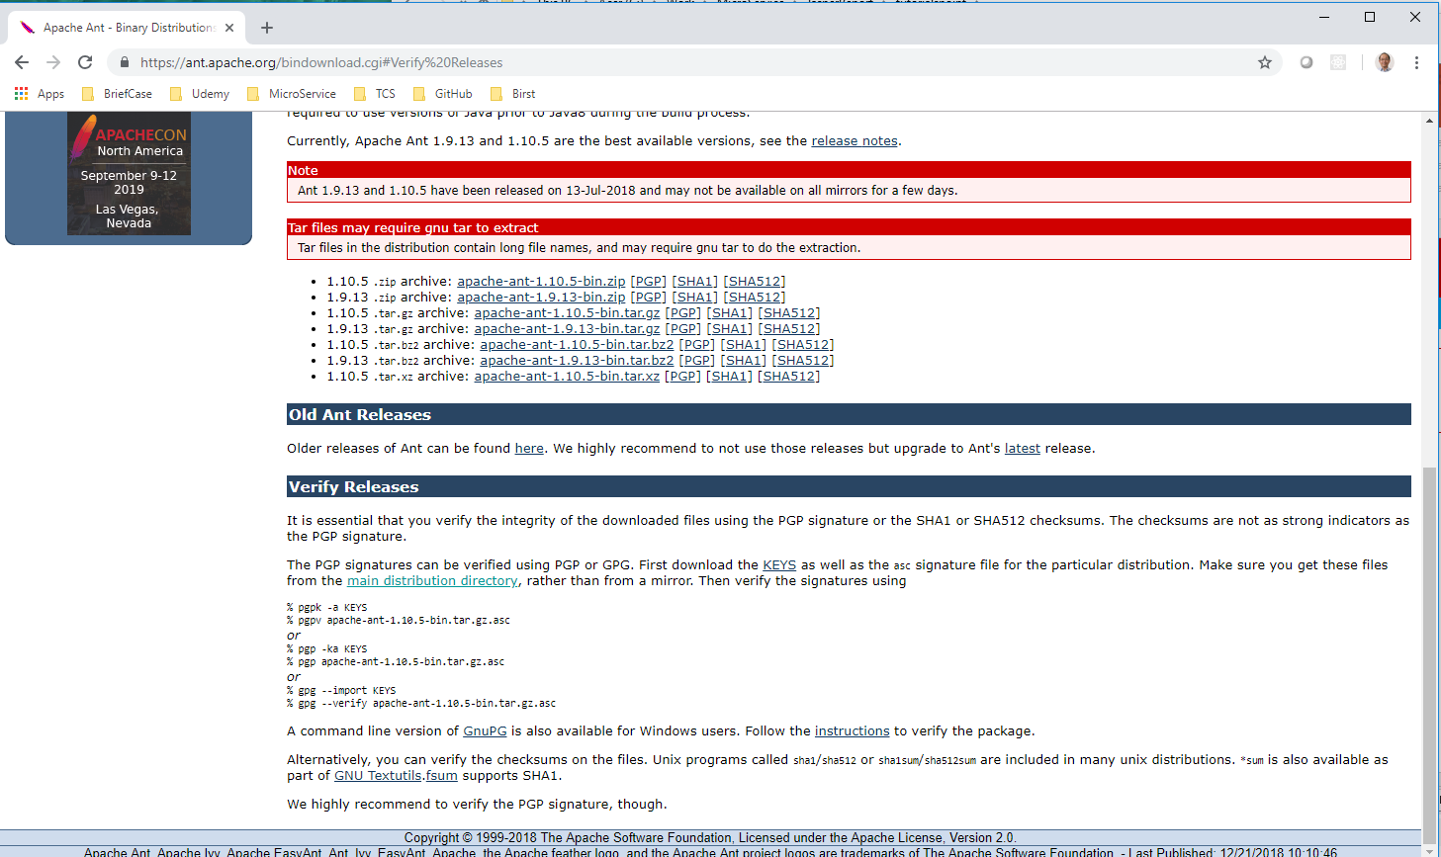
3.2 Setup Ant
https://www.tutorialspoint.com/jasper_reports/index.htm
Go to Apache Ant: https://ant.apache.org/
Download and Install for ant:
> ant -v

Slide 15
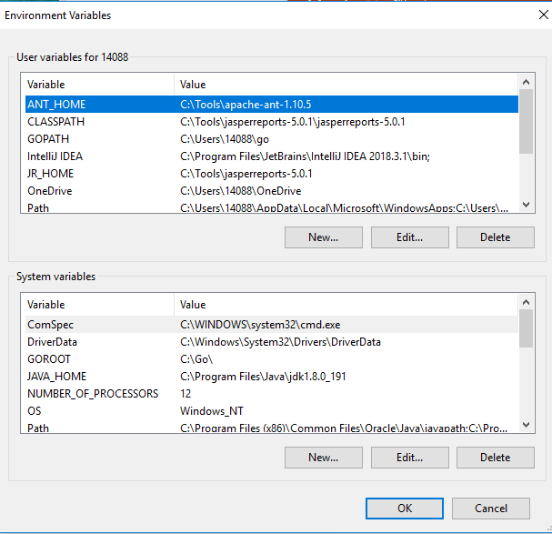
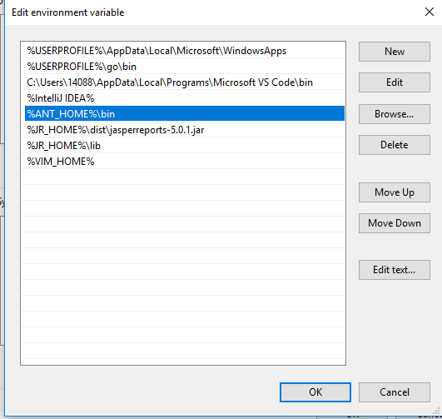
3.2 Setup Ant
https://www.tutorialspoint.com/jasper_reports/index.htm
Create Environment variable “ANT_HOME”
Set “ANT_HOME in Path

Slide 16
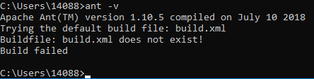
3.2 Setup Ant
https://www.tutorialspoint.com/jasper_reports/index.htm
Check Ant Installation:
> ant -v

Slide 17
3.3 Build Setup

Slide 18
3.3 Build Setup
https://www.tutorialspoint.com/jasper_reports/index.htm
Build Setup
All the examples in this document
Edit with simple Text Editor (vim download at https://www.vim.org/download.php) or visual studio code.
Save code under the directory C:\tools\jasperreports-5.0.1\test\src\com\tutorialspoint.
Compiled and executed from command prompt, using Apache ANT. We will use a baseBuild.xml file, which we import in ANT build.xml file in the subsequent chapters. Save this file to C:\tools\jasperreports-5.0.1\test.
Codes are under src_chxx folder in the Github.
Document are name ch01_xxx.ppt in the Github.

Slide 19
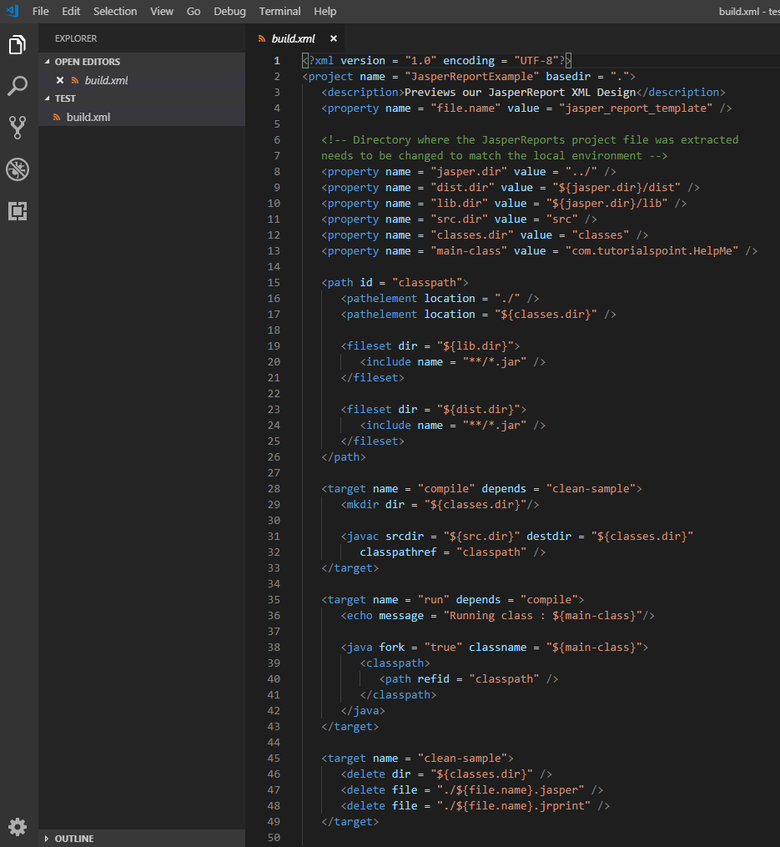
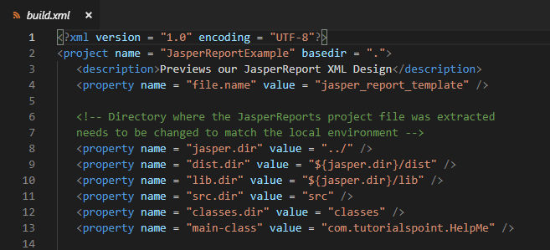
3.3 Build Setup
https://www.tutorialspoint.com/jasper_reports/index.htm
The baseBuild.xml file is as follow (code is in src_ch03 folder of GitHub):

Slide 20
3.3 Build Setup
https://www.tutorialspoint.com/jasper_reports/index.htm
This baseBuild.xml has all the required targets: cleanin the directories, compile the java files, and execute the class files.
The baseBuild.xml. Assume current folder is “C:\tools\jasperreports-5.0.1\test”. The following folders will be generated:
jasper.dir − is C:\tools\jasperreports-5.0.1 directory
lib.dir − is C:\tools\jasperreports-5.0.1\lib directory
src.dir − is C:\tools\jasperreports-5.0.1\test\src
classes.dir − is C:\tools\jasperreports-5.0.1\test\classes
main-class − com.tutorialspoint.HelpMe. This class is a simple class executed, when no class file name is passed from the command line. Save this file to C:\tools\jasperreports-5.0.1\test\src\com\tutorialspoint.

Slide 21
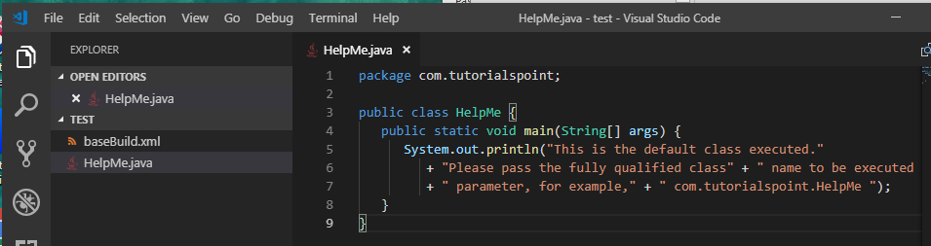
3.3 Build Setup
https://www.tutorialspoint.com/jasper_reports/index.htm
HelpMe.java.

Slide 22
3.4 Jasper Compilation

Slide 23
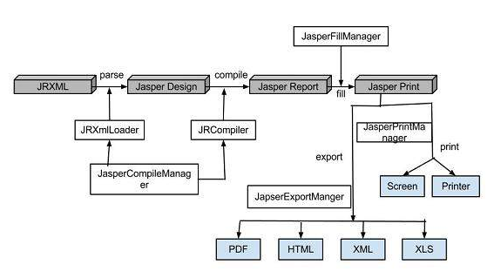
3.4 Jasper Compilation
https://www.tutorialspoint.com/jasper_reports/index.htm
Jasper Managers Classes
There are number of classes are used to compile a JRXNL report design (e.g., xxx.jrxml generated by Jasper Studio) to fill the format of a report, print a format report, export to PDF, HTML & XML files, view the generated reports, and report design.

Slide 24
3.4 Jasper Compilation
https://www.tutorialspoint.com/jasper_reports/index.htm
The list of these classes are as below:
net.sf.jasperreports.engine.JasperCompileManager − Used to compile a JRXML report template.
net.sf.jasperreports.engine.JasperFillManager − Used to fill a report with data from the data source.
net.sf.jasperreports.engine.JasperPrintManager − Used to print the documents generated by the JasperReports library.
net.sf.jasperreports.engine.JasperExportManager − Used to obtain PDF, HTML, or XML content for the documents produced by the report-filling process.
net.sf.jasperreports.view.JasperViewer − It represents a simple Java Swing application, which can load and display reports.
net.sf.jasperreports.view.JasperDesignViewer − Used at design time to preview the report templates.

Slide 25
3.5 Summary

Slide 26
3.5 Summary
https://www.tutorialspoint.com/jasper_reports/index.htm
Setup the Jasper 5.0.1 Environment (Framework)
Setup Ant
Explain baseBuild.xml
Jasper Compilation: The API we will do next. From xxx.jrxml which is built by Jasper Studio and display to user.

Slide 27
End of Chapter

