Slide 1

5 Design Phase
Peter H. Chen

Slide 2
5 Design Phase
https://www.tutorialspoint.com/jasper_reports/index.htm
We discuss the Design Phase in this document.
Design Phase
(Create JRXML File)
Execute Phase
[Fill Jasper Template with Data to Generate Jasper Print File (xxx.jrprint)]
Compile Phase
(Compile JRXML to Jasper Template)
Export Phase
[Export the Report to Any Specified Format]

Slide 3
5 Design Phase
https://www.tutorialspoint.com/jasper_reports/index.htm
The JRXML templates (or JRXML files) in JasperReport are standard XML files, having an extension of .jrxml.
All the JRXML files contain tag <jasperReport>, as root element. This in turn contains many sub-elements (all of these are optional).
JasperReport framework can handle different kinds of data sources. In this tutorial, we shall show how to generate a basic report, just by passing a collection of Java data object (using Java beans), to the JasperReport Engine.
The final report shall display a list of people with the categories including their names and countries.
The Following steps are covered in this chapter to describe — how to design a JasperReport
Creating a JRXML Report Template and.
Previewing the XML Report Template.

Slide 4
5.1 Create JRXML File

Slide 5
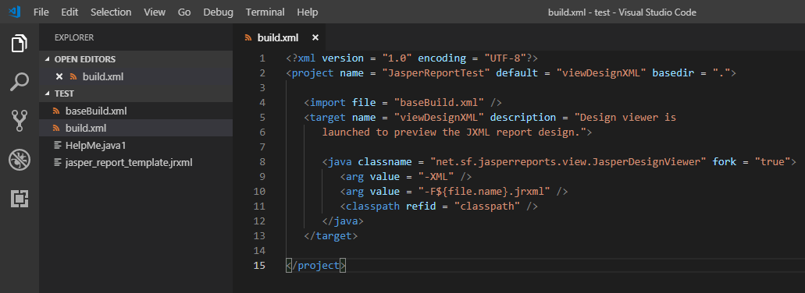
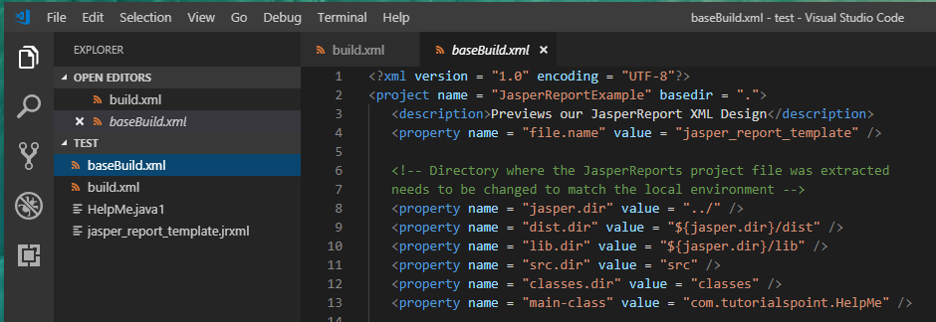
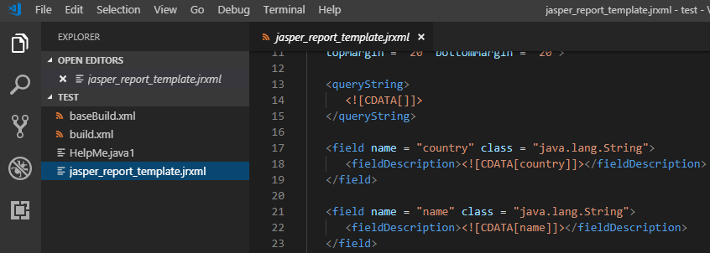
5.1 Create JRXML File
https://www.tutorialspoint.com/jasper_reports/index.htm
Create build.xml
The build.xml will call basebuild.xml.
1
Build.xml import basebuild.xml
basebuild.xml call jasper_report_template.jsxml
2

Slide 6
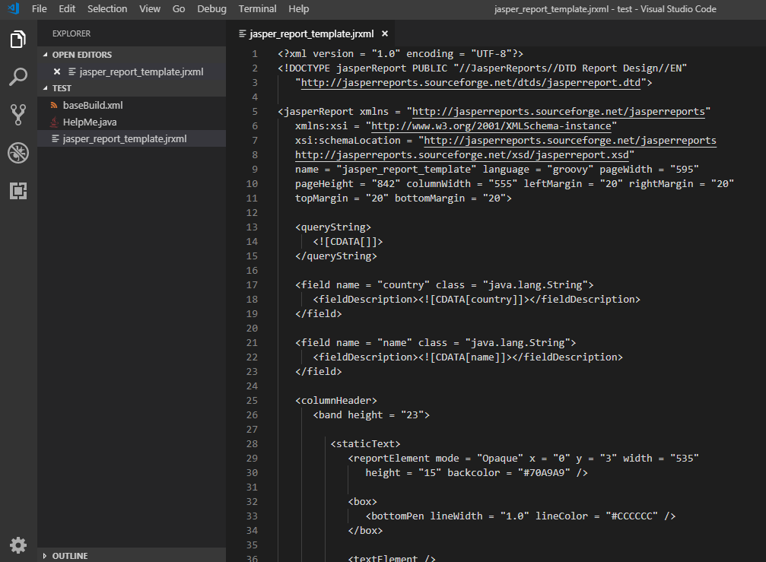
5.1 Create JRXML File
https://www.tutorialspoint.com/jasper_reports/index.htm
Creating a JRXML Report Template
Create the JRXML file, which is jasper_report_template.jrxml using a text editor and save this file in C:\tools\jasperreports-5.0.1\test as per our environment setup.

Slide 7
5.1 Create JRXML File
https://www.tutorialspoint.com/jasper_reports/index.htm
The above report template explains as follow:
<queryString> − This is empty (as we are passing data through Java Beans). Usually contains the SQL statement, which retrieves the report result.
<field name> − This element is used to map data from data sources or queries, into report templates. name is re-used in the report body and is case-sensitive.
<fieldDescription> − This element maps the field name with the appropriate element in the XML file.
<staticText> − This defines the static text that does not depend on any datasources, variables, parameters, or report expressions.
<textFieldExpression> − This defines the appearance of the result field.
$F{country} − This is a variable that contains the value of result, predefined field in the tag <field name>.
<band> − Bands contain the data, which is displayed in the report.

Slide 8
5.1 Create JRXML File
https://www.tutorialspoint.com/jasper_reports/index.htm
Previewing the XML Report Template
There is a utility net.sf.jasperreports.view.JasperDesignViewer available in JasperReports JAR file, which helps in previewing the report design without having to compile or fill it.
This utility is a standalone Java application, hence can be executed using ANT.
Let's write an ANT target viewDesignXML to view the JRXML.
We create and save build.xml under C:\tools\jasperreports-5.0.1\test directory (should be placed in the same directory where JRXML is placed).

Slide 9
5.2 Run JRXML File

Slide 10
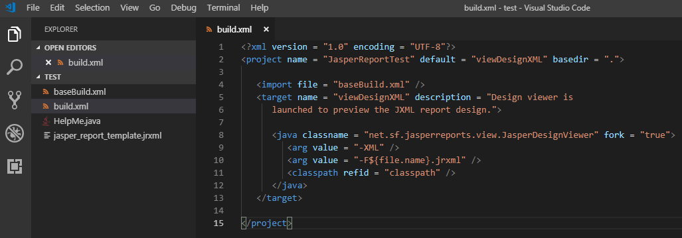
5.2 Run JRXML File
https://www.tutorialspoint.com/jasper_reports/index.htm
Below is the build.xml file:

Slide 11
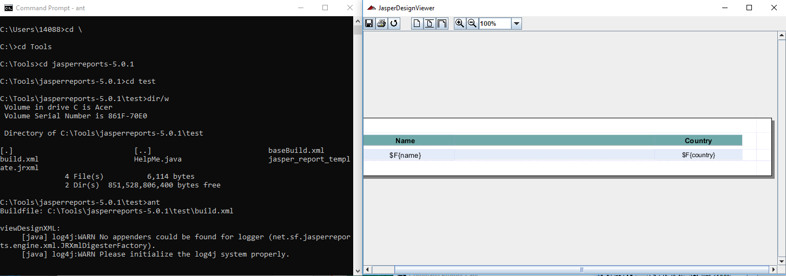
5.2 Run JRXML File
https://www.tutorialspoint.com/jasper_reports/index.htm
Review your design:
Open a command prompt and go to the directory where build.xml is placed.
Execute the command ant (As the viewDesignXML is the default target).
Output is follow

Slide 12
5.2 Run JRXML File
https://www.tutorialspoint.com/jasper_reports/index.htm
Note that only report expressions for obtaining the data are displayed.
The JasperDesignViewer does not have access to the actual data source or report parameters.
We can terminate the JasperDesignViewer by closing the window or by hitting Ctrl-c in the command-line window.

Slide 13
End of Chapter

