Slide 1

6 Compile Phase
Peter H. Chen

Slide 2
6 Compile Phase
https://www.tutorialspoint.com/jasper_reports/index.htm
We discuss the Compile Phase in this document.
Design Phase
(Create JRXML File)
Execute Phase
[Fill Jasper Template with Data to Generate Jasper Print File (xxx.jrprint)]
Compile Phase
(Compile JRXML to Jasper Template)
Export Phase
[Export the Report to Any Specified Format]

Slide 3
6 Compile Phase
https://www.tutorialspoint.com/jasper_reports/index.htm
We have generated the JasperReport template (JRXML file) in the previous chapter.
The JasperReport template (JRXML file) file cannot be used directly to generate reports. It has to be compiled to JasperReport' native binary format, called Jasper file.
After compilation, we transform JasperDesign object into JasperReport object.
net.sf.jasperreports.engine.design.JasperDesign objects
(JRXML file)
Compile by Interface
net.sf.jasperreports.engine.design.JRCompiler
net.sf.jasperreports.engine.design.JasperReport object
(Binary Format)

Slide 4
6 Compile Phase
https://www.tutorialspoint.com/jasper_reports/index.htm
The interface net.sf.jasperreports.engine.design.JRCompiler plays a central role during compilation. This interface has several implementations depending on the language used for report expressions, which can be written in Java, Groovy, JavaScript, or any other scripting language as long as compiler implementation can evaluate it at runtime.
We will compile JRXML file (jasper_report_template.jrxml).
Jasper API is JasperCompileManager.compileREportToFile (). This API is written in JasperReportCompile.Java under folder ./com/tutorialspoint.
When compile, the –Dmain-class=com.tutorialspoint.JasperReportCompile
Use ant to call build.xml.
The compile.xml will call basebuild.xml
We will view the jasper binary file by view.xml

Slide 5
6.1 Java API for Compilation

Slide 6
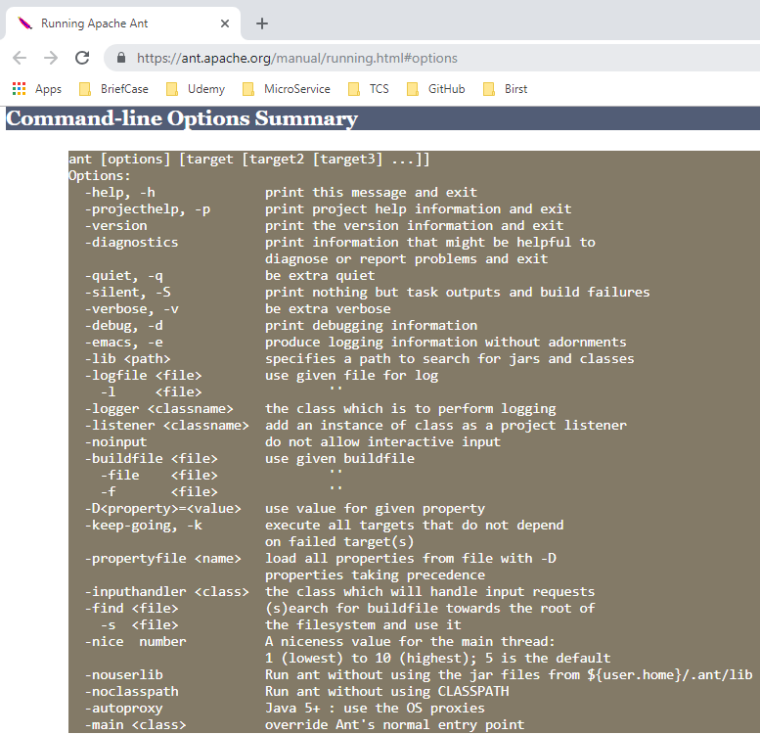
6.1 Java API for Compilation
https://www.tutorialspoint.com/jasper_reports/index.htm
The Ant command line option ‘-Dmain-class=….” is used to specify Java File location by “com.tutorialspoint.JasperReportCompile”.
The above command will find java file JasperReportCompile.java in the following folder “./src/com/utorialspoint/”.

Slide 7
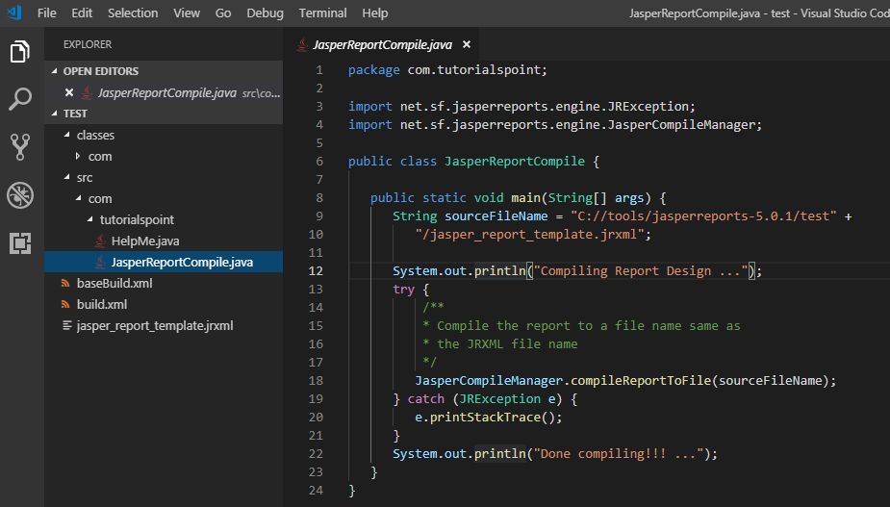
6.1 Java API for Compilation
https://www.tutorialspoint.com/jasper_reports/index.htm
Therefore, we need to put the JasperReportCompile.java under the folder “./src/com/utorialspoint/”.

Slide 8
6.2 Create compile.xml

Slide 9
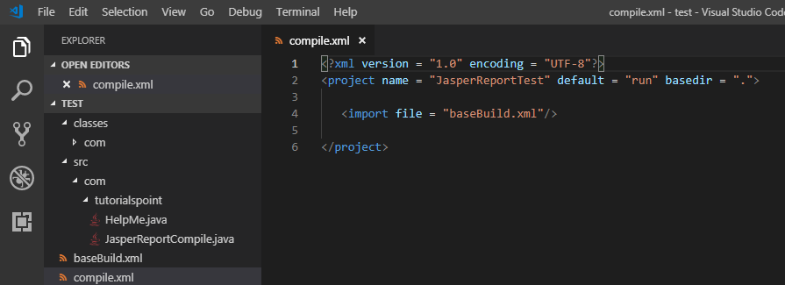
6.2 Create compile.xml
https://www.tutorialspoint.com/jasper_reports/index.htm
Create compile.xml under current (test) folder.

Slide 10
6.3 basebuild.xml

Slide 11
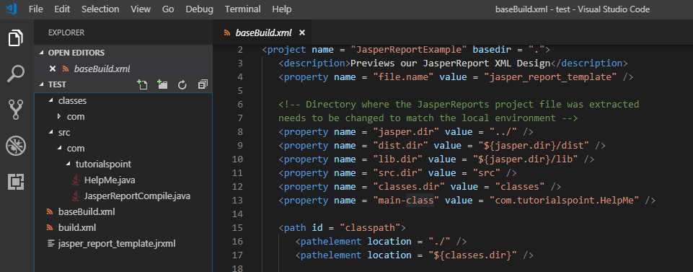
6.3 basebuild.xml
https://www.tutorialspoint.com/jasper_reports/index.htm
Copy basebuild.xml in current (test) folder.
The property name=“main-class” was originally defined as “com.tutoiralspoint.HelpMe” will be replaced by Ant command line option “com.tutoiralspoint.JavaReportCompile”

Slide 12
6.4 Execute Compilation

Slide 13
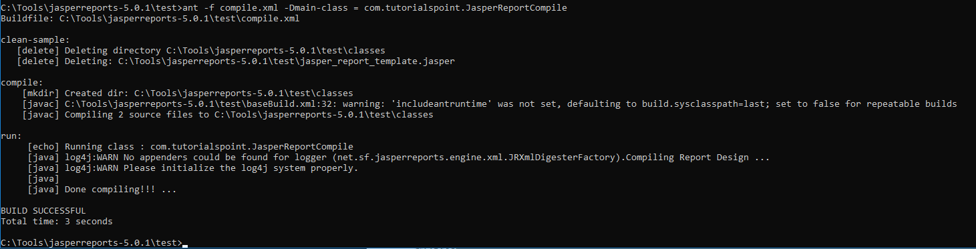
6.4 Execute Compilation
https://www.tutorialspoint.com/jasper_reports/index.htm
Execute the compilation by the following command:
> ant –f compile.xml –Dmain-class = com.tutorialspoint.JasperReportCompile
Note: The property name “main-class” was originally defined as com.tutorialspoint.HelpMe. Now, main-class is redefined into com.tutorialspoint.JasperReportCompile. The JasperReportCompile.java contains the Jasper API for compilation.

Slide 14
6.5 Compiled File: *.jasper

Slide 15
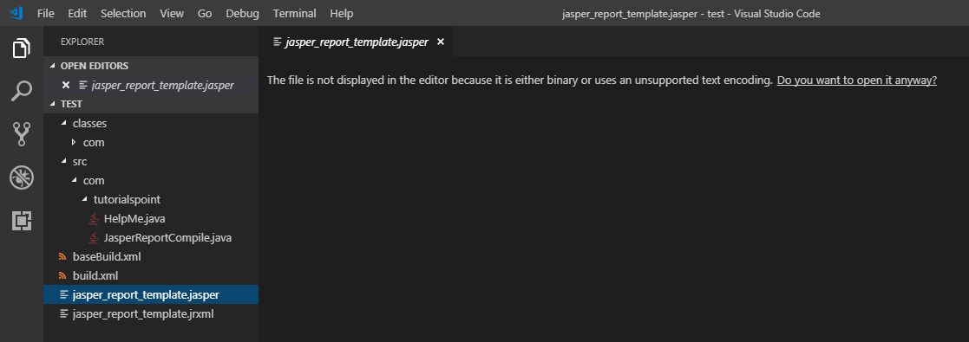
6.5 Compiled File: *.jasper
https://www.tutorialspoint.com/jasper_reports/index.htm
The binary file format jasper_report_template.jasper is generated.

Slide 16
6.6 View Binary *.Jasper

Slide 17
6.6 View Binary *.Jasper
https://www.tutorialspoint.com/jasper_reports/index.htm
View Binary *.jasper
The net.sf.jasperreports.view.JasperDesignViewer can be used to preview compiled report templates and JRXML templates.
To move further, let's add a new target viewDesign to the above build.xml file, which will allow us to preview the compiled report.
The import file - baseBuild.xml is picked from chapter Environment Setupand should be placed in the same directory as the build.xml

Slide 18
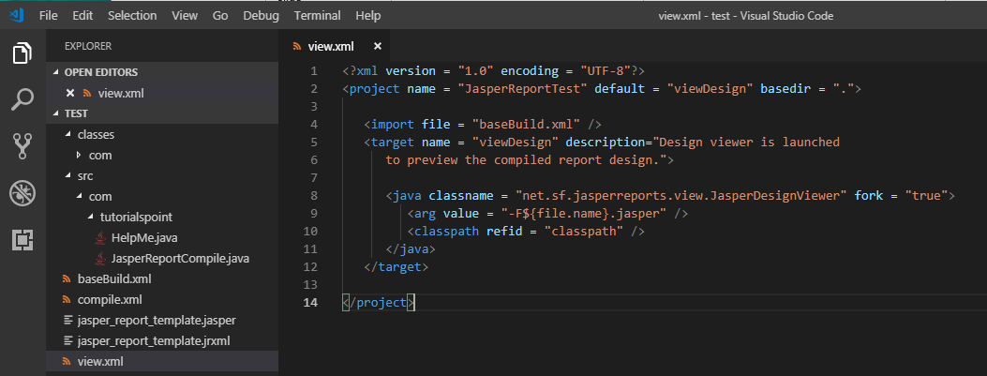
6.6 View Binary *.Jasper
https://www.tutorialspoint.com/jasper_reports/index.htm
View Binary *.jasper
Below is the revised view.xml.

Slide 19
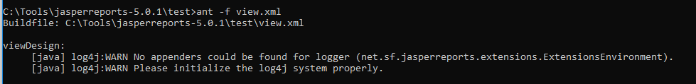
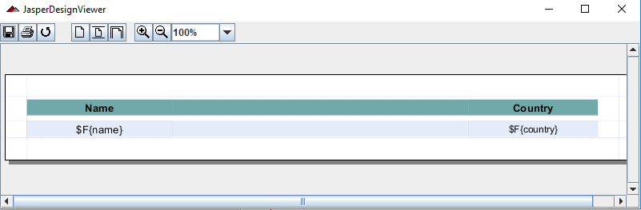
6.6 View Binary *.Jasper
https://www.tutorialspoint.com/jasper_reports/index.htm
View Binary *.jasper
Use ant command with file option “–f” to bring up view.xml
> ant –f view.xml

Slide 20
6.7 Summary

Slide 21
6.7 Summary
https://www.tutorialspoint.com/jasper_reports/index.htm
Summary
The ant call build.xml
The build.xml call baseBuild.xml
We redefine the property name main-class by ant command option –Dmain-class = …
The Jasper API Interface for compilation is JasperCompileManager.
The JasperReportCompile.java is located under ./src/com/tutoialspoint. The path is defined by property name “main-class”.
After compiled, the binary file *.jasper is generated.
Create view.xml to view the binary format *.jasper.

Slide 22
End of Chapter

