Slide 1

7 Execute Phase: Fill Report
Peter H. Chen

Slide 2
7 Execute Phase: Fill Report
https://www.tutorialspoint.com/jasper_reports/index.htm
We discuss the Execute Phase in this document.
Design Phase
(Create JRXML File)
Execute Phase
[Fill Jasper Template with Data to Generate Jasper Print File (xxx.jrprint)]
Compile Phase
(Compile JRXML to Jasper Template)
Export Phase
[Export the Report to Any Specified Format]

Slide 3
7 Execute Phase: Fill Report
https://www.tutorialspoint.com/jasper_reports/index.htm
The main purpose of any reporting tool is to produce high quality documents. Report filling process helps reporting tool to achieve this by manipulating sets of data.
The main inputs required for report-filling process are −
Report Template − This is actual JasperReport file.
Report Parameters − These are basically named values that are passed at the report filling time to the engine. We will discuss them in Report Parameter chapter.
Data Source − We can fill a Jasper file from a range of datasources like an SQL query, an XML file, a csv file, an HQL (Hibernate Query Language) query, a collection of Java Beans, etc. This will be discussed in detail in Report Data Sources chapter.
The output generated by this process is a .jrprint document which is ready to be viewed, printed, or exported to other formats.

Slide 4
7 Execute Phase: Fill Report
https://www.tutorialspoint.com/jasper_reports/index.htm
The facade class net.sf.jasperreports.engine.JasperFillManager is usually used for filling a report template with data. This class has various fillReportXXX() methods that fill report templates (templates could be located on disk, picked from input streams, or are supplied directly as in-memory).
There are two categories of fillReportXXX() methods in this facade class −
The first type, receive a java.sql.Connection object as the third parameter. Most of the times, reports are filled with data from a relational database. This is achieved by −
Connect to the database through JDBC.
Include an SQL query inside the report template.
JasperReports engine uses the connection passed in and executes the SQL query.
A report data source is thus produced for filling the report.
The second type, receive a net.sf.jasperreports.engine.JRDataSource object, when the data that need to be filled is available in other forms.

Slide 5
7.1 Create Report Template

Slide 6
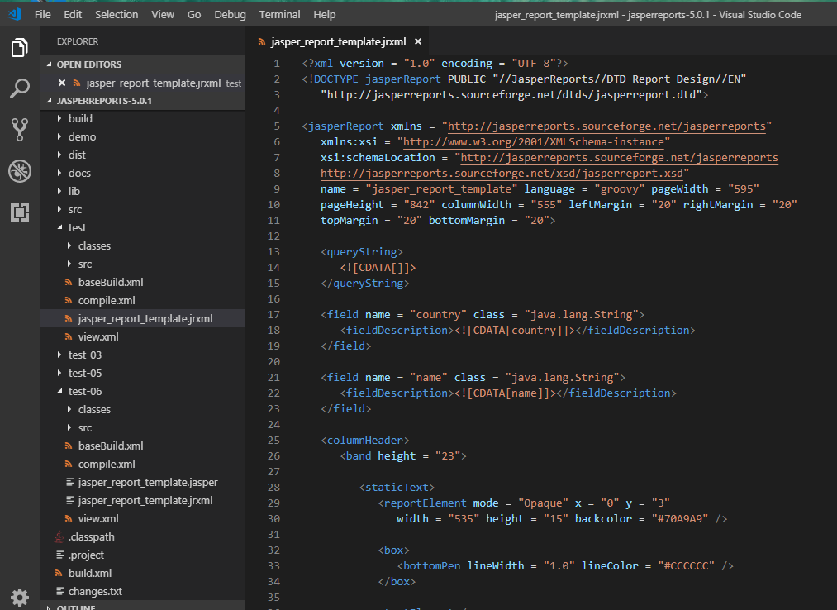
7.1 Create Report Template
https://www.tutorialspoint.com/jasper_reports/index.htm
Create a report template (C:\tools\jasperreports-5.0.1\test\ jasper_report_template.jrxml) as below

Slide 7
7.2 POJOI DataBean.java

Slide 8
7.2 POJO DataBea.java
https://www.tutorialspoint.com/jasper_reports/index.htm
Write collection of Java data objects (Java beans), to the JasperReport Engine, to fill this compiled report.
Write a POJO DataBean.java, which represents the data object (Java bean). This class defines two String objects i.e. 'name' and 'country’.

Slide 9
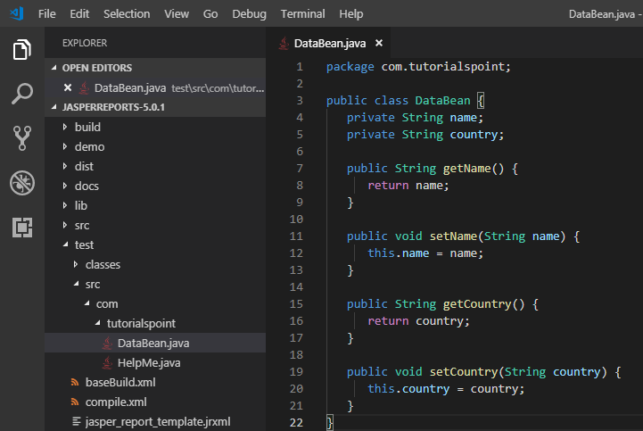
7.2 POJO DataBea.java
https://www.tutorialspoint.com/jasper_reports/index.htm
Save DataBean.java to the directory C:\tools\jasperreports-5.0.1\test\src\com\tutorialspoint.

Slide 10
7.3 DataBeanList.java

Slide 11
7.3 DataBeaList.java
https://www.tutorialspoint.com/jasper_reports/index.htm
Write a class DataBeanList.java, which has business logic to generate a collection of java bean objects.
This is further passed to the JasperReports engine, to generate the report. Here we are adding 4 DataBean objects in the List.

Slide 12
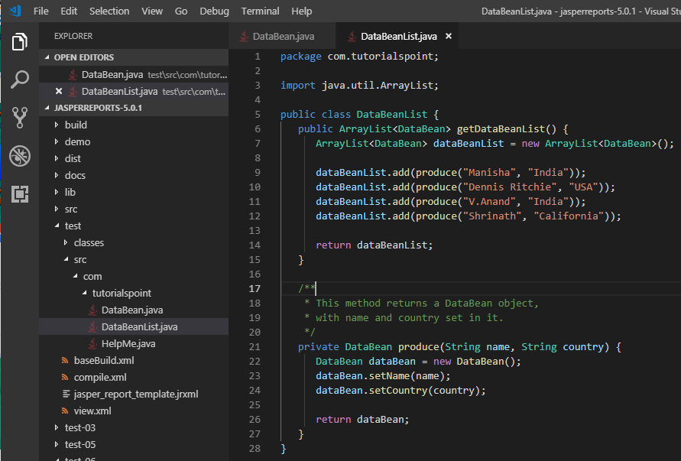
7.3 DataBeaList.java
https://www.tutorialspoint.com/jasper_reports/index.htm
Save DataBeanList.java to the directory C:\tools\jasperreports-5.0.1\test\src\com\tutorialspoint.

Slide 13
7.4 JasperReportFill.java

Slide 14
7.4 JasperReportFill.java
https://www.tutorialspoint.com/jasper_reports/index.htm
Write a main class file JasperReportFill.java, which gets the java bean collection from the class (DataBeanList) and passes it to the JasperReports engine, to fill the report template.

Slide 15
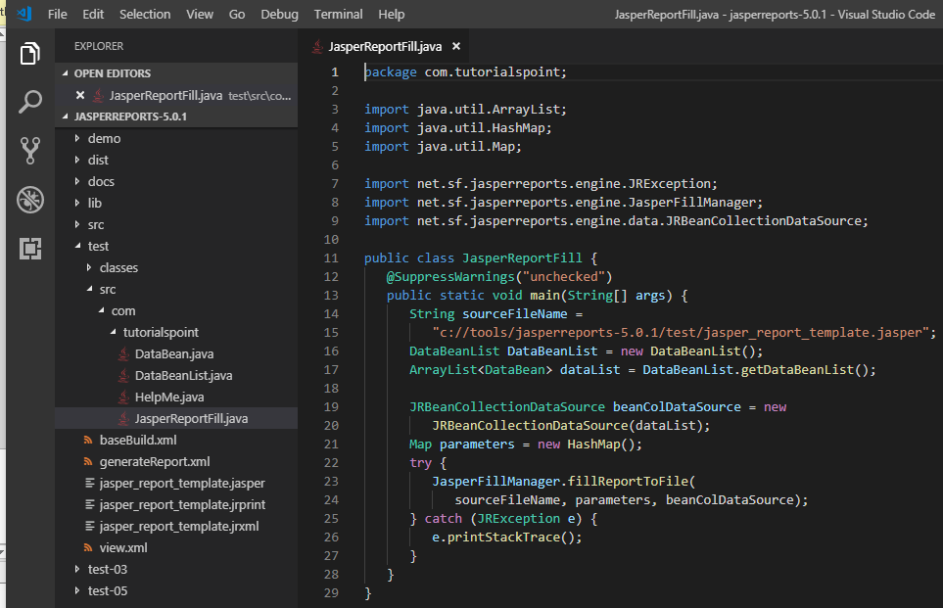
7.4 JasperReportFill.java
https://www.tutorialspoint.com/jasper_reports/index.htm
Save JasperReportFille.java to the directory C:\tools\jasperreports-5.0.1\test\src\com\tutorialspoint.

Slide 16
7.5 generateRerpot.xml

Slide 17
7.5 generateReport.xml
https://www.tutorialspoint.com/jasper_reports/index.htm
We now execute these files using our regular ANT build process. The generateReport.xml (build.xml) file is as given below −
The import file - baseBuild.xml should be placed in the same directory as the generateReport.xml (build.xml)

Slide 18
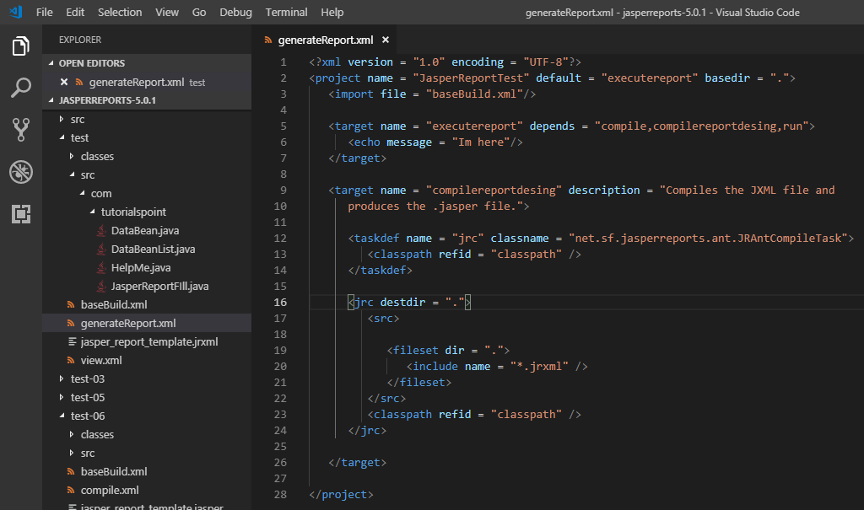
7.5 generateReport.xml
https://www.tutorialspoint.com/jasper_reports/index.htm
Save the generateReport.xml (build.xml) to the directory C:\tools\jasperreports-5.0.1\test.

Slide 19
7.6 Execute Fill Report

Slide 20
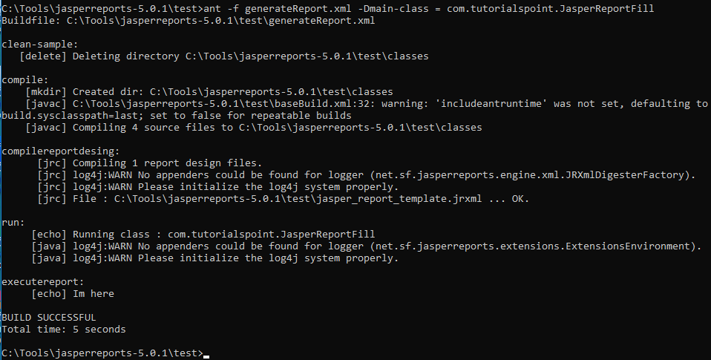
7.6 Execute Fill Report
https://www.tutorialspoint.com/jasper_reports/index.htm
Finally, execute the command ant -f geneateReport.xml -Dmain-class = com.tutorialspoint.JasperReportFill (executereport is the default target) as follows:

Slide 21
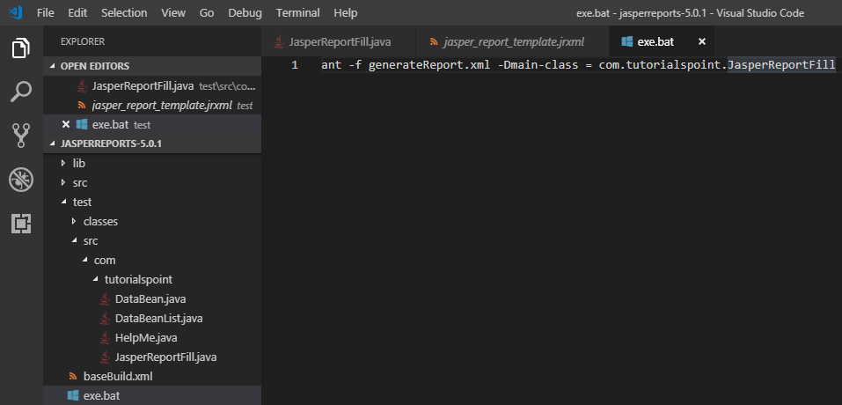
7.6 Execute Fill Report
https://www.tutorialspoint.com/jasper_reports/index.htm
The exe.bat contain the following execution command:
ant -f geneateReport.xml -Dmain-class = com.tutorialspoint.JasperReportFill

Slide 22
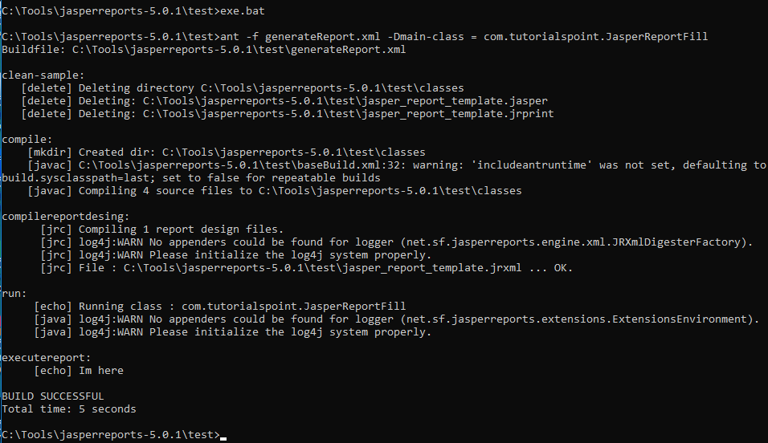
7.6 Execute Fill Report
https://www.tutorialspoint.com/jasper_reports/index.htm
We also can type “exe.bat” to execute as follow:

Slide 23
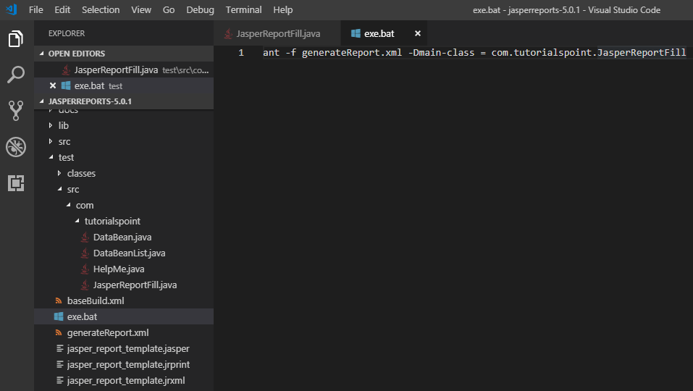
7.6 Execute Fill Report
https://www.tutorialspoint.com/jasper_reports/index.htm
After execution, a file jasper_report_template.jrprint is generated in the same directory as the .jasper file are generated at C:\tools\jasperreports-5.0.1\test)
The test folder are rename into src-ch07-Execute-Fill-Report for Github.

Slide 24
7.7 Summary

Slide 25
7.7 Summary
https://www.tutorialspoint.com/jasper_reports/index.htm
Summary
Create report template: jasper_report_template.jrxml
Create POJO DataBean.java to define Data Type.
Write a class DataBeanList.java to store POJO DataBean.java.
Write a main class file JasperReportFill.java: gets data from DataBeanList, passes it to the JasperReports engine, and to fill the report template.
Create generateReport.xml (build.xml) for ant to execute.
Create exe.bat to store the ant execution command and execute it.

Slide 26
End of Chapter

