Slide 1

9 Export Report
Peter H. Chen

Slide 2
9 Export Report
https://www.tutorialspoint.com/jasper_reports/index.htm
We discuss the Export Phase in this document.
Design Phase
(Create JRXML File)
Execute Phase
[Fill Jasper Template with Data to Generate Jasper Print File (xxx.jrprint)]
Compile Phase
(Compile JRXML to Jasper Template)
Export Phase
[Export the Report to Any Specified Format]

Slide 3
9 Export Report
https://www.tutorialspoint.com/jasper_reports/index.htm
The previous chapter, we print and view a JasperReport generated document.
This chapter discusses how to transform or export these reports into other formats such as PDF, HTML, and XLS.
Facade class net.sf.jasperreports.engine.JasperExportManager is used to achieve this functionality.
The ‘Export’ means ‘Transform’ the JasperPrint object (.jrprint file) into different format.
The following JasperReportExport.java export the JasperReport document.
The JasperExportManager provides methods to export a report into PDF, HTML, and XML only.
To export to the XLS format, we have used the class net.sf.jasperreports.engine.export.JRXlsExporter.
This code generates following three files −
sample_report.pdf
sample_report.html
sample_report.xls

Slide 4
9.1 jasper_report_template.jrxml

Slide 5
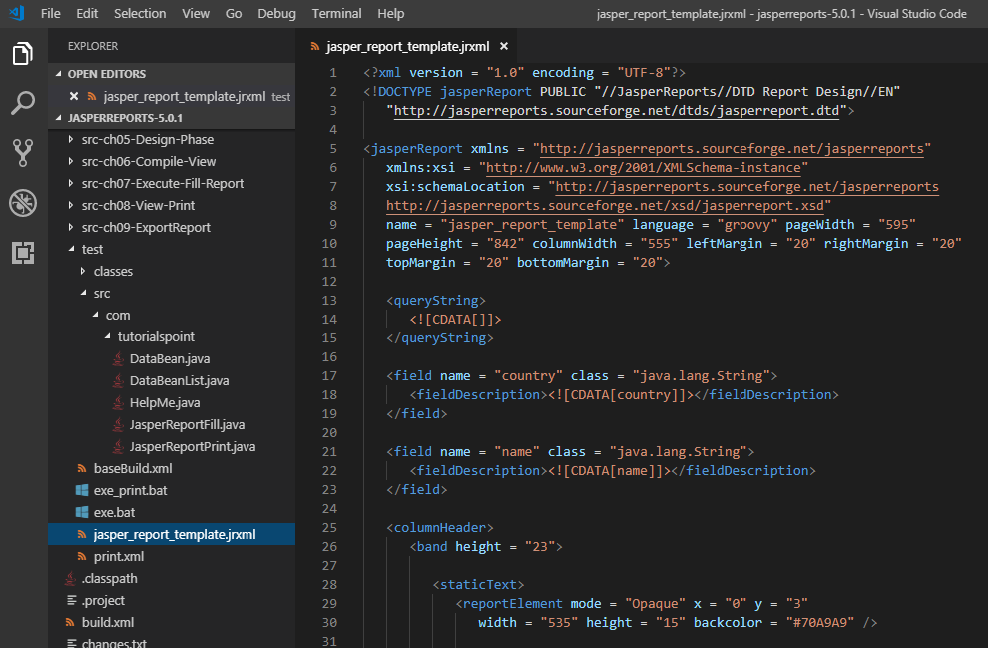
9.1 jasper_reprt_template.jrxml
https://www.tutorialspoint.com/jasper_reports/index.htm
Exporting to Other Formats
Write a report template. The contents of the JRXML file (C:\tools\jasperreports-5.0.1\test\jasper_report_template.jrxml) are as below

Slide 6
9.2 POJO DataBean.java

Slide 7
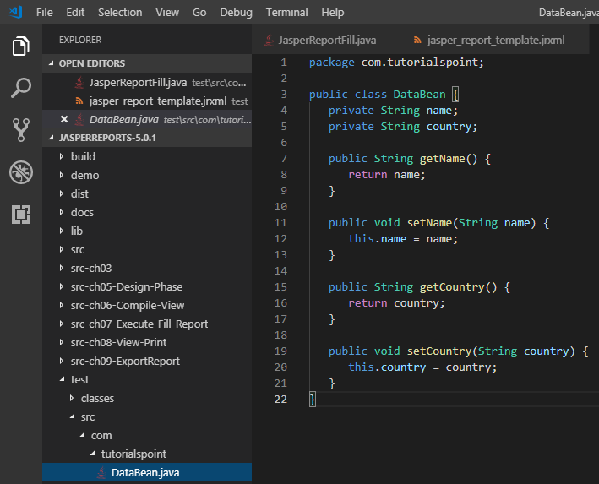
9.2 POJO DataBean.java
https://www.tutorialspoint.com/jasper_reports/index.htm
DataBean.java
Write POJO DataBean.java file C:\tools\jasperreports-5.0.1\test\src\com\tutorialspoint\DataBean.java

Slide 8
9.3 DataBeanList.java

Slide 9
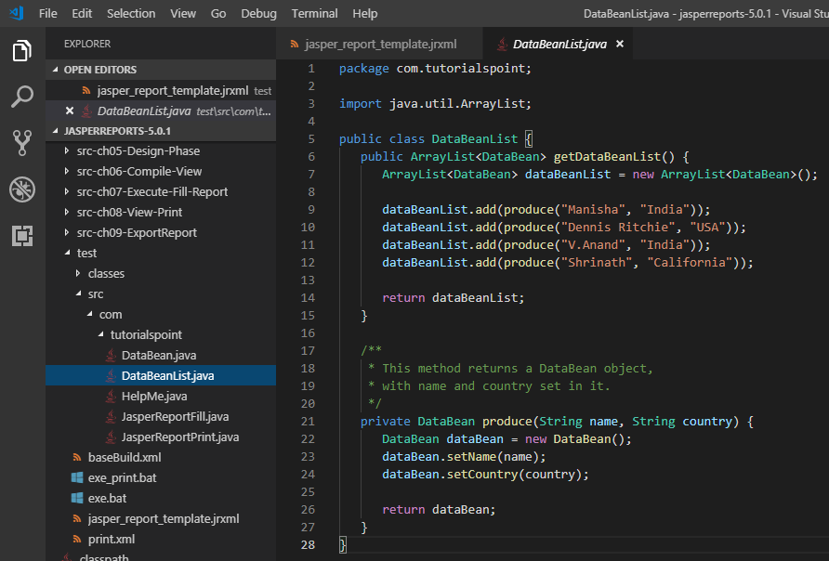
9.3 DataBeanList.java
https://www.tutorialspoint.com/jasper_reports/index.htm
DataBeanList.java
Write file C:\tools\jasperreports-5.0.1\test\src\com\tutorialspoint\DataBeanList.java

Slide 10
9.4 JasperReportFill.java

Slide 11
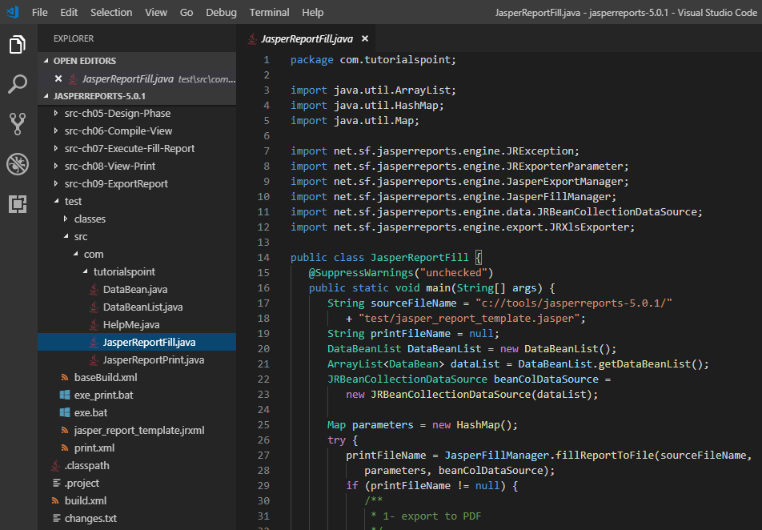
9.4 JasperReportFill.java
https://www.tutorialspoint.com/jasper_reports/index.htm
JasperReportFill.java
Write a main class file JasperReportFill.java, which gets the java bean collection from the class (DataBeanList) and passes it to the JasperReports engine, to fill the report template. Save it to the directory C:\tools\jasperreports-5.0.1\test\src\com\tutorialspoint.

Slide 12
9.5 genReport.xml

Slide 13
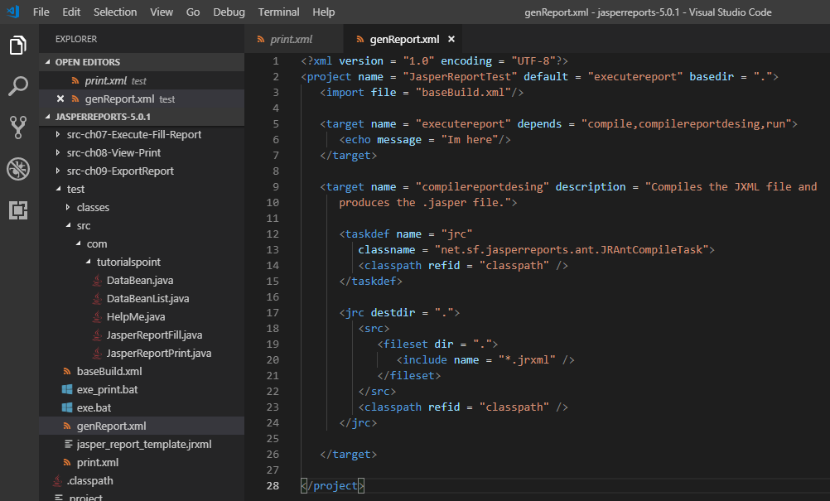
9.5 genReport.xml
https://www.tutorialspoint.com/jasper_reports/index.htm
genReport.xml
Save it to the directory C:\tools\jasperreports-5.0.1\test.

Slide 14
9.6 exe_genReport.bat

Slide 15
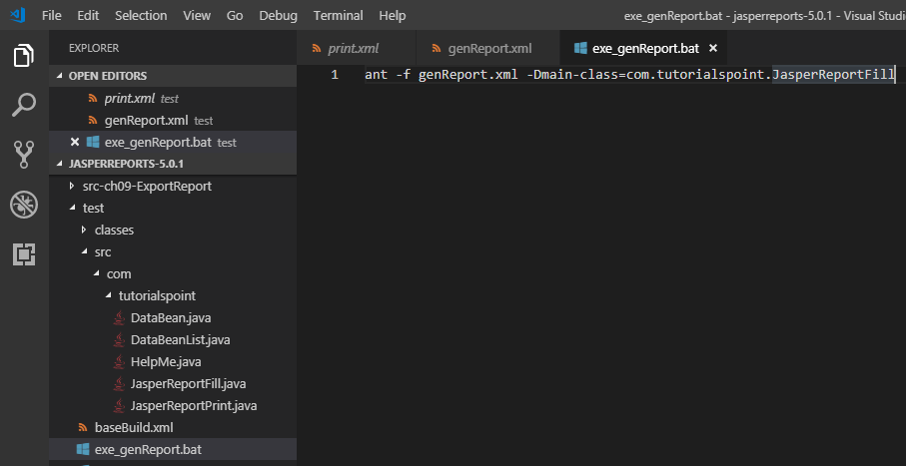
9.6 exe_genReport.bat
https://www.tutorialspoint.com/jasper_reports/index.htm
exe_genReport.bat
Save it to the directory C:\tools\jasperreports-5.0.1\test.

Slide 16
9.7 Execute exe_genReport.bat

Slide 17
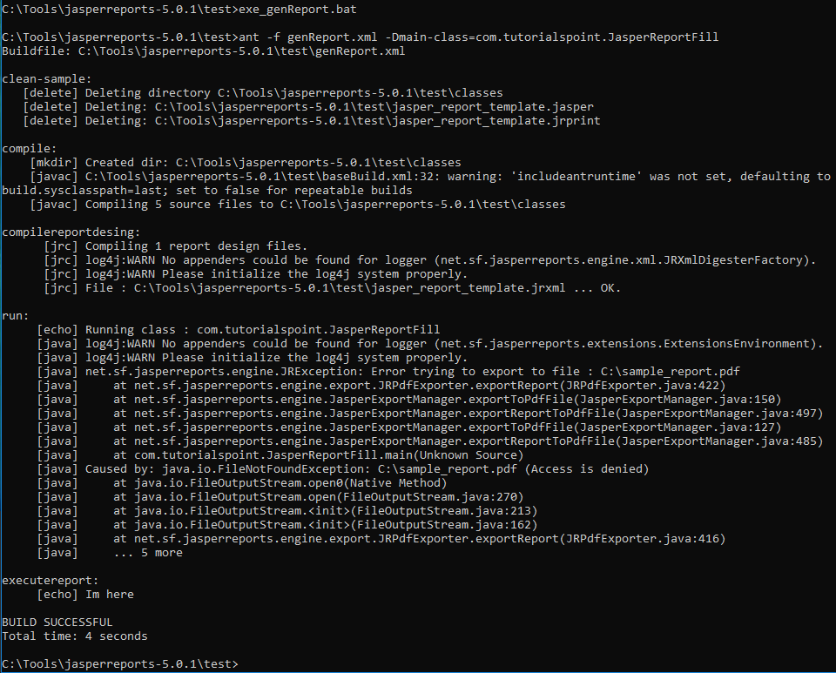
9.7 Execute exe_genReport.bat
https://www.tutorialspoint.com/jasper_reports/index.htm
> cd test
> exe_genReport.bat

Slide 18
9.8 Discussion

Slide 19
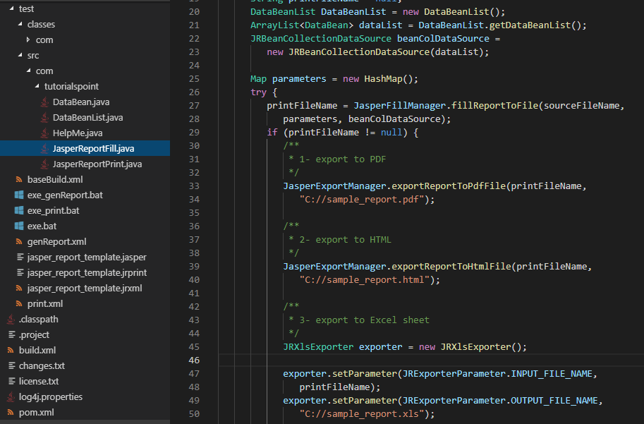
9.8 Discussion
https://www.tutorialspoint.com/jasper_reports/index.htm
JasperExportManager have error and did not generate PDF, HTML, XML files.

Slide 20
End of Chapter

