Slide 1

10 Report Parameter
Peter H. Chen

Slide 2
10 Report Parameter
https://www.tutorialspoint.com/jasper_reports/index.htm
We discuss the Export Parameter in Execute Phase.
Design Phase
(Create JRXML File)
Execute Phase
[Fill Jasper Template with Data to Generate Jasper Print File (xxx.jrprint)]
Compile Phase
(Compile JRXML to Jasper Template)
Export Phase
[Export the Report to Any Specified Format]

Slide 3
10 Report Parameter
https://www.tutorialspoint.com/jasper_reports/index.htm
The main input for filling a report are: report template, parameters, and data sources.
This chapter discusses the parameters. Next chapter will discuss the data sources.
Parameters are the object references, those are passed during report-filling operations to the report engine.
The data which cannot be passed through the data source, can be passed by using parameters. Data like author name, title of the report, etc. can be passed through parameters.
A JasperReports template or JRXML template can have zero or more parameter elements.

Slide 4
10 Report Parameter
https://www.tutorialspoint.com/jasper_reports/index.htm
Parameter Declaration
Parameter declaration as follows
<parameter name = "exampleParameter" class = "java.lang.String" />
The Name Attribute
The name attribute of the <parameter> element is mandatory. It references the parameter in report expressions by name.
Parameter name should be a single word. It should not contain any special characters like dot or comma.

Slide 5
10 Report Parameter
https://www.tutorialspoint.com/jasper_reports/index.htm
<parameter name = "exampleParameter" class = "java.lang.String" />
The Class Attribute
The class attribute is also mandatory and it specifies the class name for the parameter values. Its default value is java.lang.String. This can be changed to any class available at runtime. Irrespective of the type of a report parameter, the engine takes care of casting in the report expressions in which the $P{} token is used, hence making the manual casts is unnecessary.
The report parameter values are always packed in a java.util.Map object, which has the parameter name as its key.
Report parameters can be used in the query string of the report, so as to further customize the data set, retrieved from the database. These act like dynamic filters in the query that supplies data for the report.

Slide 6
10 Report Parameter
https://www.tutorialspoint.com/jasper_reports/index.htm
Built-in Parameters
Following are the pre-defined report parameters, ready to use in the expressions
S. NO | Parameter Name and Description
1 | REPORT_PARAMETERS_MAP Contains a map with all user defined and built-in parameters.
2 | REPORT_CONNECTION This points to the user supplied class java.sql.Connection, used for JDBC datasources.
3 | REPORT_DATA_SOURCE This is a user supplied instance of JRDataSource representing either one of the built-in data source types or a user-defined one.
4 | REPORT_MAX_COUNT This is a java.lang.Integer value, allowing the users to limit the records from datasource.

Slide 7
10 Report Parameter
https://www.tutorialspoint.com/jasper_reports/index.htm
Built-in Parameters
Following are the pre-defined report parameters, ready to use in the expressions
S. NO | Parameter Name and Description
5 | REPORT_SCRIPTLET This points to net.sf.jasperreports.engine.JRAbstractScriptlet and contains an instance of the report scriptlet provided by the user.
6 | REPORT_LOCALE This a java.util.Locale instance, containing the resource bundle desired locale.
7 | REPORT_RESOURCE_BUNDLE This points to java.util.ResourceBundle object and contains localized messages.
8 | REPORT_TIME_ZONE This is a java.util.TimeZone instance, used for the date formatting.

Slide 8
10 Report Parameter
https://www.tutorialspoint.com/jasper_reports/index.htm
Built-in Parameters
Following are the pre-defined report parameters, ready to use in the expressions
S. NO | Parameter Name and Description
9 | REPORT_VIRTUALIZER This is an instance of net.sf.jasperreports.engine.JRVirtualizerobject, and used for the page virtualization (optimize memory consumption).
10 | REPORT_CLASS_LOADER This is a java.lang.ClassLoader instance to be used during the report filling process to load resources such as images, fonts, and subreport templates
11 | IS_IGNORE_PAGINATION If set to java.lang.Boolean.TRUE the report will be generated on one long page and page break will not occur.

Slide 9
10.1 JasperReportFill.java

Slide 10
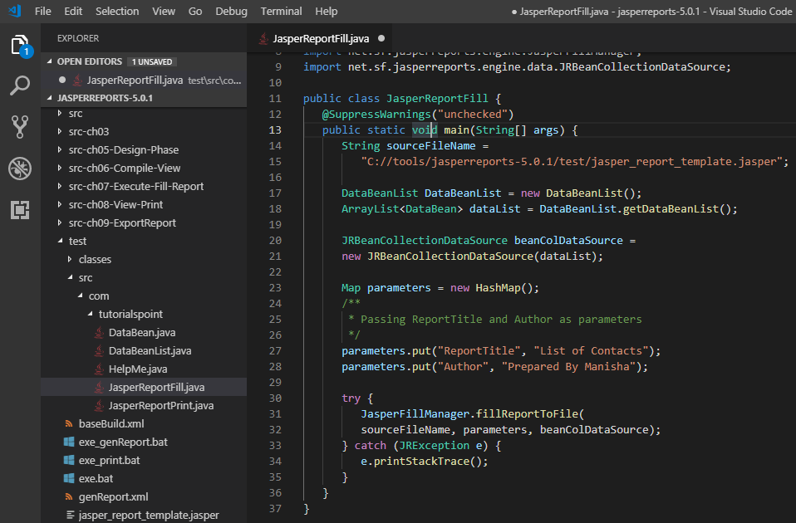
10.1 JasperReportFill.java
https://www.tutorialspoint.com/jasper_reports/index.htm
Pass ReportTitle and Author to the report (generated by JasperReportFill.java).
C:\tools\jasperreports-5.0.1\test\src\com\tutorialspoint\JasperReportFill.java

Slide 11
10.2 POJO DataBean.java

Slide 12
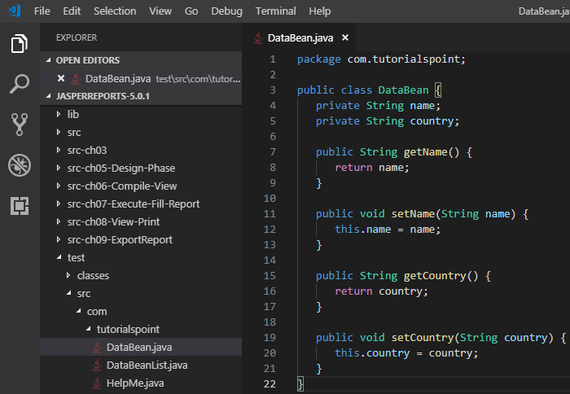
10.2 POJA DataBean.java
https://www.tutorialspoint.com/jasper_reports/index.htm
The POJO DataBean.java file C:\tools\jasperreports-5.0.1\test\src\com\tutorialspoint\DataBean.java are as below:

Slide 13
10.3 DataBeanList.java

Slide 14
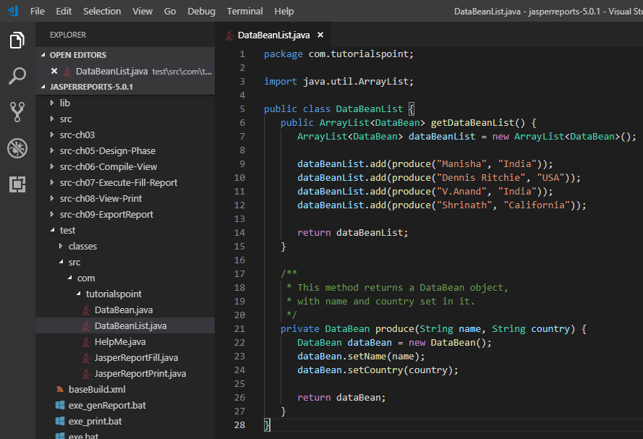
10.3 DataBeanList.java
https://www.tutorialspoint.com/jasper_reports/index.htm
The DataBeanLIst.java file C:\tools\jasperreports-5.0.1\test\src\com\tutorialspoint\DataBeanList.java are as given below

Slide 15
10.4 jasper_report_template.jrxml

Slide 16
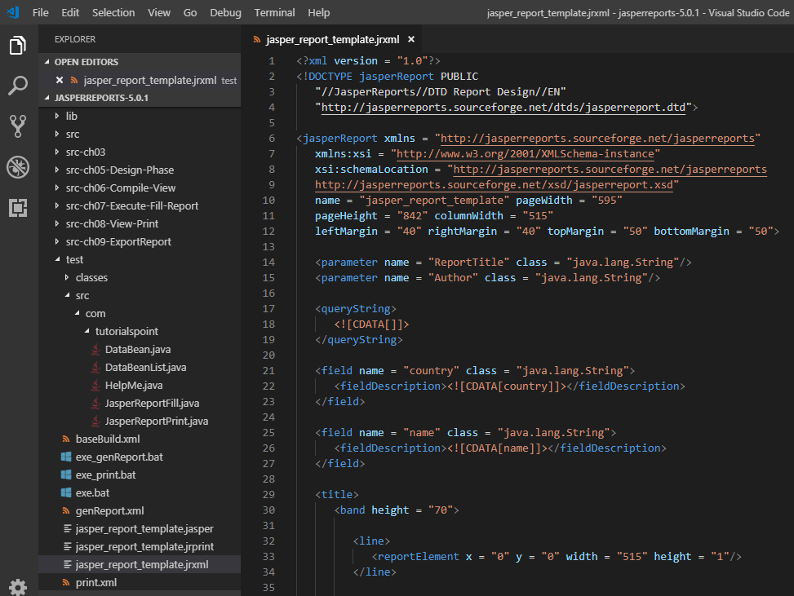
10.4 jasper_report_template.jrxml
https://www.tutorialspoint.com/jasper_reports/index.htm
Add parameters the <ReportTitle> and <Author> to report template (Chapter Report Designs). The Report Title and Author will be displayed at the beginning of the report.
The jasper_report_template.jrxml is as follows. Save it to C:\tools\jasperreports-5.0.1\test directory

Slide 17
10.5 buildParam.xml

Slide 18
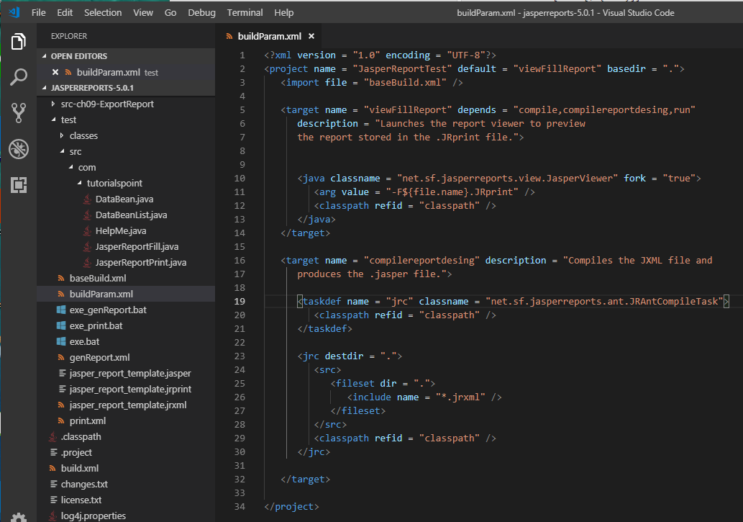
10.5 buildParam.xml
https://www.tutorialspoint.com/jasper_reports/index.htm
buildParam.xml (build.xml) (C:\tools\jasperreports-5.0.1\test)

Slide 19
10.5 buildParam.xml
https://www.tutorialspoint.com/jasper_reports/index.htm
Report Generation
Compile and execute the above file using our regular ANT build process.
The contents of the file buildParam.xml (build.xml) (saved under directory C:\tools\jasperreports-5.0.1\test) are as below.
The import file - baseBuild.xml is picked from the chapter Environment Setup and should be placed in the same directory as the build.xml.

Slide 20
10.6 exe_buildParam.bat

Slide 21
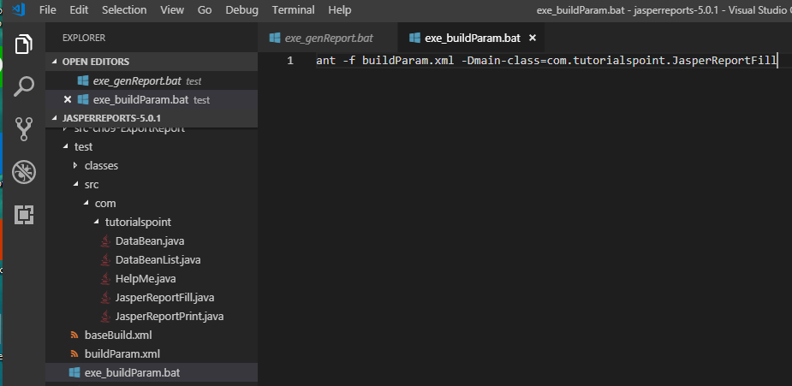
10.6 exe_buildParam.bat
https://www.tutorialspoint.com/jasper_reports/index.htm
Write exe_buildParam.bat
ant -f buildParam.xml -Dmain-class=com.tutorialspoint.JasperReportFill

Slide 22
10.7 Execute exe_buildParam.bat

Slide 23
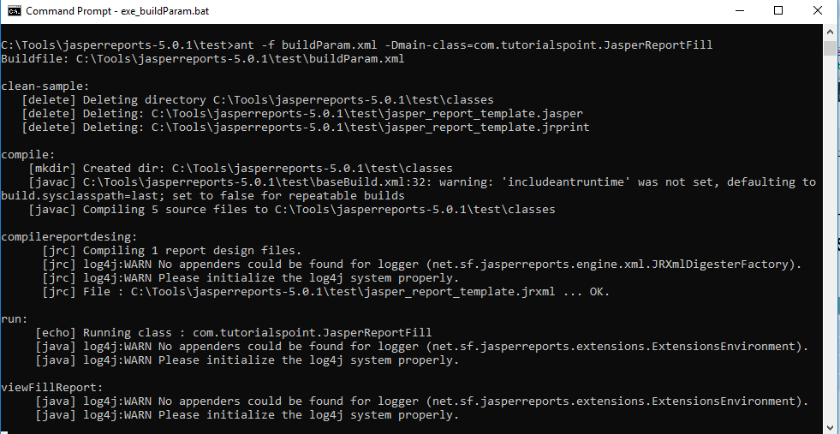
10.7 Execute exe_buildParam.bat
https://www.tutorialspoint.com/jasper_reports/index.htm
> exe_buildParam.bat

Slide 24
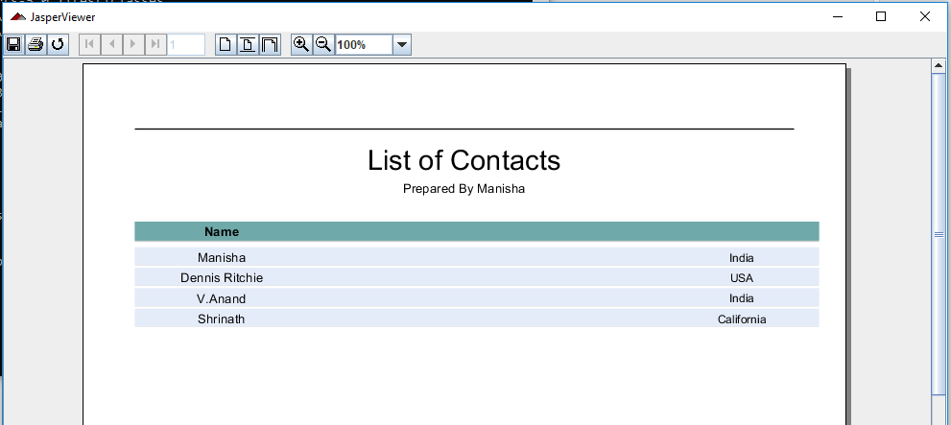
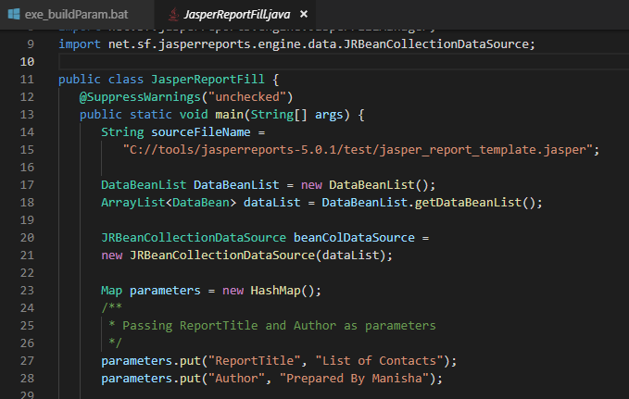
10.7 Execute exe_buildParam.bat
https://www.tutorialspoint.com/jasper_reports/index.htm
Here, we see that, the ReportTitle "List Of Contacts" and Author "Prepared By Manisha" are displayed at the beginning of the report.
These parameters are passed in JasperReportFill.java

Slide 25
End of Chapter

