Slide 1

12 Field
Peter H. Chen

Slide 2
12 Field
https://www.tutorialspoint.com/jasper_reports/index.htm
We discuss the Field in Design Phase. This chapter exercises Sort Field Example.
Design Phase
(Create JRXML File)
Execute Phase
[Fill Jasper Template with Data to Generate Jasper Print File (xxx.jrprint)]
Compile Phase
(Compile JRXML to Jasper Template)
Export Phase
[Export the Report to Any Specified Format]

Slide 3
12 Field
https://www.tutorialspoint.com/jasper_reports/index.htm
What is Field?
Report fields are elements represent mapping of data between datasource and report template.
Fields can be combined in the report expressions to obtain the desired output.
A report template can contain zero or more <field> elements.
When declaring report fields, the data source should supply data corresponding to all the fields defined in the report template.

Slide 4
12 Field
https://www.tutorialspoint.com/jasper_reports/index.htm
Field Declaration
Field declaration is done as shown below:
<field name = "FieldName" class = "java.lang.String"/>
The Name Attribute
The name attribute of the <field> element is mandatory. It references the field in report expressions by name.
The Class Attribute
The class attribute specifies the class name for the field values. Its default value is java.lang.String. This can be changed to any class available at runtime. Irrespective of the type of a report field, the engine takes care of casting in the report expressions in which the $F{} token is used, hence making manual casts unnecessary.

Slide 5
12 Field
https://www.tutorialspoint.com/jasper_reports/index.htm
Field Description
The <fieldDesciption> element is an optional element. This is very useful when implementing a custom data source. For example, we can store a key or some information, by which we can retrieve the value of field from the custom data source at runtime. By using the <fieldDesciption> element instead of the field name, you can easily overcome restrictions of field-naming conventions when retrieving the field values from the data source.

Slide 6
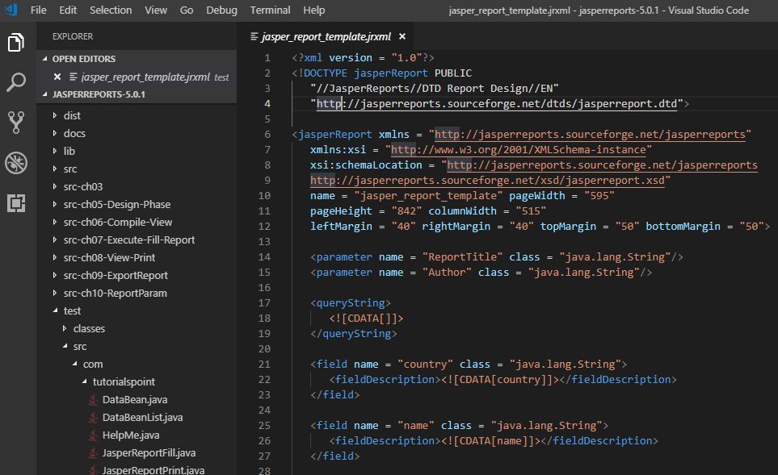
12 Field
https://www.tutorialspoint.com/jasper_reports/index.htm
Field Description
Following is a piece of code from our existing JRXML file (Chapter 05: Report Designs). Here, we can see usage of name, class, and fieldDescription elements.
<field name = "country" class = "java.lang.String">
<fieldDescription><![CDATA[country]]></fieldDescription>
</field>
<field name = "name" class = "java.lang.String">
<fieldDescription><![CDATA[name]]></fieldDescription>
</field>

Slide 7
12.1 jasper_report_template.jrxml

Slide 8
12.1 jasper_report_template.jrxml
https://www.tutorialspoint.com/jasper_reports/index.htm
Sort Fields
At the times when data sorting is required and the data source implementation doesn't support it (for e.g. CSV datasource), JasperReports supports in-memory field-based data source sorting. The sorting can be done using one or more <sortField> elements in the report template.
If at least one sort field is specified, during report filling process, the data source is passed to a JRSortableDataSource instance. This in turn, fetches all the records from data source, performs in memory sort according to the specified fields, and replaces the original data source.
The sort field name should be identical to the report field name. Fields used for sorting should have types that implement java.util.Comparable. Natural order sorting is performed for all fields except those of type java.lang.String (for String type, collator corresponding to the report fill locale is used). When several sort Fields are specified, the sorting will be performed using the fields as sort keys in the order in which they appear in the report template. Following example demonstrates the sorting feature.

Slide 9
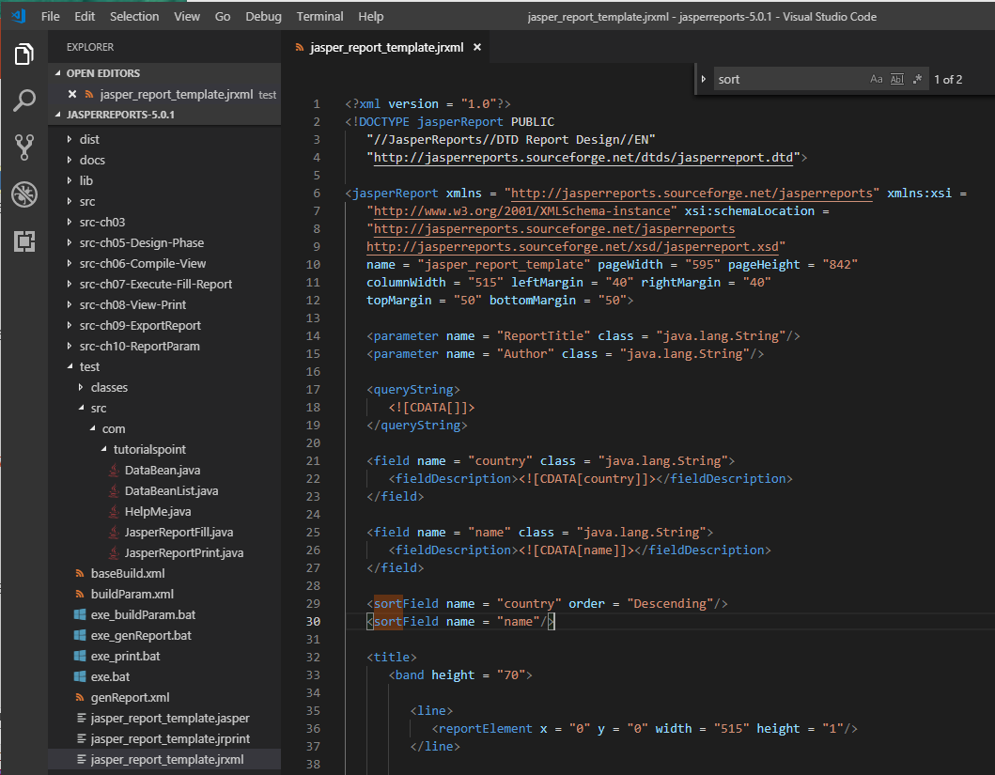
12.1 jasper_report_template.jrxml
https://www.tutorialspoint.com/jasper_reports/index.htm
Add the <sortField> element to our existing report template (Chapter 05 Report designs). The sort field country is in descending order.
Create the revised report template (jasper_report_template.jrxml) is as follow in C:\tools\jasperreports-5.0.1\test directory

Slide 10
12.2 POJO DataBean.java

Slide 11
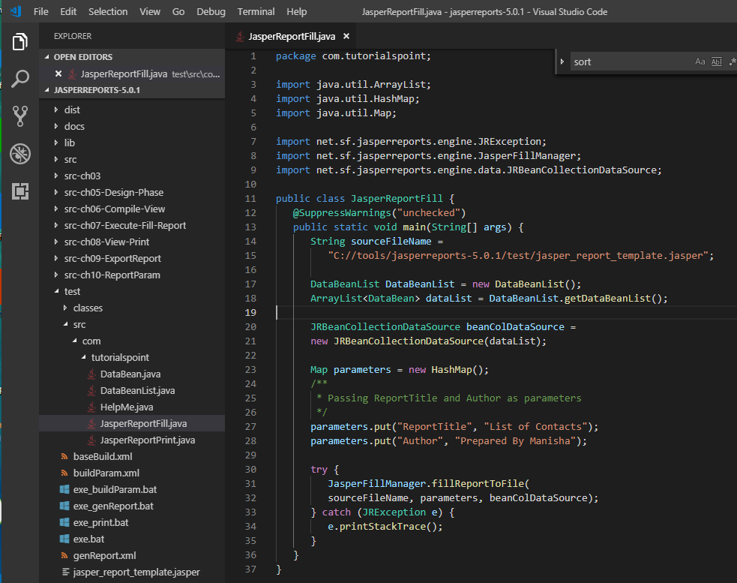
12.2 JPOJO DataBean.java
https://www.tutorialspoint.com/jasper_reports/index.htm
The java codes for report filling remains unchanged (No change).
C:\tools\jasperreports-5.0.1\test\src\com\tutorialspoint\JasperReportFill.java

Slide 12
12.3 JasperReportFill.java

Slide 13
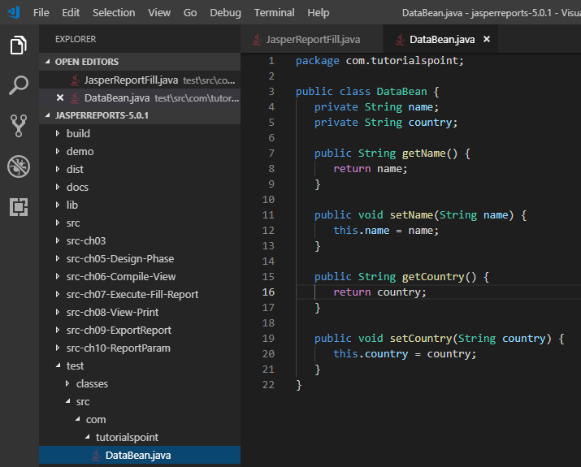
12.3 POJO DataBean.java
https://www.tutorialspoint.com/jasper_reports/index.htm
POJO DataBean.java remain unchanged (No Change).
C:\tools\jasperreports-5.0.1\test\src\com\tutorialspoint\DataBean.java

Slide 14
12.4 DataBeanList.java

Slide 15
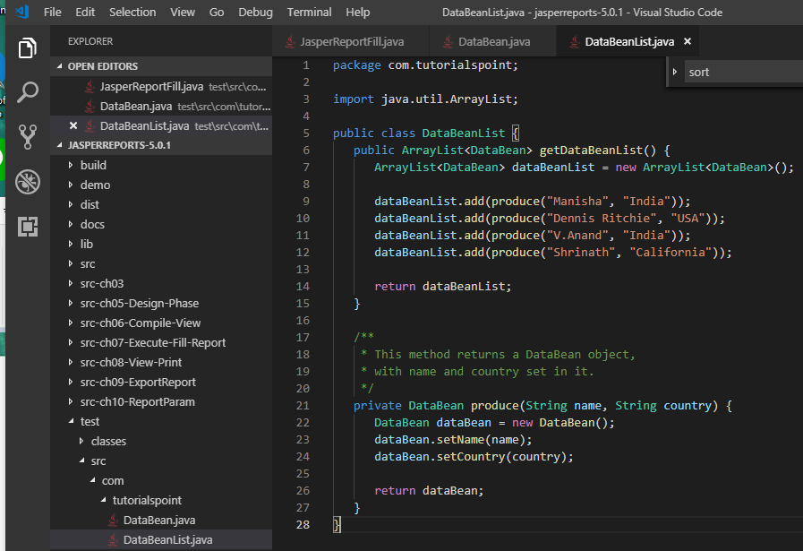
12.4 DataBeanList.java
https://www.tutorialspoint.com/jasper_reports/index.htm
POJO DataBeanList.java remain unchanged (No Change).
C:\tools\jasperreports-5.0.1\test\src\com\tutorialspoint\DataBeanList.java

Slide 16
12.5 buildField.xml

Slide 17
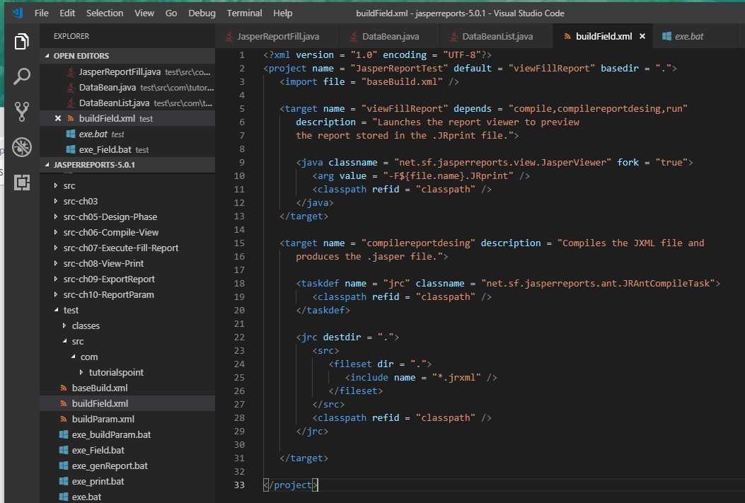
12.5 buildField.xml
https://www.tutorialspoint.com/jasper_reports/index.htm
Write buildField.xml to call baseBuild.xml is picked from chapter 03 Environment Setup and in test folder.

Slide 18
12.6 exe_Field.bat

Slide 19
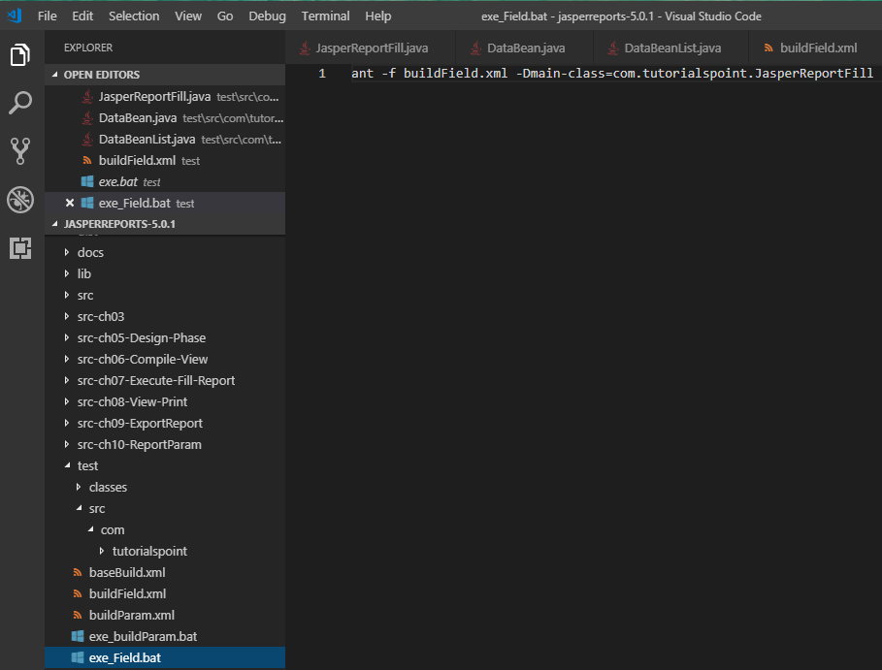
12.6 exe_Field.bat
https://www.tutorialspoint.com/jasper_reports/index.htm
Write exe_Field.bat with command:
ant -f buildField.xml -Dmain-class=com.tutorialspoint.JasperReportFill

Slide 20
12.7 Run exe_Field.bat

Slide 21
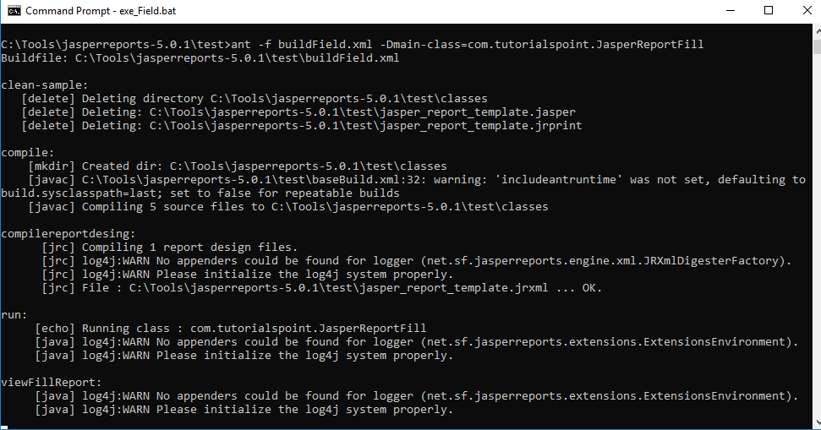
12.7 Run exe_Field.bat
https://www.tutorialspoint.com/jasper_reports/index.htm
Run exe_Field.bat

Slide 22
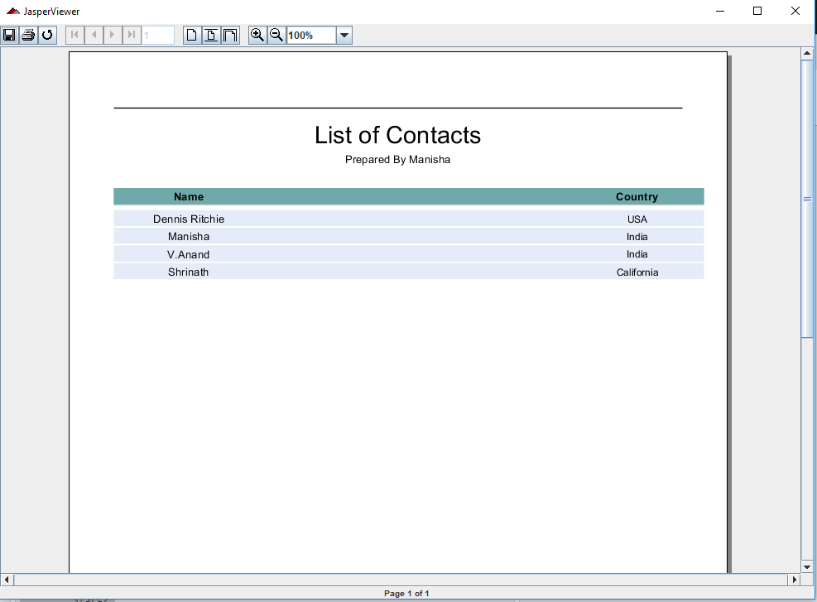
12.7 Run exe_Field.bat
https://www.tutorialspoint.com/jasper_reports/index.htm
Sort Field Country in Descendent.

Slide 23
End of Chapter

