Slide 1

13 Expression
Peter H. Chen

Slide 2
13 Expression
https://www.tutorialspoint.com/jasper_reports/index.htm
We discuss the Expression in Design Phase. This chapter exercises Expression for Dynamic Data Example.
Design Phase
(Create JRXML File)
Execute Phase
[Fill Jasper Template with Data to Generate Jasper Print File (xxx.jrprint)]
Compile Phase
(Compile JRXML to Jasper Template)
Export Phase
[Export the Report to Any Specified Format]

Slide 3
13 Expression
https://www.tutorialspoint.com/jasper_reports/index.htm
Report expressions for Dynamic Data
Report expressions are the powerful features of JasperReports, which allow us to display calculated data on a report.
Calculated data is the data that is not a static data and is not specifically passed as a report parameter or datasource field.
Report expressions are built from combining report parameters, fields, and static data.
The Java language is used for writing report expressions by default.
Other scripting languages for report expressions like Groovy scripting language, JavaScript, or BeanShell script are supported by JasperReports compilers.
This chapter will explain you − how do report expressions work, assuming that they have been written using the Java language only.

Slide 4
13 Expression
https://www.tutorialspoint.com/jasper_reports/index.htm
In a JRXML report template, there are several elements that define expressions as
<variableExpression>
<initialValueExpression>
<groupExpression>
<printWhenExpression>
<imageExpression>
<textFieldExpression>

Slide 5
13 Expression
https://www.tutorialspoint.com/jasper_reports/index.htm
Expression Declaration
Basically, all report expressions are Java expressions, which can reference the report fields, report variables, and report parameters.
Field Reference in Expression
To use a report field reference in an expression, the name of the field must be put between $F{and} character sequences, as shown below
<textfieldexpression>
$F{Name}
</textfieldexpression>
Following is a piece of code from our existing JRXML file (chapter 05 Report Design)
<textFieldExpression class = "java.lang.String">
<![CDATA[$F{country}]]>
</textFieldExpression>

Slide 6
13 Expression
https://www.tutorialspoint.com/jasper_reports/index.htm
Variable Reference in Expression
To reference a variable in an expression, we must put the name of the variable between $V{and} as shown in the example given below
<textfieldexpression>
"Total height : " + $V{SumOfHeight} + " ft."
</textfieldexpression>
Parameter Reference in Expression
To reference a parameter in an expression, the name of the parameter should be put between $P{and} as shown in the example given below
<textfieldexpression>
"ReportTitle : " + $P{Title}
</textfieldexpression>

Slide 7
13 Expression
https://www.tutorialspoint.com/jasper_reports/index.htm
Following is a piece of code from our existing JRXML file, which demonstrates the referencing of parameter in an expression. (JRXML from chapter 05 Report Designs)
<textField isBlankWhenNull = "true" bookmarkLevel = "1">
<reportElement x = "0" y = "10" width = "515" height = "30"/>
<textElement textAlignment = "Center">
<font size = "22"/>
</textElement>
<textFieldExpression class = "java.lang.String">
<![CDATA[$P{ReportTitle}]]> </textFieldExpression> <anchorNameExpression>
<![CDATA["Title"]]>
</anchorNameExpression>
</textField>
<textField isBlankWhenNull = "true">
<reportElement x = "0" y = "40" width = "515" height = "20"/>
<textElement textAlignment = "Center">
<font size = "10"/>
</textElement>
<textFieldExpression class = "java.lang.String">
<![CDATA[$P{Author}]]>
</textFieldExpression>
</textField>

Slide 8
13 Expression
https://www.tutorialspoint.com/jasper_reports/index.htm
As you have seen above, the parameter, field, and variable references are in fact real Java objects.
Knowing their class from the parameter, field, or variable declaration made in the report template, we can even call methods on those object references in the expressions.
The following example shows − how to extract and display the first letter from java.lang.String report field "Name"
<textFieldExpression>
$F{Name}.substring(0, 1)
</textFieldExpression>

Slide 9
13 Expression
https://www.tutorialspoint.com/jasper_reports/index.htm
Resource Bundle Reference in Expression
To reference a resource in an expression, the key should be put between $R{and} as shown in the example given below
<textfieldexpression>
$R{report.title} </textfieldexpression>
Based on the runtime-supplied locale and the report.title key, the resource bundle associated with the report template is loaded.
Hence, the title of report is displayed by extracting the String value from the resource bundle.
More on internationalization can be found in the chapter 24 Internationalization.

Slide 10
13 Expression
https://www.tutorialspoint.com/jasper_reports/index.htm
Calculator
Calculator is an entity in JasperReports, which evaluates expressions and increments variables or datasets at report-filling time.
During compiling process, the information is produced and stored in the compile report by the compiler.
This information is used during the report-filling time to build an instance of the net.sf.jasperreports.engine.fill.JRCalculator class.
Java source file is generated and compiled by Java-based report compilers on the fly.
This generated class is a subclass of the JRCalculator, and the bytecode produced by compiling it is stored inside the JasperReport object.
This bytcode is loaded at the report filling time and the resulting class is instantiated to obtain the calculator object needed for expression evaluation.

Slide 11
13 Expression
https://www.tutorialspoint.com/jasper_reports/index.htm
Conditional Expressions
JasperReports doesn't support if-else statements when defining variable expressions.
Instead, you can use the ternary operators {cond} ? {statement 1} : {statement 2}.
This operator can be nested inside a Java expression to obtain the desired output based on multiple conditions.

Slide 12
13.1 jasper_report_template.jrxml

Slide 13
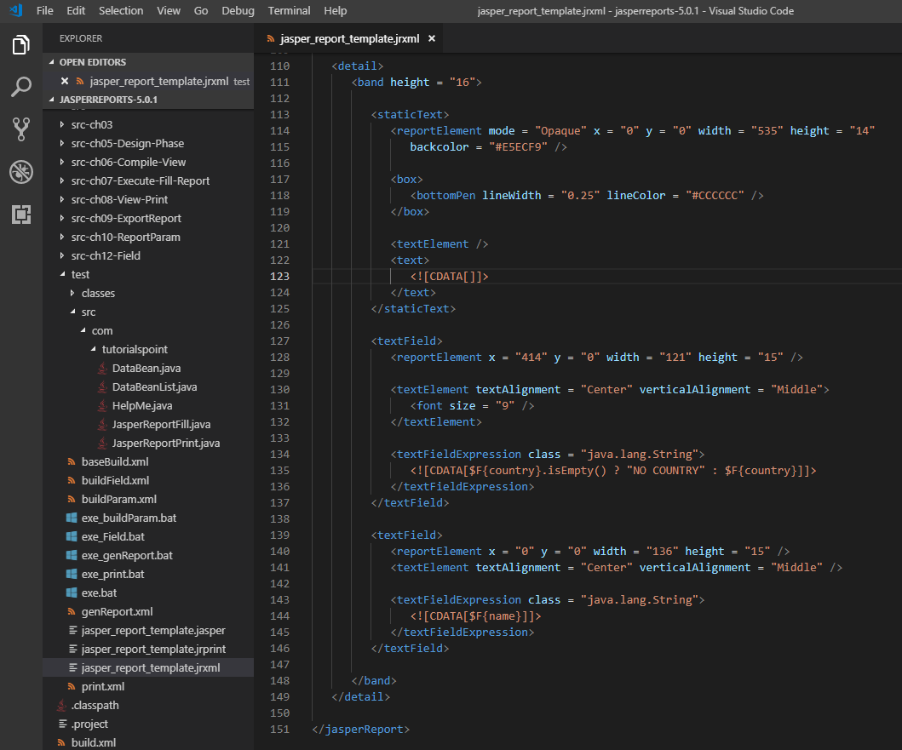
13.1 jasper_report_template.jrxml
https://www.tutorialspoint.com/jasper_reports/index.htm
Conditional Expressions Example:
Add conditional expression for field country (Chapter 05 Report Designs) for jasper_report_template.jrxml at C:\tools\jasperreports-5.0.1\test directory.

Slide 14
13.2 POJO DataBean.java

Slide 15
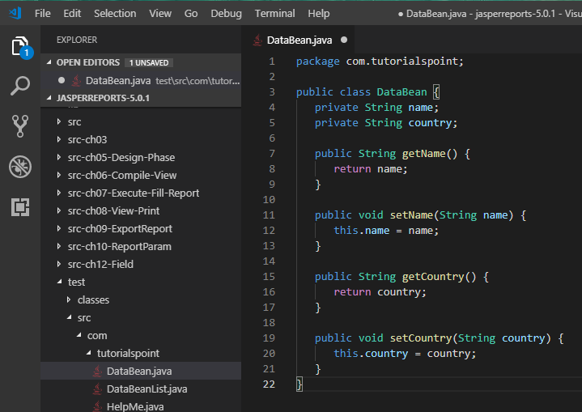
13.2 PJOJ DataBean.java
https://www.tutorialspoint.com/jasper_reports/index.htm
No change in POJO file C:\tools\jasperreports-5.0.1\test\src\com\tutorialspoint\DataBean.java:

Slide 16
13.3 DataBeanList.java

Slide 17
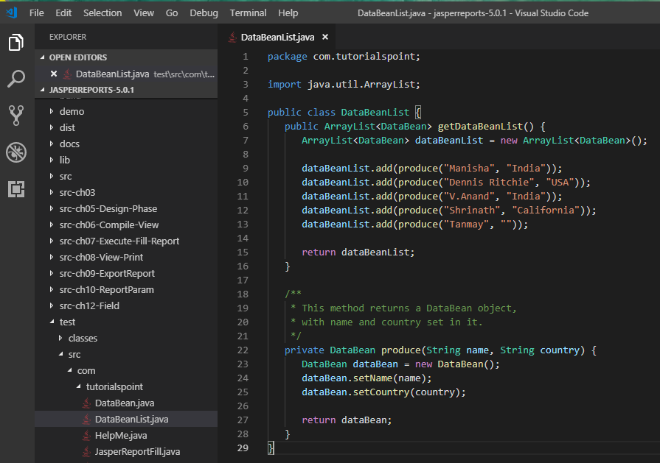
13.3 DataBeanList.java
https://www.tutorialspoint.com/jasper_reports/index.htm
Add Country “” in DataBeanList.java file C:\tools\jasperreports-5.0.1\test\src\com\tutorialspoint\DataBeanList.java:

Slide 18
13.4 buildExpression.xml

Slide 19
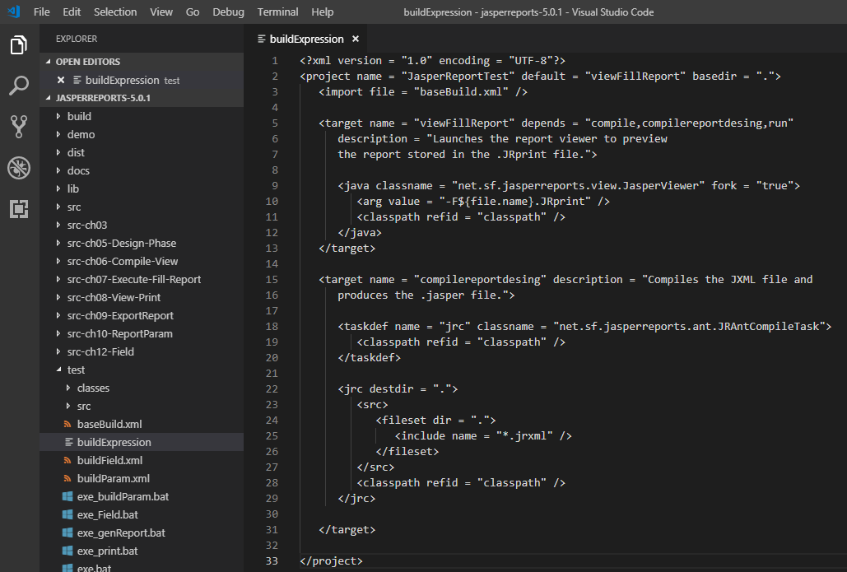
13.4 buildExpression.xml
https://www.tutorialspoint.com/jasper_reports/index.htm
Report Generation
Create buildExpression.xml (saved under directory C:\tools\jasperreports-5.0.1\test) are given below.
The import file - baseBuild.xml is picked from chapter the Chapter 03 Environment Setup and should be placed in the same directory as the build.xml

Slide 20
13.5 exe_Expression.bat

Slide 21
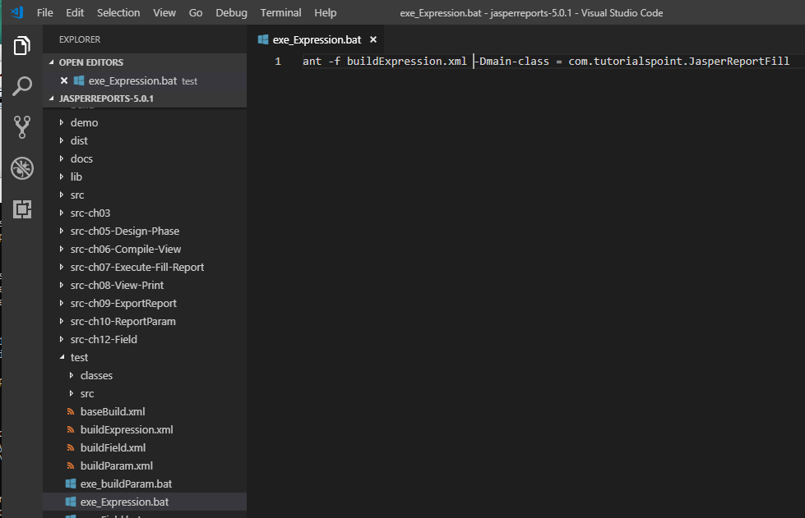
13.5 exe_Expression.bat
https://www.tutorialspoint.com/jasper_reports/index.htm
Exe_Expression.bat
ant -f build_Expression.xml -Dmain-class = com.tutorialspoint.JasperReportFill

Slide 22
13.6 Run exe_Expression.bat

Slide 23
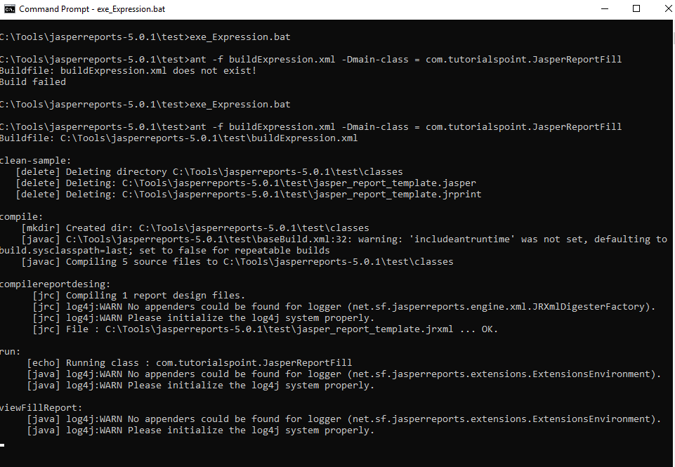
13.5 Run exe_Expression.bat
https://www.tutorialspoint.com/jasper_reports/index.htm
> exe_Expression.bat

Slide 24
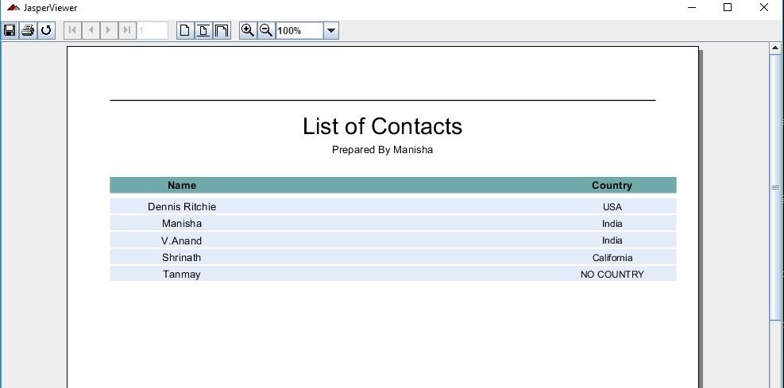
13.5 Run exe_Expression.bat
https://www.tutorialspoint.com/jasper_reports/index.htm
Display Report “NO COUNTRY”

Slide 25
End of Chapter

