Slide 1

14 Variable
Peter H. Chen

Slide 2
14 Variable
https://www.tutorialspoint.com/jasper_reports/index.htm
We discuss the variable in Design Phase.
Design Phase
(Create JRXML File)
Execute Phase
[Fill Jasper Template with Data to Generate Jasper Print File (xxx.jrprint)]
Compile Phase
(Compile JRXML to Jasper Template)
Export Phase
[Export the Report to Any Specified Format]

Slide 3
14 Variable
https://www.tutorialspoint.com/jasper_reports/index.htm
Variable
Report variables are special objects built on top of the report expression.
Report variables simplify the following tasks:
Report expressions, which are heavily used throughout the report template. These expressions can be declared only once by using the report variables.
Report variables can perform various calculations based on the corresponding expressions values such as count, sum, average, lowest, highest, variance, etc.
If variables are defined in a report design, then these can be referenced by new variables in the expressions. Hence, the order in which the variables are declared in a report design is important.

Slide 4
14 Variable
https://www.tutorialspoint.com/jasper_reports/index.htm
Variable Declaration
A variable declaration is as follows
<variable name = "CityNumber" class = "java.lang.Integer" incrementType = "Group"
incrementGroup = "CityGroup" calculation = "Count">
<variableExpression>
<![CDATA[Boolean.TRUE]]>
</variableExpression>
</variable>
As seen above, <variable> element contains number of attributes.
These attributes are summarized below

Slide 5
14 Variable
https://www.tutorialspoint.com/jasper_reports/index.htm
The Name Attribute
Similar to parameters and fields, the name attribute of </variable> element is mandatory. It allows referencing the variable by its declared name in the report expressions.
The Class Attribute
The class attribute is also mandatory that specifies the class name for the variable values. Its default value is java.lang.String.
This can be changed to any class available in the classpath, both at the report-compilation time and the report filling time.
The engine takes care of type-casting in report expressions which the $V{} token is used, hence manual type-casting is not required.

Slide 6
14 Variable
https://www.tutorialspoint.com/jasper_reports/index.htm
Calculation
This attribute determines − what calculation to perform on the variable when filling the report.

Slide 7
14 Variable
https://www.tutorialspoint.com/jasper_reports/index.htm
The following subsections describe all the possible values for the calculation attribute of the <variable> element.
Average − The variable value is the average of every non-null value of the variable expression. Valid for numeric variables only.
Count − The variable value is the count of non-null instances of the variable expression.
First − The variable value is the value of the first instance of the variable expression. Subsequent values are ignored.
Highest − The variable value is the highest value for the variable expression.
Lowest − The variable value is the lowest value for the variable expression in the report.
Nothing − No calculations are performed on the variable.
StandardDeviation − The variable value is the standard deviation of all non-null values matching the report expression. Valid for numeric variables only.
Sum − The variable value is the sum of all non-null values returned by the report expression.
System − The variable value is a custom calculation (calculating the value for that variable yourself, using the scriptlets functionality of JasperReports).
Variance − The variable value is the variance of all non-null values returned by evaluation of the report variable's expression.

Slide 8
14 Variable
https://www.tutorialspoint.com/jasper_reports/index.htm
Incrementor FactoryClass
This attribute determines the class used to calculate the value of the variable when filling the current record on the report. Default value would be any class implementing net.sf.jasperreports.engine.fill.JRIncrementerFactory.
The factory class will be used by the engine to instantiate incrementor objects at runtime depending on the calculation attribute set for the variable.
IncrementType
This determines when to recalculate the value of the variable. This attribute uses values, as below −
Column − The variable value is recalculated at the end of each column.
Group − The variable value is recalculated when the group specified by incrementGroup changes.
None − The variable value is recalculated with every record.
Page − The variable value is recalculated at the end of every page.
Report − The variable value is recalculated once, at the end of the report.

Slide 9
14 Variable
https://www.tutorialspoint.com/jasper_reports/index.htm
IncrementGroup
This determines the name of the group at which the variable value is recalculated, when incrementType is Group. This takes name of any group declared in the JRXML report template.
ResetType
This determines when the value of a variable is reset. This attribute uses values, as below −
Column − The variable value is reset at the beginning of each column.
Group − The variable value is reset when the group specified by incrementGroup changes.
None − The variable value is never reset.
Page − The variable value is reset at the beginning of every page.
Report − The variable value is reset only once, at the beginning of the report.

Slide 10
14 Variable
https://www.tutorialspoint.com/jasper_reports/index.htm
ResetGroup
This determines the name of the group at which the variable value is reset, when resetType is Group. The values for this attribute would be the name of any group declared in the JRXML report template.

Slide 11
14 Variable
https://www.tutorialspoint.com/jasper_reports/index.htm
Built-In Report Variables
There are some built-in system variables, ready to use in expressions, as follows (1)
S. NO | Variable Name and Description
1 | PAGE_NUMBER This variable's value is its current page number. It can be used to display both the current page number and the total number of pages using a special feature of JasperReports text field elements, the evaluationTime attribute.
2 | COLUMN_NUMBER This variable contains the current column number.
3 | REPORT_COUNT This report variable contains the total number of records processed.
4 | PAGE_COUNT This variable contains the number of records that were processed when generating the current page.

Slide 12
14 Variable
https://www.tutorialspoint.com/jasper_reports/index.htm
Built-In Report Variables
There are some built-in system variables, ready to use in expressions, as follows (2)
S. NO | Variable Name and Description
5 | COLUMN_COUNT This variable contains the number of records that were processed when generating the current column.
6 | GroupName_COUNT The name of this variable is derived from the name of the group it corresponds to, suffixed with the _COUNT sequence. This variable contains the number of records in the current group.

Slide 13
14.1 jasper_report_template.jrxml

Slide 14
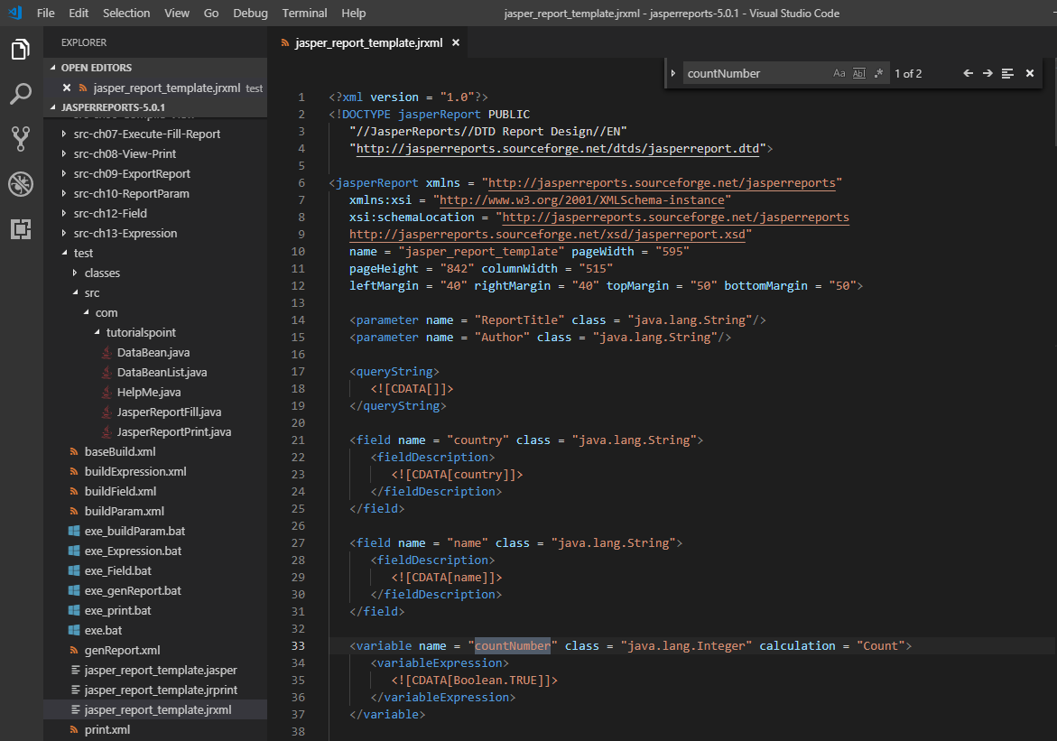
14.1 jasper_report_template.jrxml
https://www.tutorialspoint.com/jasper_reports/index.htm
Variable Example:
Add a variable (countNumber) to our existing report template (Chapter 05 Report Designs). We will prefix the count to each record. The revised report template (jasper_report_template.jrxml) is as follows.
Save it to C:\tools\jasperreports-5.0.1\test directory

Slide 15
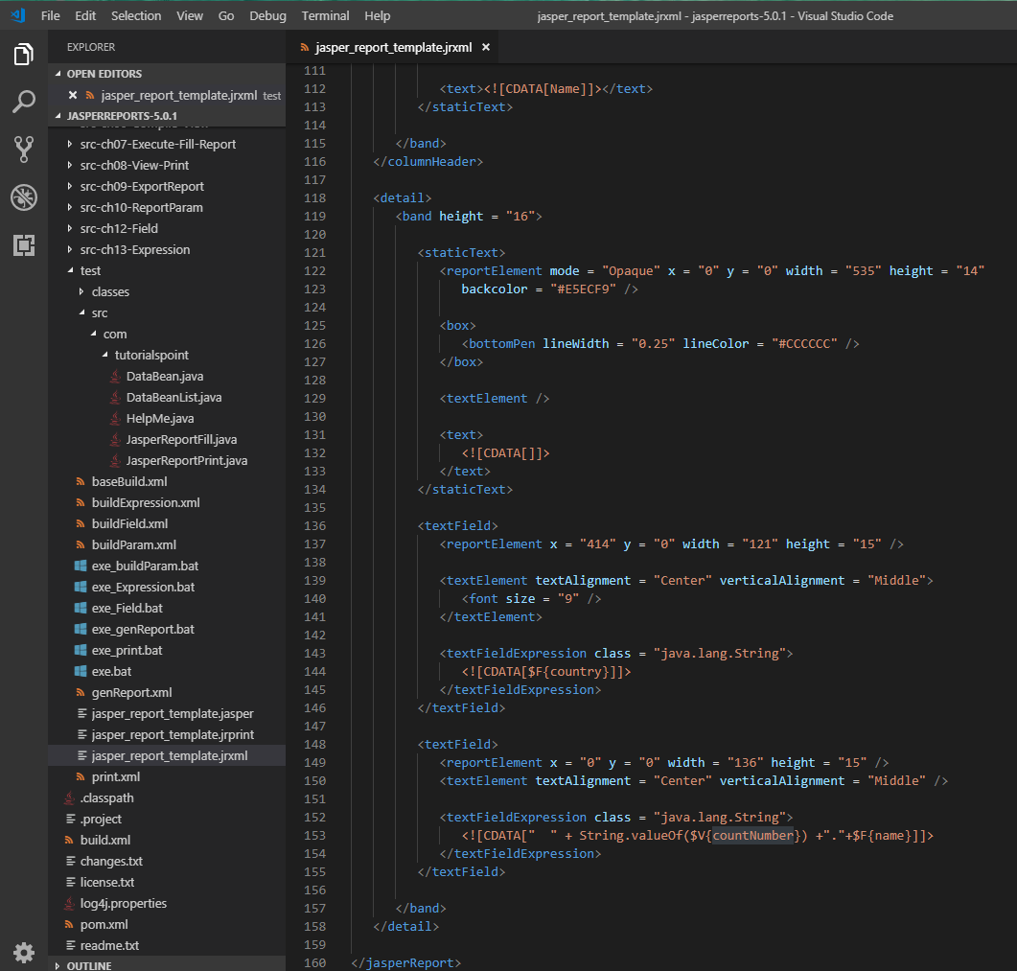
14.1 jasper_report_template.jrxml
https://www.tutorialspoint.com/jasper_reports/index.htm
Variable Example:
Add a variable (countNumber) to jasper_report_template.jrxml is as follows.

Slide 16
14.2 JasperReportFill.java

Slide 17
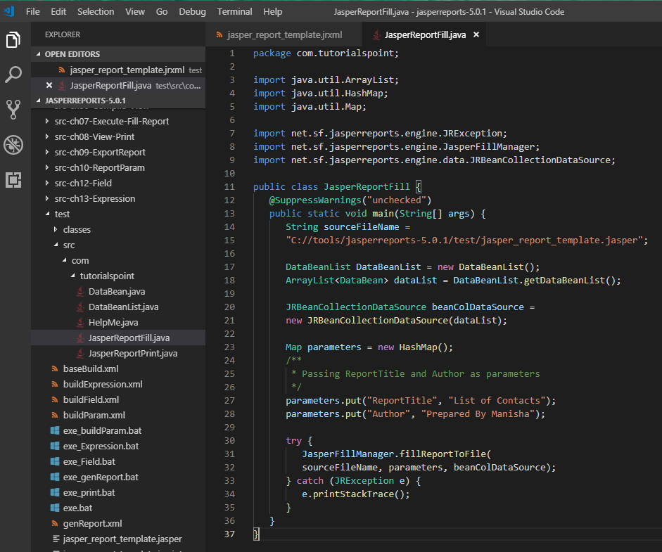
14.2 JasperReportFill.java
https://www.tutorialspoint.com/jasper_reports/index.htm
JasperReportFill.java file remains no change in C:\tools\jasperreports-5.0.1\test\src\com\tutorialspoint are as given below

Slide 18
14.3 POJO DataBean.java

Slide 19
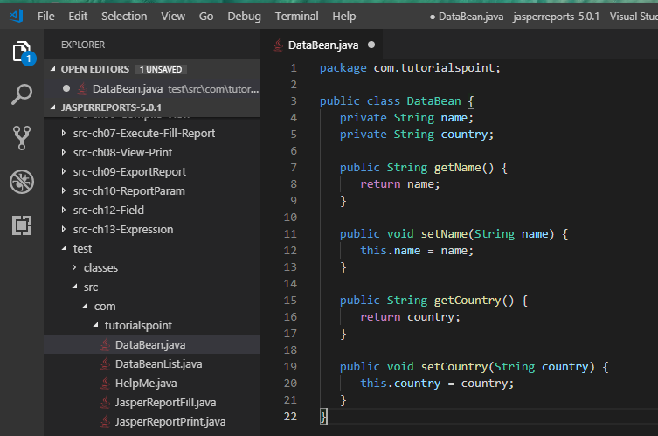
14.3 DataBean.java
https://www.tutorialspoint.com/jasper_reports/index.htm
No change in POJO file C:\tools\jasperreports-5.0.1\test\src\com\tutorialspoint\DataBean.java

Slide 20
14.4 DataBeanList.java

Slide 21
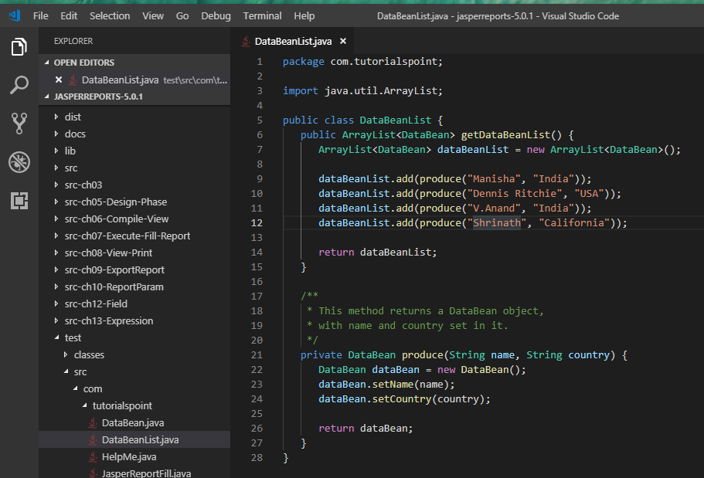
14.4 DataBeanList.java
https://www.tutorialspoint.com/jasper_reports/index.htm
Java file C:\tools\jasperreports-5.0.1\test\src\com\tutorialspoint\DataBeanList.java

Slide 22
14.5 buildVariable.xml

Slide 23
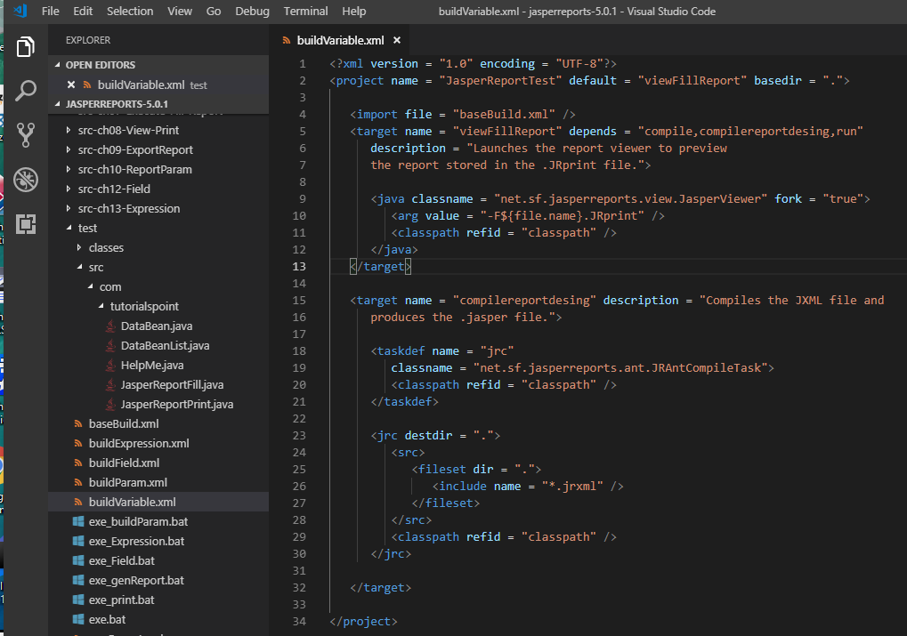
14.5 buildVariable.xml
https://www.tutorialspoint.com/jasper_reports/index.htm
Report Generation
We will compile and execute the above file using our regular ANT build process. The contents of the file buildVaraible.xml (saved under directory C:\tools\jasperreports-5.0.1\test) are as given below.
The import file - baseBuild.xml is picked from the chapter 03 Environment Setup and should be placed in the same directory as the build.xml

Slide 24
14.6 exe_Variable.bat

Slide 25
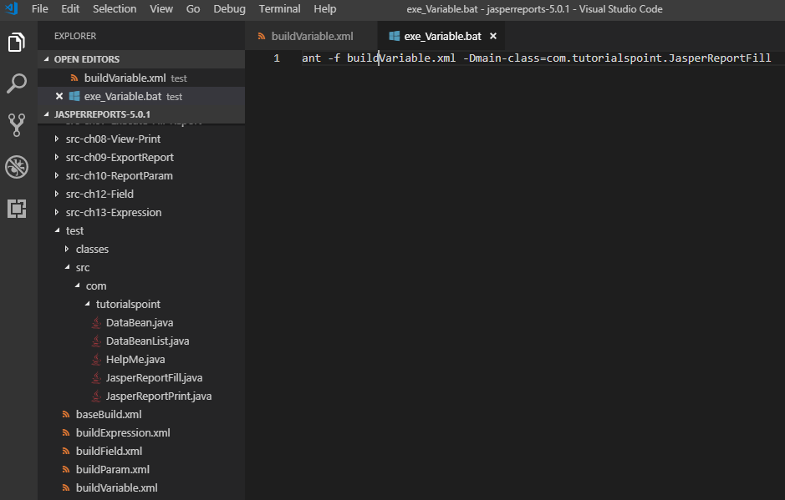
14.6 exe_Variable.bat
https://www.tutorialspoint.com/jasper_reports/index.htm
exe_Varaible.bat
ant -f build_Varaible.xml -Dmain-class=com.tutorialspoint.JasperReportFill

Slide 26
14.7 Run exe_Variable.bat

Slide 27
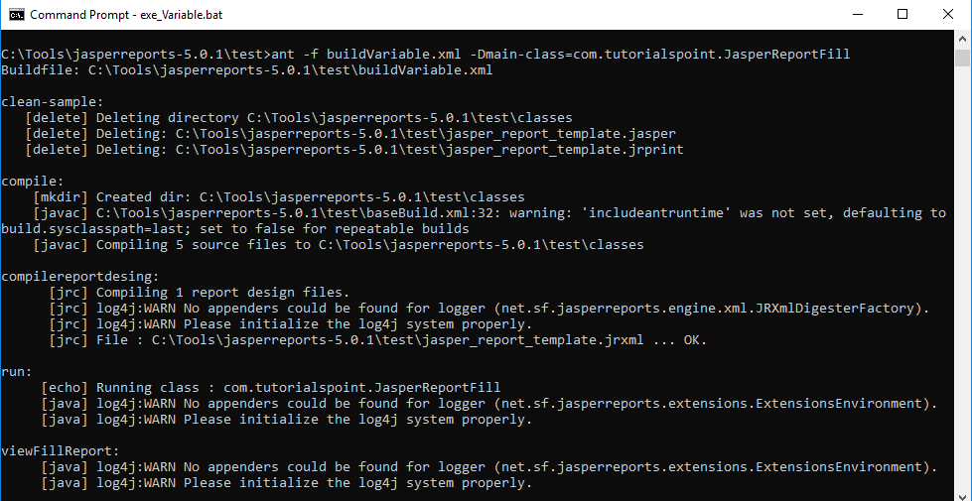
14.7 Run exe_Variable.bat
https://www.tutorialspoint.com/jasper_reports/index.htm
Run exe_Varaible.bat

Slide 28
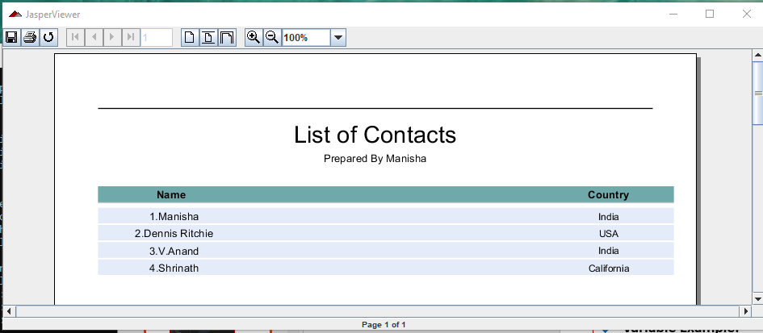
14.7 Run exe_Variable.bat
https://www.tutorialspoint.com/jasper_reports/index.htm
Display countNumber of each record.

Slide 29
End of Chapter

