Slide 1

15 Section
Peter H. Chen

Slide 2
15 Section
https://www.tutorialspoint.com/jasper_reports/index.htm
We discuss the Section in Design Phase.
Design Phase
(Create JRXML File)
Execute Phase
[Fill Jasper Template with Data to Generate Jasper Print File (xxx.jrprint)]
Compile Phase
(Compile JRXML to Jasper Template)
Export Phase
[Export the Report to Any Specified Format]

Slide 3
15 Section
https://www.tutorialspoint.com/jasper_reports/index.htm
Section:
We discussed the structure of a simple report template in the chapter 02 Getting Started. JasperReports structures the report template into multiple sections or Bands.
Sections are portions of the report that have a specified height and can contain report objects like lines, rectangles, images, or text fields.
The report engine iterates through the virtual records of the supplied report data source, at report filling time.
Depending on each section's defined behavior, the engine then renders each report section when appropriate. For instance, the detail section is rendered for each record in the data source.
When page breaks occur, the page header and page footer sections are rendered as needed.
In JasperReports, report sections are also called as report bands. Sections are made up of one or more bands. These sections are filled repeatedly at report-generating time and prepare the final document.

Slide 4
15 Section
https://www.tutorialspoint.com/jasper_reports/index.htm
Main Section:
A report template in JasperReports has the following main sections
<title></title>
<pageheader></pageheader>
<columnheader></columnheader>
<groupheader></groupheader>
<detail></detail>
<groupfooter></groupfooter>
<columnfooter></columnfooter>
<pagefooter></pagefooter>
<lastpagefooter></lastpagefooter>
<summary></summary>
<nodata></nodata>
<background></background>

Slide 5
15 Section
https://www.tutorialspoint.com/jasper_reports/index.htm
The following table summarizes each of the sections (1)
S. NO | Section and Description
1 | Title This section appears only once at the beginning of the report.
2 | Page Header This section appears at the beginning of each page in the generated document.
3 | Column Header This section appears at the beginning of each column in the generated document. If the report has only one column defined, then column header and footer sections are ignored.

Slide 6
15 Section
https://www.tutorialspoint.com/jasper_reports/index.htm
The following table summarizes each of the sections (2)
S. NO | Section and Description
4 | Group Header This section is introduced by a report group (chapter Groups). Each time the grouping expression changes its value, the group header section is printed above the detail section. In case, if more than one group is defined, the group header is printed in the order of group definition.
5 | Detail This section is repeated for each line of data supplied by the report's data source. The detail section can be made of multiple bands.

Slide 7
15 Section
https://www.tutorialspoint.com/jasper_reports/index.htm
The following table summarizes each of the sections (3)
S. NO | Section and Description
6 | Group Footer This section is introduced by a report group (chapter Groups). The group footer section is printed below the detail section before the value of the grouping expression changes. The group footer is always printed for the last line of data in data source. In case, if more than one group is defined, the group footer is printed in the reverse order of group definition.
7 | Column Footer This section appears at the bottom of each column. If the report's column count is 1, then column header and footer sections are ignored.
8 | Page Footer This section appears at the bottom of each page.

Slide 8
15 Section
https://www.tutorialspoint.com/jasper_reports/index.htm
The following table summarizes each of the sections (4)
S. NO | Section and Description
9 | Last Page Footer This section replaces the regular page footer on the last page of the report. In case, the summary section is also present, then this might not be the very last page of the document. This section is sometimes useful when summary information has to be displayed at the bottom of the last page.
10 | Summary This section appears only once at the end of the report.

Slide 9
15 Section
https://www.tutorialspoint.com/jasper_reports/index.htm
The following table summarizes each of the sections (5)
S. NO | Section and Description
11 | No Data This section is printed when the When No Data Print report property is set to No Data Section. If the <noData> section is defined in the report template, and if the data source is empty, then the <noData> section will be the only one taken into account at fill time, and its content will produce the report output.
12 | Background The background section is displayed on every page and cannot overflow to the next page. Elements placed on this section are evaluated at page initialization time and are displayed in the background. All other page objects are displayed on top of the background objects. This section is useful for creating page watermarks.

Slide 10
15 Section
https://www.tutorialspoint.com/jasper_reports/index.htm
Section, Elements, and Attribute Relation
The following diagram shows the elements and attributes relationship in a section of a report.
Section
Section Elements
Section Attributes
<Band>
<line>
<height>
<printWhenExpression>
<splitType>
<textField>
<staticText>
<image>
<rectangle>
<reportElement>
<subReport>
<ellipse>
<elementGroup>

Slide 11
15 Section
https://www.tutorialspoint.com/jasper_reports/index.htm
Section Elements
All the above mentioned report sections are optional.
But any report template will have at least one such section.
Each of these sections contains a single <band> element as its only sub-element.
A <band> can contain zero or more following sub-elements −
<line>, <rectangle>, <ellipse>, <image>, <staticText>, <textField>, <subReport>, or <elementGroup>
Each of these elements must contain a single <reportElement> as its first element (except elementGroup).
A <reportElement> determines how data is laid out for that particular element. Unlike variables and parameters, report elements are not required to have a name, because normally you do not need to obtain any individual element inside a report template.

Slide 12
15 Section
https://www.tutorialspoint.com/jasper_reports/index.htm
The table below summarizes the attributes of <reportElement> (1)
Attribute | Description | Valid Values
x | Specifies the x coordinate of the band element. | An integer value indicating the x coordinate of the element in pixels. This attribute is required.
y | Specifies the y coordinate of the band element. | An integer value indicating the y coordinate of the element in pixels. This attribute is required.
width | Specifies the width of the band element. | An integer value indicating the element width in pixels. This attribute is required.
height | Specifies the height of the band element. | An integer value indicating the element height in pixels. This attribute is required.

Slide 13
15 Section
https://www.tutorialspoint.com/jasper_reports/index.htm
The table below summarizes the attributes of <reportElement> (2)
Attribute | Description | Valid Values
key | Unique identifier of band element. | A unique string value.
stretchType | Specifies how does the element stretch when the containing band stretches | NoStretch (default) − The element will not stretch. RelativeToTallestObject− The element will stretch to accommodate the tallest object in its group. RelativeToBand − The element will stretch to fit the band's height.

Slide 14
15 Section
https://www.tutorialspoint.com/jasper_reports/index.htm
The table below summarizes the attributes of <reportElement> (3)
Attribute | Description | Valid Values
positionType | Specifies the element's position when the band stretches. | Float − The element will move depending on the size of the surrounding elements. FixRelativeToTop (default) − The element will maintain a fixed position relative to the band's top. FixRelativeToBottom − The element will maintain a fixed position relative to the band's bottom.
isPrintRepeatedValues | Specifies if repeated values are printed. | true (default) − Repeated values will be printed. false − Repeated values will not be printed.

Slide 15
15 Section
https://www.tutorialspoint.com/jasper_reports/index.htm
The table below summarizes the attributes of <reportElement> (4)
Attribute | Description | Valid Values
mode | Specifies the background mode of the element | Opaque, Transparent
isRemoveLineWhenBlank | Specifies if the element should be removed when it is blank and there are no other elements in the same horizontal space. | true, false
isPrintInFirstWholeBand | Specifies if the element must be printed in a whole band, that is, a band that is not divided between report pages or columns. | true, false

Slide 16
15 Section
https://www.tutorialspoint.com/jasper_reports/index.htm
The table below summarizes the attributes of <reportElement> (5)
Attribute | Description | Valid Values
isPrintWhenDetailOverFlows | Specifies if the element will be printed when the band overflows to a new page or column. | true, false
printWhenGroupChanges | Specifies that the element will be printed when the specified group changes. | A string value.

Slide 17
15 Section
https://www.tutorialspoint.com/jasper_reports/index.htm
The table below summarizes the attributes of <reportElement> (6)
Attribute | Description | Valid Values
forecolor | Specifies the foreground color of the element. | Either a hexadecimal RGB value preceded by the # character, or one of the following predefined values: black, blue, cyan, darkGray, gray, green, lightGray, magenta, orange, pink, red, yellow, white.
backcolor | Specifies the background color of the element. | Same as Valid Values for forecolor

Slide 18
15 Section
https://www.tutorialspoint.com/jasper_reports/index.htm
Section Attributes
Following are the attributes of a report section −
Height
Height of the section specifies the height in pixels for that particular section and is very important in the overall report design.
Print When Expression
A Boolean expression that determines whether the section should be printed or not.

Slide 19
15 Section
https://www.tutorialspoint.com/jasper_reports/index.htm
Split Allowed
A flag indicating whether the section is allowed to split when it does not fit on the current page. If true, the section will be transferred to the next page. Note that in case, the section does not fit on the next page, then the section will be split regardless of the flag's value. splitType can take following values −
splitType="Stretch:" Splits stretched content. If the section stretches on the current page (if the available space is less than declared height), the region that is added to the original height is allowed to split onto the next page.
splitType="Prevent:" Prevent split on first attempt. If the section does not fit on the next page, the split occurs normally, as band split prevention is effective only on the first split attempt.
splitType="Immediate:" Split immediately. The band is allowed to split anywhere except above, its topmost element.

Slide 20
15.1 jasper_report_template.jrxml

Slide 21
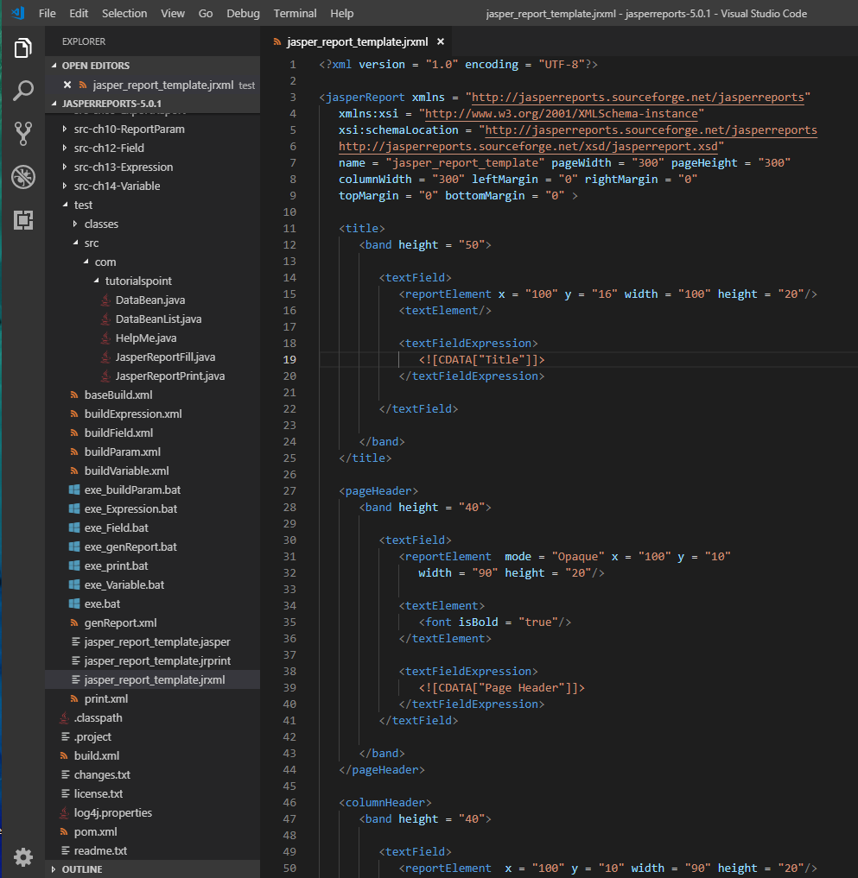
15.1 jasper_report_template.jrxml
https://www.tutorialspoint.com/jasper_reports/index.htm
Section Example:
Write report template (jasper_report_template.jrxml). Save this file to C:\tools\jasperreports-5.0.1\test directory.
This file we display a text in each of the sections (we discussed above).

Slide 22
15.2 JasperReportFill.java

Slide 23
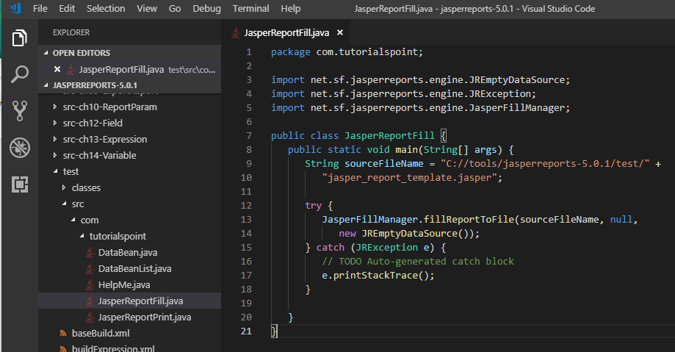
15.2 JasperReportFill.java
https://www.tutorialspoint.com/jasper_reports/index.htm
Write file JasperReportFill.java to C:\tools\jasperreports-5.0.1\test\src\com\tutorialspoint directory
Here, we use an instance of JREmptyDataSource when filling reports to simulate a data source with one record in it, but with all the fields in this single record being null.

Slide 24
15.3 buildSection.xml

Slide 25
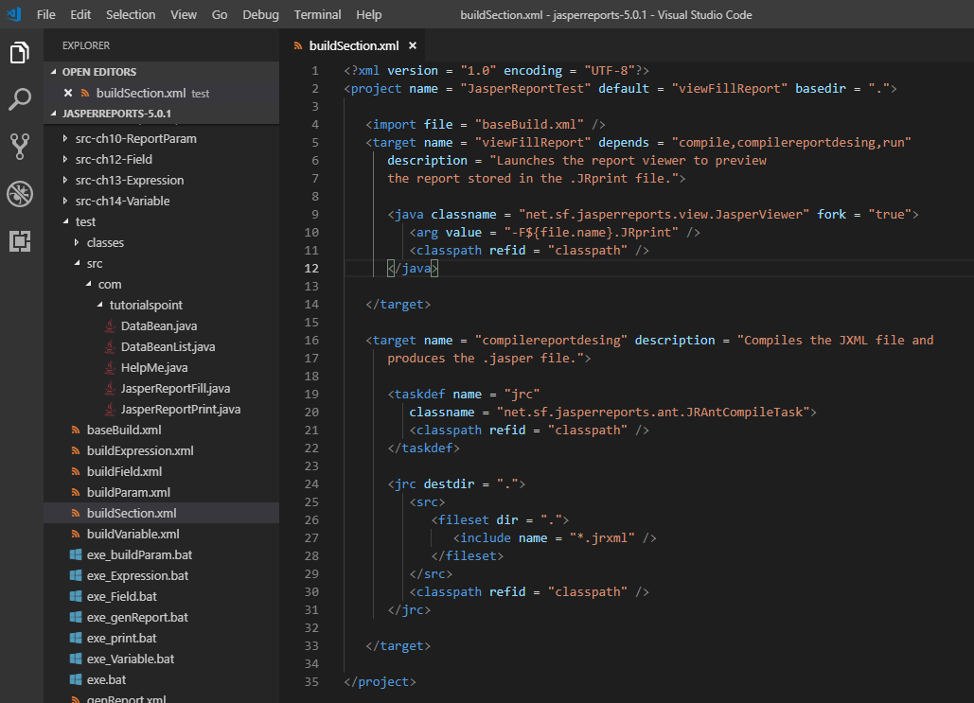
15.3 buildSection.xml
https://www.tutorialspoint.com/jasper_reports/index.htm
Report Generation
Write buildSection.xml (saved under directory C:\tools\jasperreports-5.0.1\test) are as below.
The import file - baseBuild.xml is picked up from the chapter 03 Environment Setup and should be placed in the same directory as the buildSection.xml.

Slide 26
15.4 exe_Section.bat

Slide 27
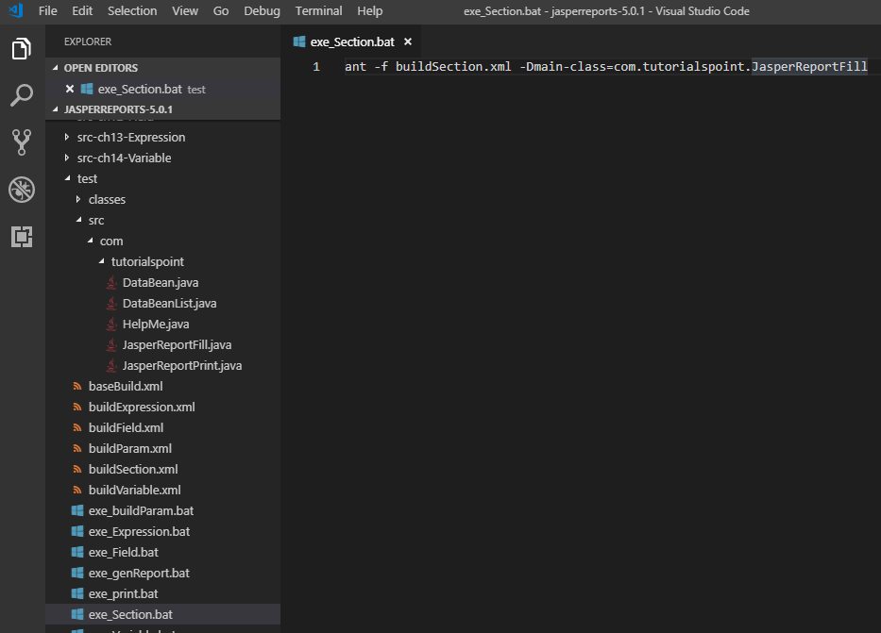
15.4 exe_Section.bat
https://www.tutorialspoint.com/jasper_reports/index.htm
Exe_Section.bat
ant -f buildSectopn.xml -Dmain-class=com.tutorialspoint.JasperReportFill

Slide 28
15.5 Run exe_Section.bat

Slide 29
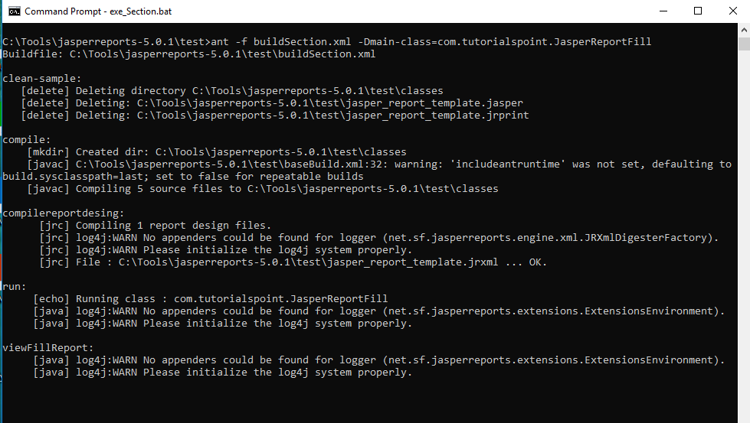
15.5 Run exe_Section.bat
https://www.tutorialspoint.com/jasper_reports/index.htm
Run exe_Section.bat

Slide 30
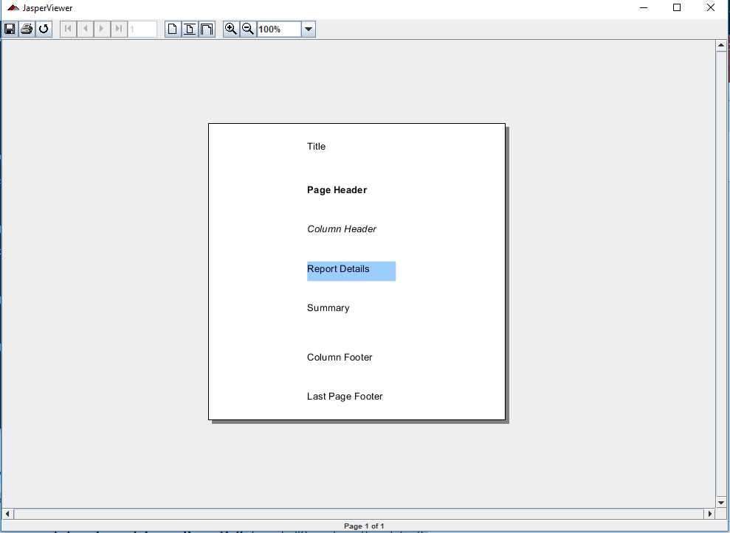
15.5 Run exe_Section.bat
https://www.tutorialspoint.com/jasper_reports/index.htm
We see in each of the sections a text is printed.
Note that JRXML contains a <lastPageFooter> element, this is displayed in the last page of the report instead of the <pageFooter> element being displayed.
The <columnHeader> and <columnFooter> elements only display on the report if they have more than one column.

Slide 31
End of Chapter

