Slide 1

16 Group
Peter H. Chen

Slide 2
16 Group
https://www.tutorialspoint.com/jasper_reports/index.htm
We discuss the Group in Design Phase.
Design Phase
(Create JRXML File)
Execute Phase
[Fill Jasper Template with Data to Generate Jasper Print File (xxx.jrprint)]
Compile Phase
(Compile JRXML to Jasper Template)
Export Phase
[Export the Report to Any Specified Format]

Slide 3
16 Group
https://www.tutorialspoint.com/jasper_reports/index.htm
Group:
Groups in JasperReports help to organize data on report in a logical manner.
A report group represents a sequence of consecutive records in the data source, which have something in common, such as the value of a certain report fields.
A report group is defined by the <group> element. A report can have any number of groups. Once declared, groups can be referred throughout the report.
A report group has three elements −
Group expression − This indicates the data that must change to start a new data group.
Group header section − Helps place label at the beginning of the grouped data.
Group footer section − Helps place label at the end of the grouped data.

Slide 4
16 Group
https://www.tutorialspoint.com/jasper_reports/index.htm
During the iteration through the data source at report-filling time if the value of the group expression changes, a group rupture occurs and the corresponding <groupFooter> and <groupHeader> sections are inserted in the resulting document.
Report group mechanism does not perform any sorting on the data supplied by the data source. Data grouping works as expected only when the records in the data source are already ordered according to the group expressions used in the report.

Slide 5
16 Group
https://www.tutorialspoint.com/jasper_reports/index.htm
Group Attributes
The <group> element contains attributes that allow us to control how grouped data is laid out. The attributes are summarized in table below (1)
S. NO | Attribute and Description
1 | name This is mandatory. It references the group in report expressions by name. It follows the same naming conventions that we mentioned for the report parameters, fields, and report variables. It can be used in other JRXML attributes when you want to refer a particular report group.
2 | isStartNewColumn When set to true, each data group will begin on a new column. Default value is false.
3 | isStartNewPage When set to true, each data group will begin on a new page. Default value is false.

Slide 6
16 Group
https://www.tutorialspoint.com/jasper_reports/index.htm
Group Attributes
The <group> element contains attributes that allow us to control how grouped data is laid out. The attributes are summarized in table below (2)
S. NO | Attribute and Description
4 | isResetPageNumber When set to true, the report page number will be reset every time a new group starts. Default value is false.
5 | isReprintHeaderOnEachPage When set to true, the group header will be reprinted on every page. Default value is false.
6 | minHeightToStartNewPage Defines minimum amount of vertical space needed at the bottom of the column in order to place the group header on the current column. The amount is specified in report units.

Slide 7
16 Group
https://www.tutorialspoint.com/jasper_reports/index.htm
Group Attributes
The <group> element contains attributes that allow us to control how grouped data is laid out. The attributes are summarized in table below (3)
S. NO | Attribute and Description
7 | footerPosition Renders position of the group footer on the page, as well as its behavior in relation to the report sections that follow it.Its value can be: Normal, StackAtBottom, ForceAtBottom, and CollateAtBottom. Default value is Normal.
8 | keepTogether When set to true, prevents the group from splitting on its first break attempt.

Slide 8
16.1 jasper_report_template.jrxml

Slide 9
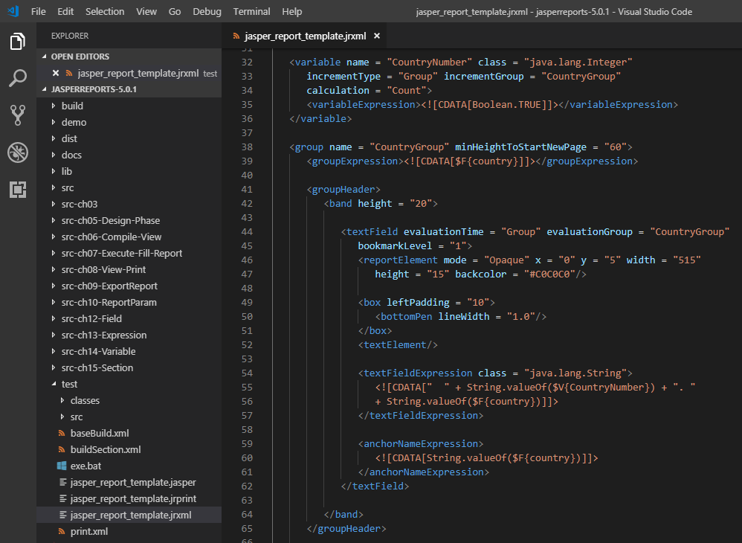
16.1 jasper_report_template.jrxml
https://www.tutorialspoint.com/jasper_reports/index.htm
Group Example:
Add group (CountryGroup) to existing report template (Chapter 05 Report Designs). Occurrence of each country is counted and the count is displayed as the group footer. In the group header, the count of each record is prefixed.
Write jasper_report_template.jrxml to C:\tools\jasperreports-5.0.1\test directory

Slide 10
16.2 JasperReportFill.java

Slide 11
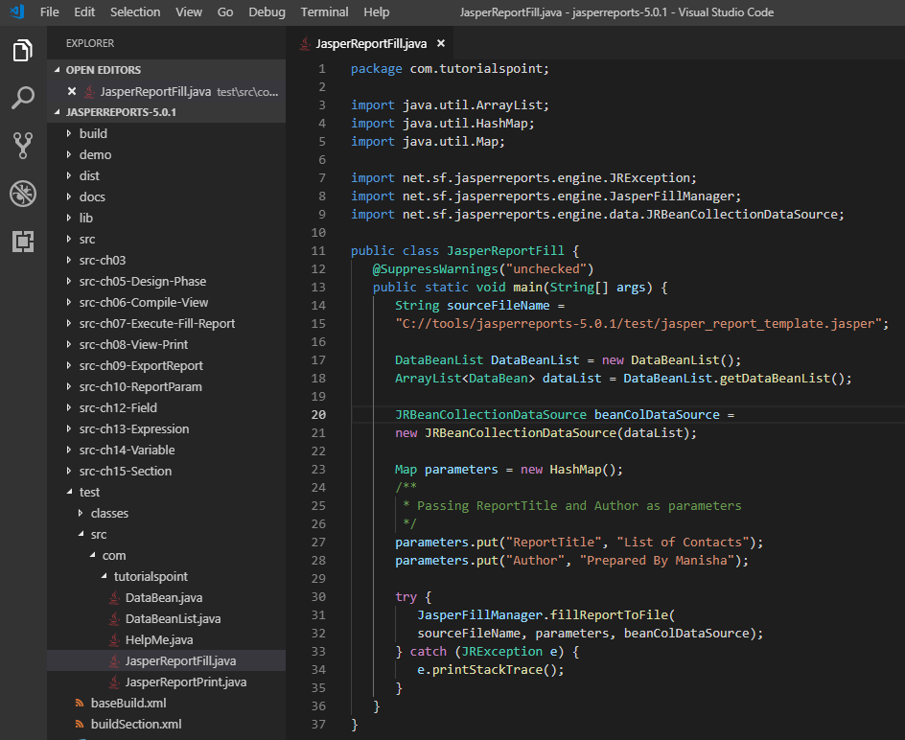
16.2 JasperReportFill.java
https://www.tutorialspoint.com/jasper_reports/index.htm
JaperReportFill.java:
In folder C:\tools\jasperreports-5.0.1\test\src\com\tutorialspoint

Slide 12
16.3 buildGroup.xml

Slide 13
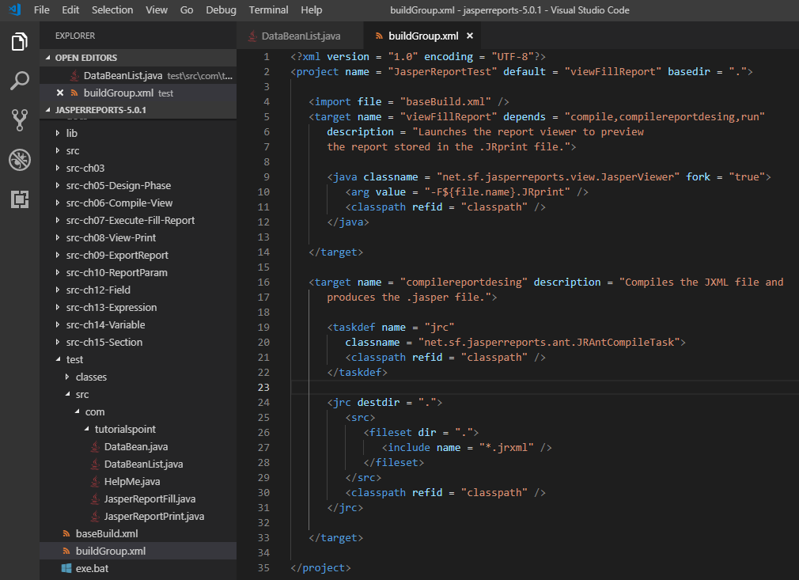
16.3 buildGroup.xml
https://www.tutorialspoint.com/jasper_reports/index.htm
buildGroup.xml:
Write buildGroup.xml (No change in content) and saved under directory C:\tools\jasperreports-5.0.1\test.
The import file - baseBuild.xml is picked up from the chapter 03 Environment Setup and should be placed in the same directory as the buildGroup.xml

Slide 14
16.4 exe_Group.bat

Slide 15
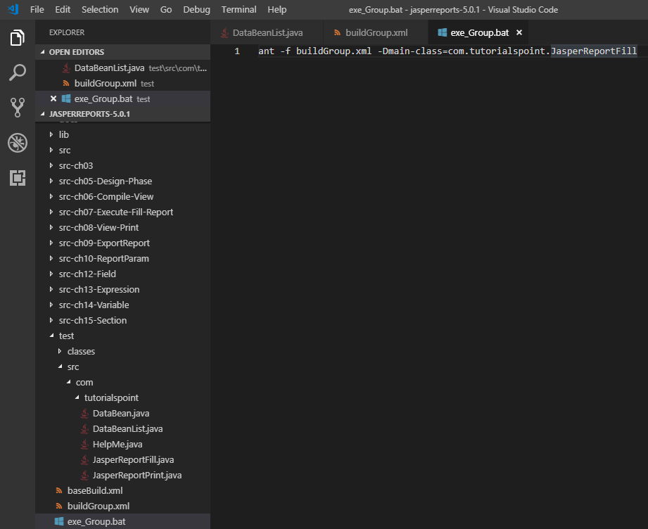
16.4 exe_Group.bat
https://www.tutorialspoint.com/jasper_reports/index.htm
exe_Group.bat:
ant -f buildGroup.xml -Dmain-class=com.tutorialspoint.JasperReportFill

Slide 16
16.5 Run exe_Group.bat

Slide 17
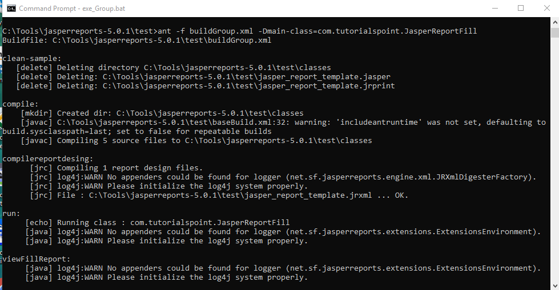
16.5 Run exe_Group.bat
https://www.tutorialspoint.com/jasper_reports/index.htm
Run exe_Group.bat:

Slide 18
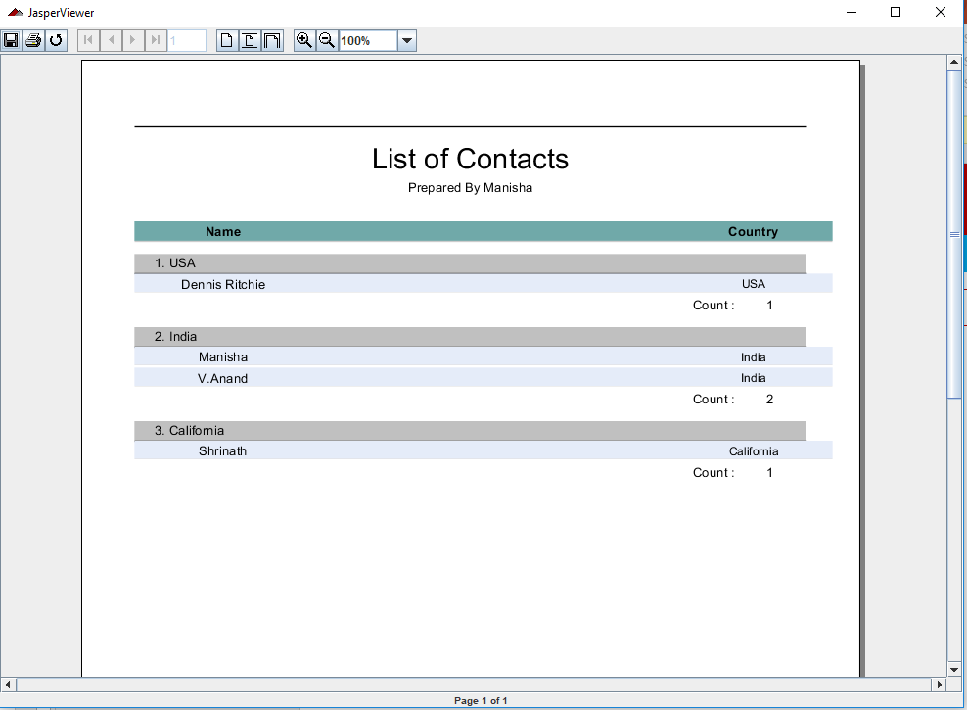
16.5 Run exe_Group.bat
https://www.tutorialspoint.com/jasper_reports/index.htm
View Jasper Report:
Each country is grouped.
The count of occurrence of each country is displayed at the footer of each group.

Slide 19
End of Chapter

