Slide 1

17 Font
Peter H. Chen

Slide 2
17 Font
https://www.tutorialspoint.com/jasper_reports/index.htm
We discuss the Font in Design Phase.
Design Phase
(Create JRXML File)
Execute Phase
[Fill Jasper Template with Data to Generate Jasper Print File (xxx.jrprint)]
Compile Phase
(Compile JRXML to Jasper Template)
Export Phase
[Export the Report to Any Specified Format]

Slide 3
17 Font
https://www.tutorialspoint.com/jasper_reports/index.htm
Font
A report contains text elements and each of these can have its own font settings.
These settings can be specified using the <font> tag available in the <textElement> tag.
A report can define a number of fonts.
Once defined, they can be used as default or base font settings for other font definitions throughout the entire report.
Report Fonts
A report font is a collection of font settings, declared at the report level. A report font can be reused throughout the entire report template when setting the font properties of text elements.
Report fonts are now deprecated. Do not use <reportFont/> elements declared within the document itself. Use the <style/> element instead.

Slide 4
17 Font
https://www.tutorialspoint.com/jasper_reports/index.htm
Font Attributes
Table below summarizes the main attributes of the <font> element.
S. NO | Attribute and Description
1 | fontName The font name, which can be the name of a physical font, a logical one, or the name of a font family from the registered JasperReports font extensions.
2 | size The size of the font measured in points. It defaults to 10.
3 | isBold The flag specifying if a bold font is required. It defaults to false.
4 | isItalic The flag specifying if an italic font is required. It defaults to false.

Slide 5
17 Font
https://www.tutorialspoint.com/jasper_reports/index.htm
Font Attributes
Table below summarizes the main attributes of the <font> element.
S. NO | Attribute and Description
5 | isUnderline The flag specifying if the underline text decoration is required. It defaults to false.
6 | isStrikeThrough The flag specifying if the strikethrough text decoration is required. It defaults to false.
7 | pdfFontName The name of an equivalent PDF font required by the iText library when exporting documents to PDF format.

Slide 6
17 Font
https://www.tutorialspoint.com/jasper_reports/index.htm
Font Attributes
Table below summarizes the main attributes of the <font> element.
S. NO | Attribute and Description
8 | pdfEncoding The equivalent PDF character encoding, also required by the iText library.
9 | isPdfEmbedded The flag that specifies whether the font should be embedded into the document itself. It defaults to false. If set to true, helps view the PDF document without any problem.

Slide 7
17 Font
https://www.tutorialspoint.com/jasper_reports/index.htm
Font Types
In JasperReports fonts can be categorized as −
Logical Fonts − Five font types, which have been recognized by the Java platform since version 1.0, are called logical fonts. These are − Serif, SansSerif, Monospaced, Dialog, and DialogInput. These logical fonts are not actual font libraries that are installed anywhere on the system. They are merely font type names recognized by the Java runtime. These must be mapped to some physical font that is installed on the system.
Physical Fonts − These fonts are the actual font libraries consisting of, for example, TrueType or PostScript Type 1 fonts. The physical fonts may be Arial, Time, Helvetica, Courier, or any number of other fonts, including international fonts.
Font Extensions − The JasperReports library can make use of fonts registered on-the-fly at runtime, through its built-in support for font extensions. A list of font families can be made available to the JasperReports using font extension. These are made out of similarly looking font faces and supporting specific locales.

Slide 8
17 Font
https://www.tutorialspoint.com/jasper_reports/index.htm
As described in the table above we need to specify in the attribute fontNamethe name of a physical font, the name of a logical font, or the name of a font family from the registered JasperReports font extensions.

Slide 9
17 Font
https://www.tutorialspoint.com/jasper_reports/index.htm
PDF Font Name
JasperReports library uses the iText library, when exporting reports to PDF (Portable Document Format). PDF files can be viewed on various platforms and will always look the same. This is partially because in this format, there is a special way of dealing with fonts. fontName attribute is of no use when exporting to PDF. Attribute pdfFontName exist where we need to specify the font settings.
The iText library knows how to deal with built-in fonts and TTF files and recognizes the following built-in font names −
Courier
Courier-Bold
Courier-BoldOblique
Courier-Oblique
Helvetica
Helvetica-Bold
Helvetica-BoldOblique
Helvetica-Oblique
Symbol
Times-Roman
Times-Bold
Times-BoldItalic
Times-Italic
ZapfDingbats

Slide 10
17 Font
https://www.tutorialspoint.com/jasper_reports/index.htm
Default Fonts and Inheritance
Each text element inherits font and style attributes from its parent element, which in turn inherits these attributes from its parent. If no styles and/or fonts are defined for elements, the default style (and/or font - but this is now deprecated) declared in the <jasperReport/> root element will be applied.
Defining default styles or fonts in JasperReports is not mandatory. If no font is defined for a given element, the engine looks either for the inherited font attributes, or, if no attributes are found on this way, it looks for the net.sf.jasperreports.default.font.name property in the /src/default.jasperreports.properties file. Its value defines the name of the font family to be used when font properties are not explicitly defined for a text element or inherited from its parent.

Slide 11
17 Font
https://www.tutorialspoint.com/jasper_reports/index.htm
The main default font properties and their values defined in the /src/default.jasperreports.properties file are in the table below
Property | Description
net.sf.jasperreports.default.font.name=SansSerif | The default font name.
net.sf.jasperreports.default.font.size=10 | The default font size.
net.sf.jasperreports.default.pdf.font.name=Helvetica | The default PDF font.
net.sf.jasperreports.default.pdf.encoding=Cp1252 | The default PDF character encoding.
net.sf.jasperreports.default.pdf.embedded=false | By default PDF fonts are not embedded.

Slide 12
17.1 jasper_report_template.jrxml

Slide 13
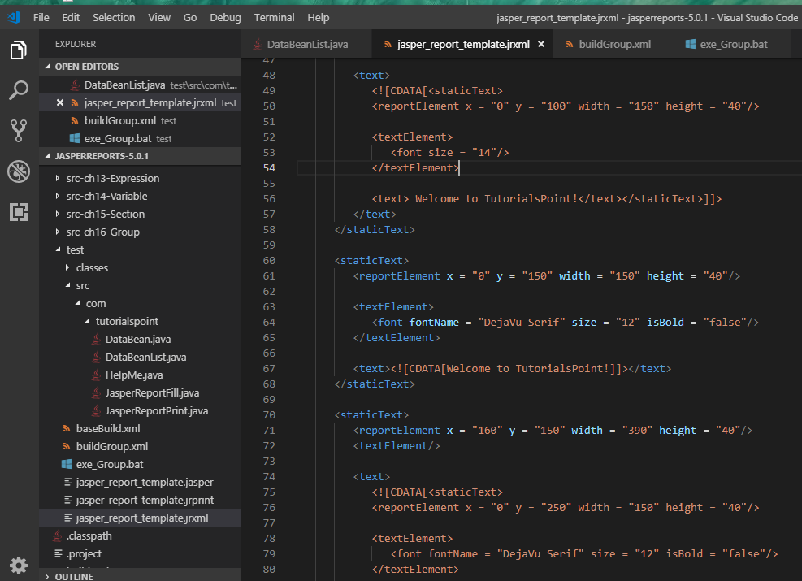
17.1 jasper_report_template.jrxml
https://www.tutorialspoint.com/jasper_reports/index.htm
Font Example:
Write a new report template (jasper_report_template.jrxml). The contents of the JRXML are as below. Save it to C:\tools\jasperreports-5.0.1\test directory.
We will display a text in the title of the report in various font formats.

Slide 14
17.2 JasperFontsReportFill.java

Slide 15
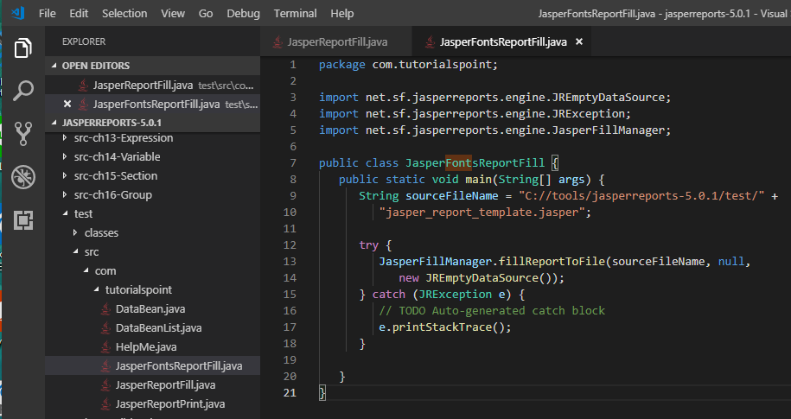
17.2 JasperFontsReportFill.java
https://www.tutorialspoint.com/jasper_reports/index.htm
The java code to fill and generate the report is as given below.
Save JasperFontsReportFill.java to C:\tools\jasperreports-5.0.1\test\src\com\tutorialspoint directory.
Here, we use an instance of JREmptyDataSource when filling reports to simulate a data source with one record in it, but with all the fields being null.

Slide 16
17.3 buildFont.xml

Slide 17
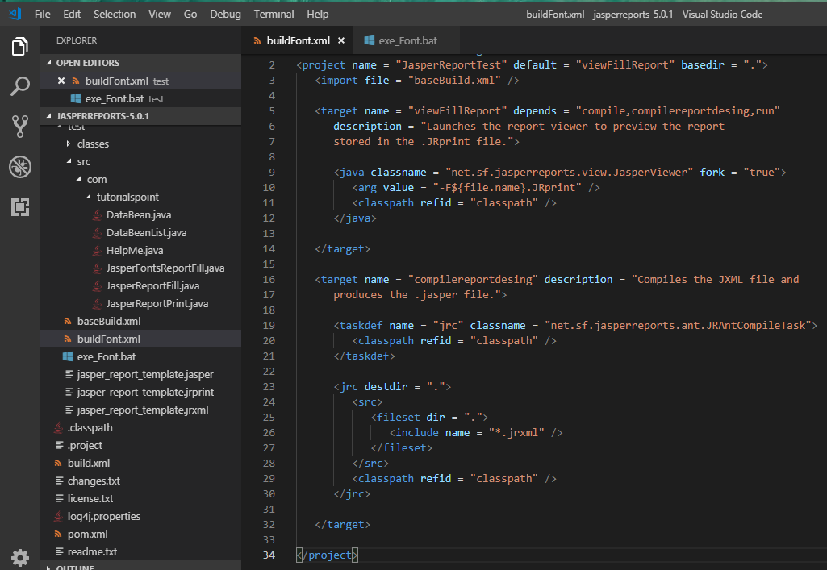
17.3 buildFont.xml
https://www.tutorialspoint.com/jasper_reports/index.htm
Write buildFont.xml (saved under directory C:\tools\jasperreports-5.0.1\test) are as given below.
The import file - baseBuild.xml is picked from chapter 03 Environment Setup and should be placed in the same directory as the buildFont.xml.

Slide 18
17.4 exe_Font.bat

Slide 19
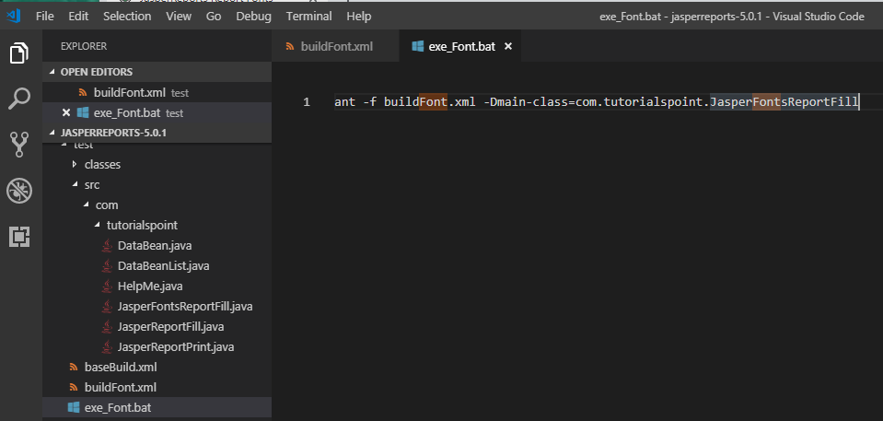
17.4 exe_Font.bat
https://www.tutorialspoint.com/jasper_reports/index.htm
Write exe_Font.bat
ant -f buildFont.xml -Dmain-class=com.tutorialspoint.JasperFontsReportFill

Slide 20
17.5 Run exe_Font.bat

Slide 21
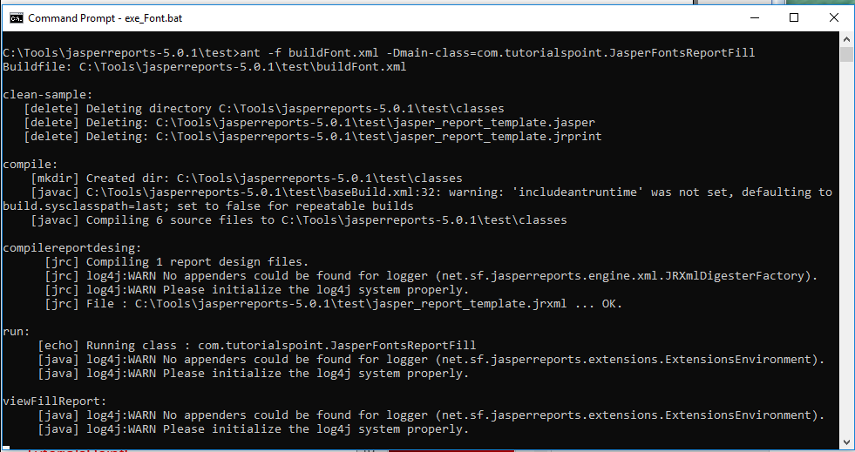
17.5 Run exe_Font.bat
https://www.tutorialspoint.com/jasper_reports/index.htm
Run exe_Font.bat

Slide 22
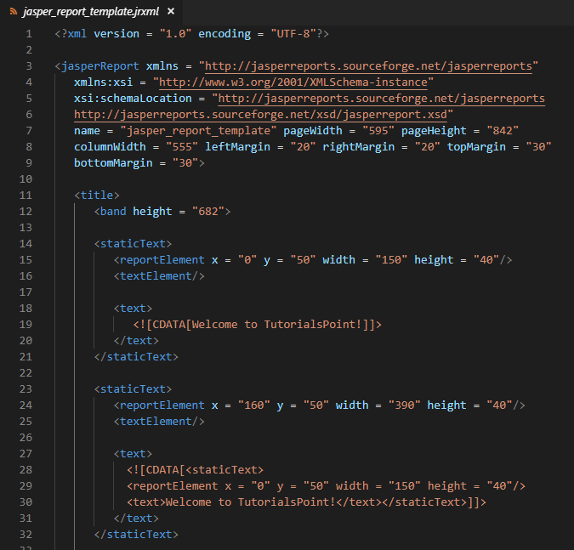
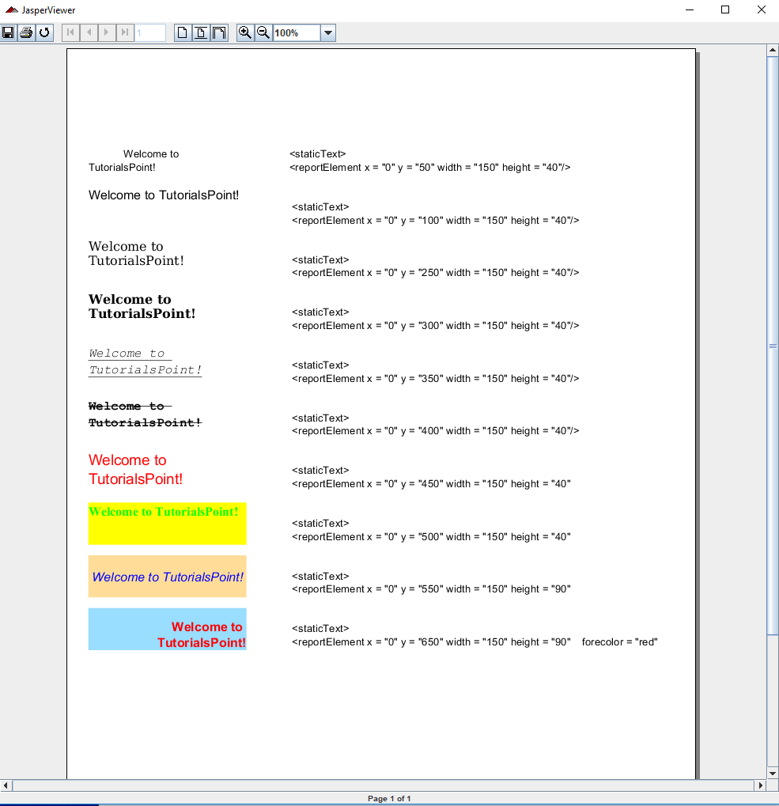
17.5 Run exe_Font.bat
https://www.tutorialspoint.com/jasper_reports/index.htm
Display exe_Font.bat

Slide 23
End of Chapter

