Slide 1

18 Unicode
Peter H. Chen

Slide 2
18 Unicode
https://www.tutorialspoint.com/jasper_reports/index.htm
We discuss the Unicode.
Design Phase
(Create JRXML File)
Execute Phase
[Fill Jasper Template with Data to Generate Jasper Print File (xxx.jrprint)]
Compile Phase
(Compile JRXML to Jasper Template)
Export Phase
[Export the Report to Any Specified Format]

Slide 3
18 Unicode
https://www.tutorialspoint.com/jasper_reports/index.htm
In JasperReports, working with texts needs some dedicated tools to process both the character representations and the text formatting properties.
Any text can be considered as a character sequence with a particular representation structure.
The text appearance consists in both layout (and paragraph) and font settings. But while in most cases, the text layout remains invariant, font settings may change when running the report in different Locales.
Different languages need different character sets with respect to specific characters representation. Therefore, working with texts means working with fonts. Chapter 17 discuss Font JasperReports.
One of the main features concerning the text content in a given report is the possibility to internationalize it. We can run the report in different localized environments, using different languages and other localization settings without any hardcoded modification. Character encoding is an important feature when a report is intended to be internationalized.

Slide 4
18 Unicode
https://www.tutorialspoint.com/jasper_reports/index.htm
Character Encoding (1)
A character is the smallest unit of writing conveying a meaningful information.
Character is an abstract concept, a character does not have a visual appearance. "Uppercase Latin A" is a different character from "lowercase Latin a" and from "uppercase Cyrillic A" and "uppercase Greek Alpha".
A visual representation of a character is known as a glyph.
A certain set of glyphs is called a font. "Uppercase Latin A", "uppercase Cyrillic A" and "uppercase Greek Alpha" may have identical glyphs, but they are different characters.
At the same time, the glyphs for "uppercase Latin A" can look very different in Times New Roman, Gill Sans and Poetica chancery italic, but they still represent the same character.
The set of available characters is called a character repertoire. Repertoire pronounces as ra-per-twaire meaning stock. Character repertoire means chatacter stock.

Slide 5
18 Unicode
https://www.tutorialspoint.com/jasper_reports/index.htm
Character Encoding (2)
The location (index) of a given character within a repertoire is known as its code position, or code point.
The method of numerically representing a code point within a given repertoire is called the character encoding.
Encodings are normally expressed in terms of octets.
An octet is a group of eight binary digits, i.e., eight ones and zeros.
An octet can express a numeric range between 0 and 255, or between 0x00 and 0xFF, to use hexadecimal notation.

Slide 6
18 Unicode
https://www.tutorialspoint.com/jasper_reports/index.htm
Unicode (1)
A Unicode is a character repertoire (character Stock) that contains most of the characters used in the languages of the world.
It can accommodate millions of characters, and already contains hundreds of thousands.
Unicode is divided into "planes" of 64K characters.
The only one used in most circumstances is the first plane, known as the basic multilingual plane, or BMP.
UTF-8 is the recommended encoding.
It uses a variable number of octets to represent different characters.
In a JRXML file, the encoding attribute is specified in the header.
It is used at report compilation time to decode the XML content.
For instance, if the report contains French words only and characters such as ç, é, â, then the ISO-8859-1 (a.k.a Latin-1) encoding is sufficient:
<?xml version = "1.0" encoding = "ISO-8859-1"?>

Slide 7
18 Unicode
https://www.tutorialspoint.com/jasper_reports/index.htm
Unicode (2)
As seen above, ideally we can choose the encoding fit to the minimal character set, which can correctly represent all the characters in the document.
But in case of Multilanguage documents (i.e. documents containing words spelled in several languages), one should choose the encoding adapted to the minimal character set, able to correctly represent all the characters in the document, even if they belong to different languages.
One of the character encodings able to handle multilingual documents is the UTF-8, used as default encoding value by JasperReports.
The texts are usually kept in resource bundle files rather than within the document during internationalization. So, there are cases where the JRXML itself looks completely ASCII-compatible, but generated reports at runtime do contain texts unreadable with ASCII. As a result, for a certain type of document export formats (such as CSV, HTML, XHTML, XML, and text) one has to know the encoding for the generated document too.

Slide 8
18 Unicode
https://www.tutorialspoint.com/jasper_reports/index.htm
Unicode (2)
Different languages are supported by different character encodings. So each time, we need to run a report in a localized environment. Further, we have to know, which is the most appropriate character encoding for the generated document language. In this case, the encoding property defined in the JRXML file itself might be no more useful.
To solve this kind of issues we can use an export customer property known as net.sf.jasperreports.export.character.encoding. This export custom property is default to UTF-8 and is present in JasperReports.
This default value is set in the default.jasperreports.properties file. For more specific options at export time, the CHARACTER_ENCODING export parameter is also available.

Slide 9
18.1 jasper_report_template.jrxml

Slide 10
18.1 jasper_report_template.jrxml
https://www.tutorialspoint.com/jasper_reports/index.htm
Unicode Example:
Write a new report template (jasper_report_template.jrxml). The contents of the JRXML are as below. Save it to C:\tools\jasperreports-5.0.1\test directory.
Here, we display a text in different languages using the Unicode characters (\uXXXX).
Any character encoded with UTF-8 can be represented using only its 4-digits hexadecimal code.
For instance, the Greek letter Γ can be written as \u0393. When such a notation is encountered, the engine calls for the appropriate character representation in the character set, and only that particular character will be printed out.
The JRXML is as follow:

Slide 11
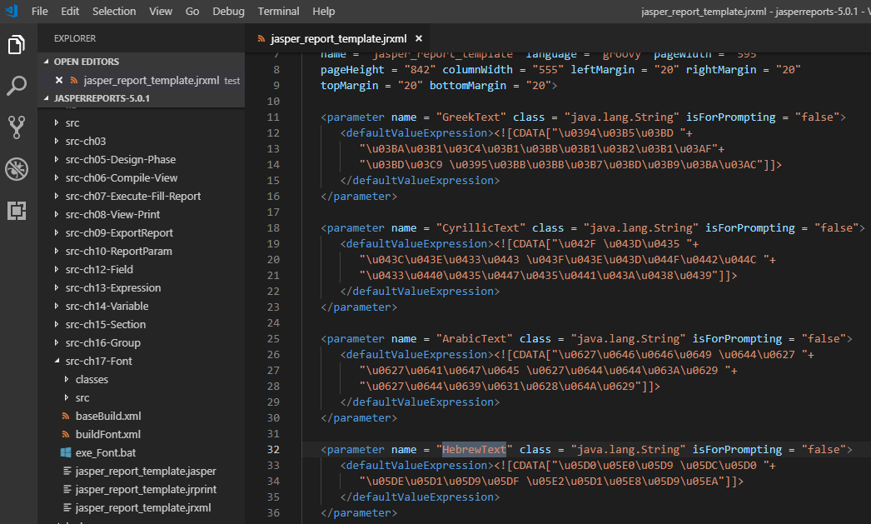
18.1 jasper_report_template.jrxml
https://www.tutorialspoint.com/jasper_reports/index.htm
Unicode Example:
The JRXML is as follow. The UTF-8 encoding is used for localized Unicode text and stored in document parameters.

Slide 12
17.2 JasperFontsReportFill.java

Slide 13
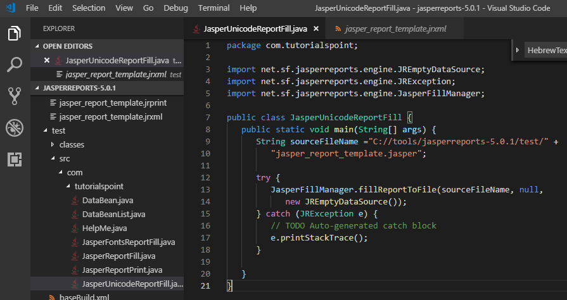
17.2 JasperFontsReportFill.java
https://www.tutorialspoint.com/jasper_reports/index.htm
The java code to fill and generate the report is as below.
Save file JasperUnicodeReportFill.java to C:\tools\jasperreports-5.0.1\test\src\com\tutorialspoint directory.
Here we use an instance of JREmptyDataSource when filling reports to simulate a data source with one record in it, but with all the fields in this single record being null.

Slide 14
17.3 buildUnicode.xml

Slide 15
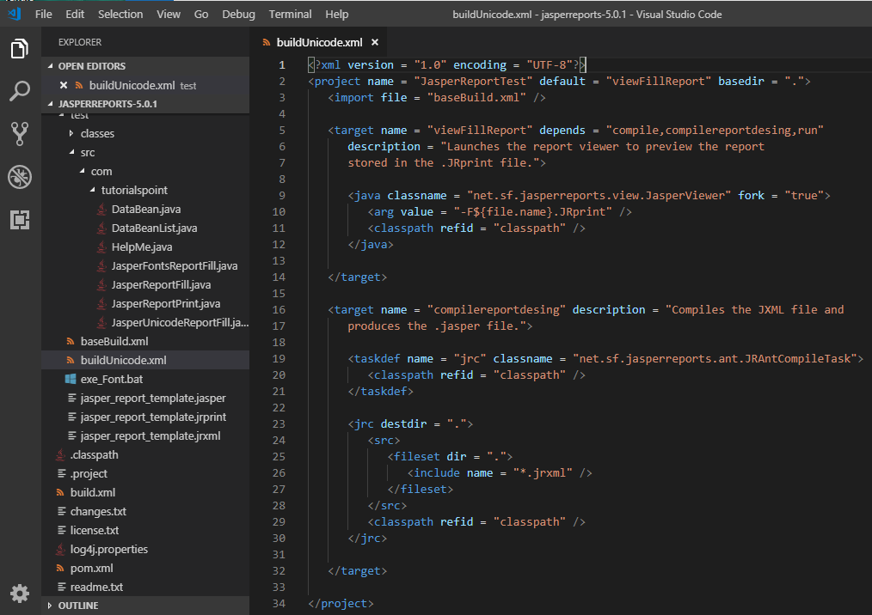
17.3 buildUnicode.xml
https://www.tutorialspoint.com/jasper_reports/index.htm
Write buildUnicide.xml and saved under directory C:\tools\jasperreports-5.0.1\test as below.
The import file - baseBuild.xml is picked from chapter 03 Environment Setup and should be placed in the same directory as the build.xml.

Slide 16
17.4 exe_Unicode.bat

Slide 17
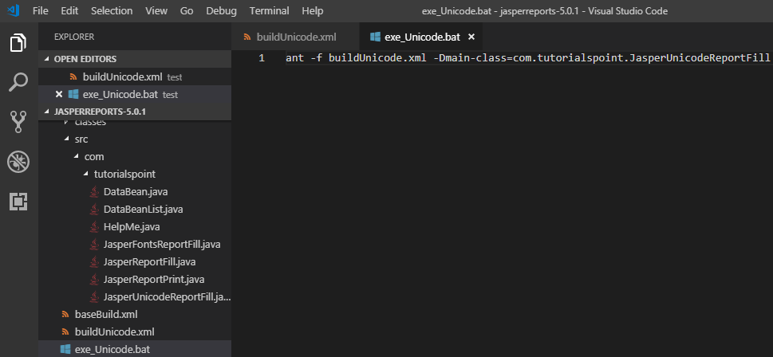
17.4 exe_Unicode.bat
https://www.tutorialspoint.com/jasper_reports/index.htm
Write exe_Unicode.bat with the command ant -f buildUnicode.xml -Dmain-class=com.tutorialspoint.JasperUnicodeReportFill (viewFullReport is the default target) as follows

Slide 18
17.5 Run exe_Unicode.bat

Slide 19
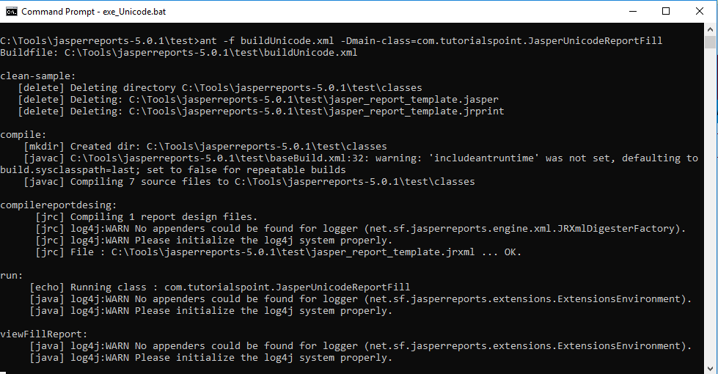
17.5 Run exe_Unicode.bat
https://www.tutorialspoint.com/jasper_reports/index.htm
Run exe_Unicode.bat

Slide 20
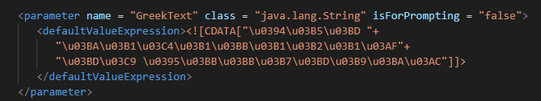
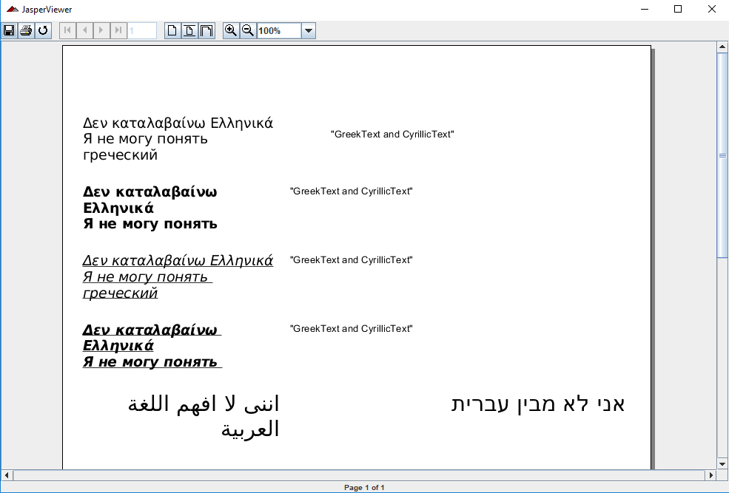
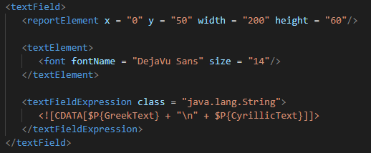
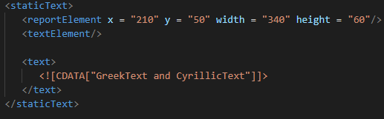
17.5 Run exe_Unicode.bat
https://www.tutorialspoint.com/jasper_reports/index.htm
Display Unicode: The display text is in different languages. The languages are grouped together on the left side and English explanation on the right side.

Slide 21
End of Chapter

